Slide 1
Advanced text processing: Week 1 Class 1 Subword tokenisation
Ryan Ka Yau Lai
University of California, Santa Barbara
Presented at University of Nevada, Reno

Slide 2
About this course
00

Slide 3

After this class, you will be able to …
Describe mechanisms behind classic statistical models (memory-based learning, naïve Bayes, conditional random fields) and modern neural models (feed-forward neural networks, recurrent neural networks, transformers)
Implement computational models in scikit-learn and Keras
Apply computational linguistic models to solve problems in a field of your choice (e.g. theoretical linguistics, language teaching, digital humanities…)
Examine the implications of modern language technology on language teaching, linguistic theory, & American & global society more generally

Slide 4
What should you already know?
01
02
03
04
Programming
Mathematics
Basic Python
nltk / spaCy for preprocessing
NumPy for maths
Basic probability
Matrix and vector manipulation
Gradients & Jacobians
Linguistics
Comp ling
Syntax (nouns, verbs, subjects, objects)
Morphology (affixes, lemmas, types & tokens)
Discourse (coreference)
N-grams
Vector-space semantics
HMM & Viterbi algorithm
Supervised learning w/ logistic regression

Slide 5

Assessment
Participation (8%, up to 2 unexcused absences)
12 quizzes (12%, 1% @)
This week: Syllabus quiz
Quiz released on Class 1 of each week
Group discussions on Class 2
You can change responses until Sunday
4 practical coding exercises (24%) through GitHub classroom
4 brief reading responses (24%)
3-4 questions to test understanding + critical thinking
Project (32%)
Full project proposal + Tiny start (e.g. pilot study, data collection …)

Slide 6
Now let’s get started with our first topic!

Slide 7
Subword tokenisation

Slide 8

Learning objectives
After this lesson, you will be able to …
Describe the disadvantages of traditional word-based tokenization
Implement the steps involved in the basic byte-pair encoding algorithm
Explain how subword encoding affects the performance of n-gram language models

Slide 9
01
Intro to subword tokenisation

Slide 10
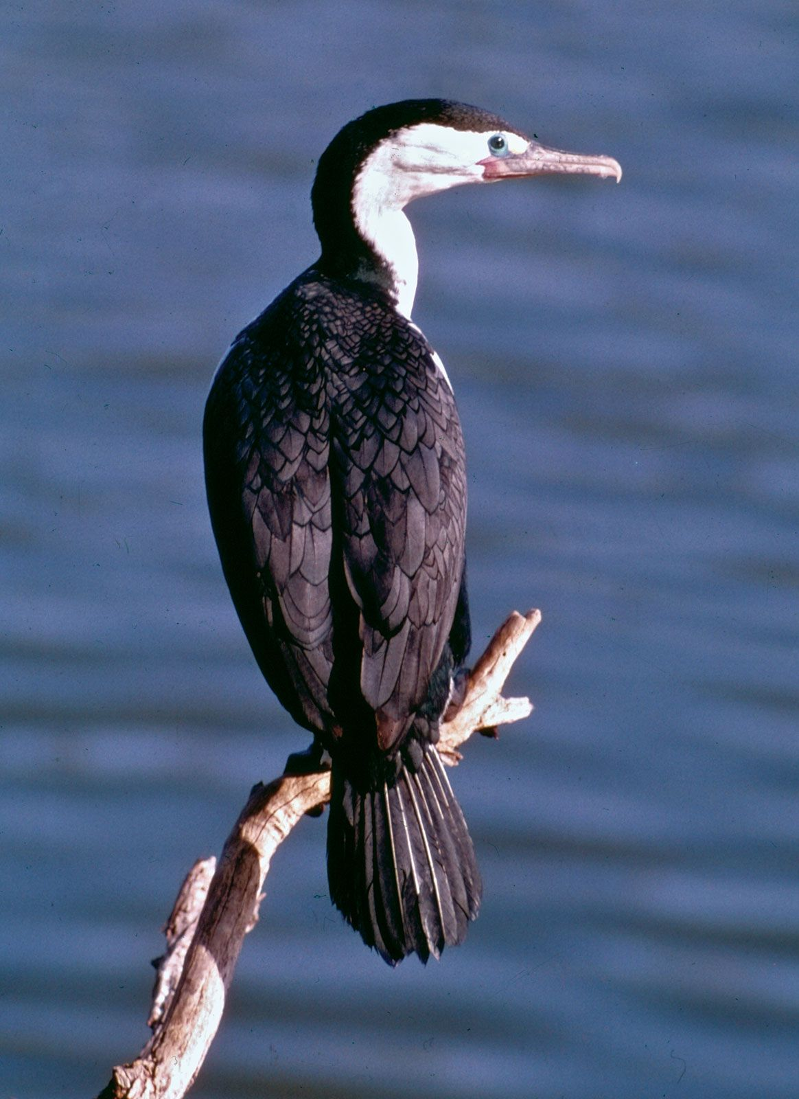
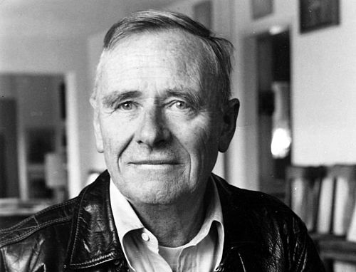
Think back to n-grams …
The common cormorant or shag
Lays eggs inside a paper bag
Christopher Isherwood, The Common Cormorant

Slide 11
Think back to n-grams …
The common <UNK> or shag
Lays eggs inside a paper bag
Christopher Isherwood, The Common Cormorant

Slide 12
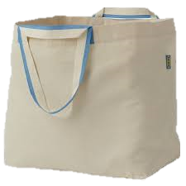
And to word vectors …
lay
egg
common
bag
bird
shag
cormorant

Slide 13
Traditional tokenisation
Largely one word/punctuation mark = one token
No information within the token – everything within a token is treated as a whole
Strawberry: No way of knowing ‘straw’ + ‘berry’
Traditional tokenisation cannot ‘see’ structure below the word!
The common cormorant or shag ,
Lays eggs inside a paper bag .

Slide 14
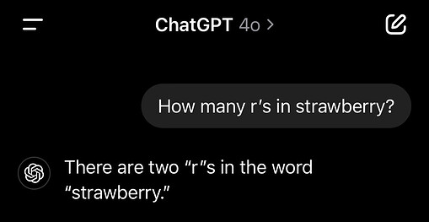
Consequences of tokenisation
ChatGPT cannot count how many ‘r’s there are in ‘strawberry’
Reason: character-level information is not available to ChatGPT!

Slide 15
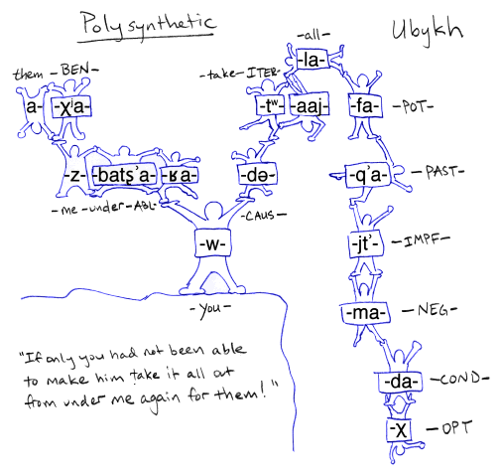
Tokenisation in polysynthetic languages?
Words are often entire sentences
Unlikely to appear more than once!
Under word-level tokenisation:
Replace them with <UNK> ➤ Too many <UNK>s
Lemmatise them ➤ Lose most info about the sentence

Slide 16
Big idea 1
Instead of treating words as tokens, we can divide words into subwords and treat those as tokens in language models, semantic space models, etc.

Slide 17
02
Byte-pair encoding
The basic subword tokenisation algorithm

Slide 18
Some definitions
Vocabulary: The set of types, i.e. all possible tokens, recognised by the model (including <UNK>)
Subword: A kind of token that can go below the level of a word, i.e. a part of a word (but not multiple words)
Approximates morphemes

Slide 19
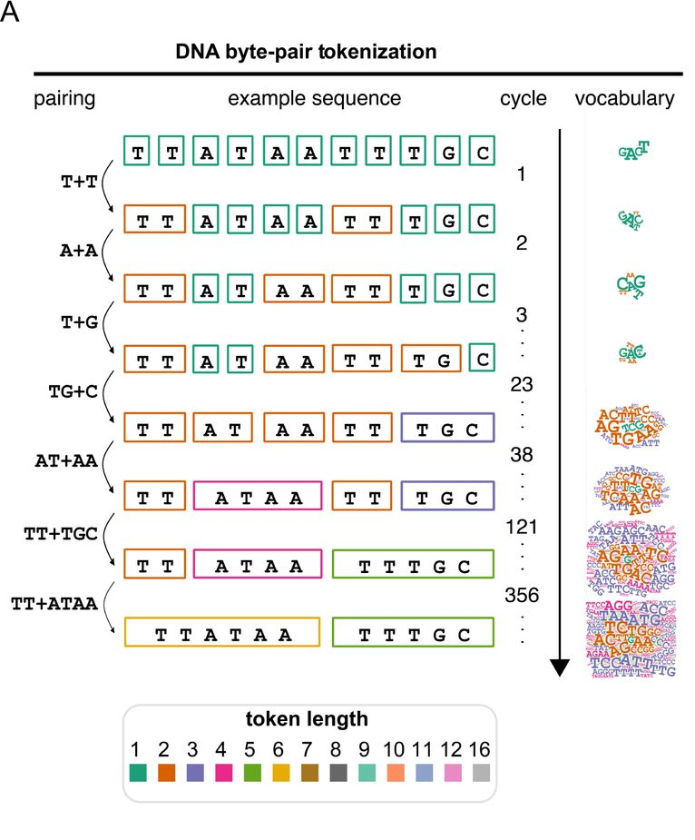
Byte-pair encoding (BPE)
The most basic algorithm for subword tokenisation
Many advanced algorithms build on BPE
Used in OpenAI’s GPT models!
Even biologists are using it!

Slide 20
Byte-pair encoding (BPE)
Inputs:
Data: Texts for training
Hyperparameters: A desired vocabulary size V
Outputs:
A final vocabulary of subword types
A text tokenised using the vocabulary
Process (general idea):
Start with the smallest possible subwords (i.e. single characters)
Successively merge the most common subword sequence into a new subword

Slide 21
Byte-pair encoding: Sample
Input corpus:
["The sink stinks.", "Sit in the egg.",
"The tinker hikes.", "The hiker kisses the stinking sink."]
Initial steps:
Preprocess by splitting the corpus by word boundaries & normalising
Get the initial tokenisation by splitting the text into tokens of single characters
['the#sink#stinks#.', 'sit#in#the#egg#.', 'the#tinker#hikes#.', 'the#hiker#kisses#the#stinking#sink#.']
t h e # s i n k # s t i n k s # .
s i t # i n # t h e # e g g # .
t h e # t i n k e r # h i k e s # .
t h e # h i k e r # k i s s e s # t h e # s t i n k i n g # s i n k # .

Slide 22
Byte-pair encoding: Sample
Input corpus:
["The sink stinks.", "Sit in the egg.",
"The tinker hikes.", "The hiker kisses the stinking sink."]
Initial steps:
Get the vocabulary from the initial tokenisation
{'.', 'e', 'g', 'h', 'i', 'k', 'n', 'r', 's', 't'}

Slide 23
Byte-pair encoding: Sample
Training steps Repeat until the vocabulary has size V:
Count all the bigrams that appear in the text with the initial tokenisation, and get the top bigram
Merge all instances of the bigram in the tokenized text
Add the newly merged subword token into the vocabulary

Slide 24
Byte-pair encoding: Sample
Training steps (first iteration):
Count all the bigrams that appear in the text with the initial tokenisation, and get the top bigram
Bigram | Freq.
('i', 'n') | 7
('t', 'h') | 5
('h', 'e') | 5
('n', 'k') | 5
… | …

Slide 25
Byte-pair encoding: Sample
Training steps (first iteration):
Merge all instances of the bigram in the tokenized text
t h e # s i n k # s t i n k s # .
s i t # i n # t h e # e g g # .
t h e # t i n k e r # h i k e s # .
t h e # h i k e r # k i s s e s # t h e # s t i n k i n g # s i n k # .
t h e # s in k # s t in k s # .
s i t # in # t h e # e g g # .
t h e # t in k e r # h i k e s # .
t h e # h i k e r # k i s s e s # t h e # s t in k in g # s in k # .

Slide 26
Byte-pair encoding: Sample
Training steps (first iteration):
Add the newly merged subword token into the vocabulary.
{'.', 'e', 'g', 'h', 'i', 'k', 'n', 'r', 's', 't'}
{'.', 'e', 'g', 'h', 'i', 'k', 'n', 'r', 's', 't', 'in'}

Slide 27
Byte-pair encoding: Sample
Training steps (second iteration):
Count all the bigrams that appear in the text with the initial tokenisation, and get the top bigram
Bigram | Freq.
('t', 'h') | 5
('h', 'e') | 5
('in', 'k') | 5
('t', 'in') | 3
… | …

Slide 28
Byte-pair encoding: Sample
Training steps (second iteration):
Merge all instances of the bigram in the tokenized text
t h e # s in k # s t in k s # .
s i t # in # t h e # e g g # .
t h e # t in k e r # h i k e s # .
t h e # h i k e r # k i s s e s # t h e # s t in k in g # s in k # .
th e # s in k # s t in k s # .
s i t # in # th e # e g g # .
th e # t in k e r # h i k e s # .
th e # h i k e r # k i s s e s # th e # s t in k in g # s in k # .

Slide 29
Byte-pair encoding: Sample
Training steps (second iteration):
Add the newly merged subword token into the vocabulary.
{'.', 'e', 'g', 'h', 'i', 'k', 'n', 'r', 's', 't', 'in'}
{'.', 'e', 'g', 'h', 'i', 'k', 'n', 'r', 's', 't', 'in', 'th'}

Slide 30
Main training loop in Python
while len(vocab) < V:
bigrams = count_bigrams_in_corpus(corpus_tokenized)
top_bigram = bigrams.most_common()[0][0]
merge_bigram_in_corpus(corpus_tokenized, top_bigram)
vocab.add(top_bigram[0] + top_bigram[1])
a) Count bigrams
a) Get top bigram
b) Merge top bigram
c) Update vocabulary

Slide 31
Final product (for V = 20)
the # sink # stink s # .
s i t # in # the # e g g # .
the # tink er # hik e s # .
the # hik er # k i s s e s # the # stink in g # sink # .
{'sink', 'ink', 'stink', 'h', '.', 'th', 'g', 'the', 'r', 'hi', 's', 'in', 't', 'er', 'e', 'i', 'n', 'tink', 'k', 'hik'}

Slide 32
Tokenizing a new text
Idea: Complete all the merges in the same order as during training!
This means that during the initial tokenisation process, we must save which bigrams were merged at each step

Slide 33
Tokenizing a new text: Algorithm
Initial steps:
Preprocess by splitting the corpus by word boundaries & normalising
Get the initial tokenisation by splitting the text into tokens of single characters
Tokenising: For each bigram merged during training,
Merge the bigram in the new text.

Slide 34
Tokenizing a new text
Input corpus:
["The sinks are stinky.", "He kisses the egg."]
Initial steps:
Preprocess by splitting the corpus by word boundaries & normalising
Get the initial tokenisation by splitting the text into tokens of single characters
t h e # s i n k s # a r e # s t i n k y # .
h e # k i s s e s # t h e # e g g # .

Slide 35
Tokenizing a new text
Tokenising: For each bigram merged during training,
Merge the bigram in the new text.
t h e # s i n k s # a r e # s t i n k y # .
h e # k i s s e s # t h e # e g g # .
t h e # s in k s # a r e # s t in k y # .
h e # k i s s e s # t h e # e g g # .
...
the # sink s # a r e # stink y # .
h e # k i s s e s # the # e g g # .

Slide 36
Big idea 2
We can tokenise empirically by starting with the smallest possible units and combining the strongest combination of units each time.

Slide 37
03
Analysing output
How does subword tokenisation help?

Slide 38

Analysing the output
the # sink s # a r e # stink y # .
h e # k i s s e s # the # e g g # .
Kiss and egg: Did not appear much in training data
Each individual letter is a subword
Q: Imagine we train a trigram language model based on a BPE tokeniser that tokenises kiss and kssi as k i s s and k s s i. Which one do you think will have a greater n-gram probability?

Slide 39
Analysing the output
the # sink s # a r e # stink y # .
h e # k i s s e s # the # e g g # .
Sink and stink: Frequently appear in training data
Can be separated out from sinks and stinky (which are unseen)
Sinks and stinky are not treated as <UNK>
Q: If sjinky appeared in the new corpus, would an n-gram model trained on the training corpus assign higher probability to stinky or sjinky?

Slide 40

Questions?

Slide 41

Thanks!
Do you have any questions?
kayaulai@ucsb.edu
http://rkylai.wordpress.com
Please keep this slide for attribution

Slide 42




What is this class not about?
Processing speech data (e.g. automatic speech recognition, speech synthesis)
Corpus construction and annotation (e.g. Universal Dependencies, inter-annotator agreement)
Statistical estimation and inference (e.g. confidence intervals, MCMC)
Software engineering (e.g. unit testing, continuous integration)

