Slide 1

Qualtrics + Mturk Linguistics Experiments Workshop
Ryan Ka Yau Lai
University of California, Santa Barbara

Slide 2
Let’s start with MTurk!

Slide 3
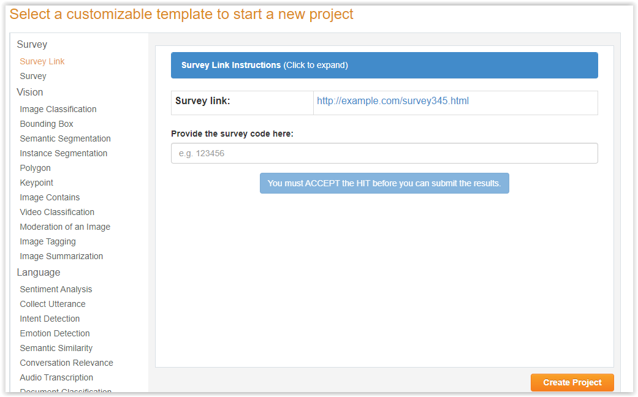
Survey Link template in MTurk Sandbox
https://requestersandbox.mturk.com/create/projects/new

Slide 4
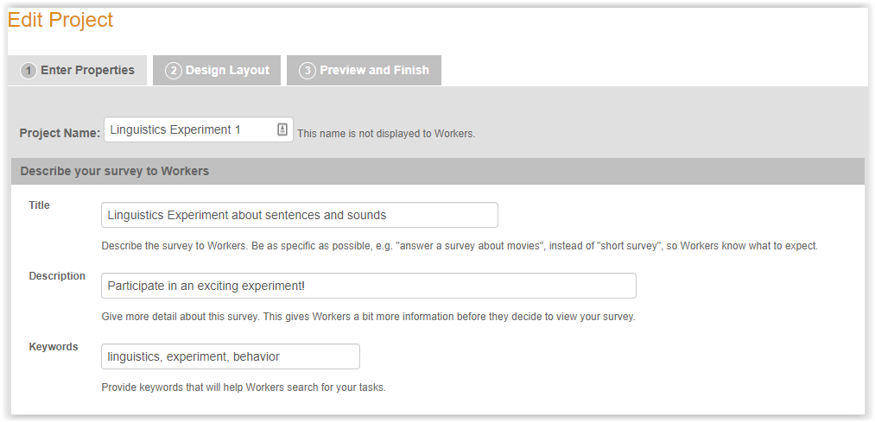
Survey Link template in MTurk Sandbox
Put in a title (as exact as possible), description, keywords

Slide 5
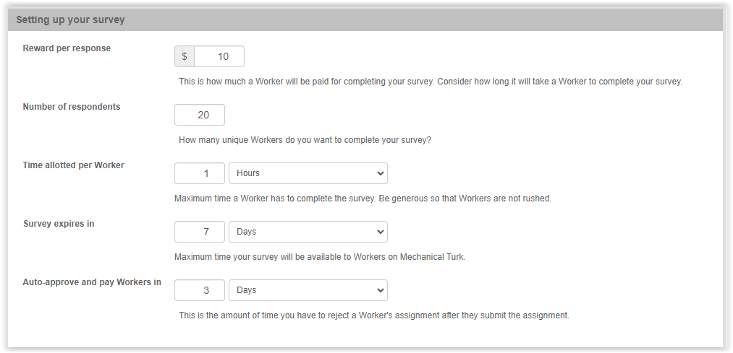
Survey Link template in MTurk Sandbox
Give reward (fairly!), number of respondents
Time allotted (be generous; usually they’re slower than you)
Auto-approve time (as short as possible)

Slide 6
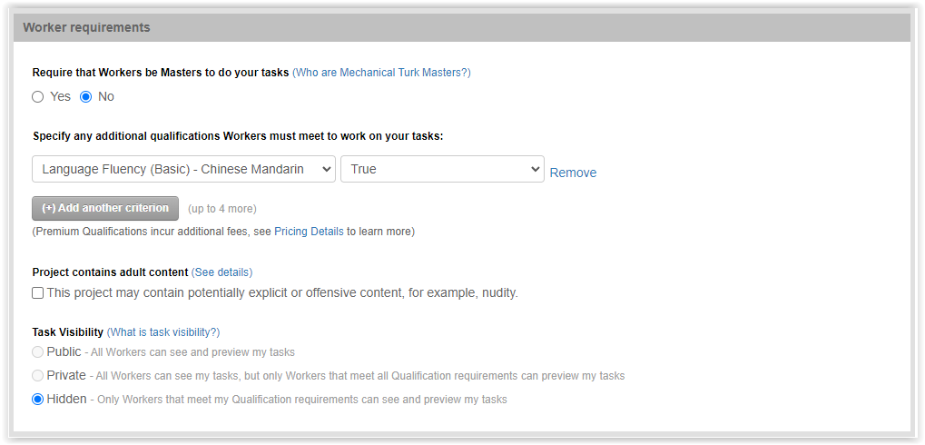
Survey Link template in MTurk Sandbox
Add qualifications

Slide 7
Now let’s go to Qualtrics – we’ll come back to MTurk in the end

Slide 8
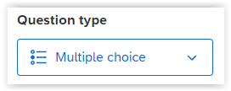
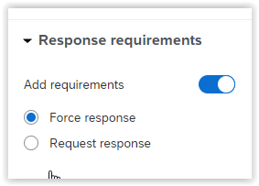
Q2: Intro
1 question = 1 trial
1 question type = 1 trial type (input type)
This question is a forced-choice task, so multiple choice is used
‘Force response’ = participants can’t skip the question

Slide 9
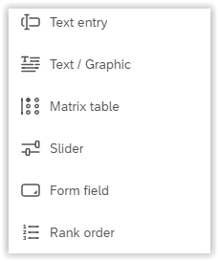
Q3/Q4: Question type
Text / Graphic: Instructions
Slider: Ratings
Rank order: Instead of rating choices, rank them
Qualtrics not enough for you? Add your own (& save as embedded data with JavaScript)

Slide 10
Q3: Text entry question type
Text / Graphic: Instructions
Slider: Ratings
Rank order: Instead of rating choices, rank them
Qualtrics not enough for you? Add your own (& save as embedded data with JavaScript)

Slide 11
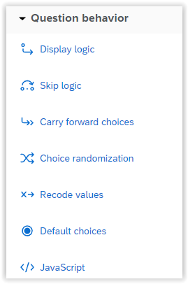
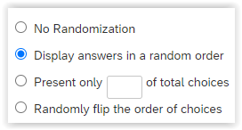
Q5: Randomise choice order
‘Choice Randomization’ from left pane
In popup, choose ‘Display answers in a random order’
Other choices: Randomly flip order, present subset

Slide 12
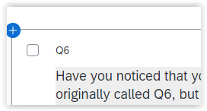
Q6 (?): Question IDs
Change it to a more meaningful question name
e.g. FC2 (second force-choice question)

Slide 13
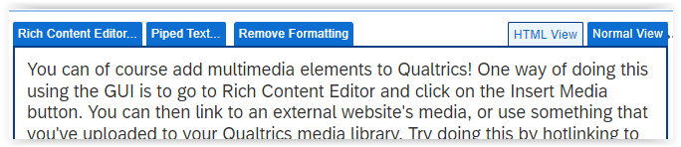
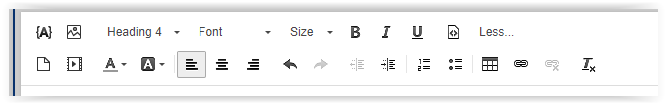
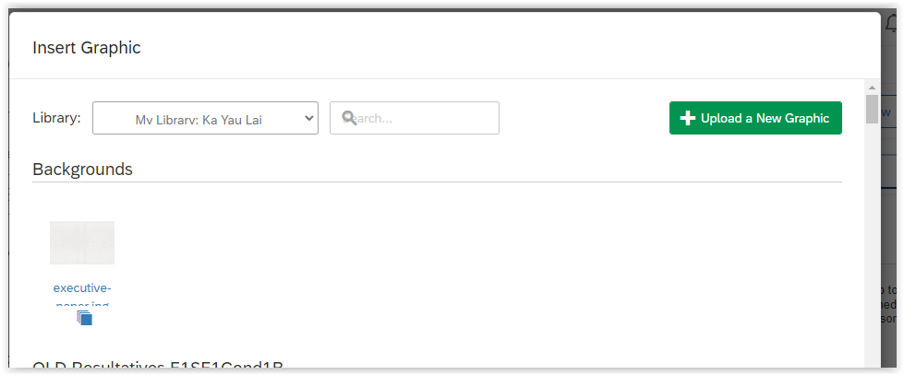
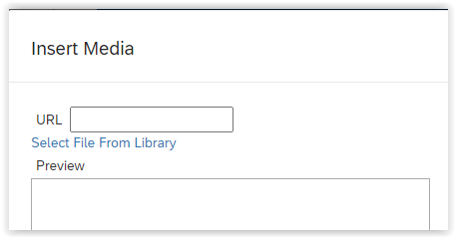
Q8block

Slide 14
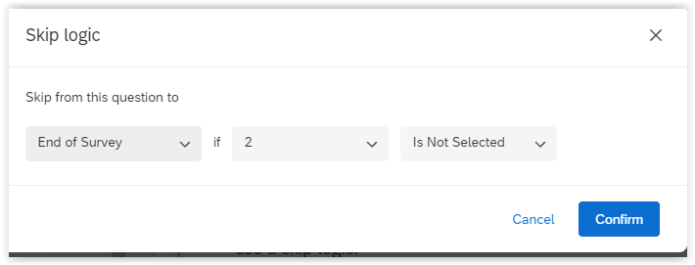
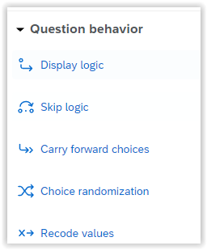
SCR1: Screening

Slide 15
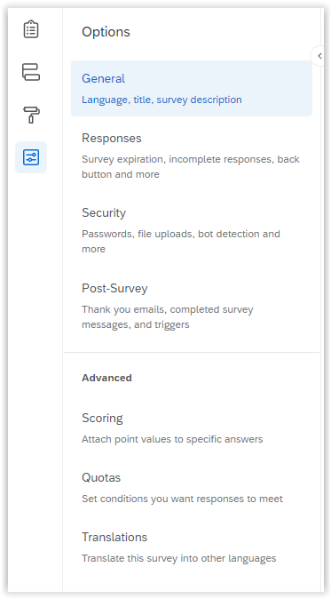
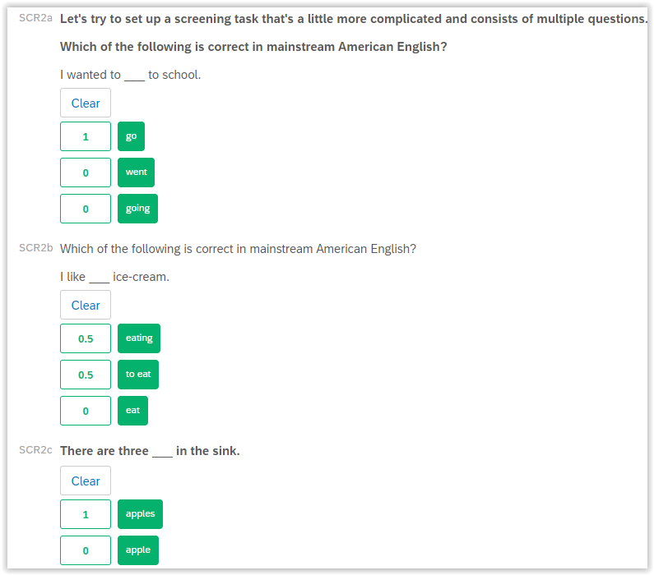
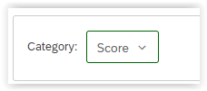
SCR2a-End: Scoring

Slide 16

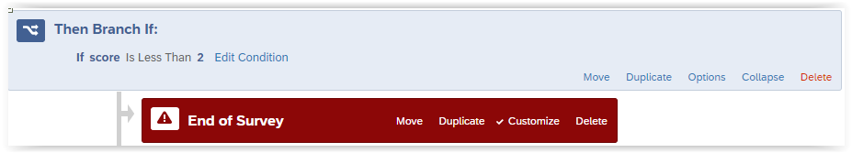
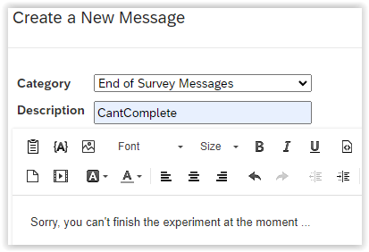
SCR2a-End: Scoring
Piped text

