Slide 1

Qualtrics + Mturk Linguistics Experiments Workshop
Ryan Ka Yau Lai
University of California, Santa Barbara

Slide 2
Let’s start with MTurk!

Slide 3
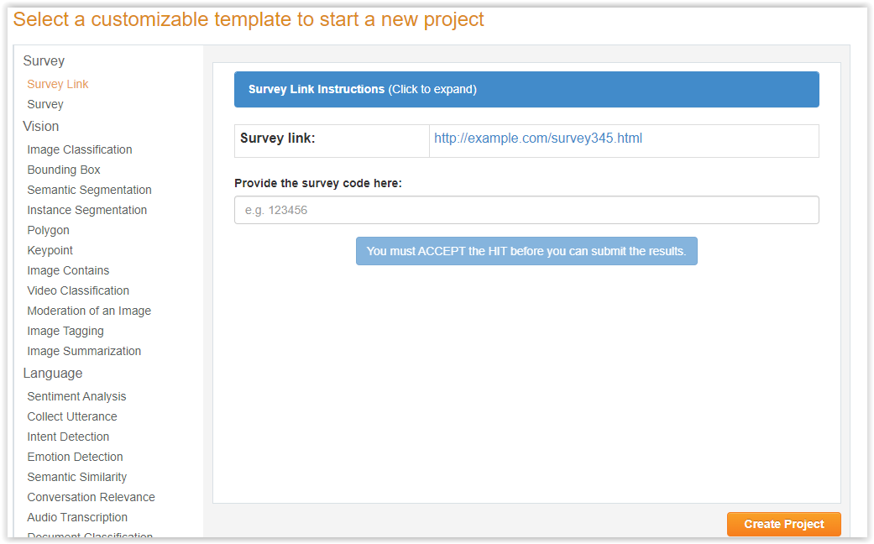
Survey Link template in MTurk Sandbox
https://requestersandbox.mturk.com/create/projects/new

Slide 4
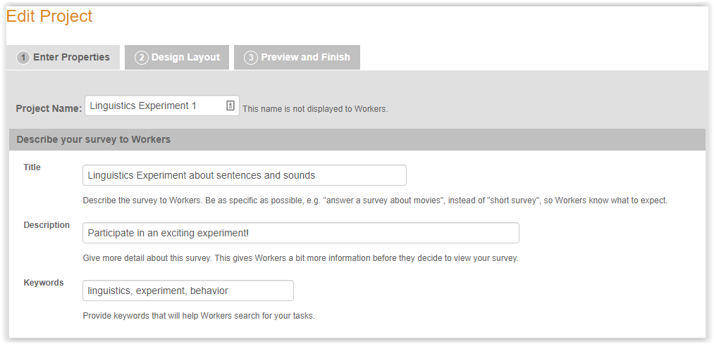
Survey Link template in MTurk Sandbox
Put in a title (as exact as possible), description, keywords

Slide 5
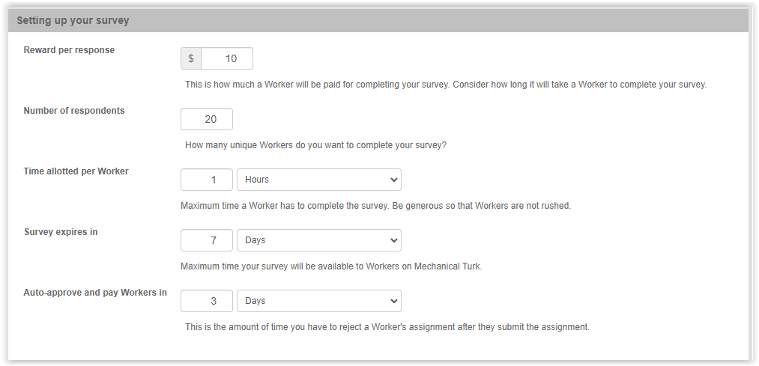
Survey Link template in MTurk Sandbox
Give reward (fairly!), number of respondents
Time allotted (be generous; usually they’re slower than you)
Auto-approve time (as short as possible)

Slide 6
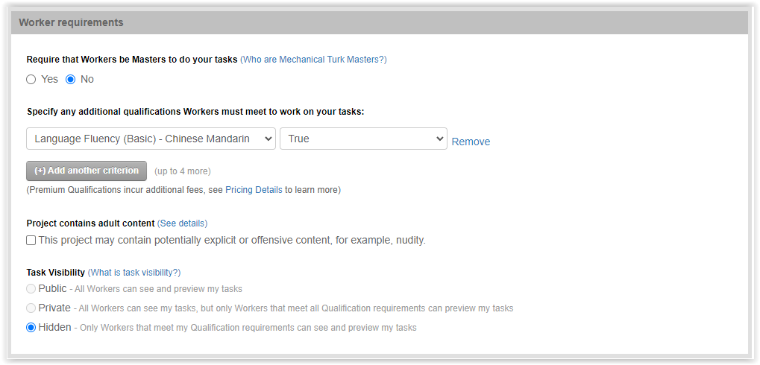
Survey Link template in MTurk Sandbox
Add qualifications

Slide 7
Now let’s go to Qualtrics – we’ll come back to MTurk in the end

Slide 8
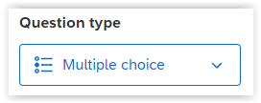
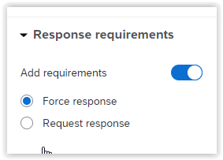
Q2: Intro
1 question = 1 trial
1 question type = 1 trial type (input type)
This question is a forced-choice task, so multiple choice is used
‘Force response’ = participants can’t skip the question

Slide 9
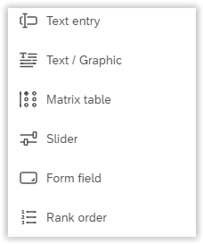
Q3/Q4: Question type
Text / Graphic: Instructions
Slider: Ratings
Rank order: Instead of rating choices, rank them
Qualtrics not enough for you? Add your own (& save as embedded data with JavaScript)

Slide 10
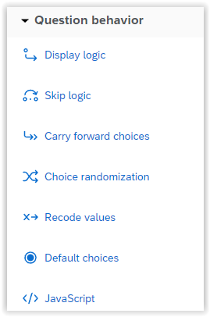
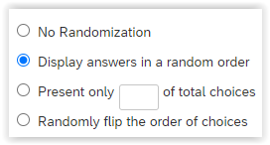
Q5: Randomise choice order
‘Choice Randomization’ from left pane
In popup, choose ‘Display answers in a random order’
Other choices: Randomly flip order, present subset

Slide 11
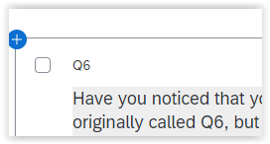
Q6 (?): Question IDs
Change it to a more meaningful question name
e.g. FC2 (second force-choice question)

Slide 12
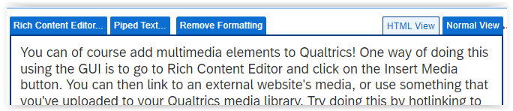
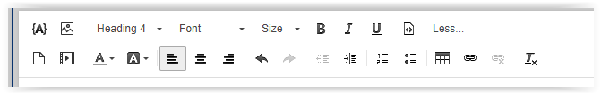
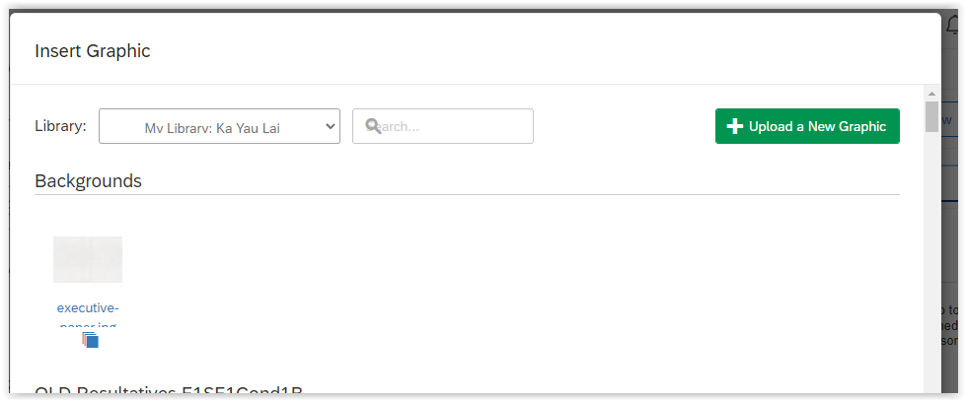
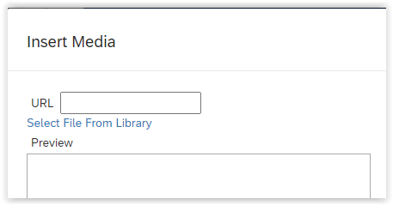
Q8block

Slide 13
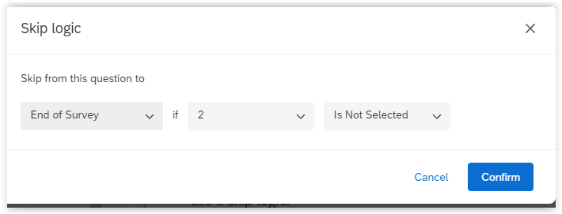
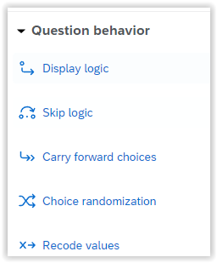
SCR1: Screening

Slide 14
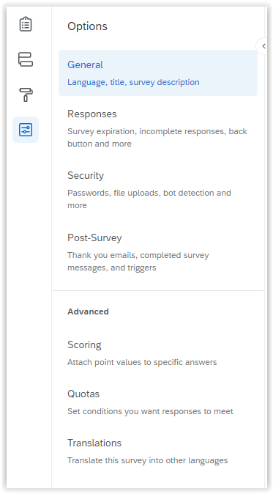
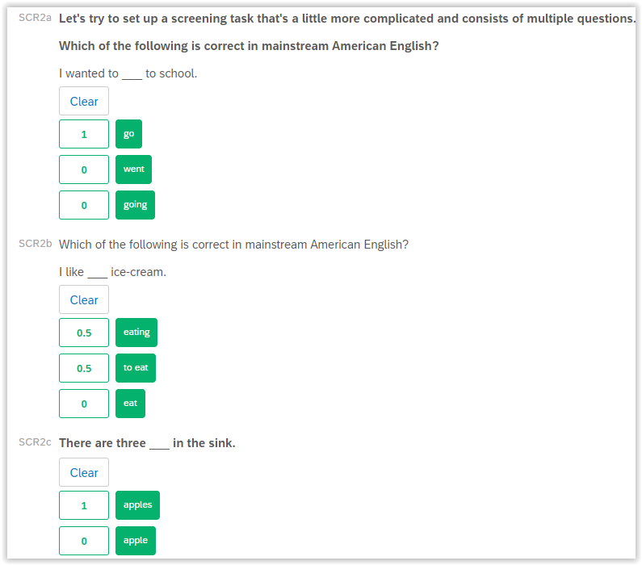
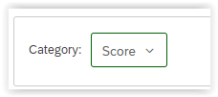
SCR2a-End: Scoring

Slide 15

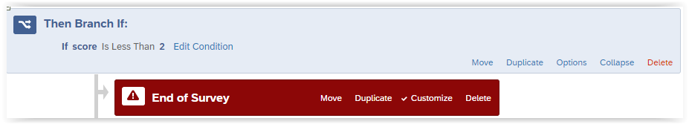
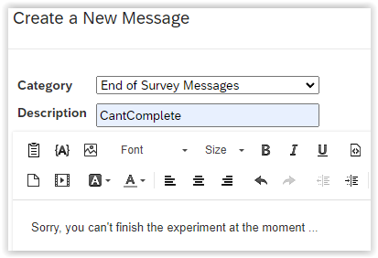
SCR2a-End: Scoring
Piped text

Slide 16
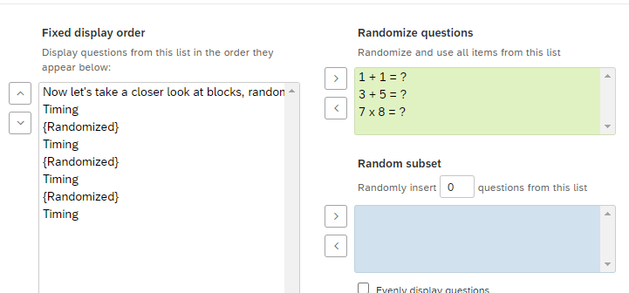
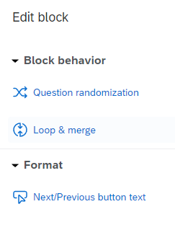
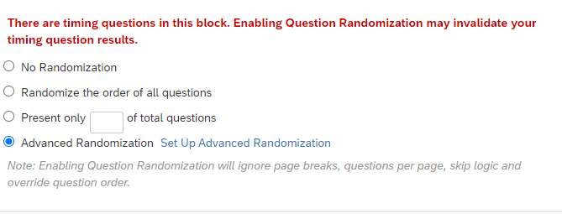
Maths-instruct to time-3

Slide 17
Maths2-instruct to -4120

Slide 18
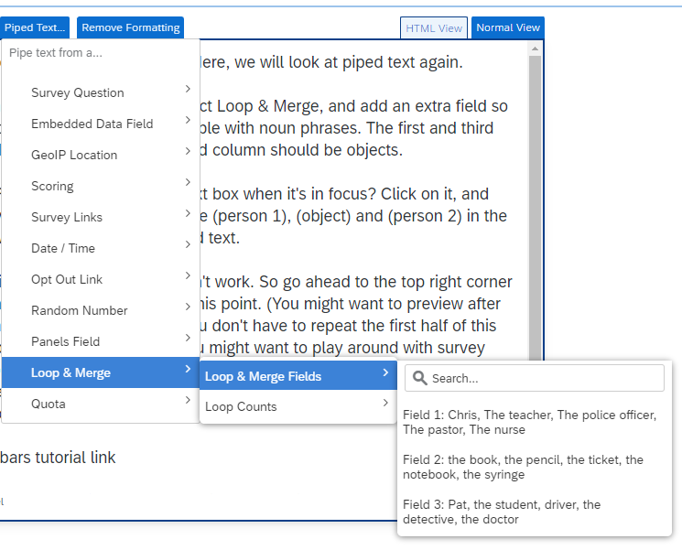
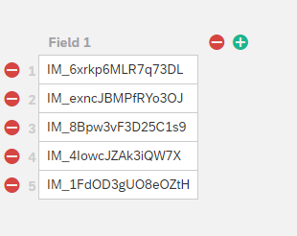
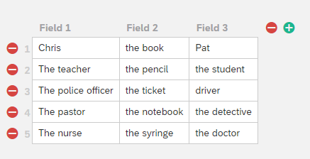
L&M1

Slide 19
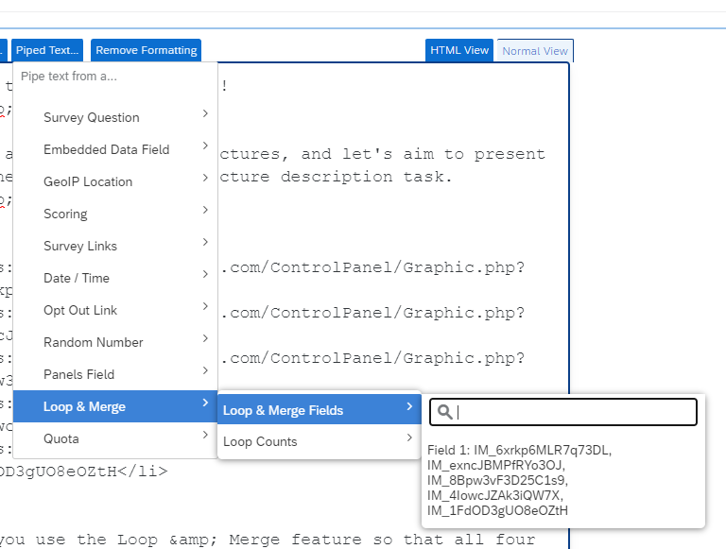
L&M2

Slide 20
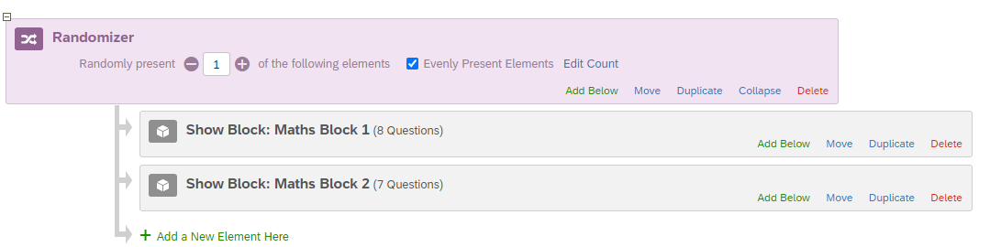
Cond1

Slide 21
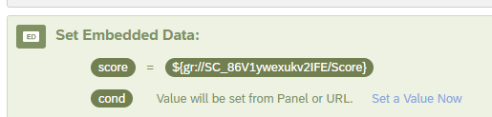
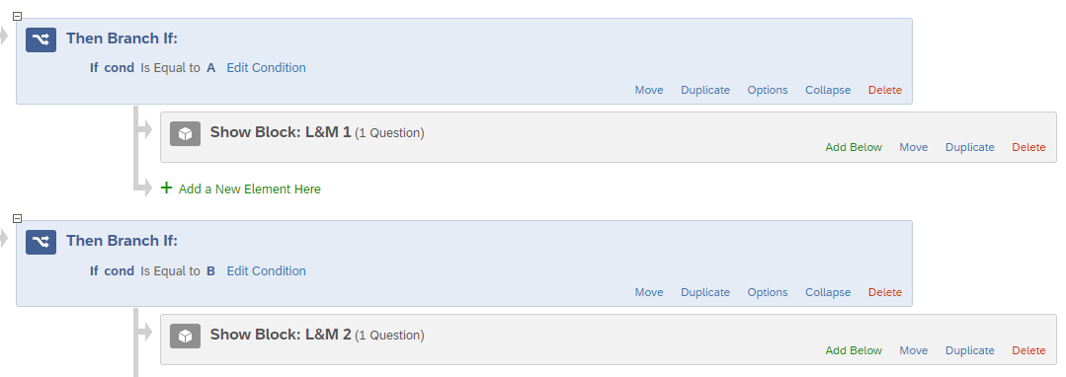
Cond2

Slide 22

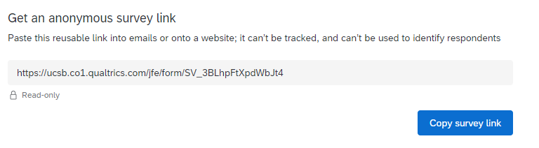
MTurk1
Add condition manually here

Slide 23
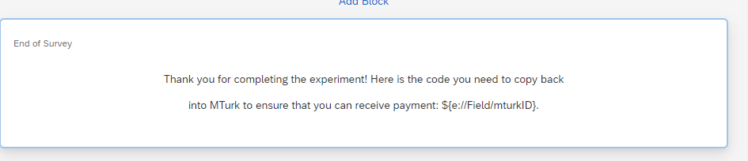
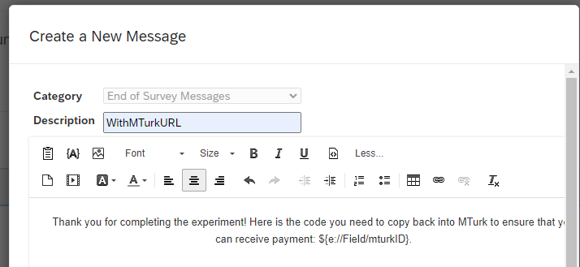
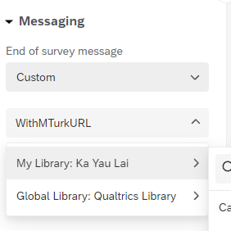
MTurk2

Slide 24
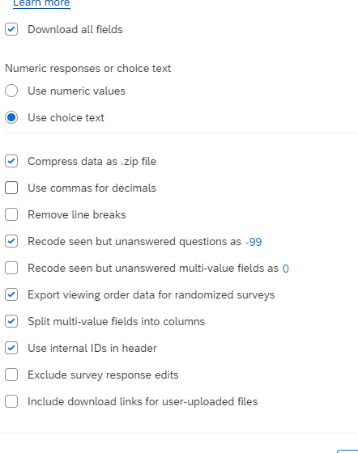
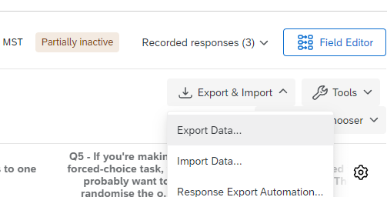
Export

Slide 25
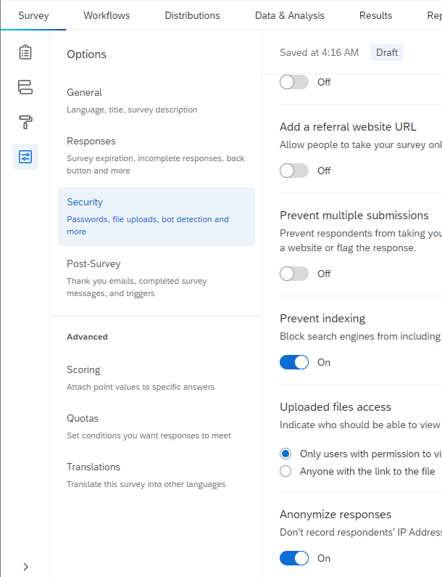
Export

Slide 26
Back to MTurk!

Slide 27
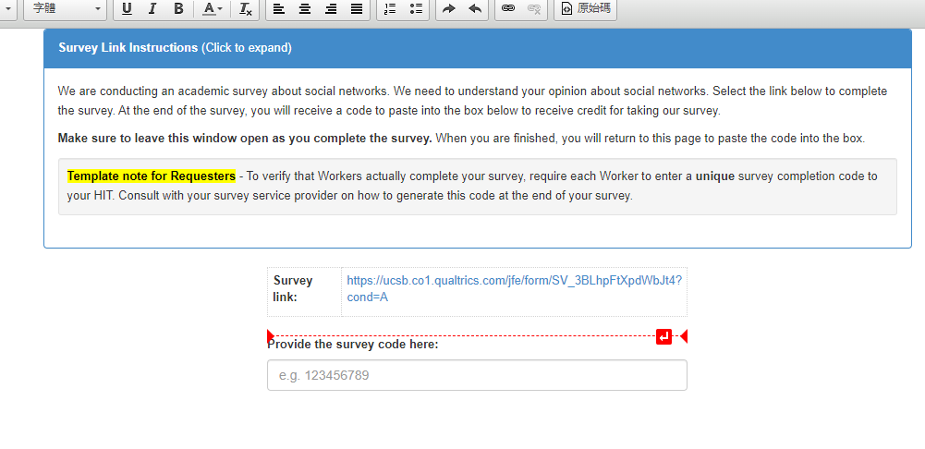
Design Layout

Slide 28
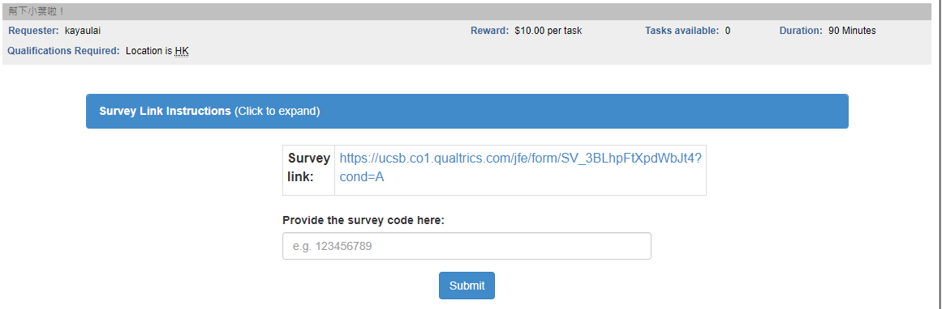
Preview!

