Slide 1

Qualtrics + Mturk Linguistics Experiments Workshop
Ryan Ka Yau Lai
University of California, Santa Barbara

Slide 2
TOC
Question types & trial types
Choice order randomization
Multimedia elements
Screening tasks
Randomising presentation order of questions
Creating questions out of the same template: Loop & Merge
Conditions: Qualtrics-defined and externally-defined
Exporting results

Slide 3
Let’s start with MTurk!

Slide 4
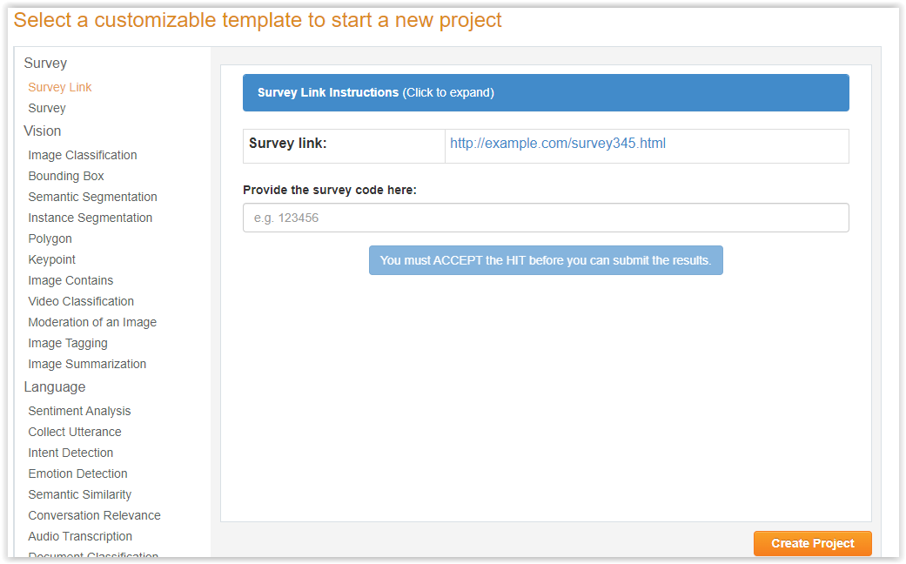
Survey Link template in MTurk Sandbox
https://requestersandbox.mturk.com/create/projects/new

Slide 5
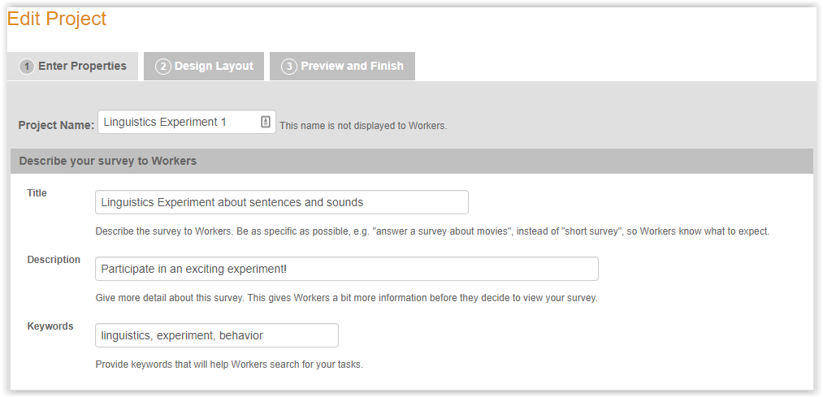
Survey Link template in MTurk Sandbox
Put in a title (as exact as possible), description, keywords

Slide 6
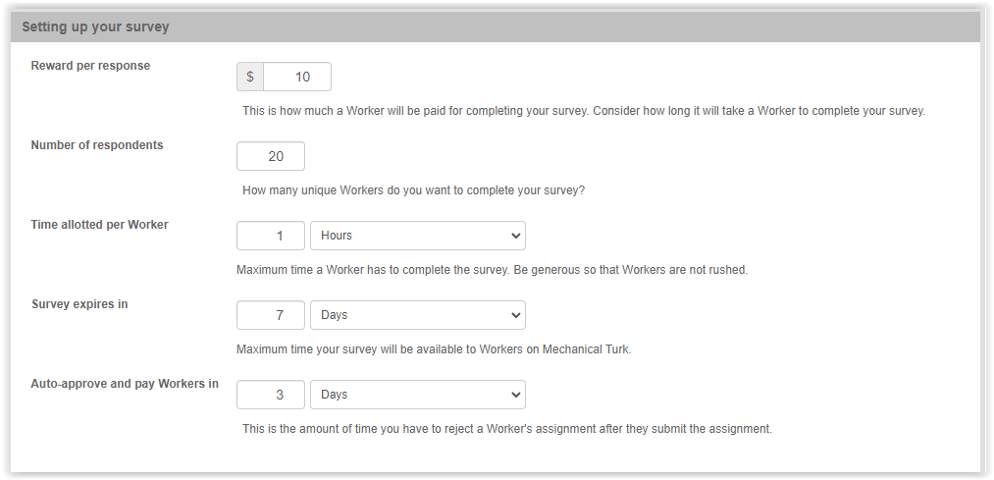
Survey Link template in MTurk Sandbox
Give reward (fairly!), number of respondents
Time allotted (be generous; usually they’re slower than you)
Auto-approve time (as short as possible)

Slide 7
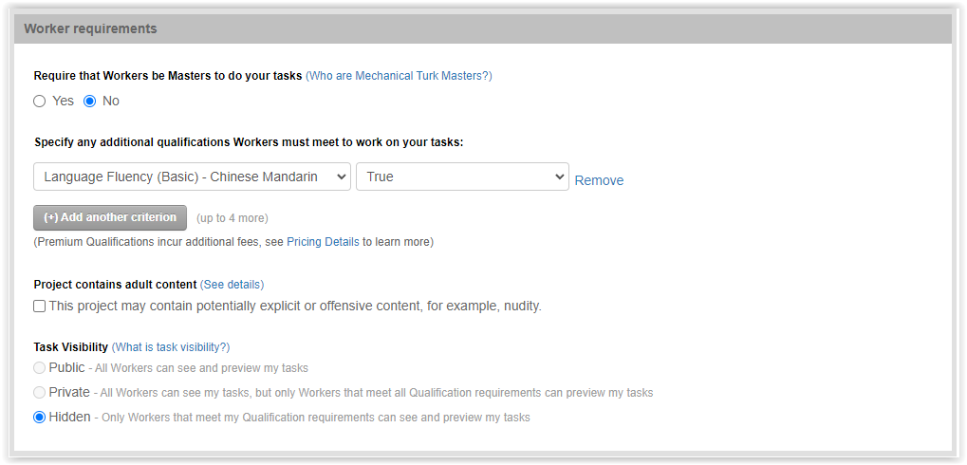
Survey Link template in MTurk Sandbox
Add qualifications

Slide 8
Now let’s go to Qualtrics – we’ll come back to MTurk in the end

Slide 9
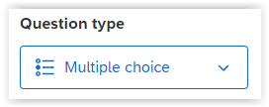
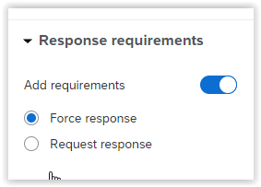
Q2: Intro
1 question = 1 trial
1 question type = 1 trial type (input type)
This question is a forced-choice task, so multiple choice is used
‘Force response’ = participants can’t skip the question

Slide 10
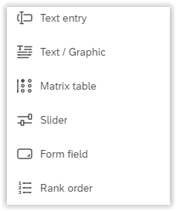
Q3/Q4: Question type
Text / Graphic: Instructions
Slider: Ratings
Rank order: Instead of rating choices, rank them
Qualtrics not enough for you? Add your own (& save as embedded data with JavaScript)

Slide 11
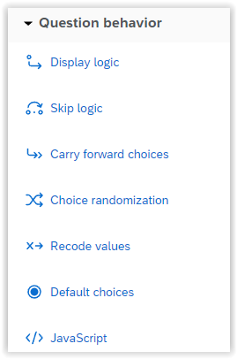
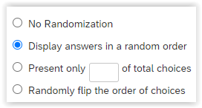
Q5: Randomise choice order
‘Choice Randomization’ from left pane
In popup, choose ‘Display answers in a random order’
Other choices: Randomly flip order, present subset

Slide 12
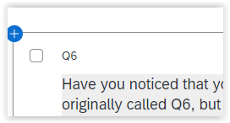
Q6 (?): Question IDs
Change it to a more meaningful question name
e.g. FC2 (second force-choice question)

Slide 13
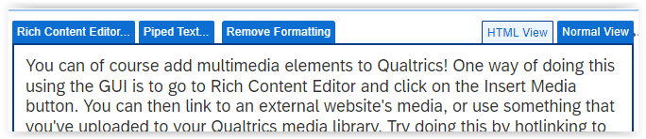
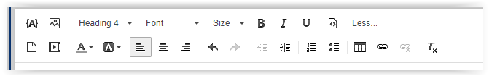
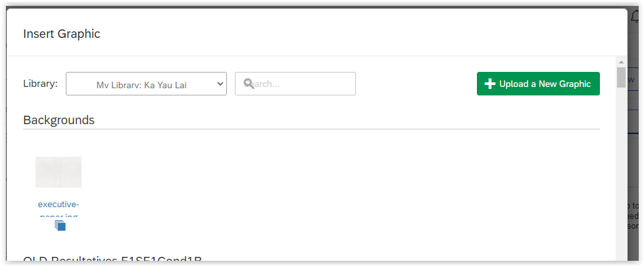
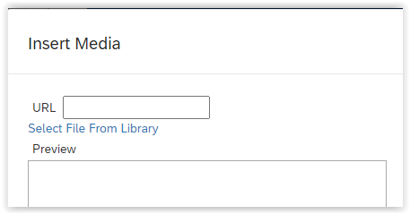
Q7mult

Slide 14
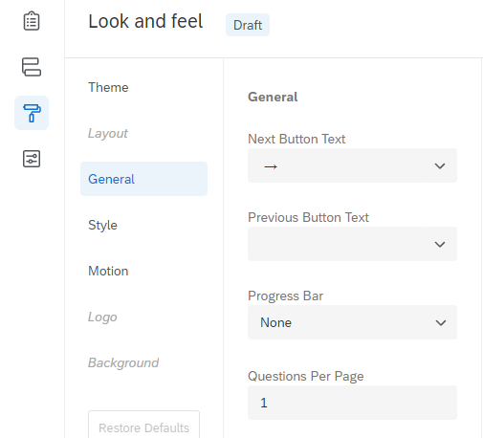
Q8block

Slide 15
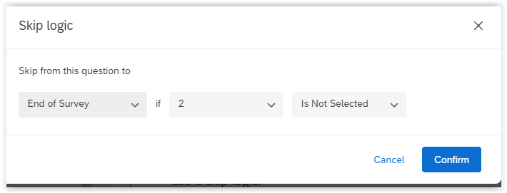
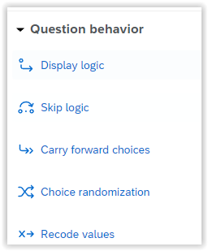
SCR1: Screening

Slide 16
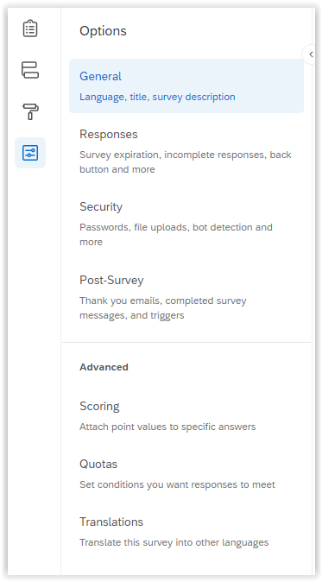
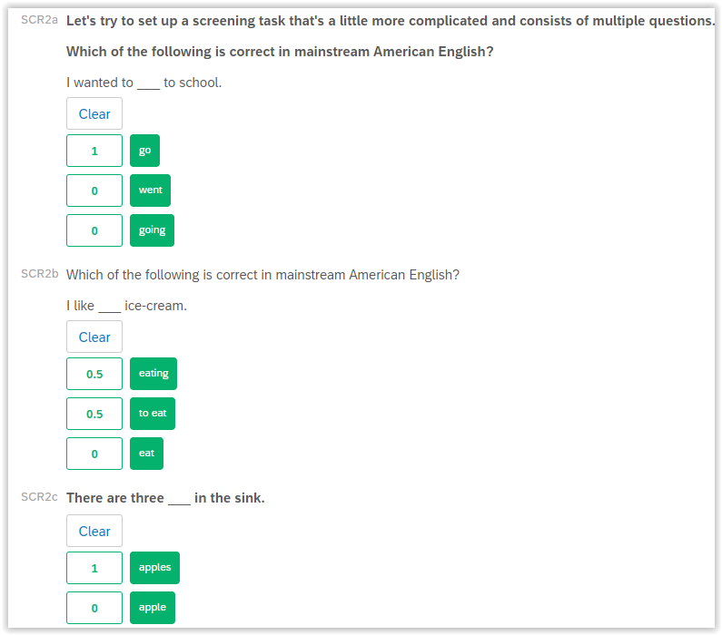
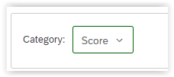
SCR2a-End: Scoring

Slide 17

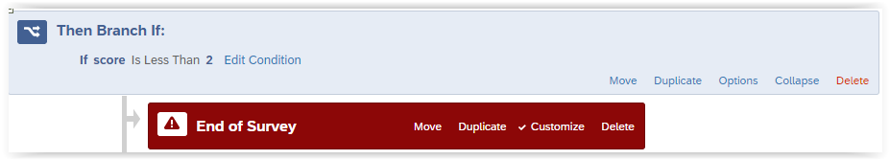
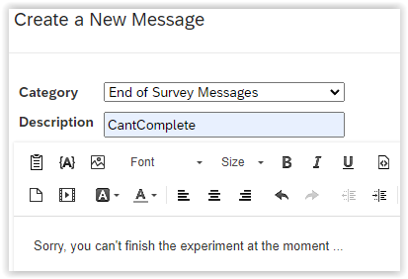
SCR2a-End: Scoring
Piped text

Slide 18
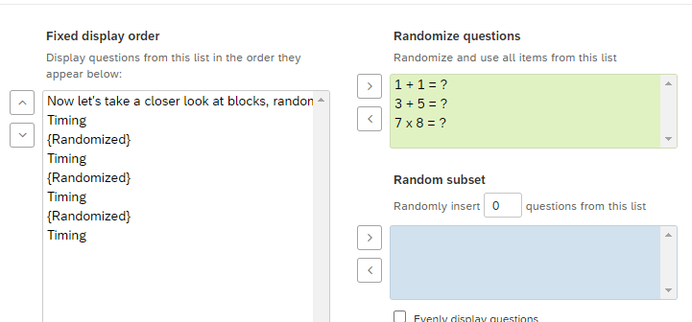
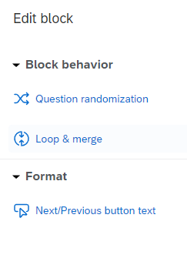
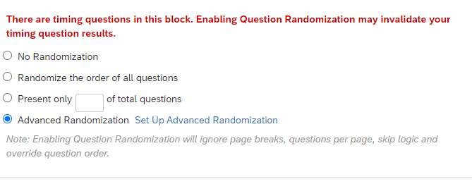
Maths-instruct to time-3

Slide 19
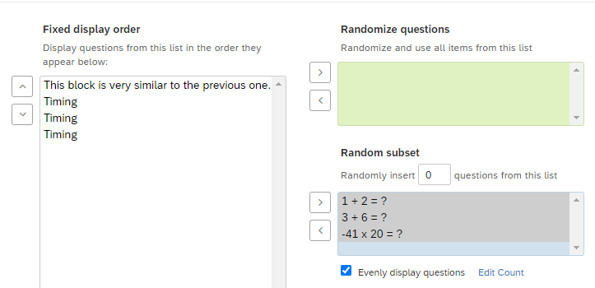
Maths2-instruct to -4120

Slide 20
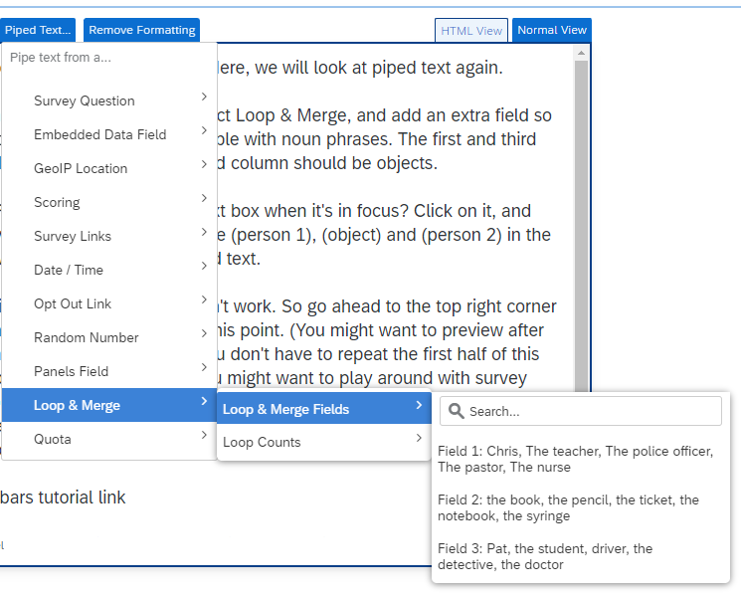
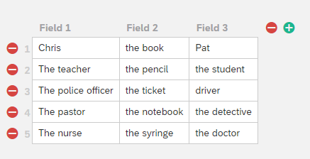
L&M1

Slide 21
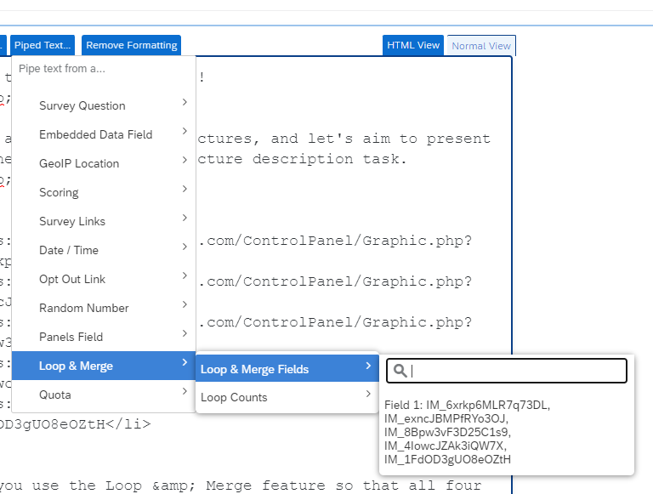
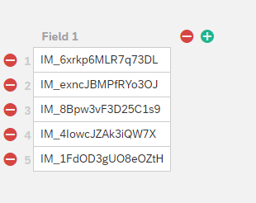
L&M2

Slide 22
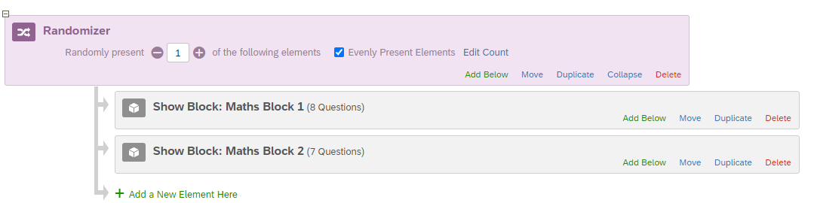
Cond1

Slide 23
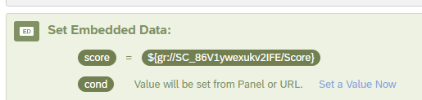
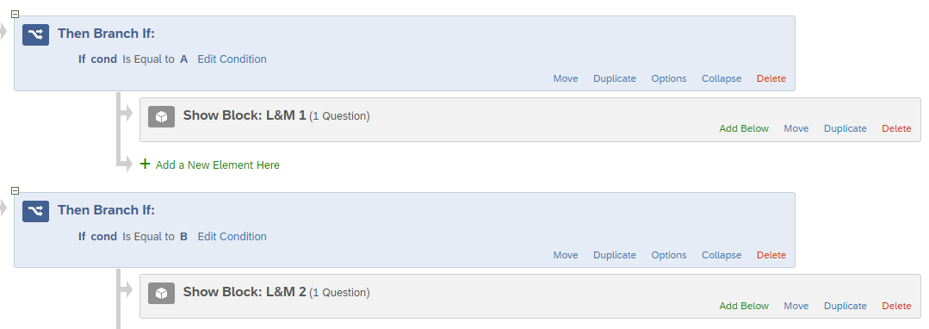
Cond2

Slide 24
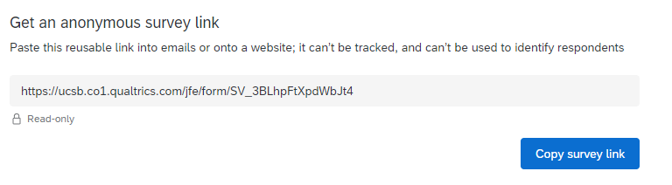
MTurk1
Add condition manually here

Slide 25
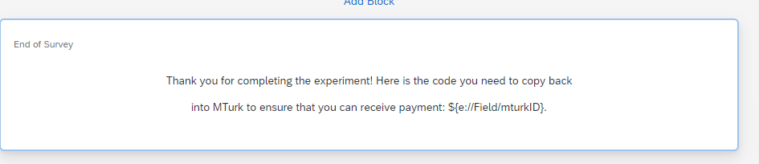

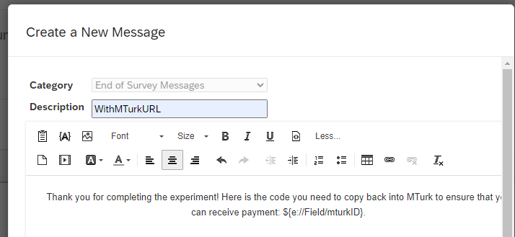
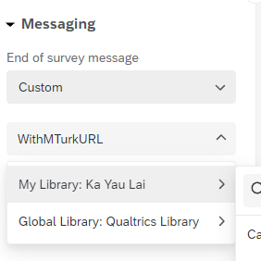
MTurk2

Slide 26
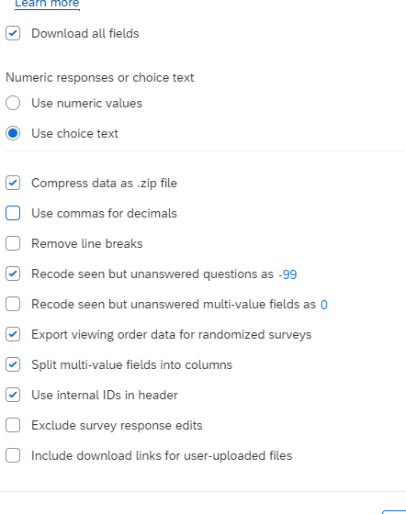
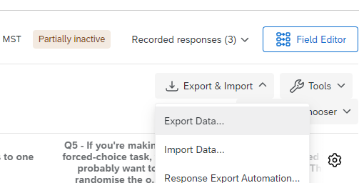
Export

Slide 27
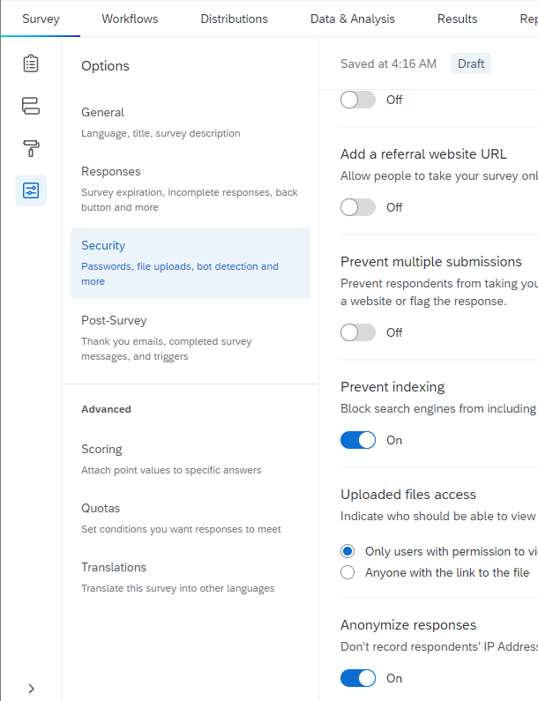
Export

Slide 28
Back to MTurk!

Slide 29
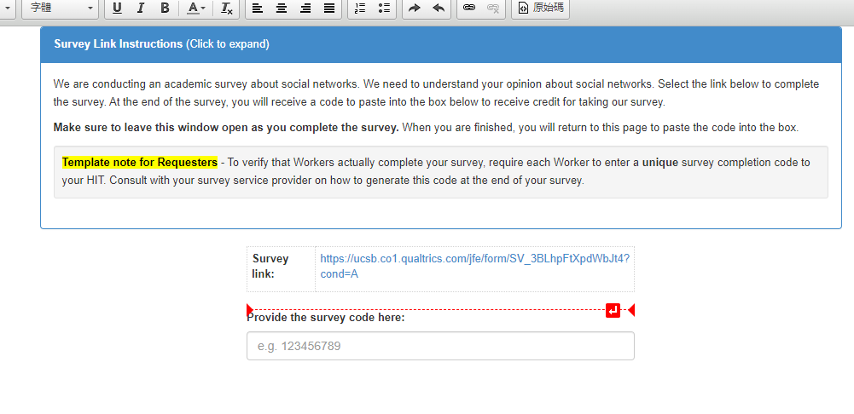
Design Layout

Slide 30
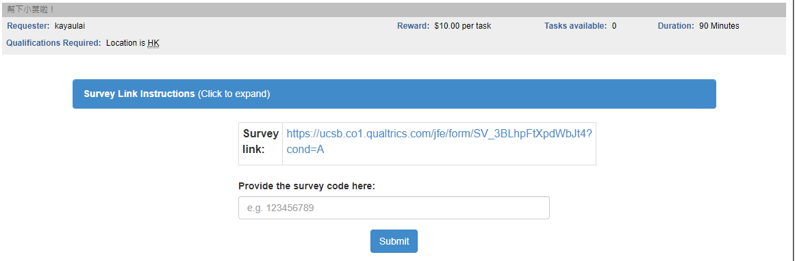
Preview!

