Slide 1
ADVERTISING
Unit 3

Slide 2

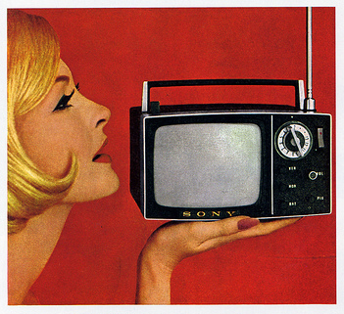
TV COMMERCIALS
https://www.youtube.com/watch?v=axSnW-ygU5g
APPLE 1984 MACINTOSH COMMERCIAL
https://www.youtube.com/watch?v=2B-XwPjn9YY
STEVE JOBS INTRODUCES MACINTOSH
https://www.youtube.com/watch?v=auEdEYY3ao4
AUDI COMMERCIAL

Slide 3
COMMON STRATEGIES USED IN TV COMMERCIALS
The Snob Effect:
This tells you that the product is most exclusive and of course rather expensive. Only the very best people use it.

Slide 4
The Scientific Effect
A serious-looking person, possibly a scientist or a doctor, tells you about the advantages of the product.
The Words and Music Effect
The name of the product is repeated over and over again, put into a rhyme and sung several times, in the hope that you don’t forget it. The sung rhyme is called a «jingle».

Slide 5
The ha-ha effect
The advertiser tries to make you laugh by showing people or cartoon figures in funny situations.
The VIP (Very Important Person) effect
Well-known people, like actors or athletes, are shown using the product.

Slide 6
The super modern effect
The advertiser tries to persuade you that this product is a new, sensational breakthrough, a «must».
The go-go effect
This is suitable for the teenage market. It shows young people having a party, singing, laughing, having a wonderful time- and, of course, using the «X» product.

Slide 7


Slide 8
Mini Presentation
Prepare a mini presentation of about 2-3 minutes on the advertising strategies used in a commercial of your own choice.
Follow these steps to prepare for the presentation:

Slide 9
Choose a TV commercial that you think is interesting/memorable/provoking etc.
Download the commercial if possible and share it with your classmates at the beginning of your presentation. If it is not possible to do so, provide a brief description of the advertisement. You may wish to use some photos or images to compensate for the lack of a video of the advertisement.

Slide 10
Give a detatiled analysis of the commercial by answering the following questions:
*What product is being advertised?
*Who is the target audience
*What are the advertising techniques
used in the commercial?
*What message does the commercial
try to give?

Slide 11


Comment on the effectiveness of the technique and your personal reaction to it as a consumer. If you think the commercial is not effective, suggest how else you would advertise the product if you were the advertiser.
ANY QUESTIONS?

Slide 12


