Slide 1
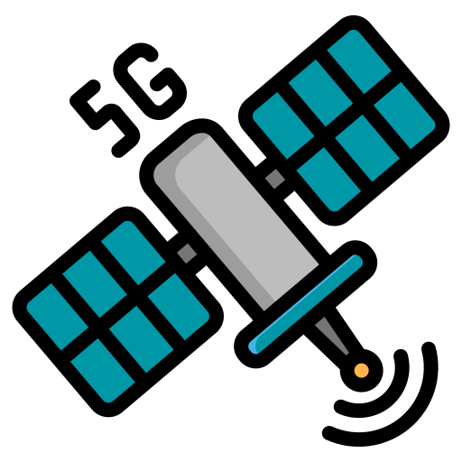

TWO ADVANTAGES OF 5G OVER 4G
BERKAY DEMİRÖREN
2309888

Slide 2

Outline
Briefing
Priori knowledge about cellular networks.
Main
Advantage One: Higher speed
Advantage Two: Higher capacity
Summary

Slide 3

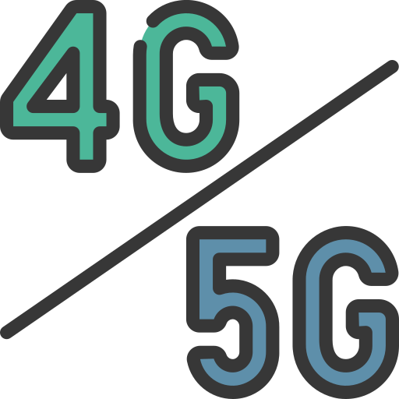
A brief informing
Mobile Networking
G Concept

Slide 4
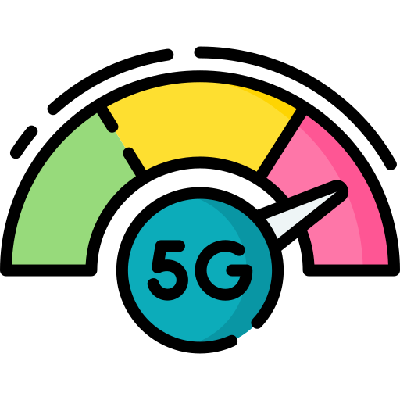

Two Technologies — Two Advantages
In Terms of Speed
In Terms of Capacity
Latency
Bit Rate
Bandwidth
Connection Density

Slide 5

In Terms of Speed
Latency
From 200 ms to 1 ms. [1]
Virtual reality gaming
Remote surgery

Slide 6

In Terms of Speed
Bit Rate
From 0.15Gps to 20 Gps.
Download a 3GB movie in 1 second.
Real-time 4K video stream.

Slide 7
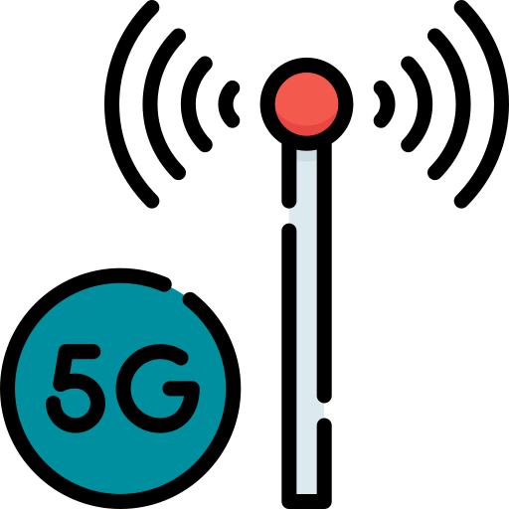
In Terms of Capacity
Bandwidth
From 8 GHz to 300 GHz.
37 times wider spectrum.
Reduced congestion.

Slide 8
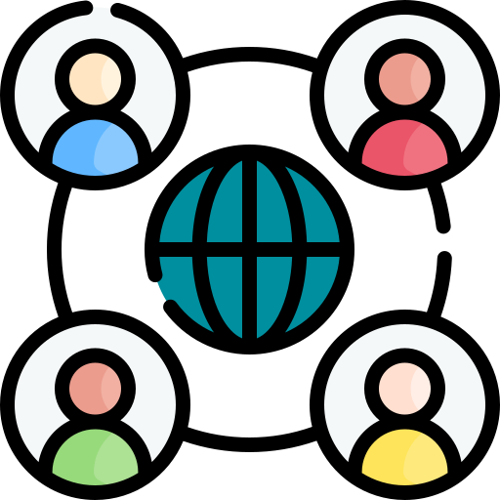
In Terms of Capacity
Connection Density
From 4K devices to 2M in 1km^2 area.
Much more data packets on the air.
Much more devices on the ground.

Slide 9

Summary
Enhanced 4G >>> 5G
Speed
- Low latency
- High bit rate
Capacity
- Wider bandwidth
- Condensable network

Slide 10


Any Questions ???

Slide 11

References
[1] Edwards, J. (2019). 5G versus 4G: How speed, latency and application support differ. Network World.
E. Hajlaoui, A. Zaier, A. Khlifi, J. Ghodhbane, M. B. Hamed and L. Sbita,2020
N. Jabagi, A. Park and J. Kietzmann, “The 5G Revolution: Expectations Versus Reality”,2020

Slide 12
Thanks for your attention :)

