Slide 1
Declarative Expressions of Behavior
Anne Ogborn
Notes:
Preroll slide
1. Have puppets available
2. mic check

Slide 2
TALK!
Notes:
This is going to be an interactive conversation.
Feel more than free to jump in.
This is definitely going to be about some things I’ve been thinking about. Things that bother me. But not things I’m an expert on, coming down to deliver the enlightened knowledge.

Slide 3
Declarative Expressions of Behavior
Anne Ogborn
Notes:
We write programs in a different language than we talk about them. "So we get a request, do the security mumble, pass it to the middleware that grabs ..."
Can we get closer to writing programs that describe the program's desired behavior? And why do such attempts always get poo-pooed by programmers?

Slide 4
"So we get a request, do the security mumble, pass it to the middleware that grabs ..."
Notes:
We write programs in a different language than we talk about them. "So we get a request, do the security mumble, pass it to the middleware that grabs ..."
Can we get closer to writing programs that describe the program's desired behavior? And why do such attempts always get poo-pooed by programmers?
This is a foofy cloud shaped drawings exploration of other ways to express software design intent, mostly by cheating.

Slide 5
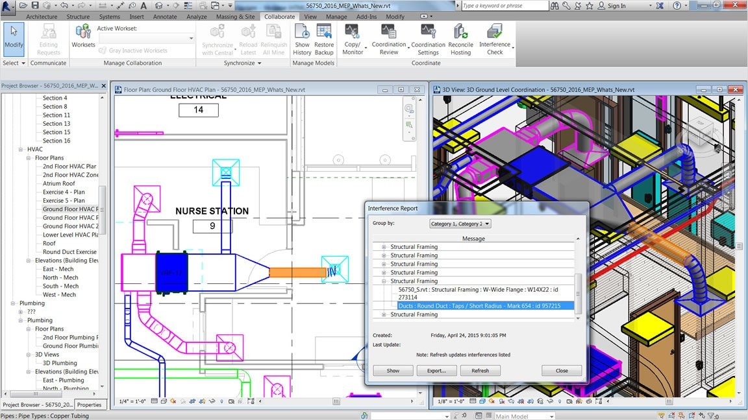
Express Design Intent
Notes:
I’m going to claim that programming is about expressing design intent.
What’s design intent? It’s what I want this thing to be. Here we have an architectural drawing. It shows some HVAC ducting. It doesn’t show there’s duct tape on the joints, or straps holding the ducts up, because the installer will know to do those things.
As programmers we communicate design intent to a particularly stupid agent, the computer.
But we often get lost in an activity we call programming – when what we wanted was to express design intent.

Slide 6
Behavior
The dynamic change of the program in time
Notes:
Well, what about initial state? Isn’t that important?

Slide 7
Declarative Program
A definition of behavior for a computing system that does not depend on explicitly describing it’s execution sequence.
Notes:
I’ll note that this is actually a pretty poor definition, ontologically.
Does a Clojure or Haskell program explicitly describe it’s execution sequence? How explicit is explicit? Does method dispatch in Java mean it’s a declarative language?
Is Css somehow more declarative than Clojure?
Get audience involved
(puppets?)

Slide 8
Memory
Control
Unit
Arithmetic
Logic
Unit
Registers
IO
Notes:
What curse has von neuman laid on us?

Slide 9
Content
Addressable
Memory
A=7
Instruction token needs B, has A, makes C
Instruction token, needs B,C makes D
Instruction token needs C,D makes A
B=4
Execution
Unit
Notes:
- the dataflow architecture
We have a content addressable memory. In it we have data tokens and instruction tokens, with tags
Data tokens have tags, which act as identifiers
Instruction tokens have a list of required tags.
When all tags are available in the CAM, the instruction can fire.
Here, the execution unit has just emitted the B token.

Slide 10
Content
Addressable
Memory
Instruction token has A,B makes C
A=7
B=4
Instruction token, Has B, needs C makes D
B=4
Instruction token needs C,D makes A
Execution
Unit
Notes:
The top instruction already had the A token, so it now has everything it needs. It activates.
The execution unit selects one of the active instruction tokens and loads it.

Slide 11
Content
Addressable
Memory
Instruction token needs A,B makes C
Instruction token, Has B, needs C makes D
B=4
Instruction token needs C,D makes A
C=11
Execution
Unit
Instruction token has A,B makes C
A=7
B=4
Notes:
Notice that we’ve deactivated the unit.
The instruction declares how to make C given A and B. So the execution unit emits C
This activates other instructions, in this case just the second one.
And so execution goes.

Slide 12
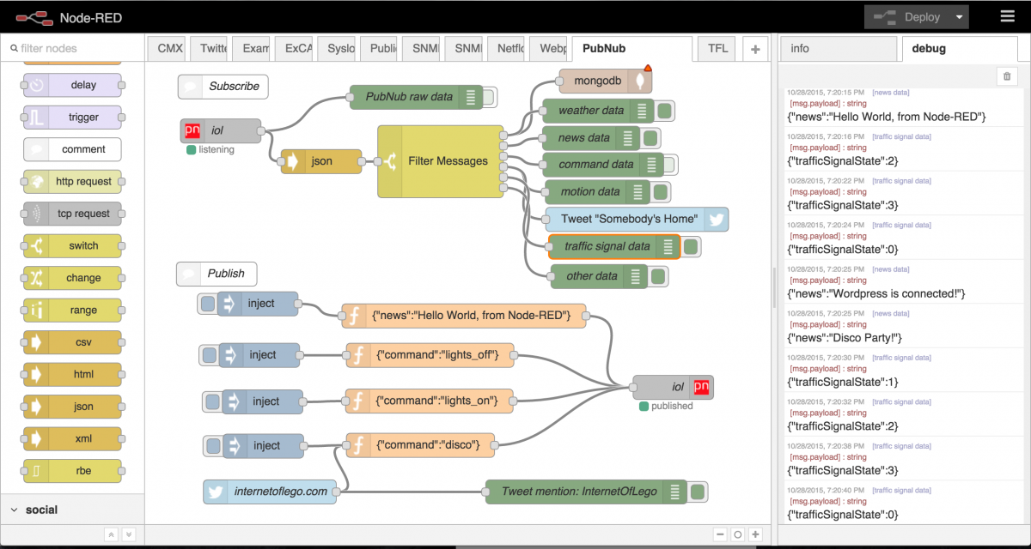
Node-red push flow
Notes:
Here’s a flow programming system by IBM.
You use this browser-based editor, draw nodes, and wire them up. Messages start on the left, usually as input, flow through the system, and there’s output on the right.
This is a push based flow system. It’s called that because messages are emitted by the output node, and the input node receives them.

Slide 13
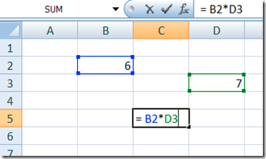
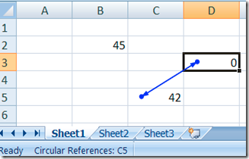
Excel – pull flow
Notes:
Here’s Excel – which is a pull based flow language. Messages act not as action statements, as in node-red, but as in values. So a message is only needed when either the consumer cell’s dependencies change,or when we edit the cell.

Slide 14
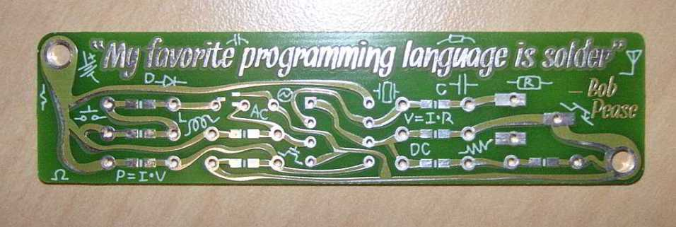
Notes:
Here’s another way of discarding von Neumann.
At the time Bob Pease was promoting this phrase, the only integrated circuits available to the hobbyist were TTL and small 8 bit MCUs.
Doing things with combinatorial or sequential logic made complete sense.

Slide 15
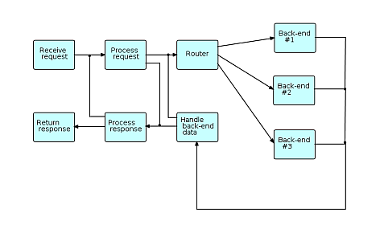
Notes:
With these kind of flow programs, one always suspects they’re cool looking, but don’t actually describe real systems we’d code at work.
So, I was tickled to find this cool little diagram on the wikipedia page for flow programming.
I’ve been playing with node-red, and one of the things I’ve built is a pretty ordinary online web application. I have it doing log in and log out.

Slide 16
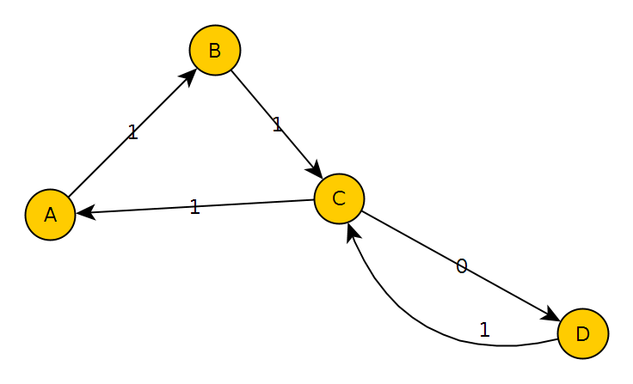
State Machines
Notes:
Here’s a declarative description of behavior most of us will be familiar with.
This is a state machine.
Anybody not recognize this?

Slide 17
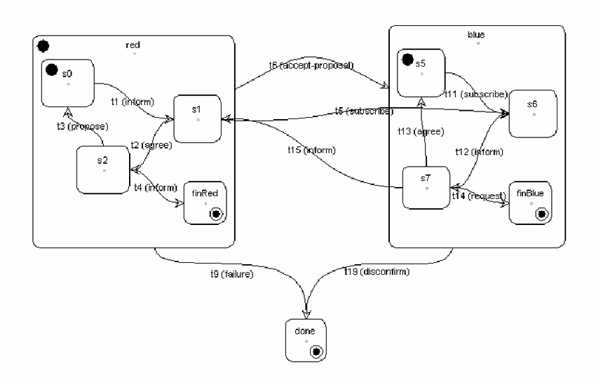
Hierarchical State Machines
Notes:
State machines can become repetitive to write, since common behavior needs to be specified for every state.
Hierarchical state machines allow us to say a system is in not one state, but in all superstates that nest that state. Incoming messages are handled by the lowest level substate that has a handler, or quietly discarded.
Hierarchical State Machines enable
“Programming by difference”,

Slide 18
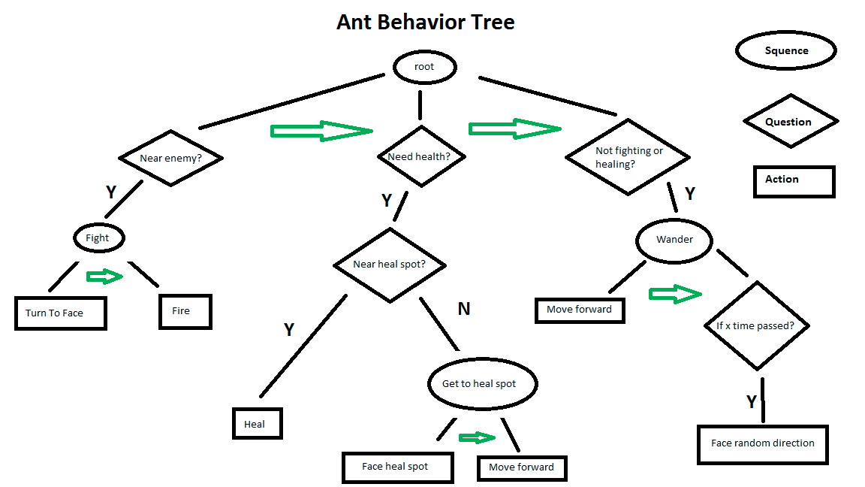
Behavior Trees
Notes:
Anybody here do any game development?
These are behavior trees. They’re commonly used in game AI, but they’re useful forall sorts of things.
In particular, they’re useful for simulating systems

Slide 19
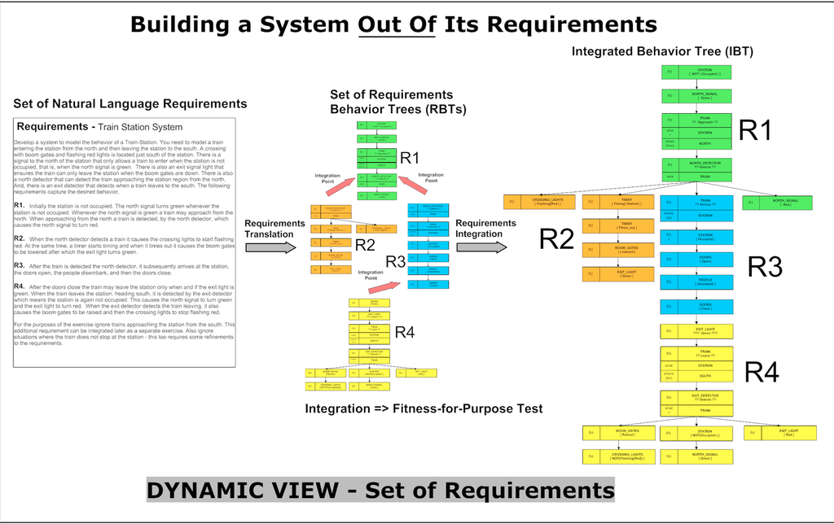
Notes:
I thought this was really interesting.
Researching for this talk, I looked at the wikipedia page for behavior trees.
And whoever wrote it treated behavior trees as primarily a design tool – as a way for humans to communicate design intent to other humans.
And every time I see that, I wonder why it’s taking a human to translate the documented design into code. It’s bothered me for decades.

Slide 20

Anaphoric Code
Situational Code
Notes:
Humans are good at anaphoric reasoning.
Anaphoric reasoning is reasoning that depends on context.
In the sentence “Sally dropped her phone. It shattered”, we understand that we mean the glass front on her phone.
These two guys don’t have matching contexts. One is asking questions about the physical world. The other is responding with answers from the internet.
Anaphoric code is code whose behavior varies based on where the code is. In this case, identical, deterministic code run on your machine and on mine will give different results if the code depends on the MAC address.

Slide 21
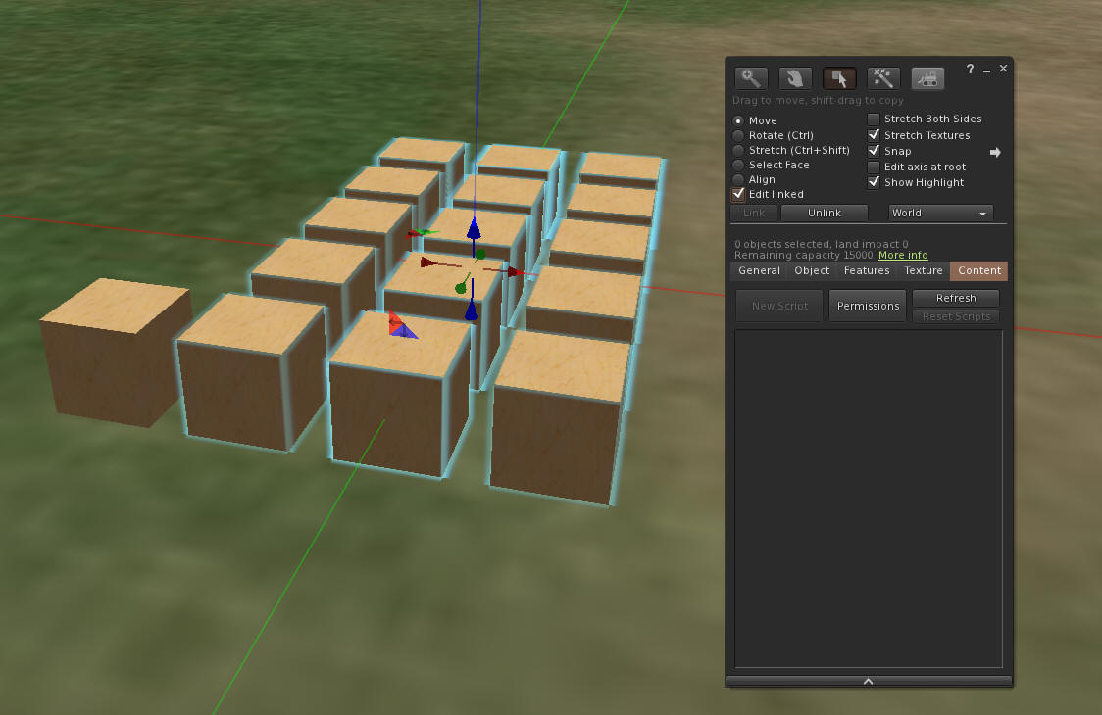
Notes:
Here’s a system that depends highly on anaphoric properties of code.
This is Second Life.
In Second Life you can build up objects like houses and cars from simple primitives called prims.
Selecting a prim and hitting ctrl 3 brings up a dialog where you can manipulate what’s “inside” a prim. Including bits of code.
And the behavior of that code depends on where it is.
Changing color changes the color of that prim.
Behavior depends on whether the prim is the ‘root’ prim – one prim is also a stand in for the whole object.
You can even do things like transmit messages only within a fixed radius.

Slide 22
CSS
Notes:
Here’s a declarative language.
Now , we said we were interested in behavior – but I’d point out that CSS does specify behavior – for example, it specifies rollover behavior.
But it also specifies a control program for the box model layout engine.
And it’s anaphoric. It depends on context.

Slide 23
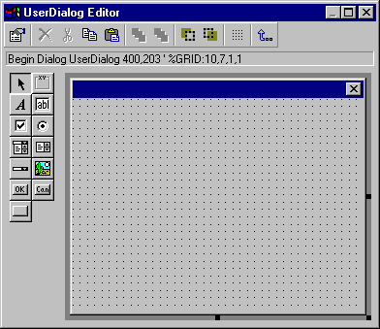
Notes:
Here’s a dialog box editor.
If you’ve used one of these, particularly one that goes both ways – from GUI to code and code to gui, you’ll know that you can spit out a lot of UI code in a hurry.

Slide 24
Declarative Expressions of Behavior
Anne Ogborn
Notes:
We write programs in a different language than we talk about them.
Can we get closer to writing programs that describe design intent without generating piles of code?
And why do such attempts always get poo-pooed by programmers?
Thanks for participating.

