Slide 1
Churn analysis
Identifying patterns/reasons for customer churn rate and developing strategies to retain customers.

Slide 2
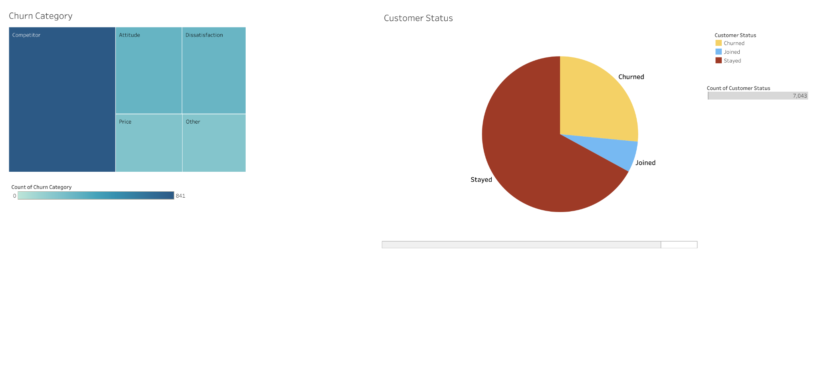
Churned Data
Observation: during our 3rd quarter our customer status was comprised of stayed(67%), churned(26.5%) and joined(6.5%)
Observation: the treemap presented suggests the main reason for our customers leaving - is to be accredited to our competitors.
Recommendation: tenerate customer feedback through surveys - to gain insight - on why customers are leaving us for our competitors.

Slide 3
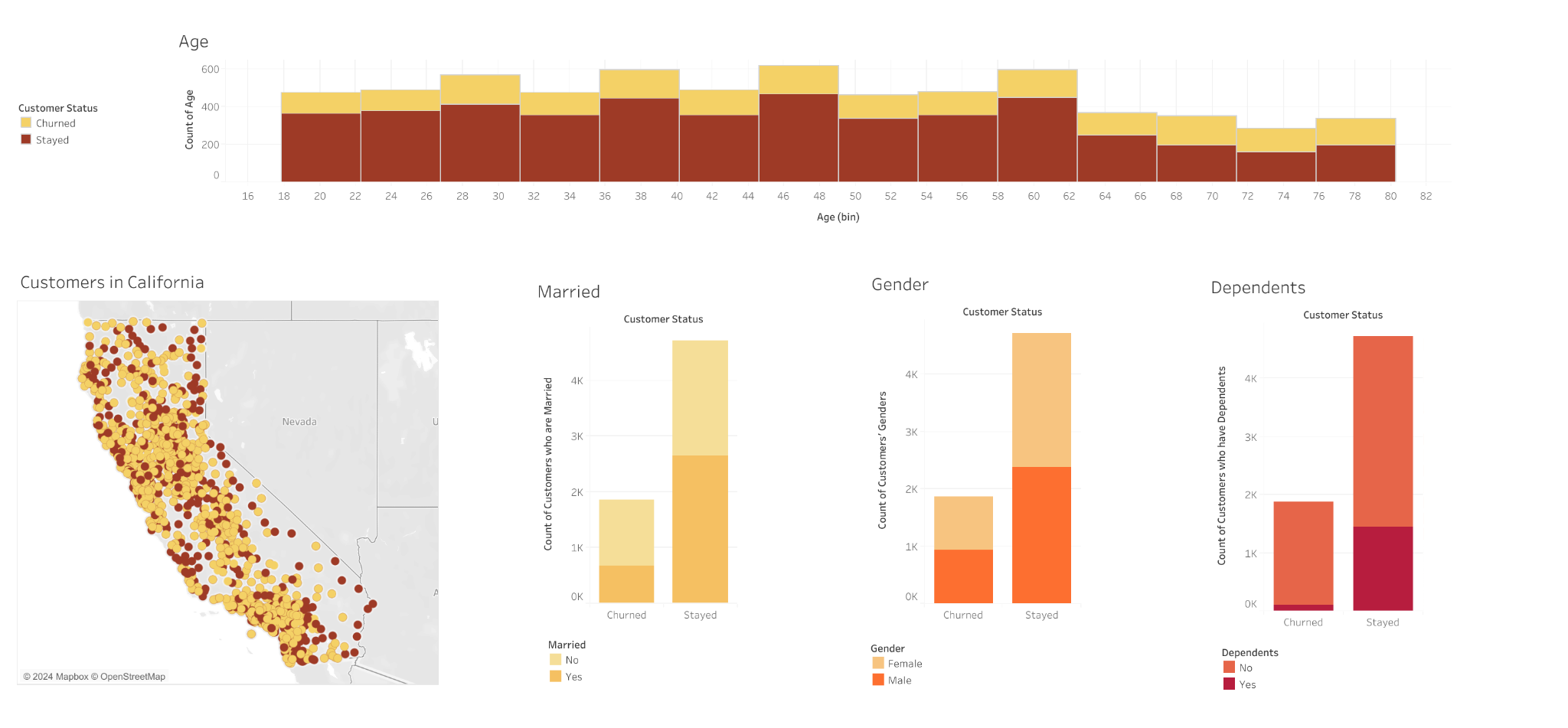
Demographic
Observation: the histogram shows us the majority of our current customers reside between the ages of 18-62. the data about our previous customers seems to be in no particular age range.
Recommendation: to retain a higher percentage of customers (for the next quarter) it is advised that we carry out strategies such as loyalty programs to reward customers for their commitment - to our organisation. This strategy should be carried out mainly for our customers ranging from ages 18-62.

Slide 4
Demographic
Observation: from the map chart, we can conclude that our current and previous customers are evenly scattered all over California - suggesting no correlation for either group of customers (churned & stayed).
Observation: this bar chart shows most of our churned customers are without marriage. Our stayed customers had a higher percentage of people who are married, in comparison to our churn customers. Customers are more likely to stay if married.
Recommendation: when marketing our products/services to individuals - we should do so in a way that attracts individuals - who could be married.

Slide 5
Demographic
Observation: from the stacked bar chart - we can infer that customers are more likely to stay if they have dependent.
Recommendation: when marketing our products/services to individuals - we should do so in a way that attracts individuals - who have dependents.
Observation: the stacked bars (presented) show us churned and stayed customers have around 50% males and females.

Slide 6
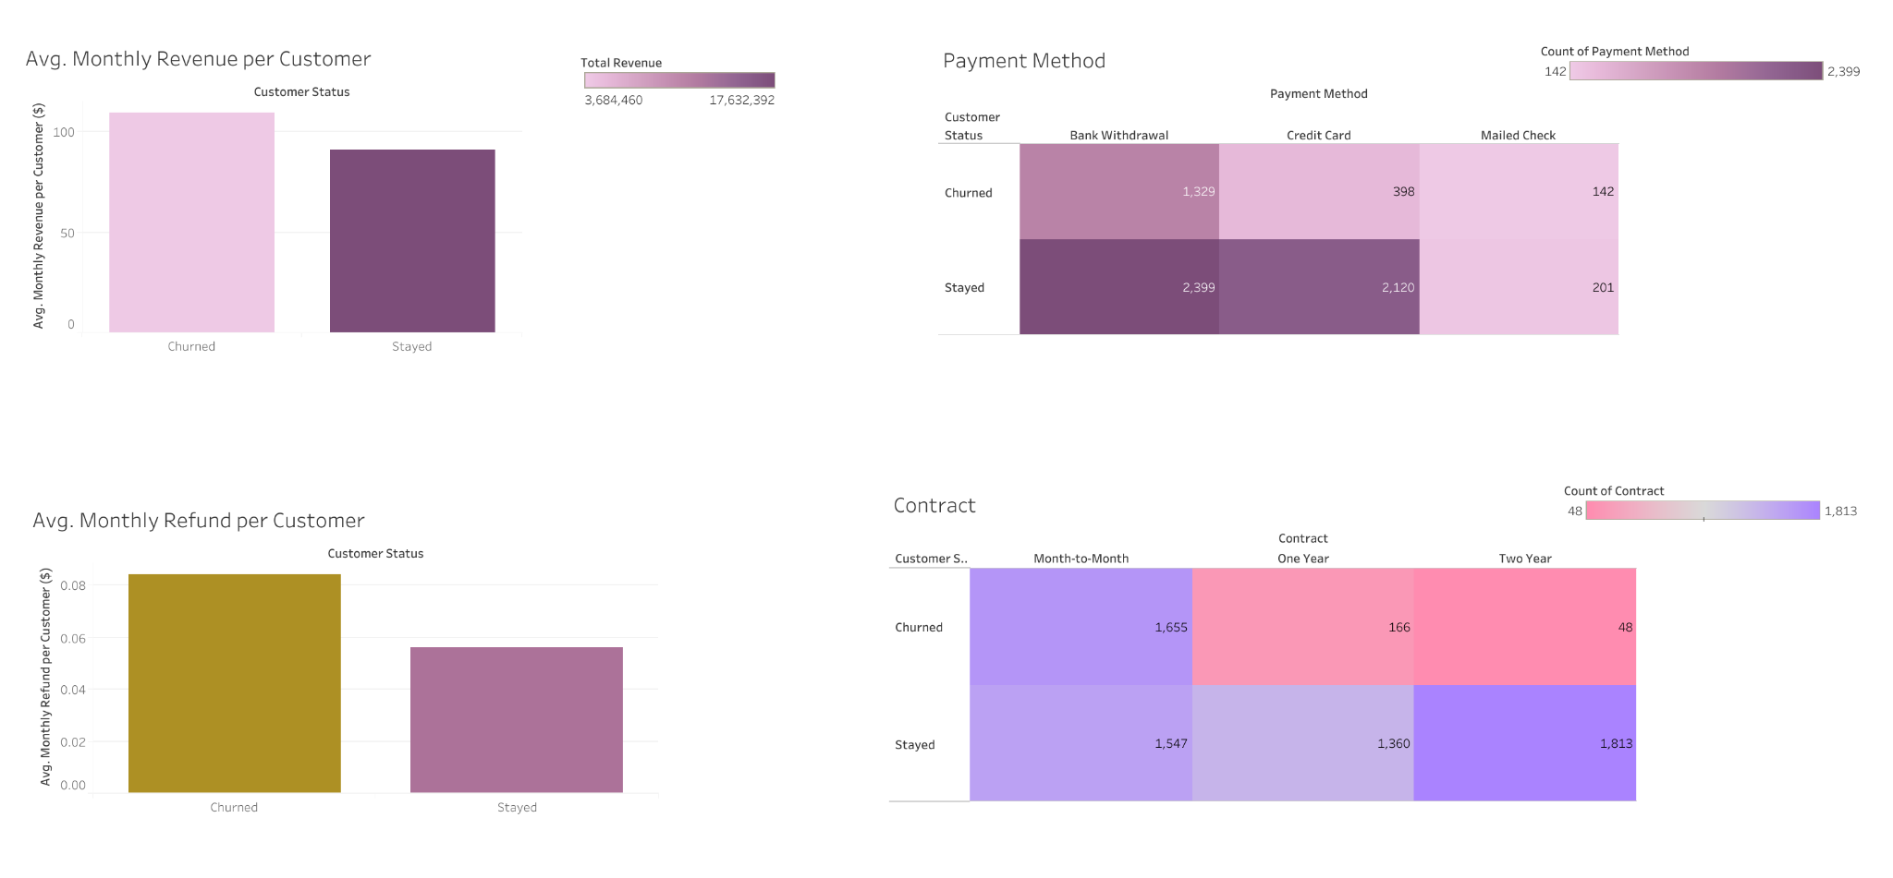
Payment
Observation: during the 3rd quarter, our churned customers generated more revenue (each) on a monthly average - in comparison to our loyal customers.
Observation: customers are more likely to stay - if their payment methods are credit cards.
Recommendation: when discussing payment methods with individuals - we should try to influence customers into utilising credit cards as their payment method.

Slide 7
Payment
Observation: our churned customers received more refunds (each) on average per month.
Recommendation: look into why our churned customers are receiving a greater refund (in comparison to our loyal customers).
Observation: this heat map shows that our churned customers prefer a month-month contract. However, customers are more likely to be loyal if their contracts are annual or bi-annual.
Recommendation: when leveraging our services, we should try persuading individuals to purchase contracts that are annual or bi-annual - specifically bi-annual.

Slide 8
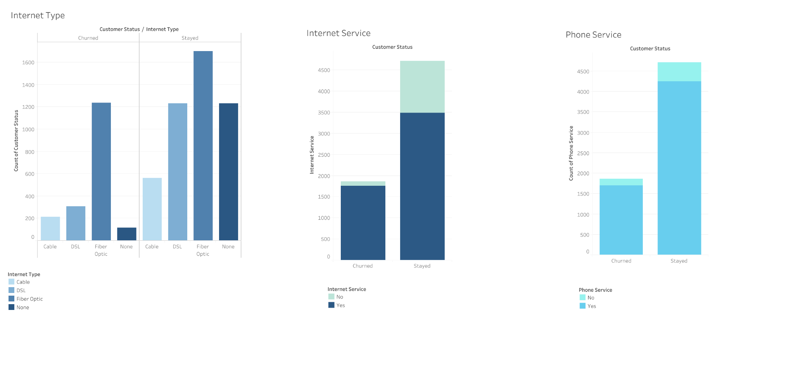
Internet and Phone
Observation: stayed and churned customers mainly prefer Fiber Optic. Customers are more likely to stay committed if their internet type is Cable, DSL or None.
Recommendation: when promoting our internet type, we should emphasise the promotion - of our Cable and DSL internet types.
Observation: a majority of churned and stayed customers received internet service.
Observation: a majority of churned and stayed customers received phone service.

Slide 9
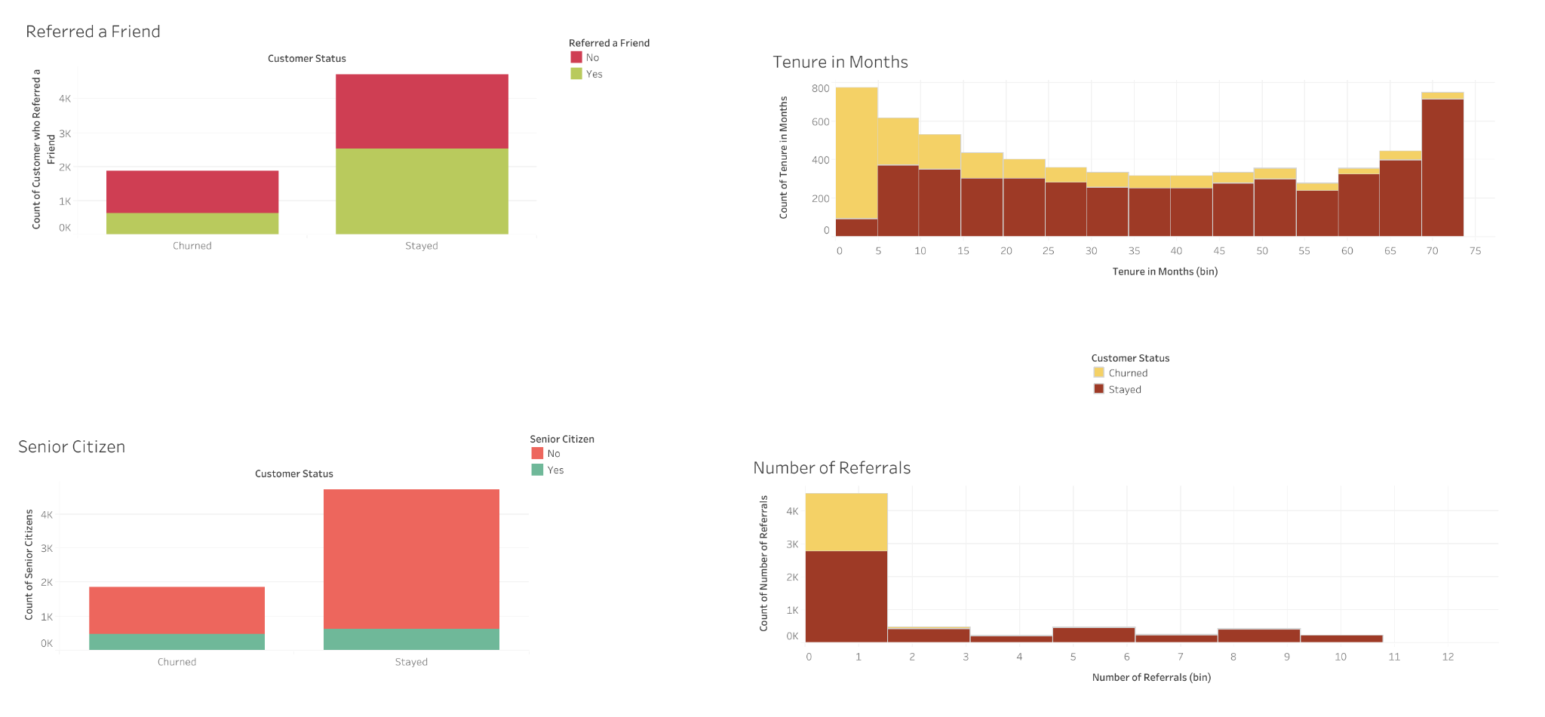
Referrals
Observation: churned customers were less likely to recommend a friend - of our services.
Recommendation: to increase our chances of sustaining customers we should try our best to persuade them to refer a friend. Also, look into why some churned and stayed customers did not refer a friend - through customer surveys.
Observation: this histogram shows (a majority of) churned customers referred 0-1 friend(s). Customers are more likely to stay if they refer more than one friend.
Recommendation: look into why the majority of churned customers did not refer more than one friend via the use of customer surveys. Also to generate more referrals we should Provide referral bonuses - to loyal customers.

Slide 10
Additional Customer Data
Observation: stayed and churned customers mainly consist of customers who are not senior citizens.
Observation: during the 3rd quarter the a high number of churned customers lasted not longer than 5 months.
Recommendation: aim to entice customers to stay longer than 5 month - this will drastically increase our chances of keeping them. We can reward their loyalty with loyalty programs, Offer exclusive access and discounts,

