Slide 1

🏠 IMMO ELIZA
DATA ANALYSIS
A Project by:
Emmanuel
Kenny
Nadiya

Slide 2
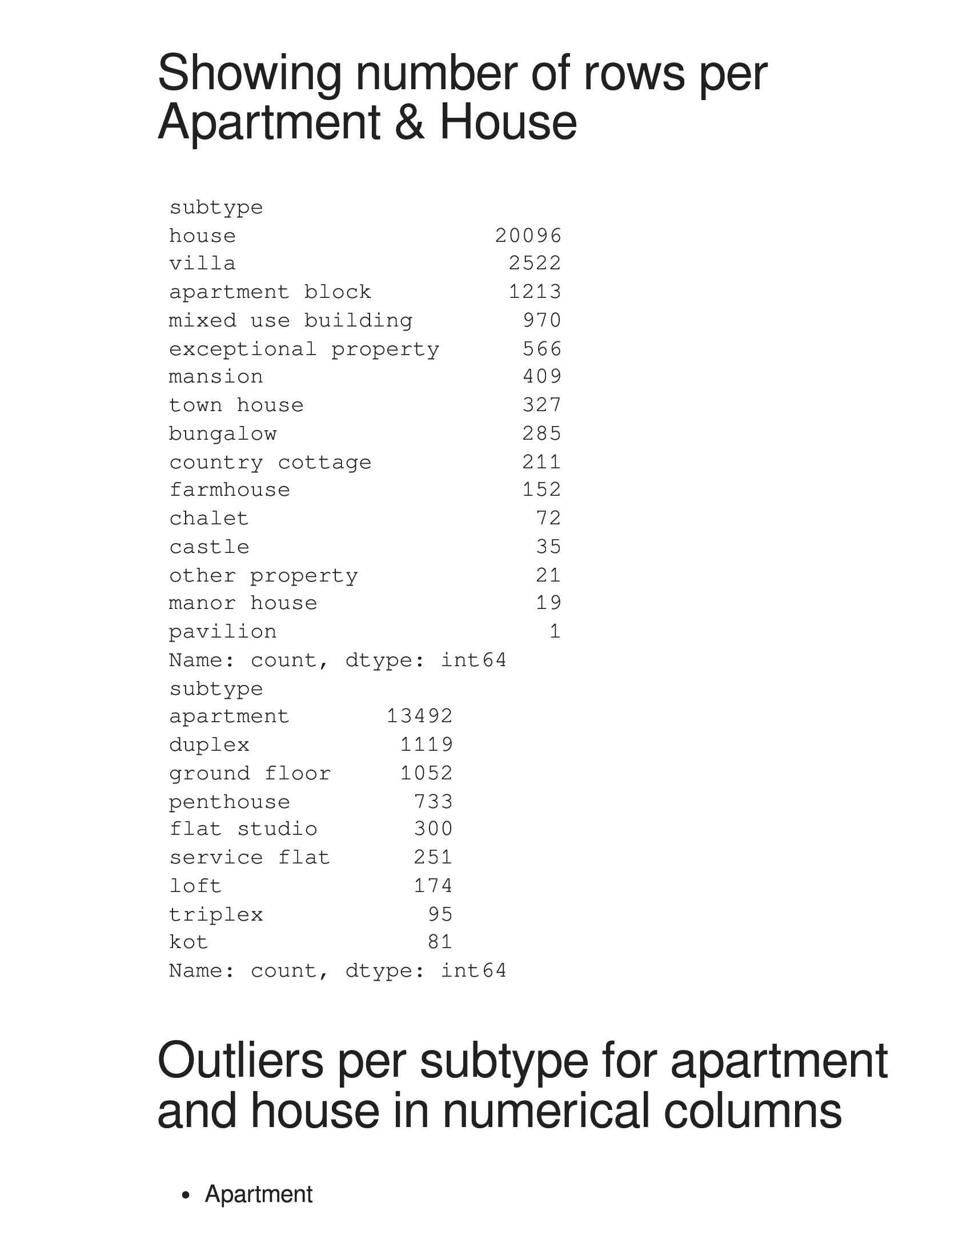

Slide 3
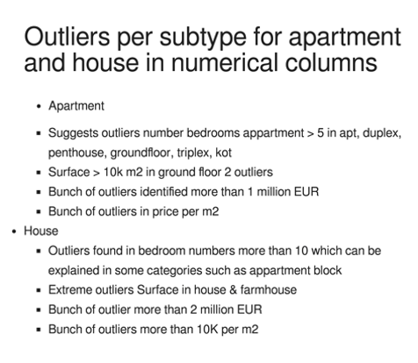

Slide 4
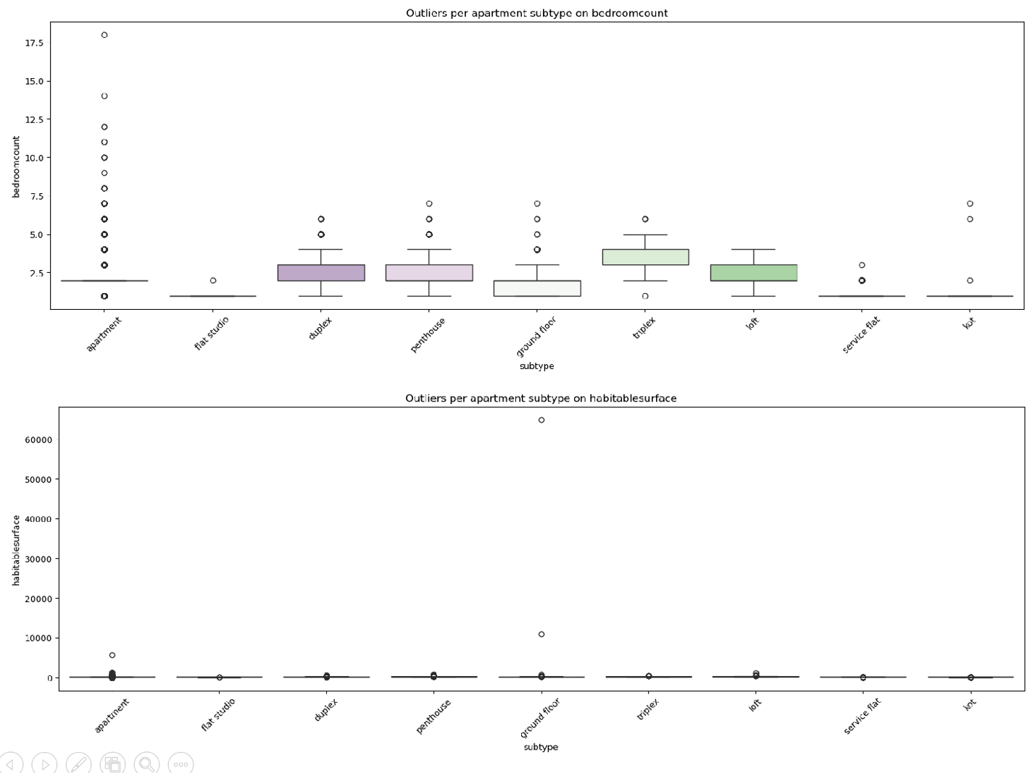

Slide 5
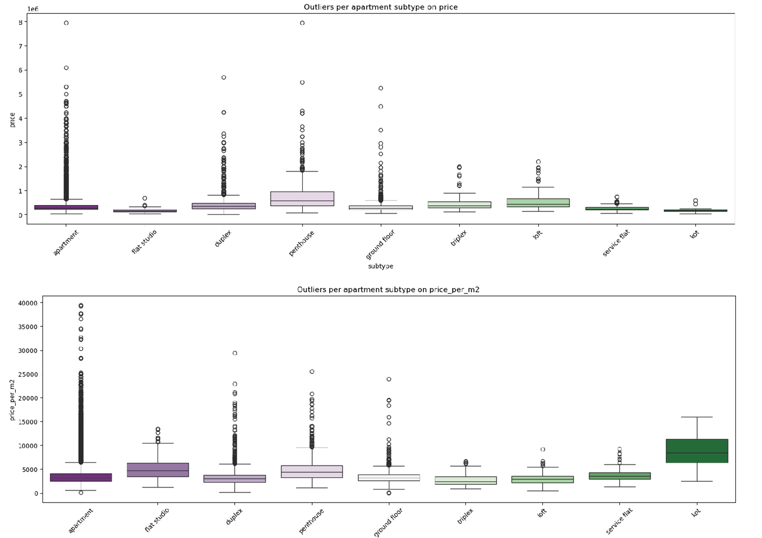

Slide 6
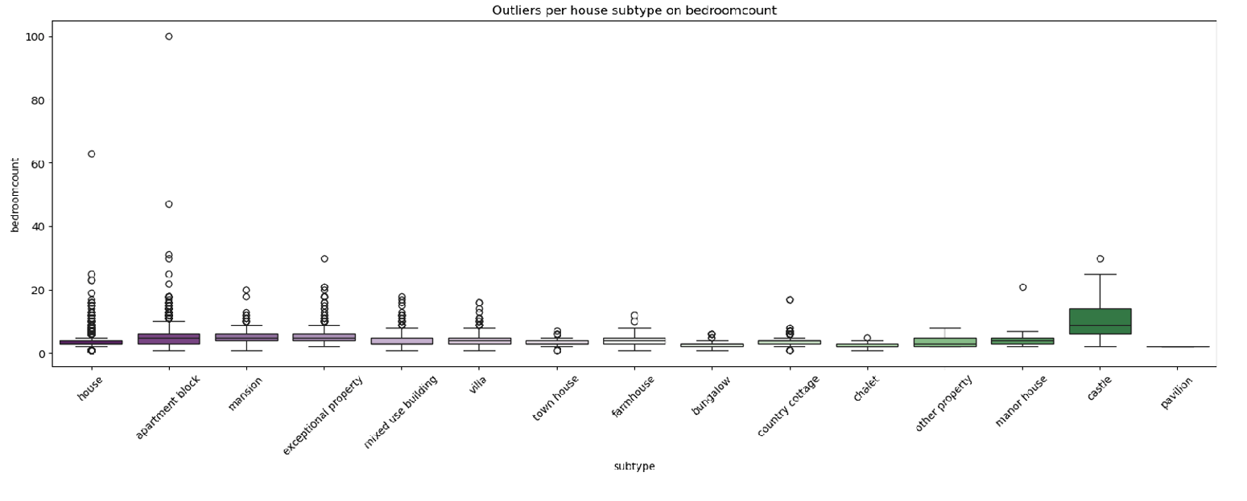
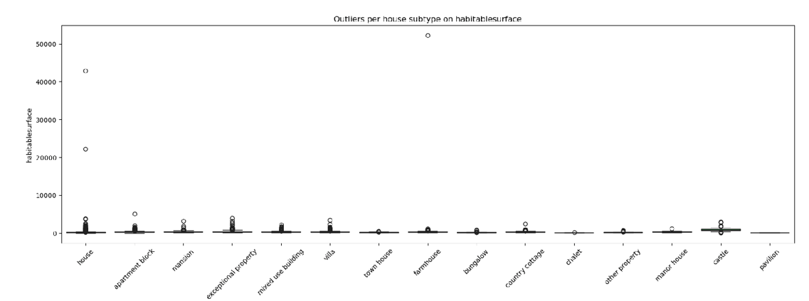

Slide 7
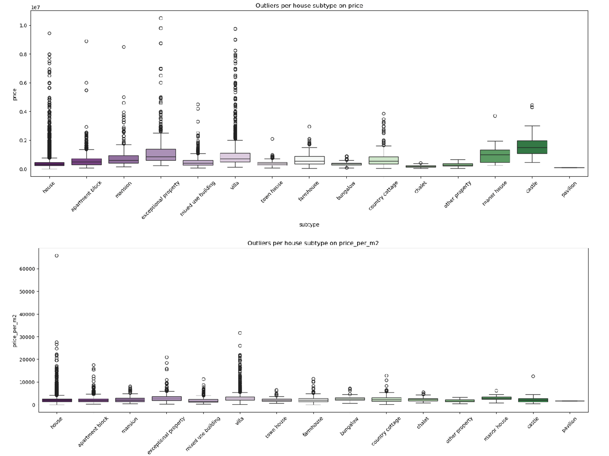

Slide 8
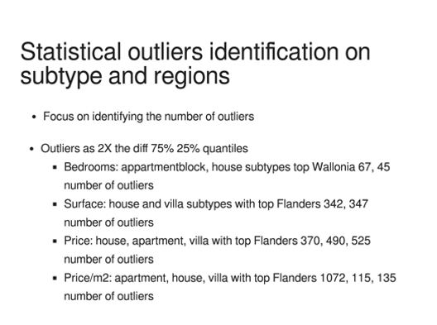

Slide 9
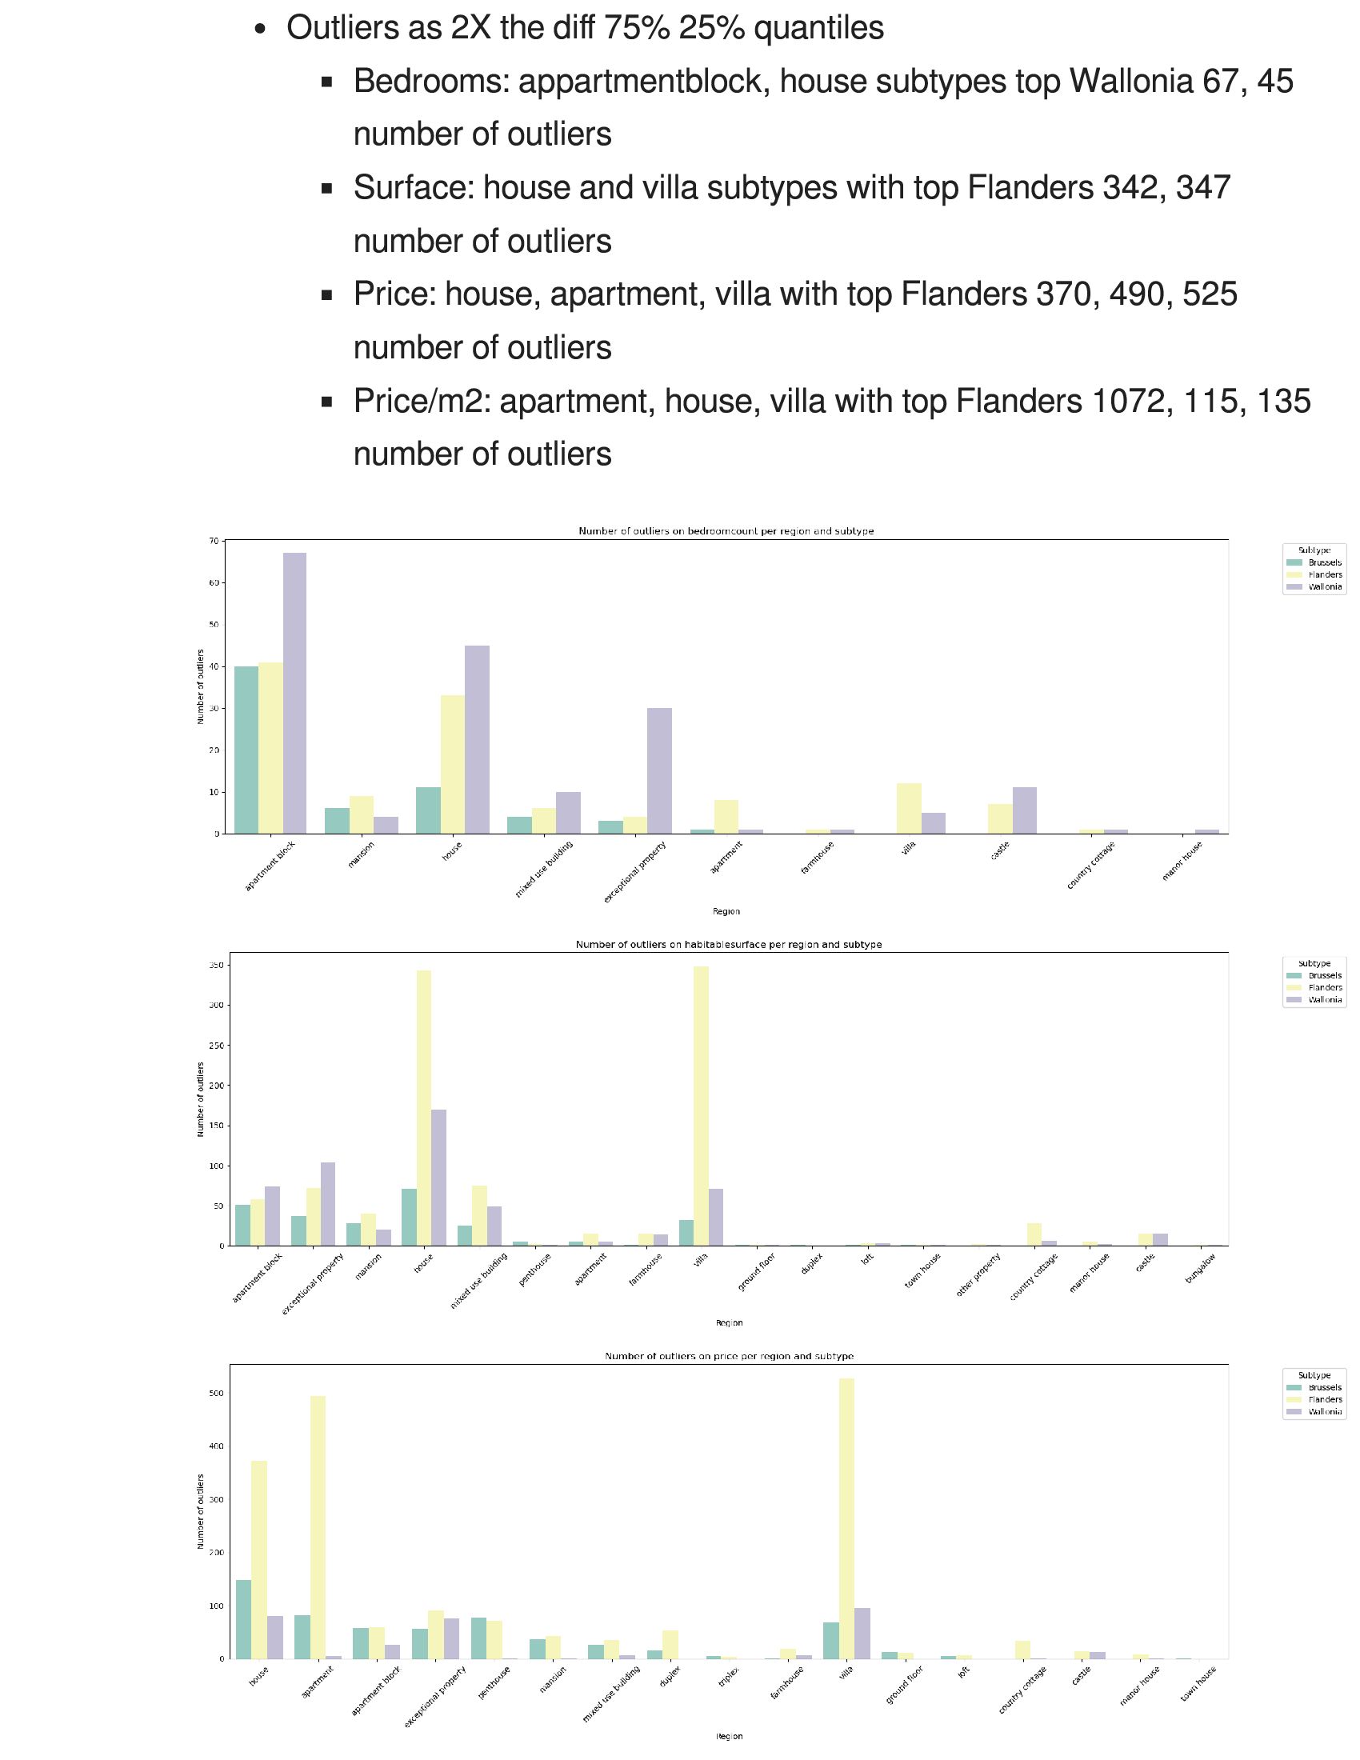

Slide 10
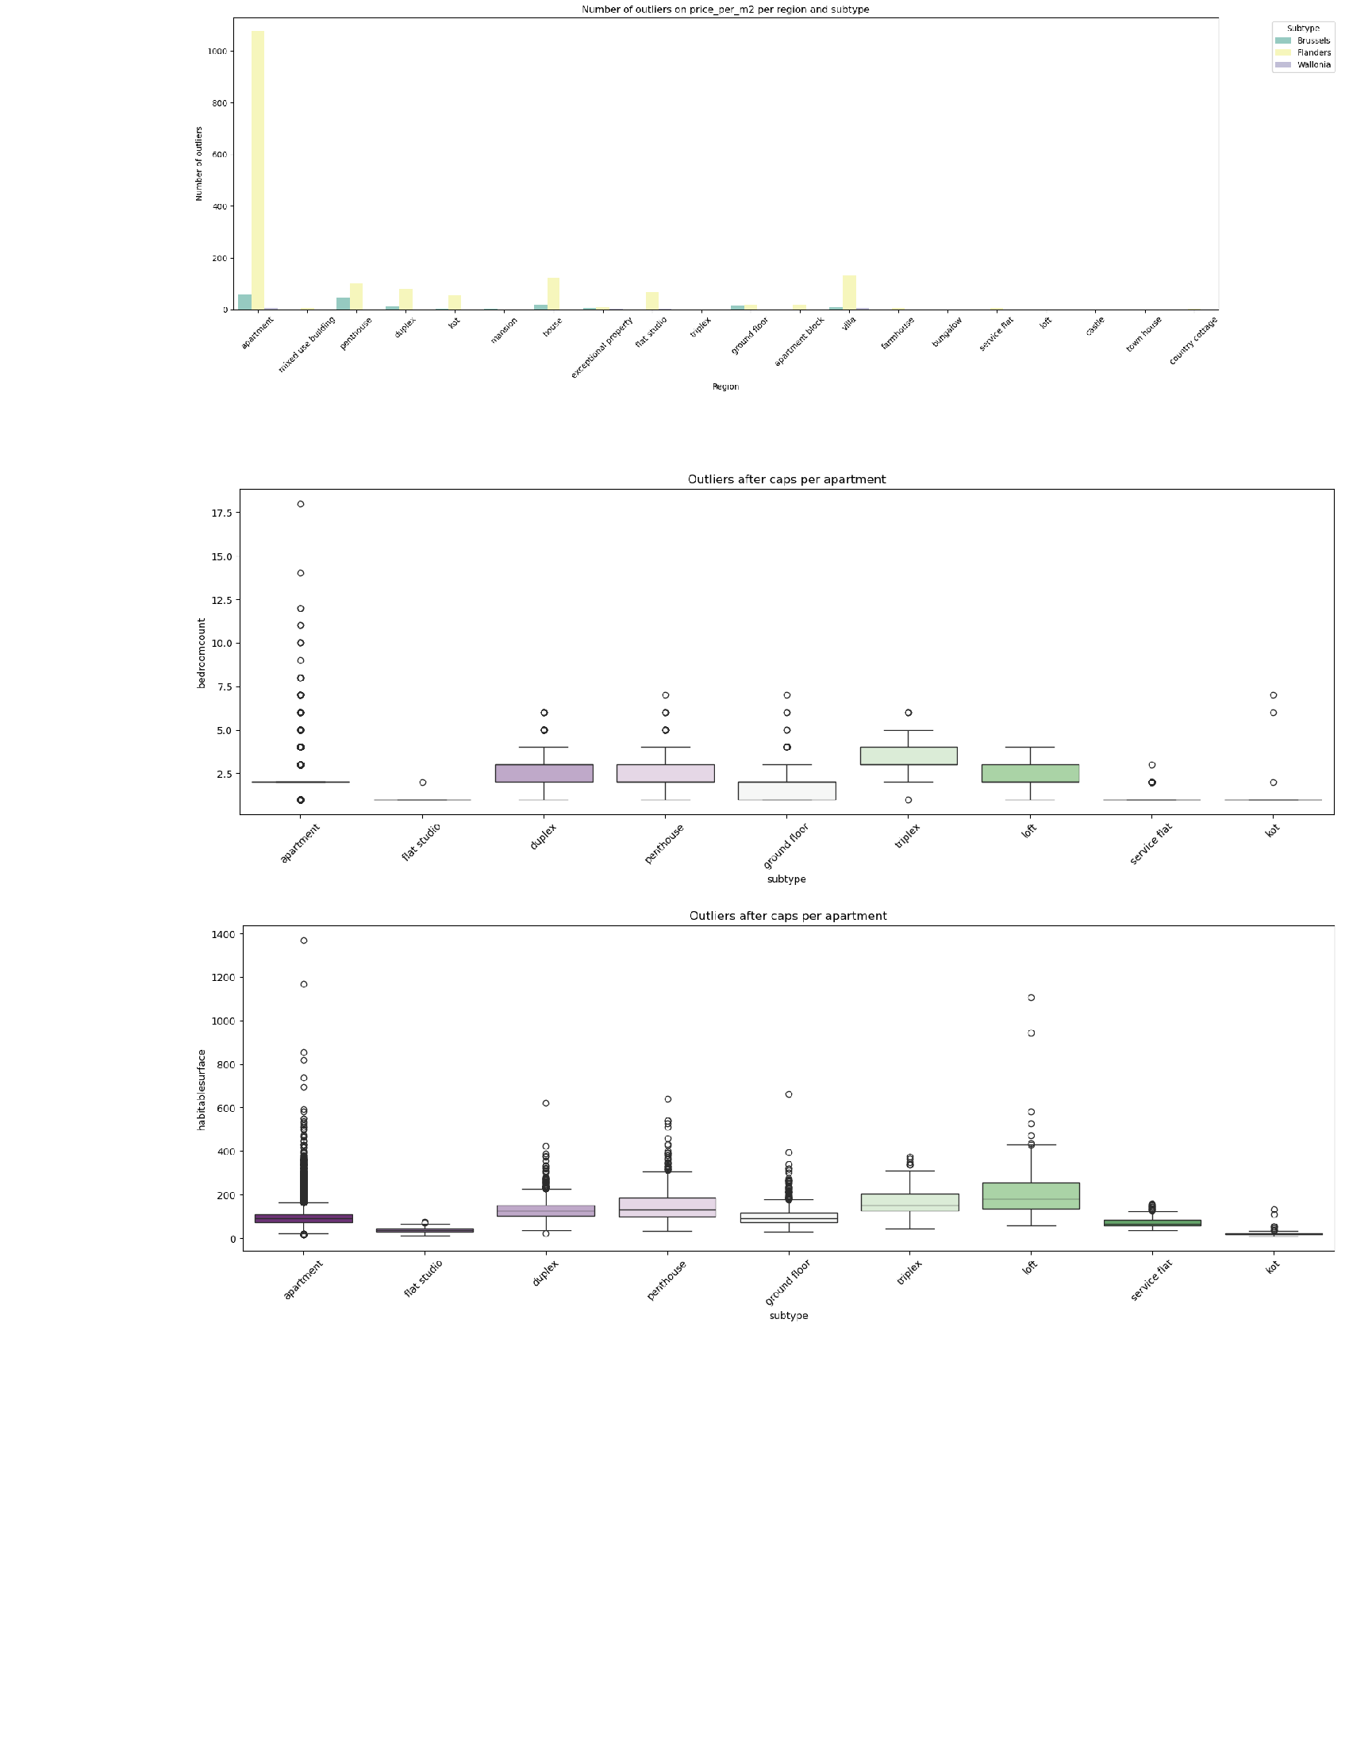

Slide 11
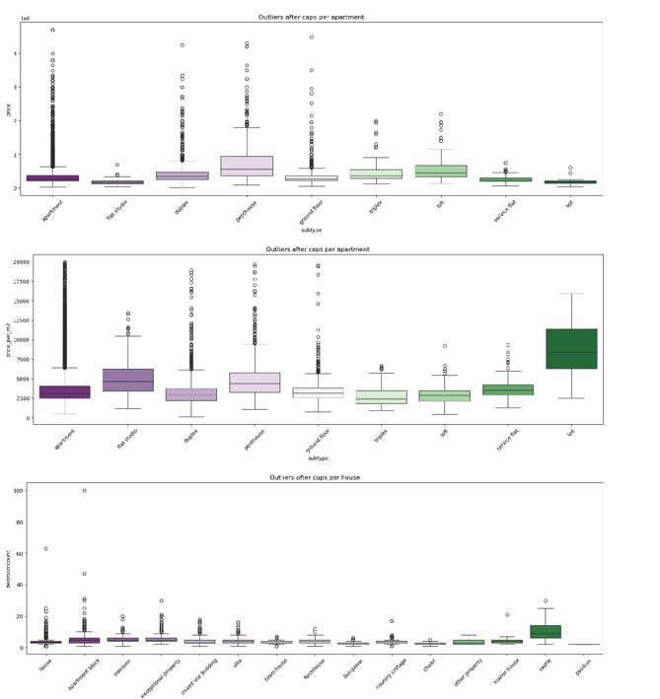

Slide 12
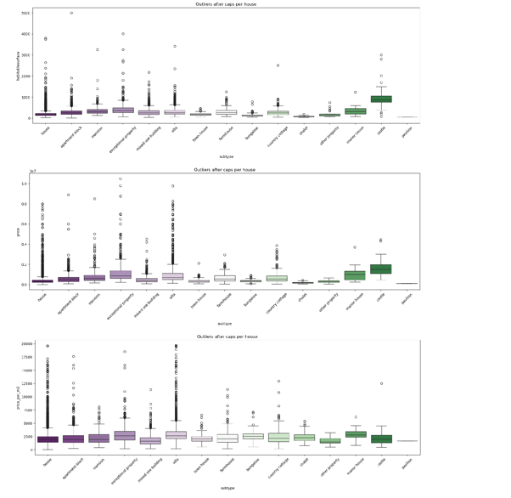

Slide 13
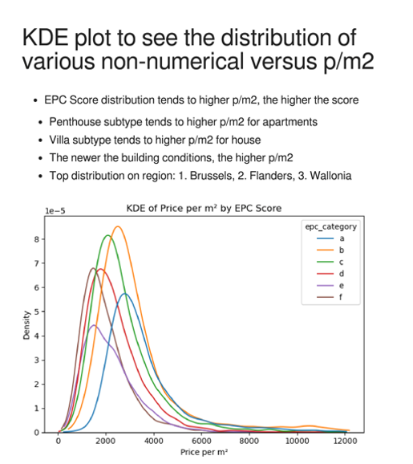

Slide 14
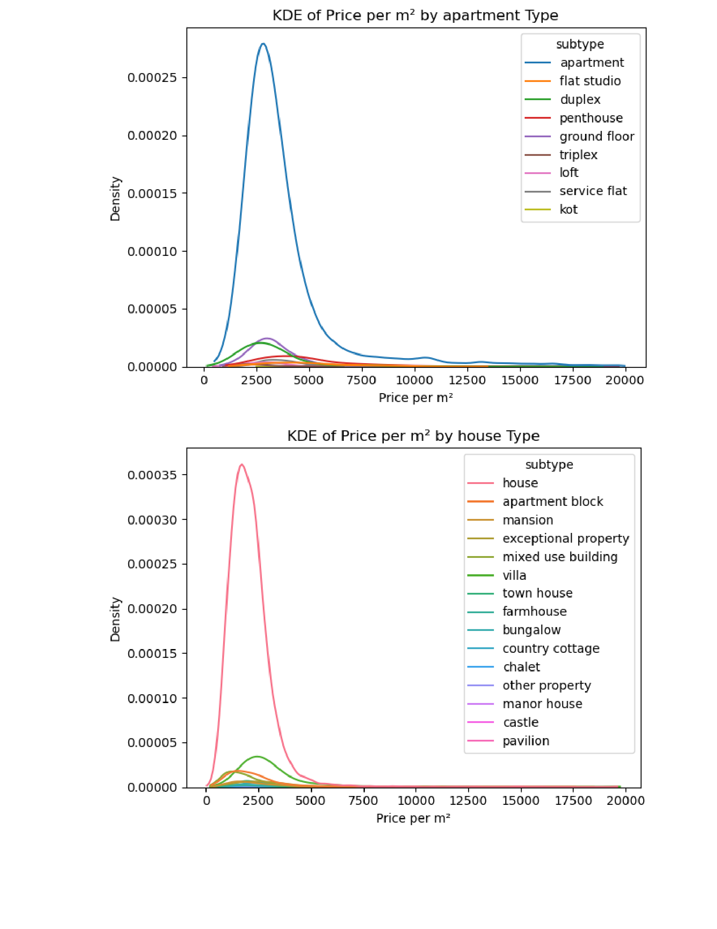

Slide 15
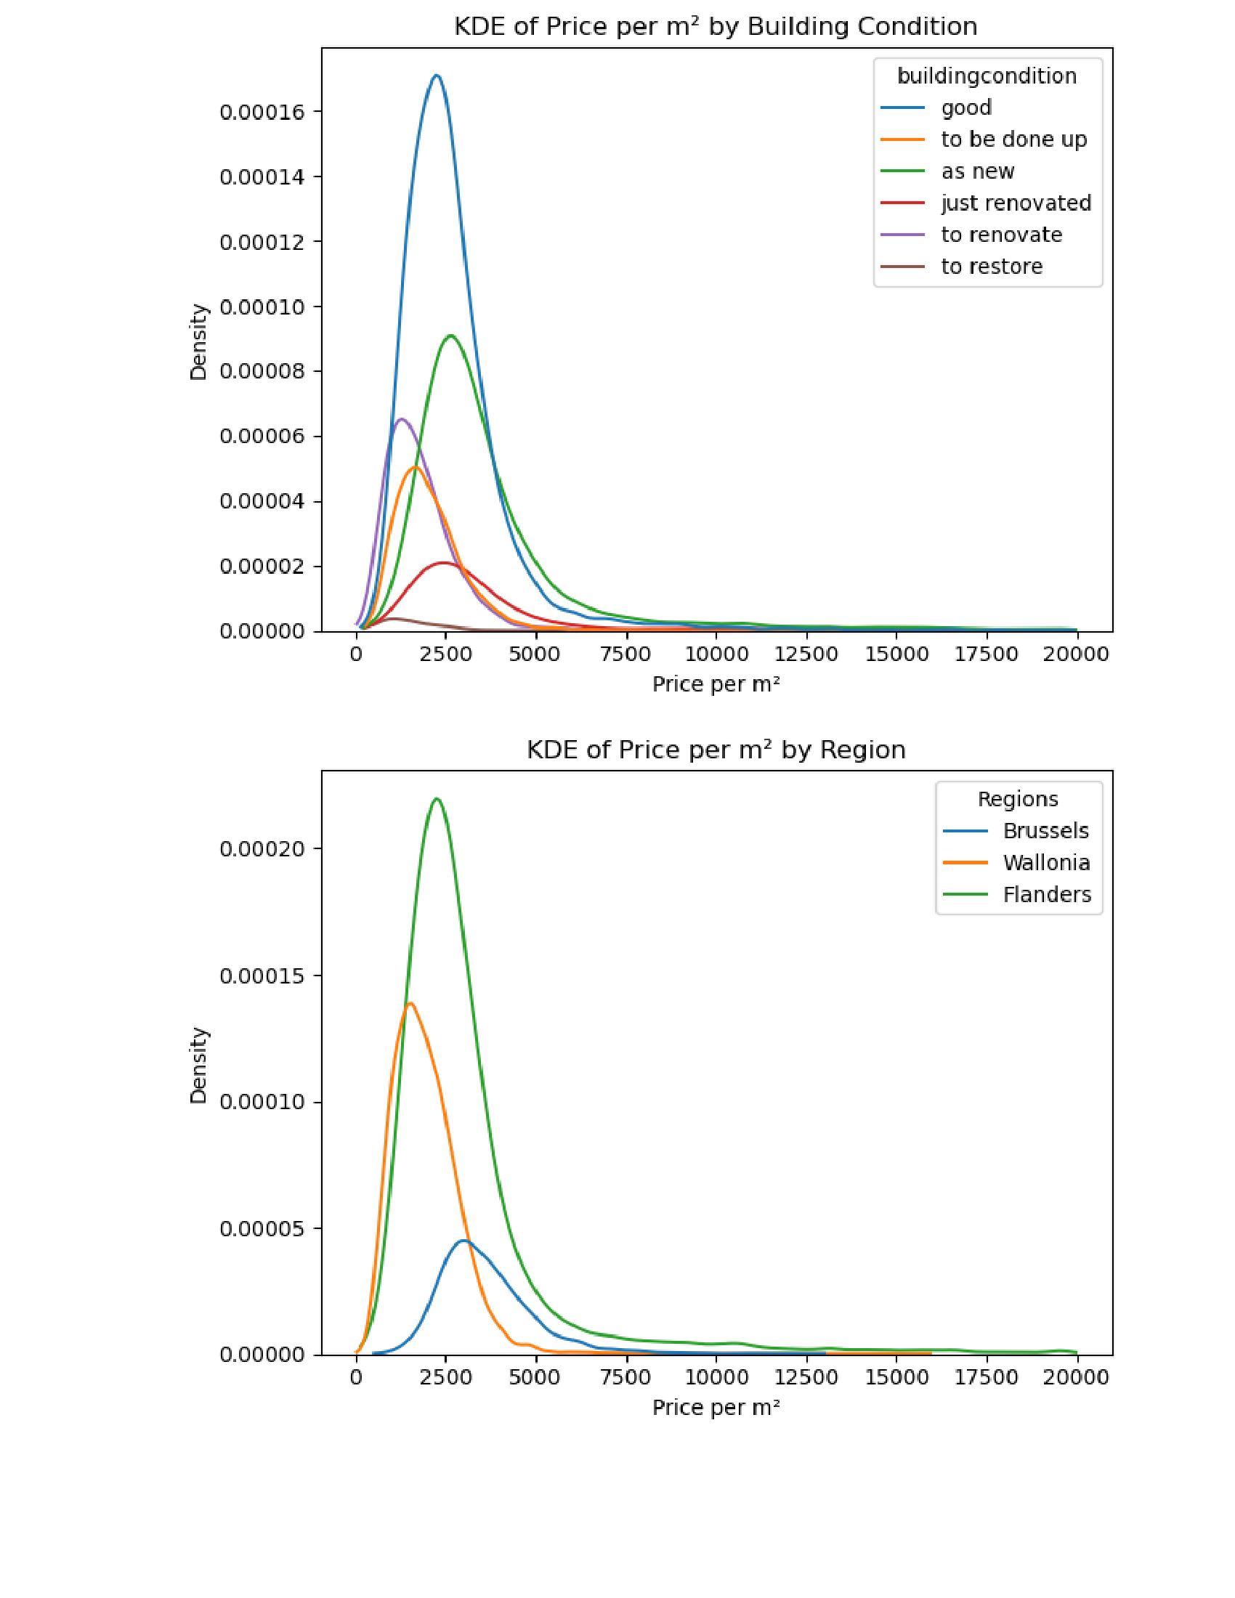

Slide 16
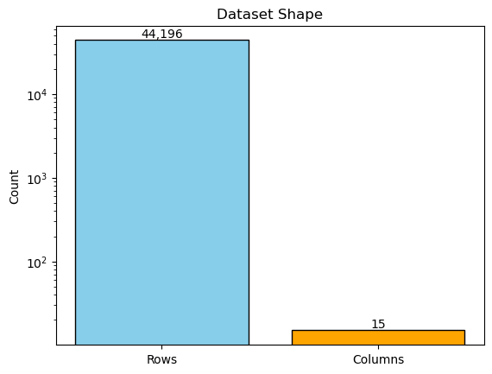
🧼 Dataset Overview
This bar chart highlights the transformation of the dataset through the cleaning process:
Original dataset: 80,199 rows × 37 columns
After cleaning: 44,174 rows × 14 columns
Final structure: 15 columns, Including newly added price/m²
This reflects the removal of irrelevant, inconsistent, or incomplete data, resulting in a more reliable dataset for analysis.

Slide 17
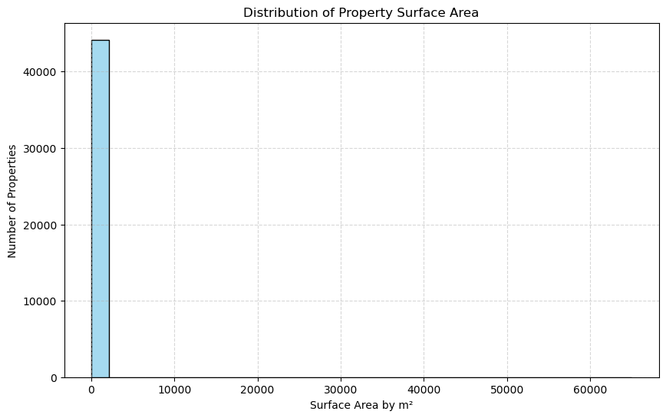
🏡 Distribution of All Properties by Surface Area
This histogram visualizes the distribution of habitable surface areas (in m²) across all property types:
Helps identify typical property sizes and detect skewness in the dataset.
Clear imbalance: many smaller units (e.g. apartments) compared to fewer large properties (e.g. villas or estates).
Presence of extreme outliers significantly distorts the visual scale, making it harder to interpret the central trends.
Follow-up analysis should consider filtering (e.g. 99th percentile) for more accurate comparisons and better visibility of common patterns.

Slide 18
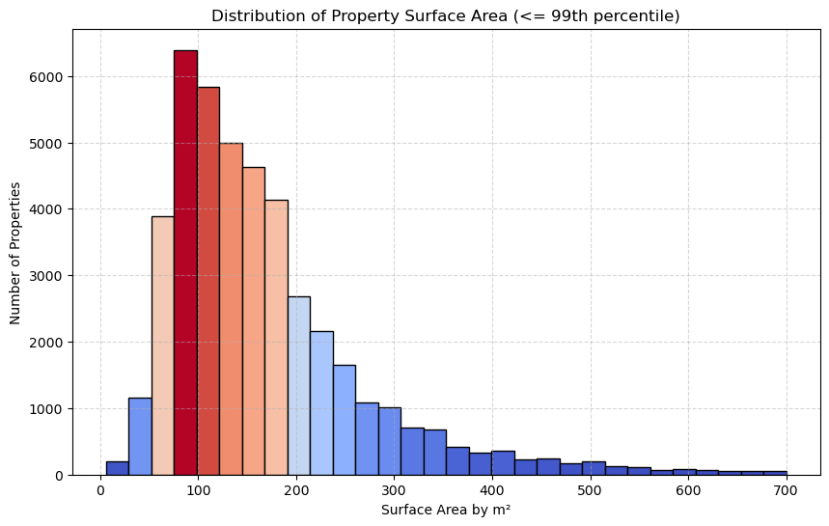
📊 Distribution of Surface Area — Without Outliers
This refined histogram removes the top 1% of properties (99th percentile) to eliminate distortion caused by extremely large homes:
Focuses on common property sizes without interference from outlier values.
Reveals a concentrated distribution between 100 m² and 200 m².
The peak of the distribution is around 100 m², indicating the most typical property size in the dataset.
Greatly improves readability and interpretability compared to the full-range version.

Slide 19
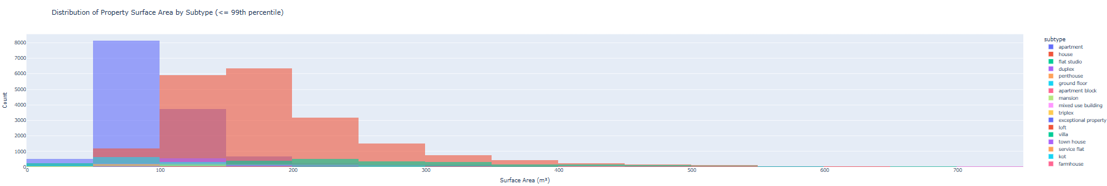
🏘️ Property Surface Area by Subtype
This interactive Plotly histogram shows the surface area distribution across different property subtypes.
We can clearly conclude that the majority of properties are houses and apartments.
Houses tend to lie between 100 & 200m², skewing towards 200m²
Apartments follow the same trend, only skewing more towards 100m² and below

Slide 20
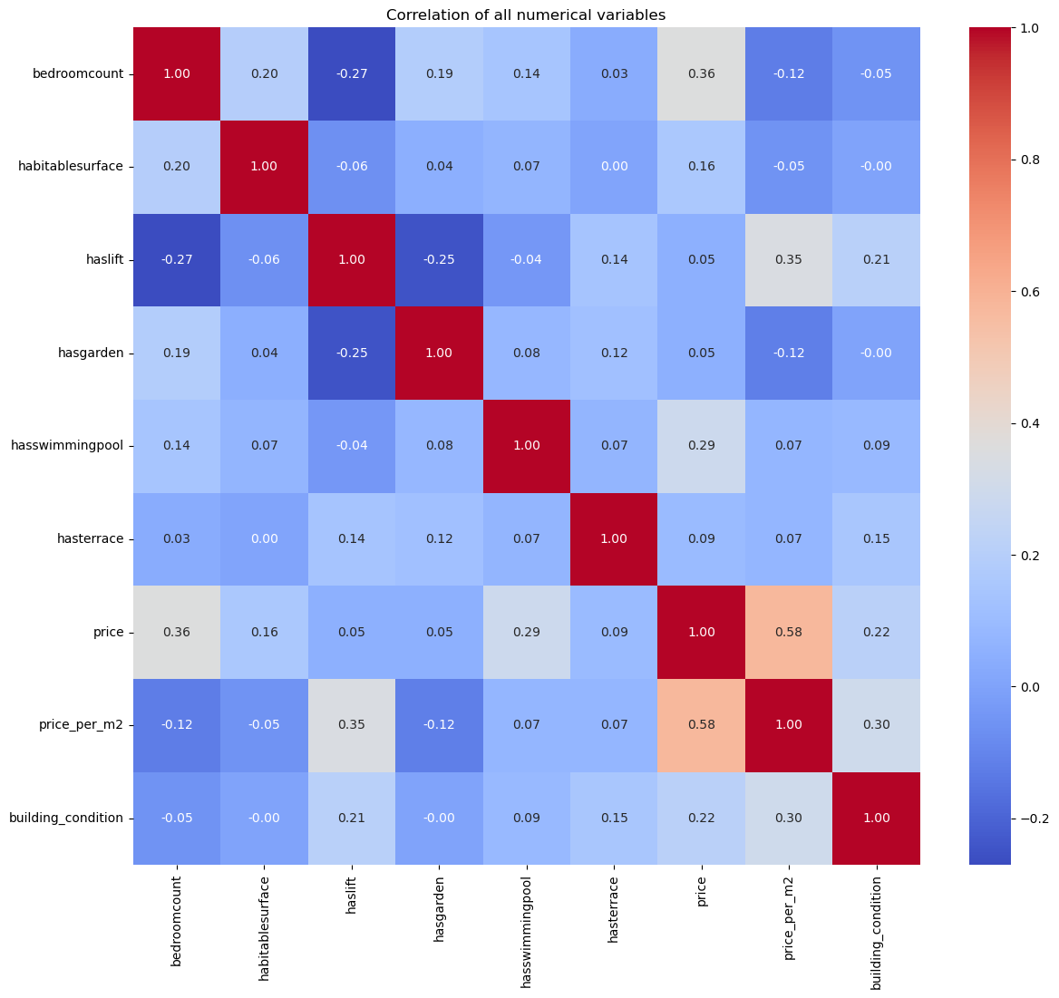
Price Corrolation Heatmap
All feature correlations with price:
Price per m² (0.58):
Bedroom Count (0.36):
Swimming Pool (0.29):
Building Condition (0.22):
Habitable Surface (0.16):
Slight positive link — larger surface contributes to price, though less so than price per m².
This seemed very strange and counterintuitive to me, so i decided to investigate further in the following charts.
Terrace (0.09):
Lift (0.05):
Garden (0.05):

Slide 21
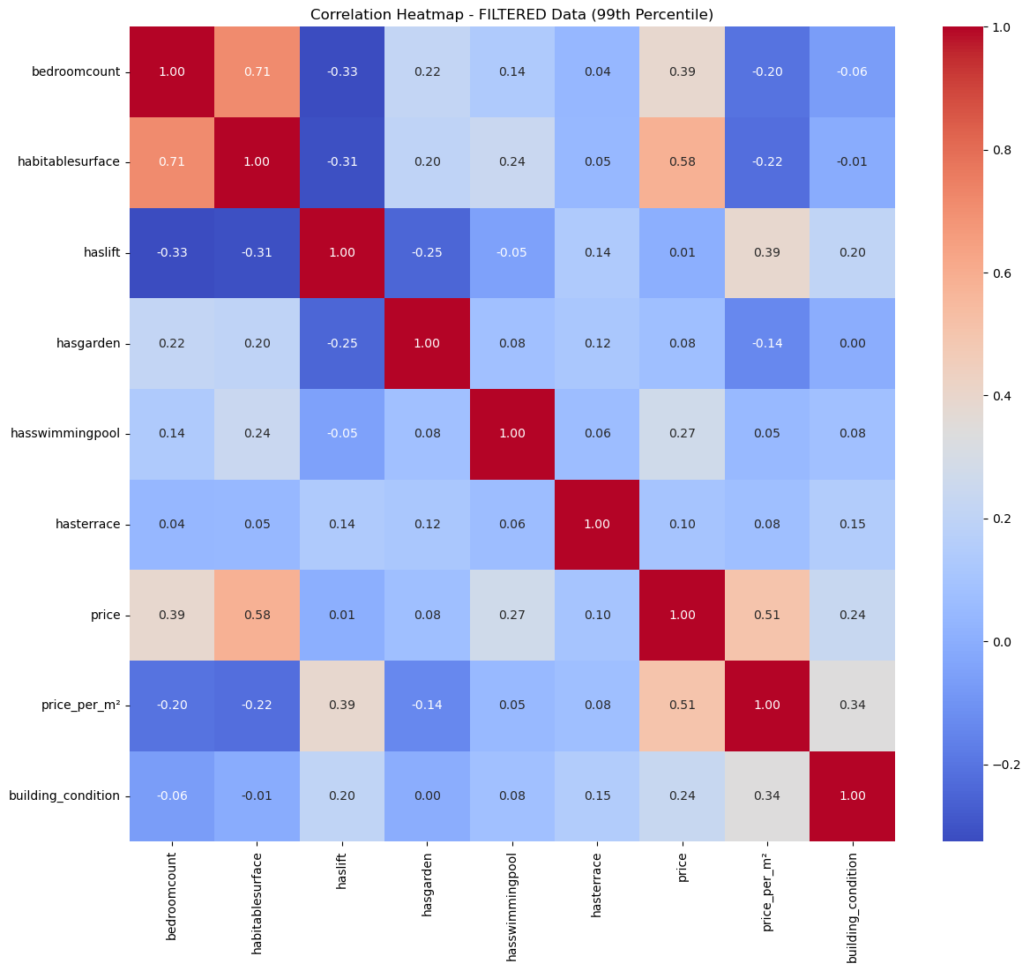
All feature correlations with price (FILTERED data):
habitablesurface: 0.58
price_per_m²: 0.51
bedroomcount: 0.39
hasswimmingpool: 0.27
building_condition: 0.24
hasterrace: 0.10
hasgarden: 0.08
haslift: 0.01
COMPARISON: Top 5 variables ORIGINAL (unfiltered): 1. price_per_m2: 0.58
2. bedroomcount: 0.36
3. hasswimmingpool: 0.29
4. building_condition: 0.22
5. habitablesurface: 0.16
FILTERED:
habitablesurface: 0.58
price_per_m²: 0.51
bedroomcount: 0.39
hasswimmingpool: 0.27
building_condition: 0.24

Slide 22
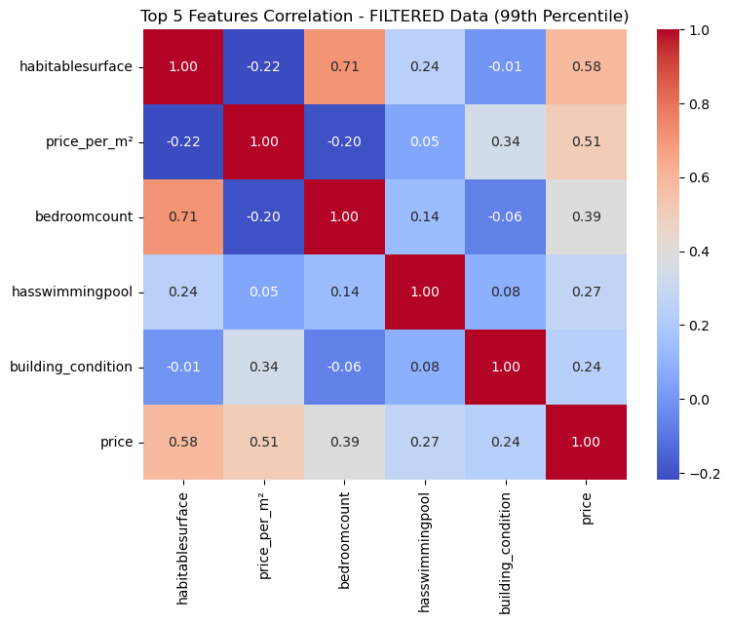
Top 5 Feature Correlation
Habitable Surface (0.58): Strongest correlation — larger living spaces consistently lead to higher property prices.
2. Price per m² (0.51): Indicates unit value — higher price per square meter generally aligns with more expensive listings.
3. Bedroom Count (0.39): More bedrooms usually result in higher prices, reflecting added functional space.
4. Has Swimming Pool (0.27): Presence of a pool tends to elevate property value, signaling premium amenities.
5. Building Condition (0.24): Better-maintained properties attract higher prices, though the effect is moderate

Slide 23
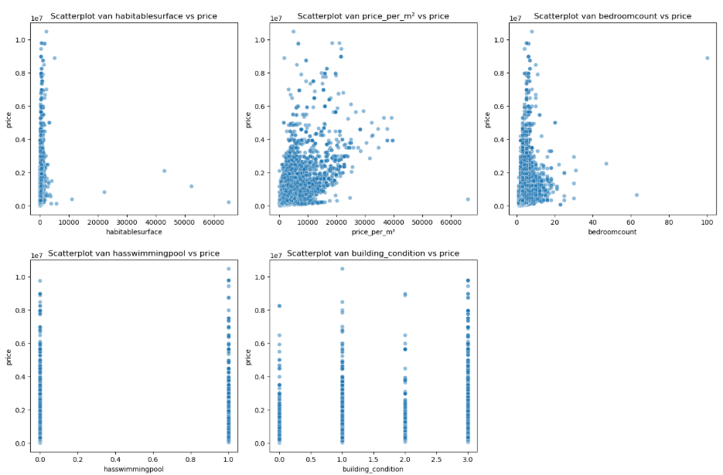
📈 Scatterplots of Top 5 Features
Habitable Surface vs Price
Strongest visual trend: larger surfaces are closely linked to higher prices.
.
Price per m² vs Price
Clear positive correlation, but with significant spread.
Bedroom Count vs Price
Moderate upward trend: more bedrooms often mean a higher price.
Has Swimming Pool vs Price
Properties with pools tend to fall on the higher end of the price scale.
Building Condition vs Price
Slight positive slope: better condition loosely associated with higher price.

Slide 24
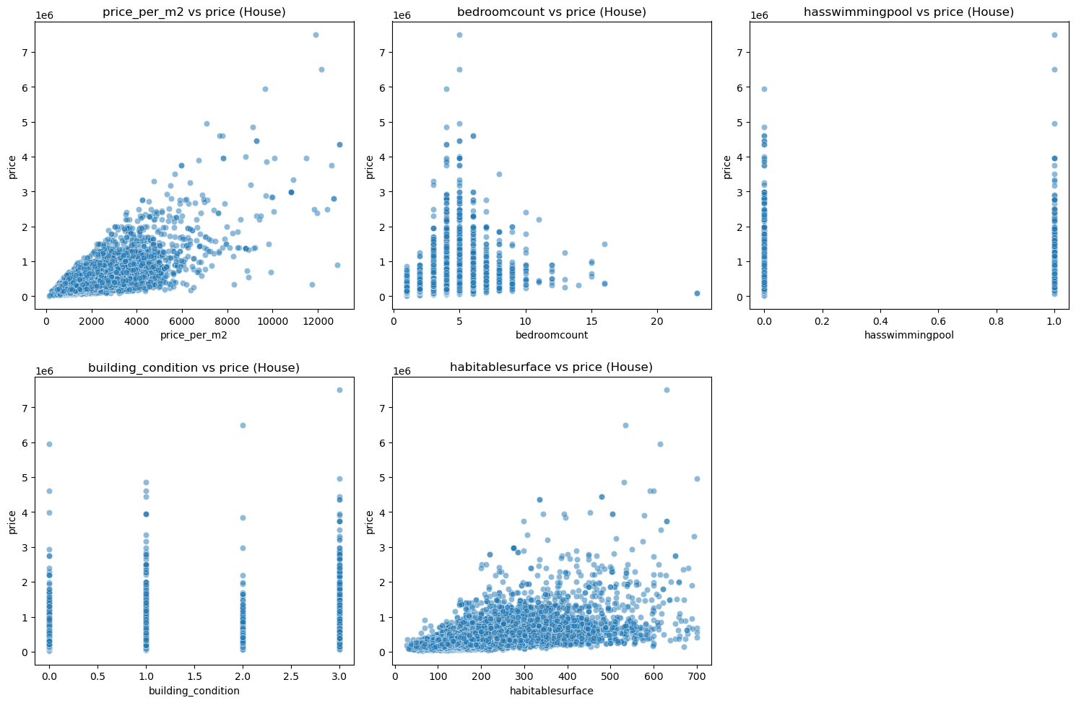
🏠Houses Only
Price per m² vs Price
Positive overall correlation, mostly under €1.5M.
Lower-priced homes show high variability in price per m².
High-end houses often have lower price per m² — inverse trend at the top.
Notable outliers: some low-priced homes with exceptionally high price per m².
Bedroom Count vs Price
Prices increase with bedroom count, up to 5 bedrooms.
Has Swimming Pool vs Price
Houses with pools generally cost more.
Building Condition vs Price
Slight upward pricing trend with improved condition
.
Habitable Surface vs Price
Strong positive relationship: larger homes = higher prices.
Most houses cluster between 0–400 m²
High-price homes over 400 m² are fewer but clearly upward-trending.
Some smaller homes still command premium prices — indicating hidden value factors.

Slide 25
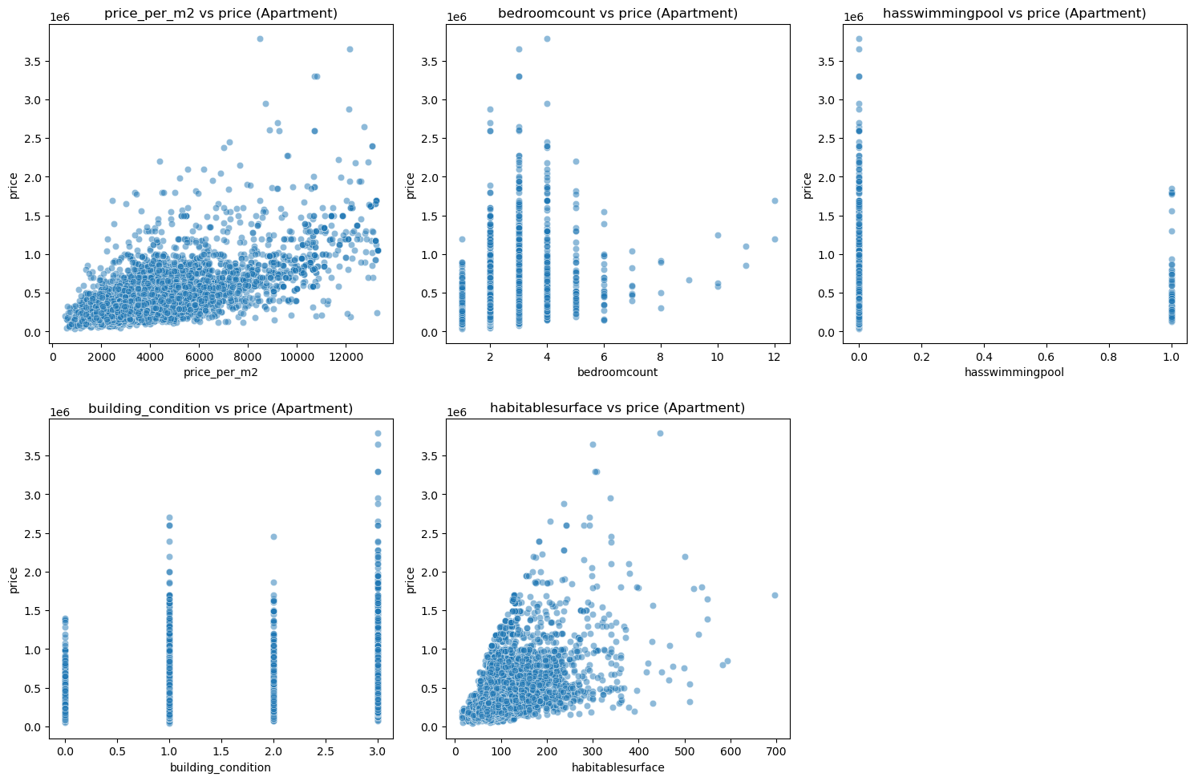
🏢Apartments Only
Price per m² vs Price
Positive correlation: higher unit prices usually mean more expensive apartments.
Majority cluster at lower price per m².
Outliers suggest ultra-pricey apartments with extremely high price per m².
Price spread broadens as price per m² increases.
Bedroom Count vs Price
No consistent trend — even 2–4 bedroom apartments vary widely in price.
Swimming Pool vs Price
Apartments with pools generally command higher prices.
Building Condition vs Price
Weak correlation — prices are highly dispersed across all condition levels.
Habitable Surface vs Price
Positive trend: more space = higher price.
Most apartments are compact, with a few high-priced, larger units.
Higher variability as surface area increases — large doesn’t always mean expensive.

Slide 26


Distribution of (medium) prices per m² per municipality
10 most expensive
Flanders
Wallonia
10 cheapest

Slide 27
Top 10 most expensive and 10 cheapest municipalities
Flanders Wallonia

Slide 28

Top 10 most expensive and 10 cheapest municipalities
in the whole of Belgium

