Slide 1
Satisfiability
Reporters:
Kaye P. Engbino
Shanesha C. Cuevas

Slide 2
TABLE OF CONTENTS
01
02
03
definition
Brief history
Actual algorithm illustration

Slide 3
TABLE OF CONTENTS
04
05
06
ALGORITHM-DESIGN TECHNIQUE USED
RUNNING TIME
APPLICATION

Slide 4
01] Definition
What is Satisfiability?

Slide 5
Definition
An expression E is satisfiable if there exists a truth assignment to the variables in E that makes E true.
It is also called the Satisfiability Problem or the B-SAT or just the SAT Problem
The Boolean satisfiability problem is the problem of determining if there exists an interpretation that satisfies a given Boolean formula.

Slide 6
Solution To the problem
A solution to a SAT problem is an assignment of values to each of the letters so that every clause in is satisfied.

Slide 7
Three components are needed
01
02
03
A set of n variables
A set of literals
A set of m distinct clauses

Slide 8
02] history
How did Satisfiability come to be?

Slide 9
Brief timeline
384 – 322 b.c
1815 - 1864
Aristotle, Ancient Greece
George Boole
300-200 b.c
1902-1983
Stoics
Alfred Tarski

Slide 10
03] Actual algorithm illustration

Slide 11
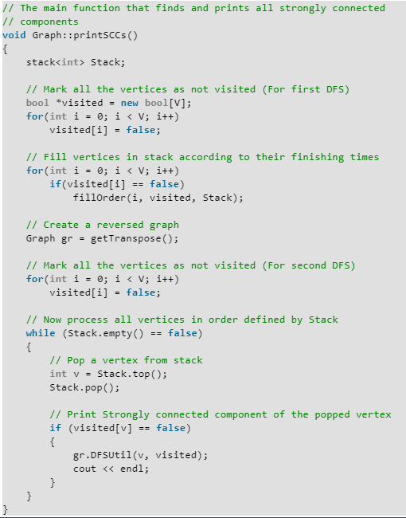
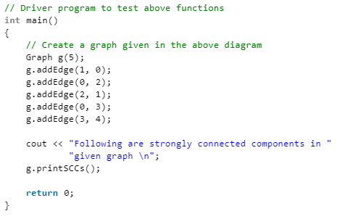

Slide 12
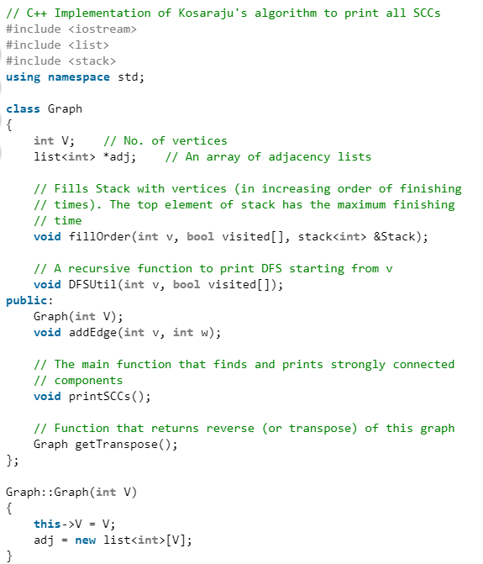
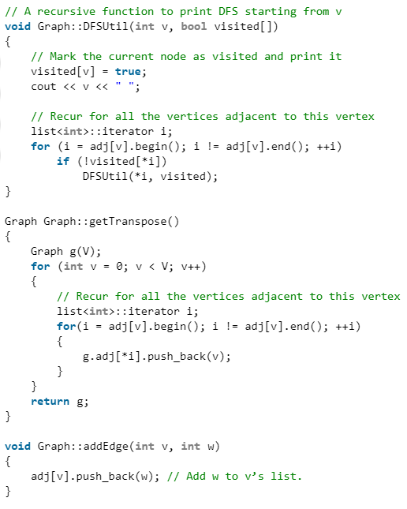

Slide 14
04] algorithm-Design technique used

Slide 15
Kosaraju’s algorithm
is designed to find the strongly connected components of a directed graph.

Slide 16
05] running time
How long will it take to be executed?

Slide 17
Running time
There is no known algorithm that efficiently solves each SAT problem, and it is generally believed that no such algorithm exists
But using the Kosaraju’s Algorithm:
O(N+E)
Space Requirement:
O(N)

Slide 18
06] applications
How is this concept used?

Slide 19
Examples of applications
Computer science
Computer architecture
Artificial intelligence
Mathematics
Software verification
logical programming
Arithmetic logic circuit design
scheduling
Logical arithmetic
Planning

Slide 20
references
[1]A.Biere, H. van Maaren and T. Walsh. A History of Satisfiability, 2007
[2]J.Gu, P.W. Purdom, J. Franco, and B. Wah. Algorithms for the Satisfiability(SAT) Problem: A Survey
[3]A.Biere, H. van Maaren and T. Walsh. Handbook of Satisfiability, 2009
[4] https://www.geeksforgeeks.org/strongly-connected-components/
[5] https://www.geeksforgeeks.org/2-satisfiability-2-sat-problem/
[6] https://codeforces.com/blog/entry/16205
[7] https://www.youtube.com/watch?v=uAdVzz1hKYY
[8] https://www.youtube.com/watch?v=uAdVzz1hKYY
And many other sources…

