Slide 1
EEP55C34 Advanced AI
Introduction to Deep Q-Learning
Arlene Haas – Ciarán Cope – Nathaniel Kaye Mellor
Group 1 Technical Presentation
Date 18/03/26

Slide 2
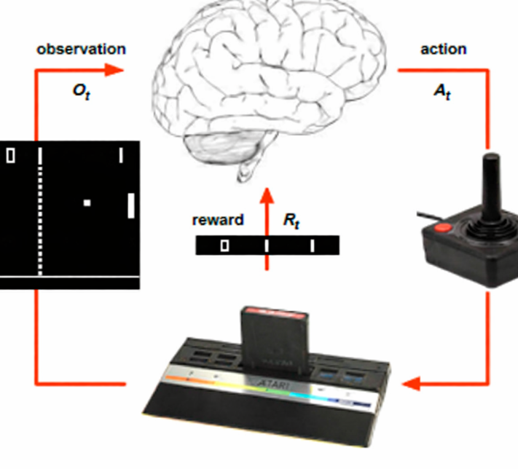
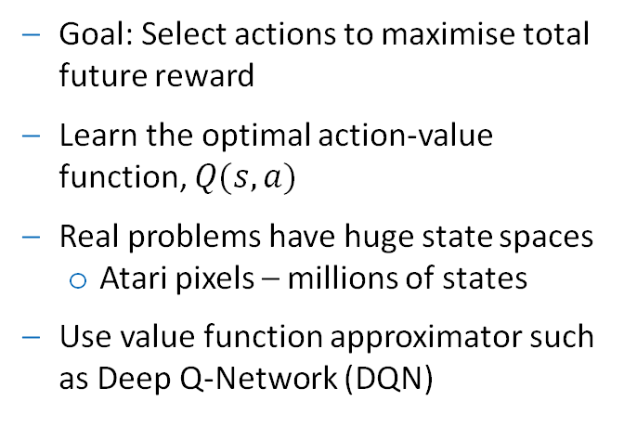
Motivation
Why do we need Deep Q-Learning?
Goal: Select actions to maximise total future reward
Learn the optimal action-value function, $Q(s, a)$
Real problems have huge state spaces
Atari pixels – millions of states
Use value function approximator such as Deep Q-Network (DQN)
Notes:
Quick recap – our project focused on getting an RL agent to learn to play the atari game pong, compare performance using CNN vs SWIN transformer
Aim of RL is for an agent to learn to make decisions by interacting with its environment, goal is to maximise the total future reward
As mentioned last week optimal behaviour is described by an action-value function Q (expected future reward starting from state s taking action a and following policy pi)
Today we are going to dive into how this works / how agent learns best action to take from a given state/ these q values
Classic RL stores Q values for all state action pairs in a look up table, real problems such as our atari game pong have huge state spaces - atari pixels - millions of states
Problems such as too many state action pairs to store in memory/ too slow to learn the value of each state individually
Need a way to approximate our value function ie these Q values
We do this using DQN

Slide 3
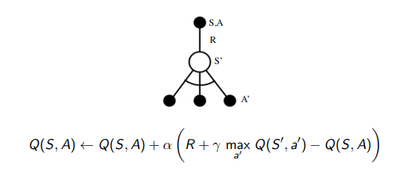
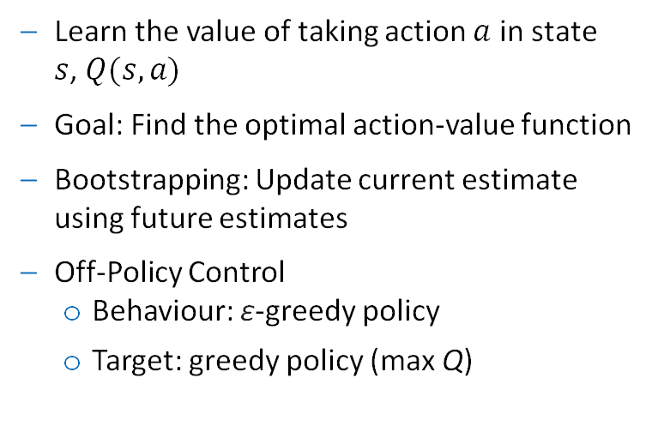
Idea Behind Q-Learning
Learn the value of taking action $a$ in state $s$, $Q(s, a)$
Goal: Find the optimal action-value function
Bootstrapping: Update current estimate using future estimates
Off-Policy Control
Behaviour: ε-greedy policy
Target: greedy policy (max Q)
Notes:
Q learning – aim is to learn the value of taking action a from state s and represented by our Q function
Goal is to find the optimal actional value function
Update our Q values following update rule
At each step, we update our estimate using the reward we just observed plus the best possible future value
This idea is called bootstrapping – update our current estimate using future estimates
Can learn at each iteration, rather than waiting until the end of the episode to update these q values
Using off policy control – exploration vs exploitation problem – here we use exploratory policy for selecting agents actions (epsilon greedy policy) but use greedy policy for q learning target, update our estimate assuming we always take the best possible action in the future

Slide 4
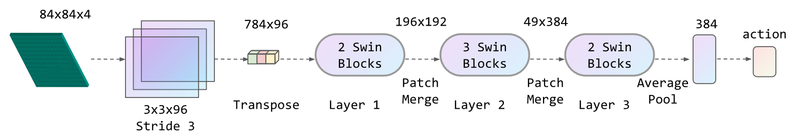
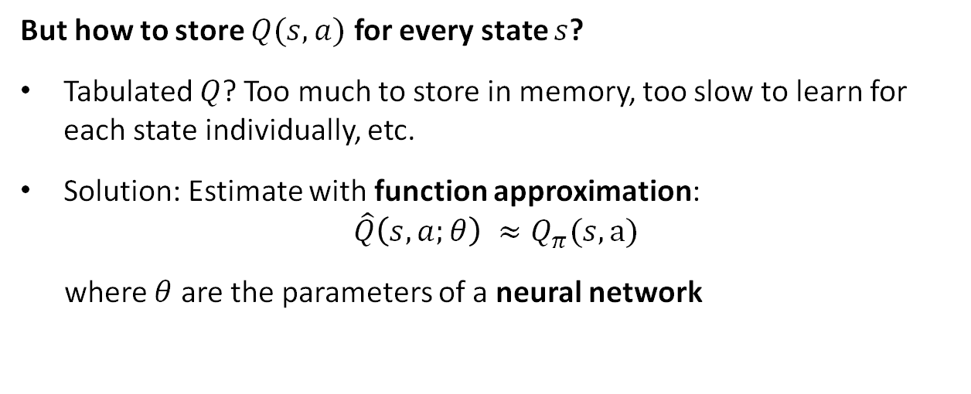
Deep Q-Learning Idea
But how to store $Q(s, a)$ for every state $s$?
Tabulated $Q$? Too much to store in memory, too slow to learn for each state individually, etc.
Solution: Estimate with function approximation:
$$\hat{Q}\left(s, a;θ\right) ≈Q_{π}(s,a)$$
where $θ$ are the parameters of a neural network
[1] Meng, Li, et al.

Slide 5
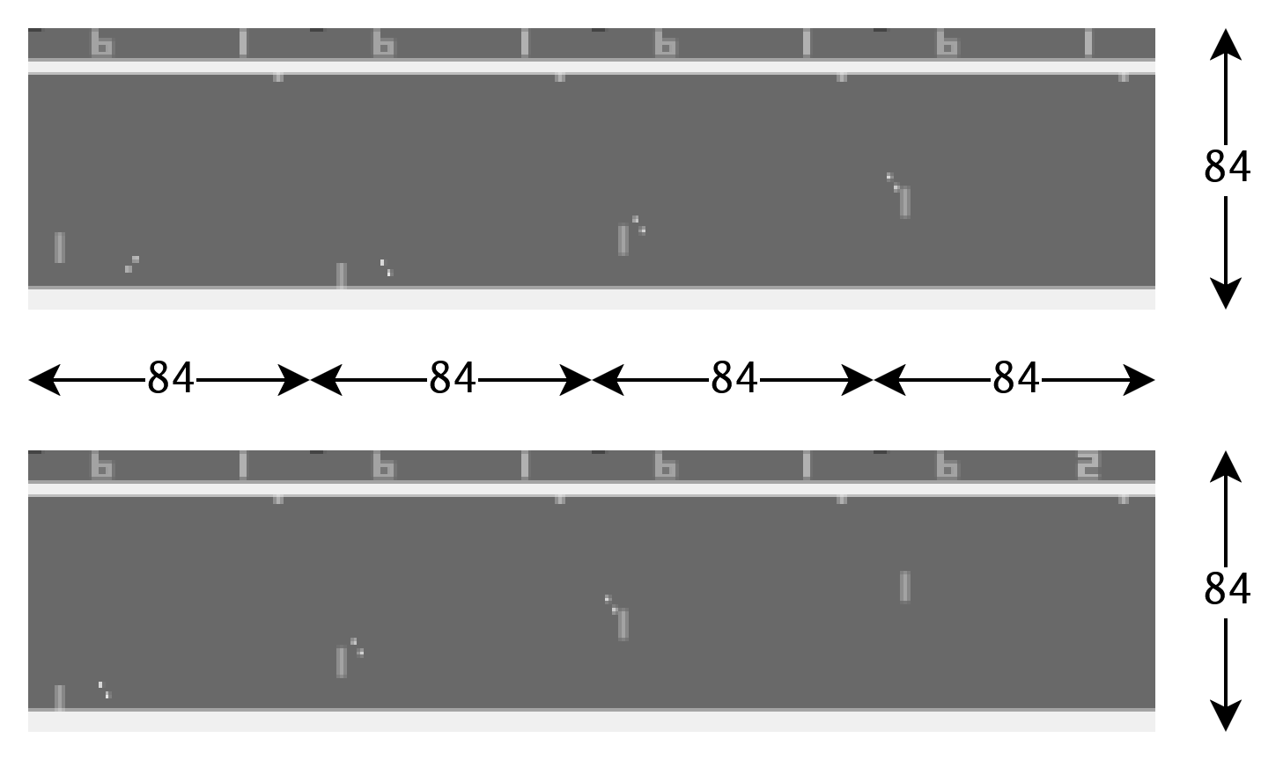



Deep Q-Learning Idea
Input and Output
For example, our Pong agent…
Input:
${\tilde{s}}_{t}= \frac{s_{t}}{255}∈{\left[0, 1\right]}^{4×84×84}$
Output:
$Q\left(s_{t}; θ\right)=f_{θ}\left(s_{t}\right)=ℝ^{\left|𝒜\right|}$
$\left|𝒜\right|=6$:
$a_{0}=$ NOOP, $a_{1}=$ FIRE, $a_{2}=$ RIGHT, $a_{3}=$ LEFT, $a_{4}=$ RIGHTFIRE, $a_{5}=$ LEFTFIRE
$$s_{t}$$
$$s_{t+1}$$

Slide 6
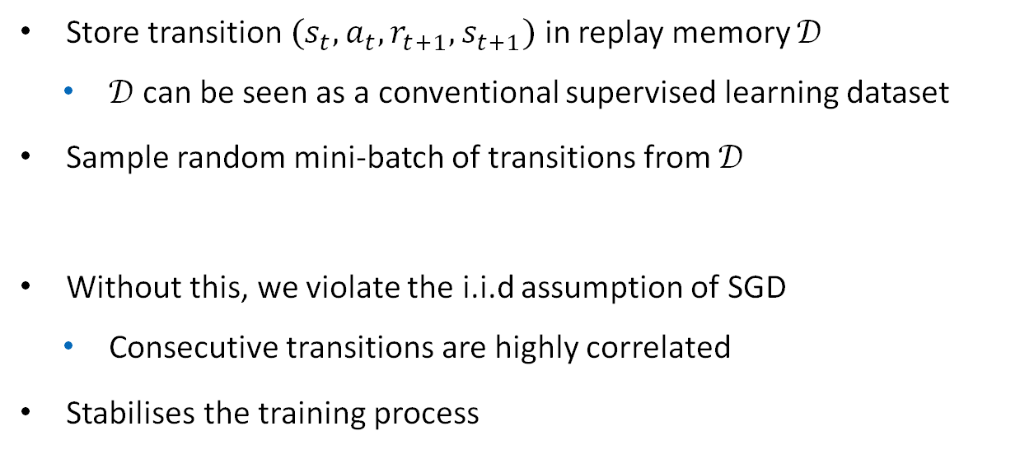
Training DQNs - DQN Techniques
Experience Replay
Store transition $(s_{t},a_{t},r_{t+1},s_{t+1})$ in replay memory $𝒟$
$𝒟$ can be seen as a conventional supervised learning dataset
Sample random mini-batch of transitions from $𝒟$
Without this, we violate the i.i.d assumption of SGD
Consecutive transitions are highly correlated
Stabilises the training process

Slide 7

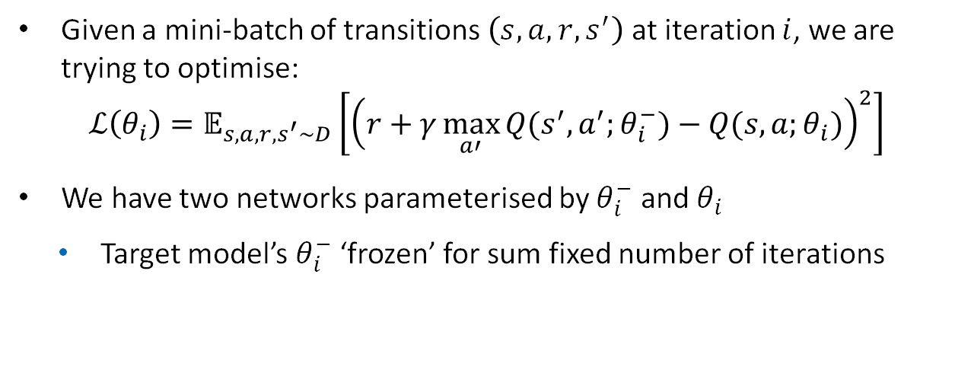
Training DQNs - DQN Techniques
Fixed Q-Targets
Given a mini-batch of transitions $\left(s, a, r, s^{′}\right)$ at iteration $i$, we are trying to optimise:
$$ℒ\left(θ_{i}\right)=𝔼_{s, a, r, s^{′}\sim D}\left[{\left(r+γ\max_{a′}{Q(s^{′},a^{′};θ_{i}^{−})}−Q(s, a;θ_{i})\right)}^{2}\right]$$
We have two networks parameterised by $θ_{i}^{−}$ and $θ_{i}$
Target model’s $θ_{i}^{−}$ ‘frozen’ for sum fixed number of iterations

Slide 8
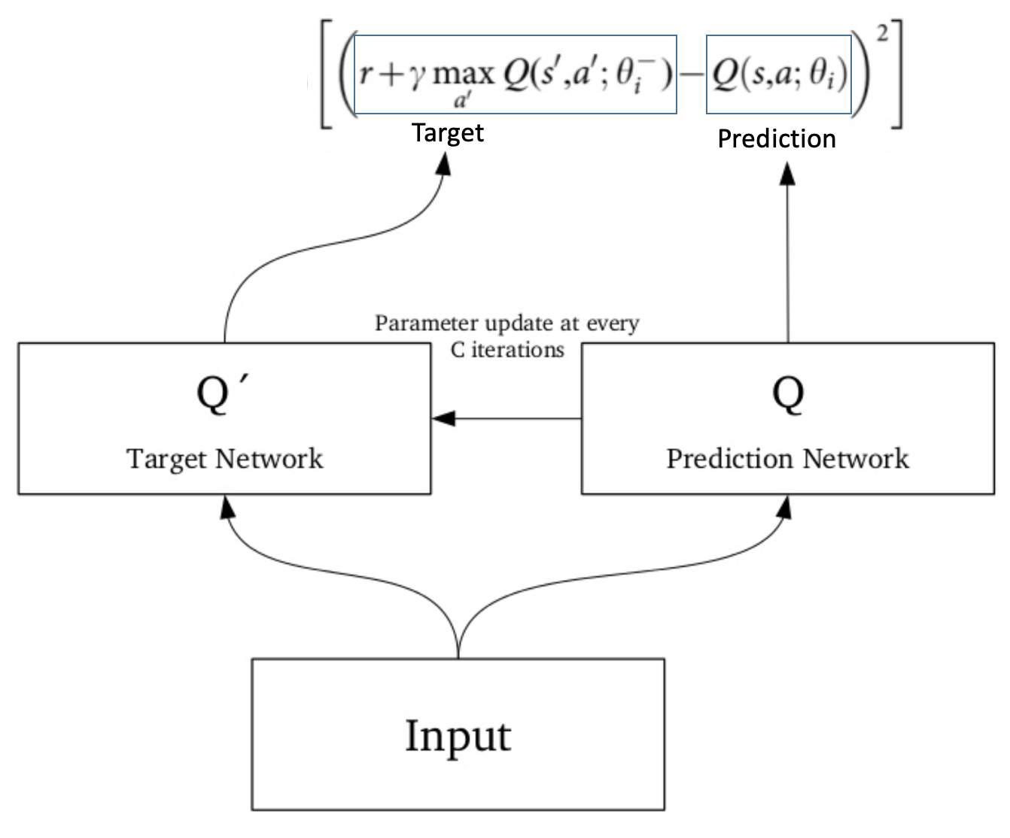
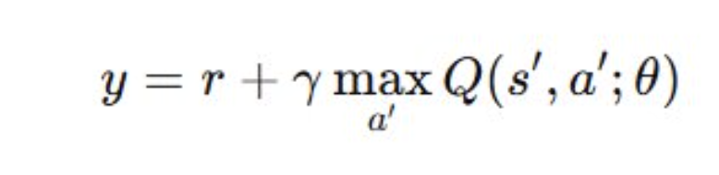
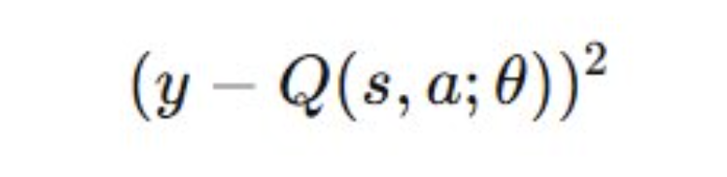
Training DQNs
Training the target comes from Q-learning. The loss is the difference between Q-value (Q) and target value (Q').
Target function:
Loss function:
The Neural Network is trained to minimise the error using gradient descent.

Slide 9
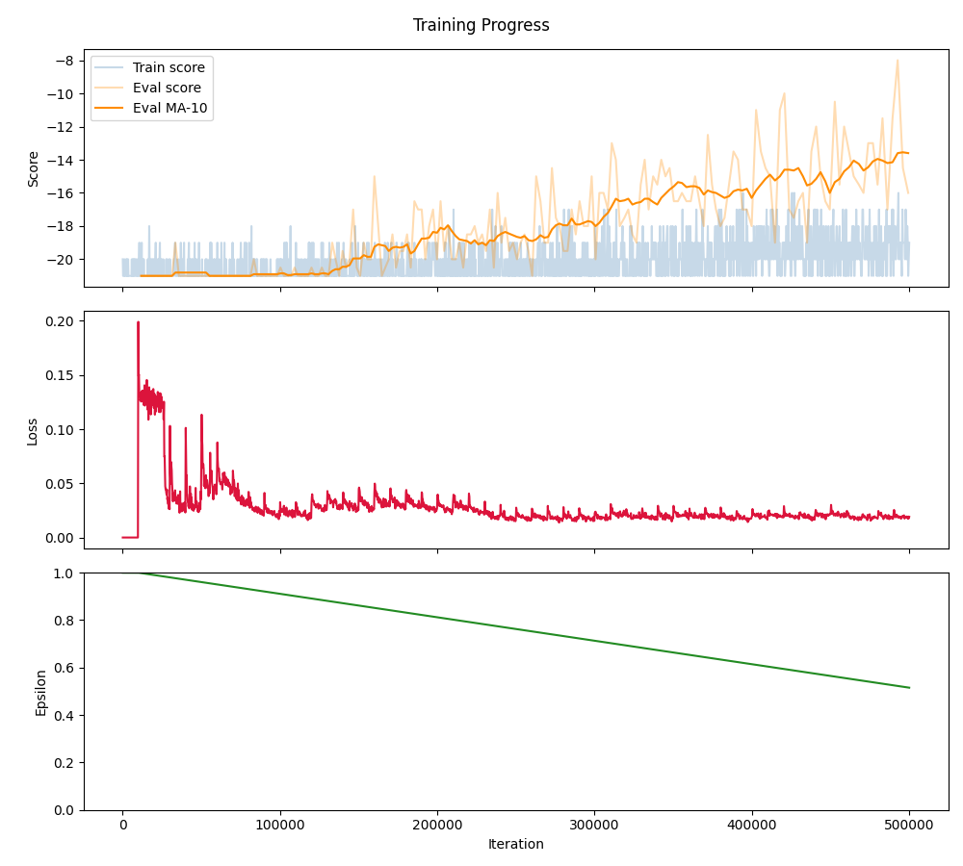
Training Loss for Pong
Spikes Illustrate Target Model Update

Slide 10
Thank You

Slide 11
References
Meng, Li, et al. "Deep reinforcement learning with swin transformers." Proceedings of the 2024 8th international conference on digital signal processing. 2024.
Volodymyr Mnih, , Koray Kavukcuoglu, David Silver, Alex Graves, Ioannis Antonoglou, Daan Wierstra, Martin Riedmiller. "Playing Atari with Deep Reinforcement Learning." (2013).

