Slide 1
EEP55C34 Advanced AI
Reinforcement Learning for Pong
Arlene Haas – Ciarán Cope – Nathaniel Kaye Mellor
Group 1 Preview Presentation
Date 12/03/26

Slide 2
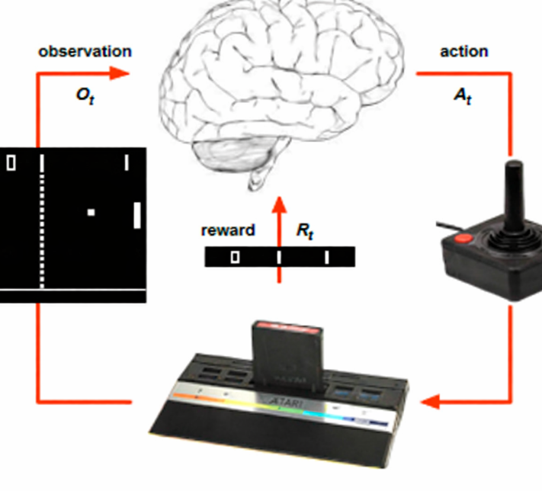
Introduction to Reinforcement Learning
What is it?
Goal: Select actions to maximise total future reward
Rules of the game are unknown
Learn directly from interactive game-play
At each step t the agent:
Executes action A_{t}
Receives observation O_{t}
Receives scalar reward R_{t}
Notes:
Unsupervised learning, no need for big datasets, agent learns from interacting with the environment, receiving rewards – trial and error learning
RL – the environment is initially unknown, the agent interacts with the environment, the agent improves its policy

Slide 3
Introduction to Reinforcement Learning
What is it?
Goal: Select actions to maximise total future reward
Rules of the game are unknown
Learn directly from interactive game-play
Notes:
Unsupervised learning, no need for big datasets, agent learns from interacting with the environment, receiving rewards – trial and error learning
RL – the environment is initially unknown, the agent interacts with the environment, the agent improves its policy

Slide 4
Introduction to Reinforcement Learning
How does the agent learn?
Aim is to learn the optimal action-value function, Q(s, a)
Agent's behaviour is defined by a policy, π
Exploration vs Exploitation challenge
Our approach:
Off-policy control
Deep Q-learning (DQN) algorithm – more on this next week :)

Slide 5
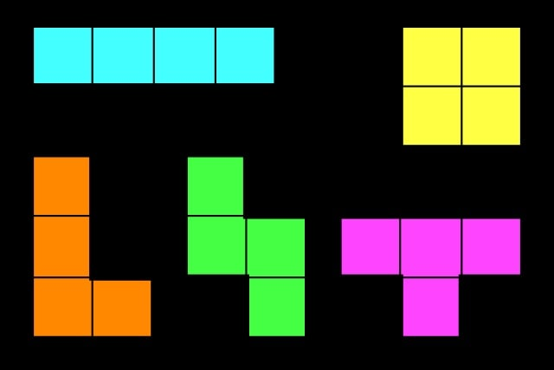
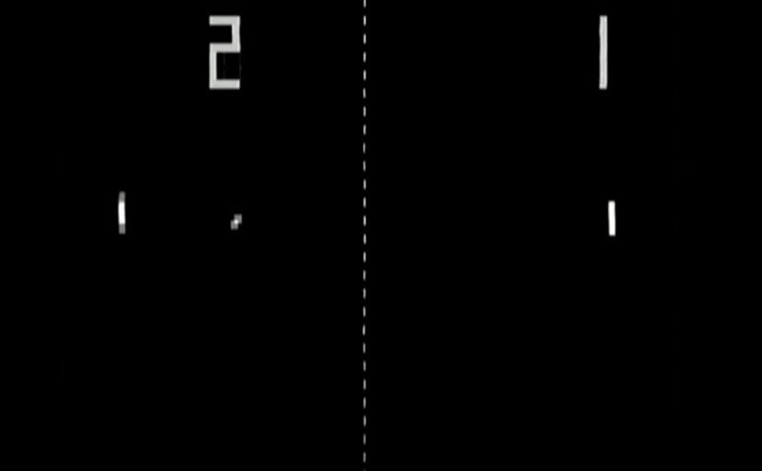
Reinforcement Learning for Pong
Baseline Goal – Train a CNN to play an arcade game
Tetris vs Pong
Unsuitable game for RL – No clear goal, rewards are too sparse, difficult for the model to learn.
States – Grid representation of the board showing the current stack of blocks
Reward - Number of lines cleared or time spent surviving the game.
Output - Q-value for each action.
Suitable game for RL – well defined rewards, a discrete action space and a clear goal
States – Raw pixels from last 4 frames, rewards and actions defined by the Arcade Learning Environment (ALE)
Reward - Change in score for that step.
Output - Q-value for each action.

Slide 6
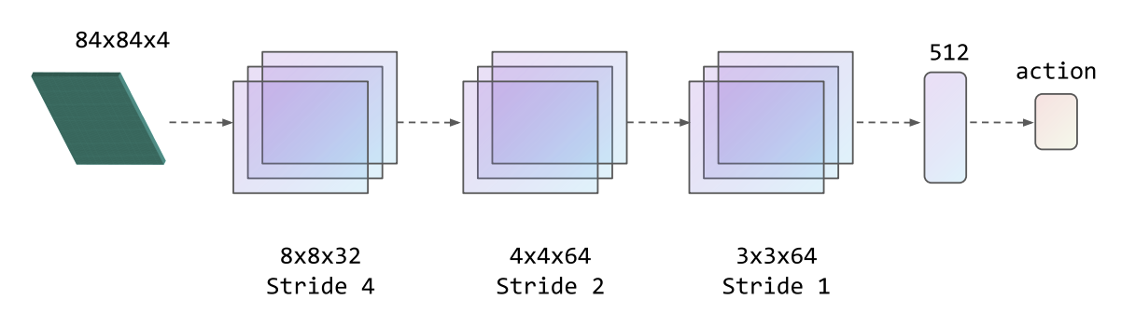
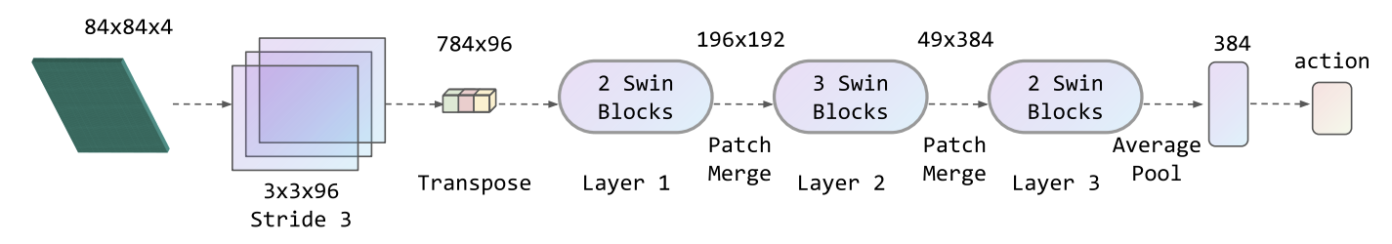
CNN / Vision Transformer / SWIN
Standard DQN architecture uses CNN as feature extractor [2]
We plan to replace this with ViT/SWIN
Compare each implementation on policy convergence speed and final policy score.
CNN Architecture
SWIN Architecture
[1] Meng, Li, et al. "Deep Reinforcement Learning with Swin Transformers."

Slide 7
Progress to date
Our agent is the green player on the right-hand side

Slide 8
100,000 iterations
*with CNN

Slide 9
300,000 iterations
18 hours later...
*with CNN

Slide 10
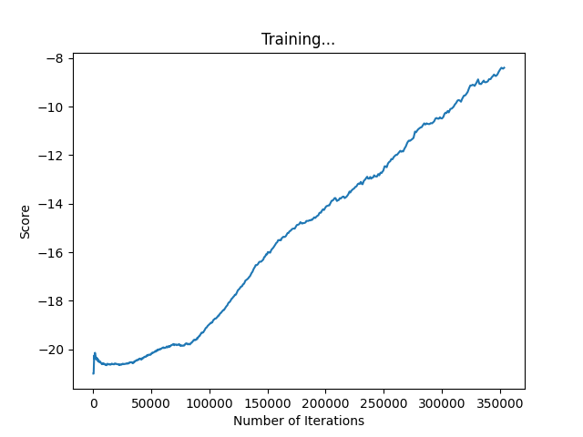
And still going...
Graph shows moving average game score that our agent obtains
In Pong, the first to 21 points wins
e.g. -8 score -> we lost 13 – 21 :(

Slide 11
Thank You

Slide 12
References
Meng, Li, et al. "Deep reinforcement learning with swin transformers." Proceedings of the 2024 8th international conference on digital signal processing. 2024.
Volodymyr Mnih, , Koray Kavukcuoglu, David Silver, Alex Graves, Ioannis Antonoglou, Daan Wierstra, Martin Riedmiller. "Playing Atari with Deep Reinforcement Learning." (2013).

