Slide 1
Pre-processing: Galaxy
Galaxy local server
Groomer
Trimmer
Raw sequence data
Processed sequence data
Processed sequence data
FastQC
Quality report
Process/program/script
Data/files

Slide 2
Pseudo-alignment: Kallisto
Kallisto
Mus_musculus.GRCm38.cdna.all.fa.gz
mouse-index-k21
Abundance.tsv
Processed sequence data
Kallisto
Abundance.h5
mouse-index-k21
Run_info.json

Slide 3
Differential gene expression: R
Step 1: download gene annotation database
gene_info_database.csv
fetch_gene_annotations.R
tx2gene.csv

Slide 4
Step 2: construct DESeq2DataSet Object
metadata
DESeq2DataSet.RData
Rscript_construct_DESeq2DataSet.R
tx2gene
normalized_gene_count.csv
Abundance.h5
rlog_transformated_data.csv

Slide 5
Step 3: construct DESeqResults Object
WT_lightvsControl.RData
DESeq2Results.RData
Script_output_DESeq2Results.R
Per1_lightvsControl.RData
WTvsPer1_control.RData
Control
Light treatment
WTvsPer1_light.RData
WT
effectAcrossGentype.RData
Per1

Slide 6
Step 4: convert DESeqResults Object to csv files with gene annotations
WT_lightvsControl.csv
gene_info_database.csv
WT_lightvsControl.RData
Per1_lightvsControl.csv
script_DESeq2ResultsToCSV.R
Per1_lightvsControl.RData
WTvsPer1_control.csv
WTvsPer1_control.RData
WTvsPer1_light.csv
WTvsPer1_light.RData
effectAcrossGentype.csv
effectAcrossGentype.RData
all_comparsion.csv

Slide 7
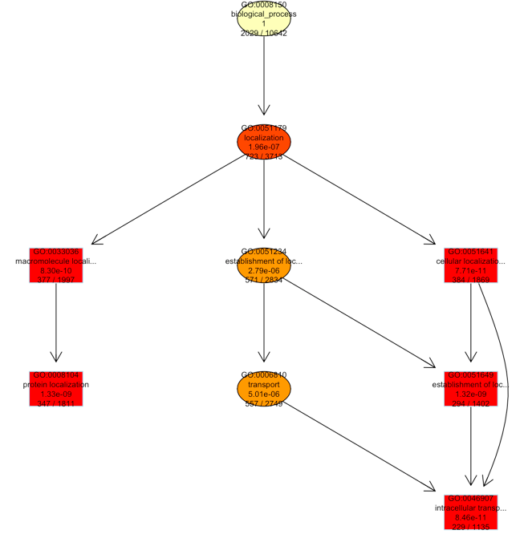
Step 5.1: topGO analysis (Biological process)
all_comparsion_topGO_BP.Rdata
all_comparsion_BP_fisher.csv
topGO_BP_visualization.Rmd
all_comparsion.csv
all_comparsion_BP_elimfisher.csv
all_comparsion_BP_KS.csv
topGO_BP_visualization.html
all_comparsion_BP_elimKS.csv

Slide 8
Step 5.2: topGO analysis (Cellular component)
all_comparsion_topGO_CC.Rdata
all_comparsion_CC_fisher.csv
topGO_CC_visualization.Rmd
all_comparsion.csv
all_comparsion_CC_elimfisher.csv
all_comparsion_CC_KS.csv
topGO_CC_visualization.html
all_comparsion_CC_elimKS.csv

Slide 9
Step 5.3: topGO analysis (Molecular function)
all_comparsion_topGO_MF.Rdata
all_comparsion_MF_fisher.csv
topGO_MF_visualization.Rmd
all_comparsion.csv
all_comparsion_MF_elimfisher.csv
all_comparsion_MF_KS.csv
topGO_MF_visualization.html
all_comparsion_MF_elimKS.csv

Slide 10
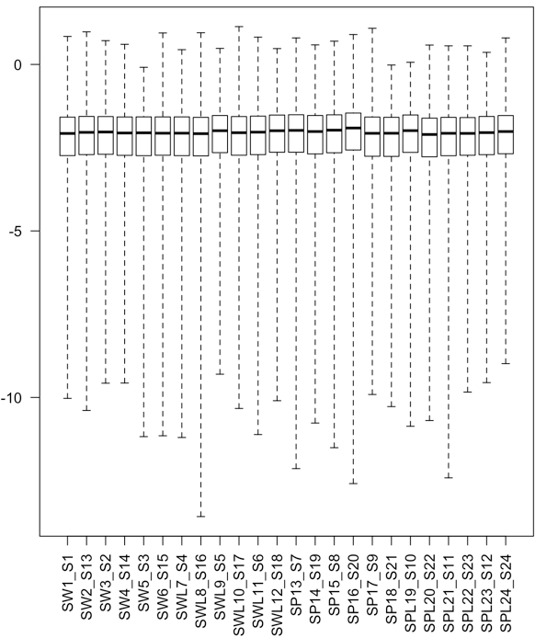
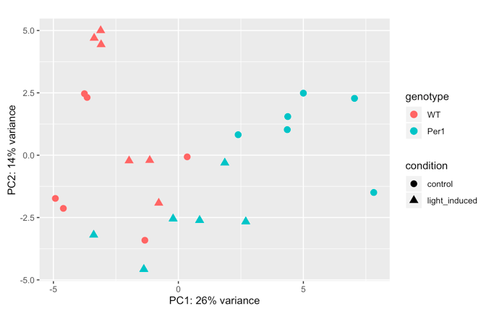
Step 6.1: DESeq2 experiment visualization (showing one example only)
metadata
DESeq2_analysis.html
DESeq2_analysis.Rmd
tx2gene
Abundance.h5

Slide 11
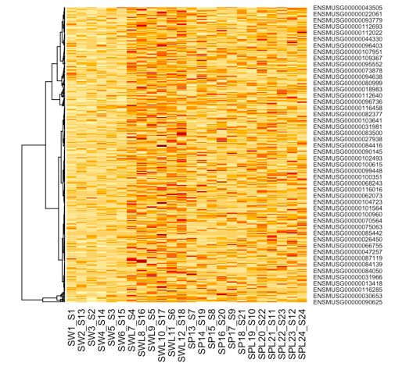
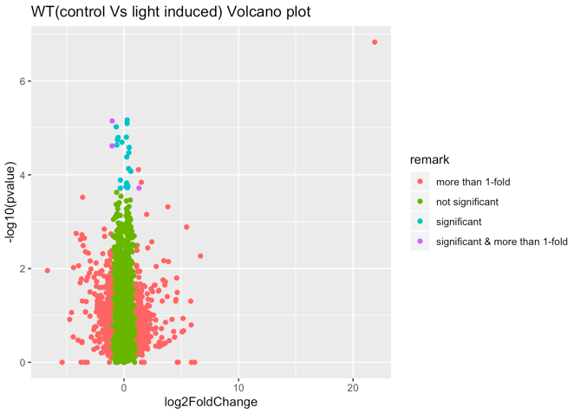
Step 6.2: DESeq2 results visualization (showing one example only)
WT_lightvsControl.RData
differential_expression_1.Rmd
differential_expression_1.html
rlog_transformated_data.csv

Slide 12
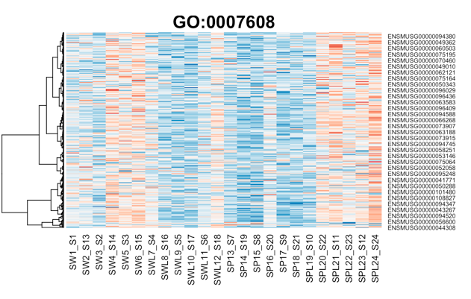
Step 6.3: topGO results visualization (showing one example only)
all_comparsion_topGO_BP.Rdata
topGO_BP_heatmaps_1.Rmd
topGO_BP_heatmaps_1.html
all_comparsion_BP_fisher.csv
rlog_transformated_data.csv

