Slide 1

Motor Sport Driver Stats

Slide 2

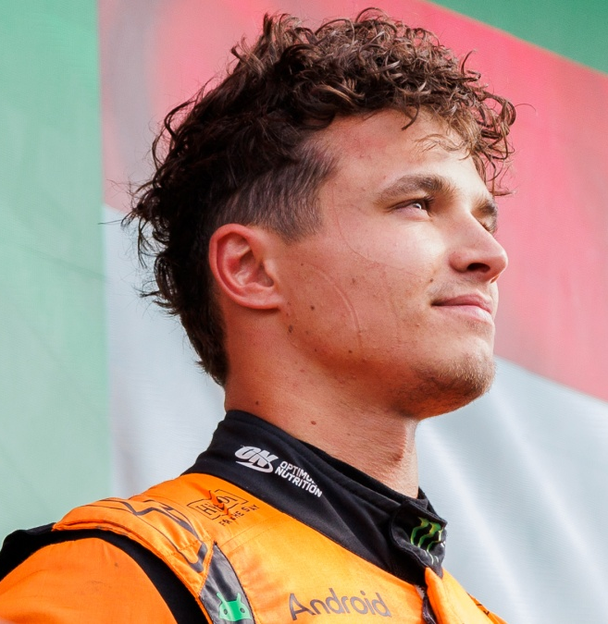
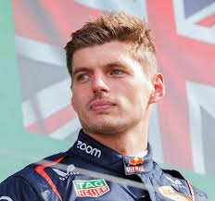
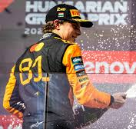
Formula One Drivers
Lando Norris
Brief driver description/history here that will take at least the full length of this box to make it look nice blah.
Stat one
Stat two
Max Verstappen
Brief driver description/history here that will take at least the full length of this box to make it look nice blah.
Stat one
Stat two
Oscar Piastri
Brief driver description/history here that will take at least the full length of this box to make it look nice blah.
Stat one
Stat two

