Slide 1
SciPy
By Jinrong Lu

Slide 2
Introduction
SciPy is a collection of mathematical algorithms and convenience functions built on the NumPy extension of Python. It is used in mathematics, science and the engineering field, which can handle interpolation, integration, optimization, image processing, numerical solution of ordinary differential equations, signal processing and other problems. It is used to compute Numpy matrix efficiently, enabling Numpy and Scipy to work together and solve problems efficiently.

Slide 3
SciPy library
a collection of numerical algorithms and domain-specific toolboxes, including signal processing, optimization, statistics, and much more.

Slide 4


SciPy is organized into subpackages covering different scientific computing domains

Slide 5
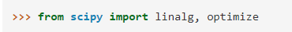
SciPy sub-packages need to be imported separately,
for example:

Slide 6
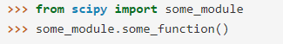
To use functions from some of the SciPy modules, you can do:

Slide 7
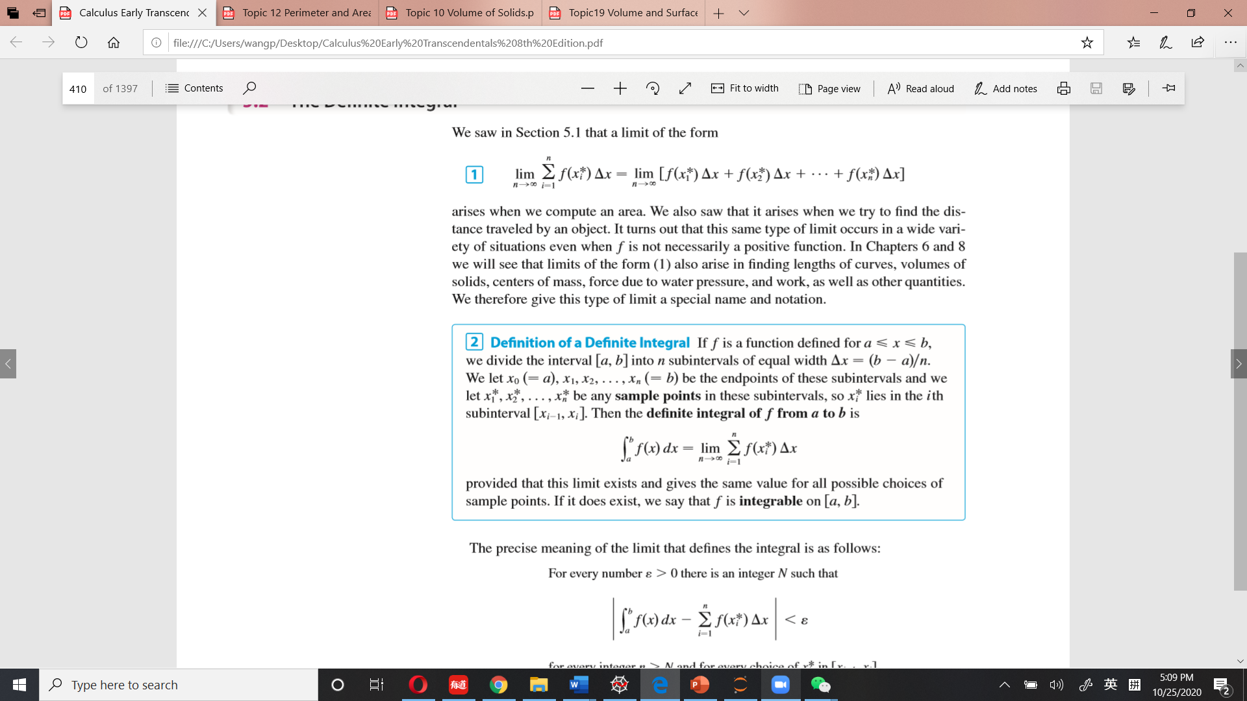
Integral

Slide 8
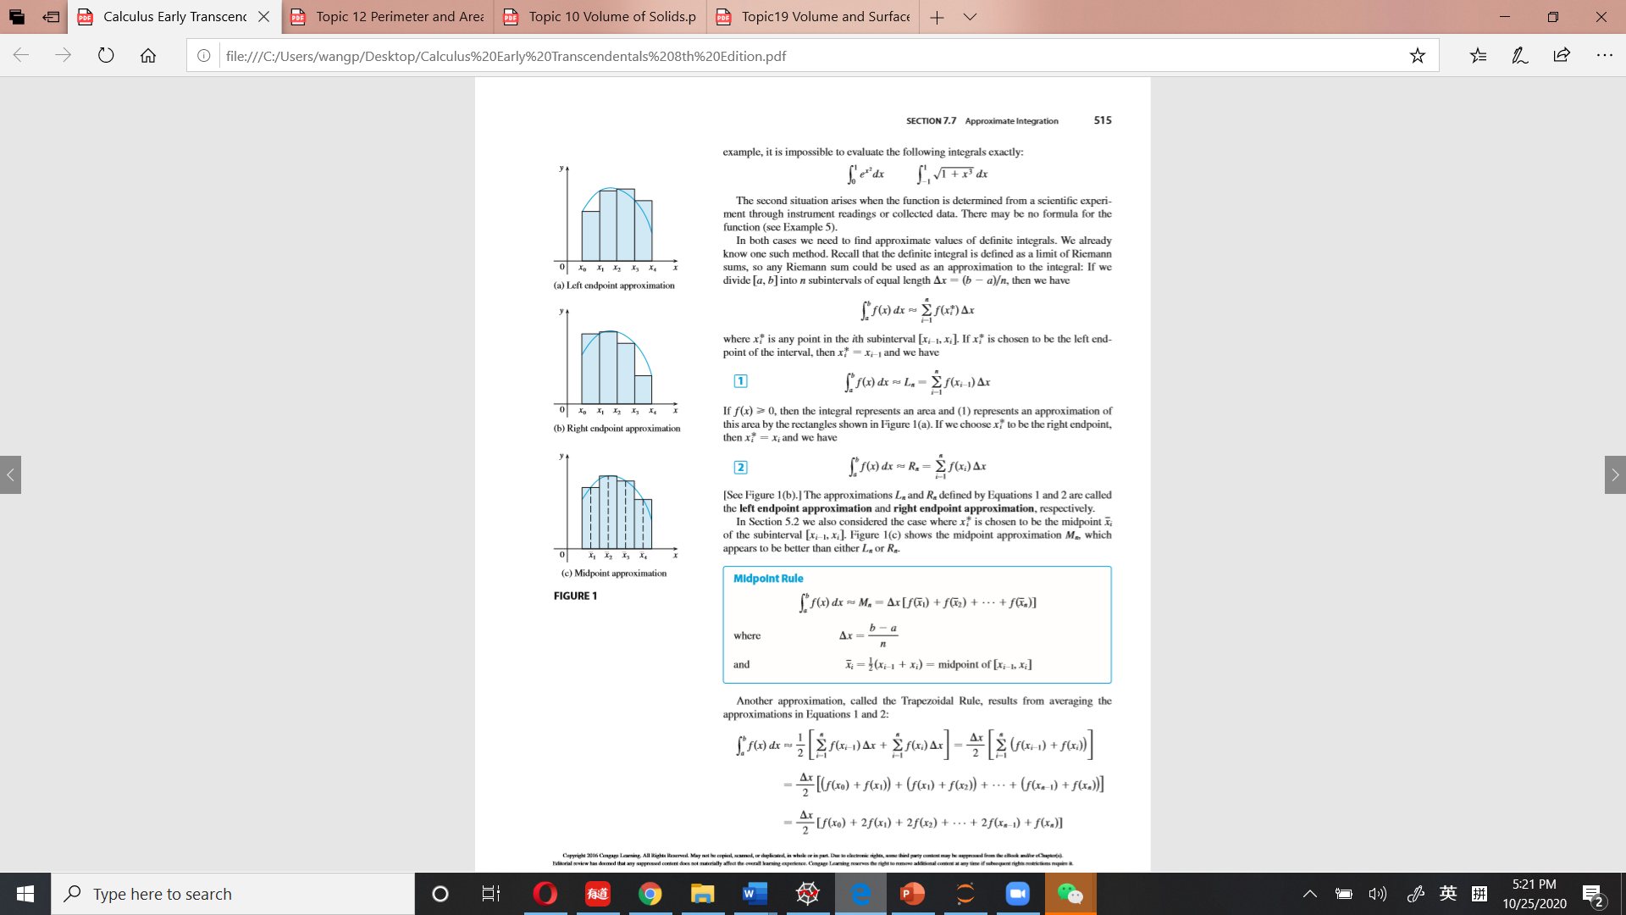

Slide 9
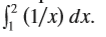
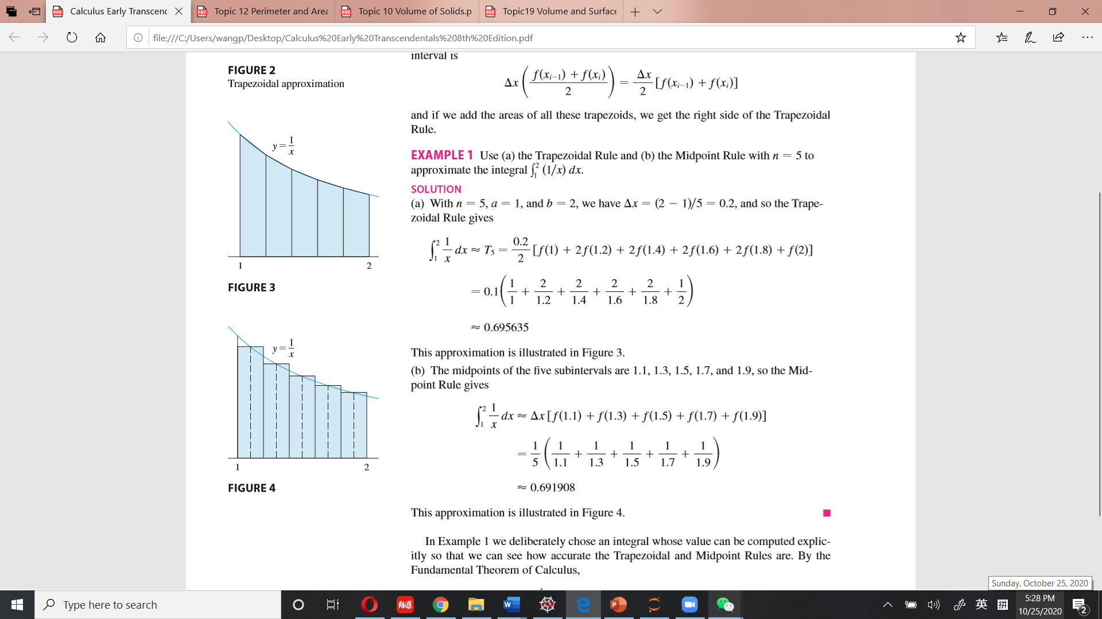
For example Use the Midpoint Rule with n=5 to approximate the integral:
The midpoints of the five subintervals are 1.1, 1.3, 1.5, 1.7, and 1.9, so the Midpoint Rule gives:

Slide 10
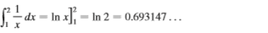

By the Fundamental Theorem of Calculus,
$\frac{Ln x}{dx}$ = $\frac{1}{x}$
So,

