Slide 1
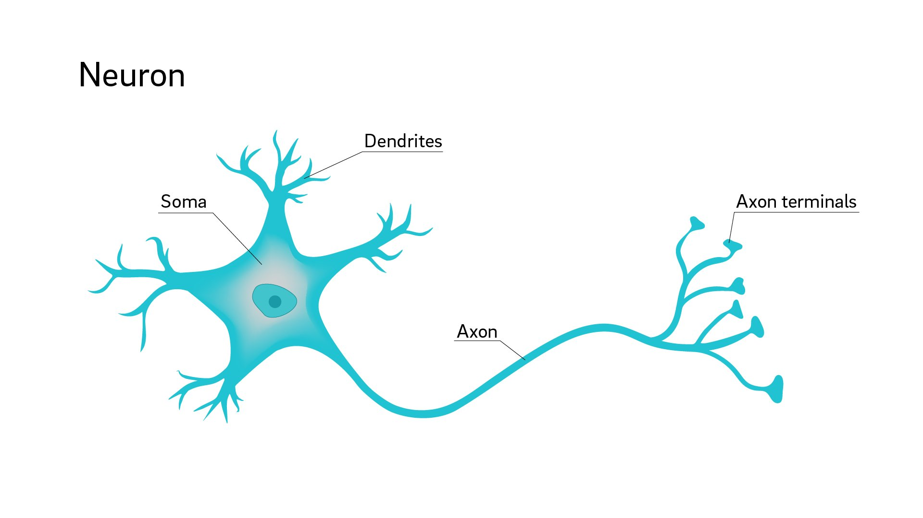



Neuron The neural network is a technology based on the structure of the neurons inside a human brain.

Slide 2
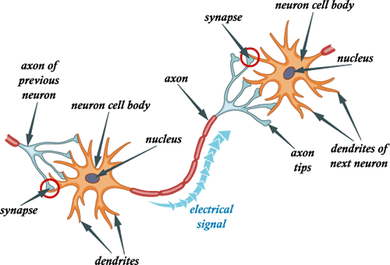










Neuron

Slide 3
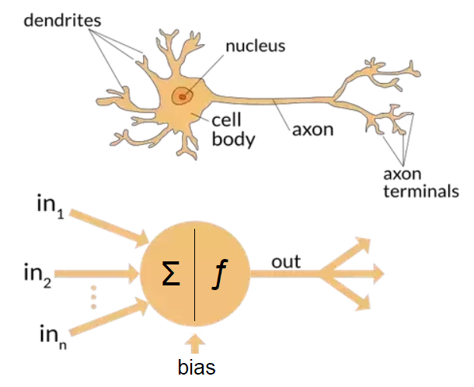
Neuron a Neural network algorithm will try to create a function to map your input to your desired output.
Node

Slide 4
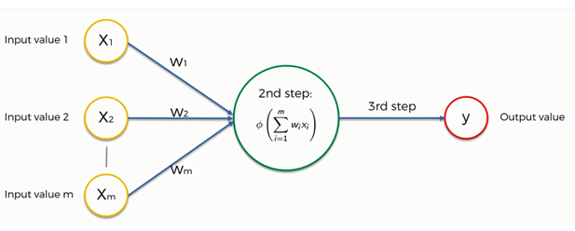
A single layer feedforward neural network ( also called Perceptron)
What happens inside a neuron?

Slide 5

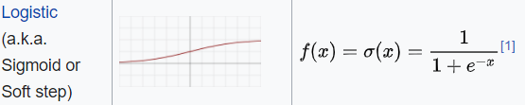


Activation Functions

Slide 6
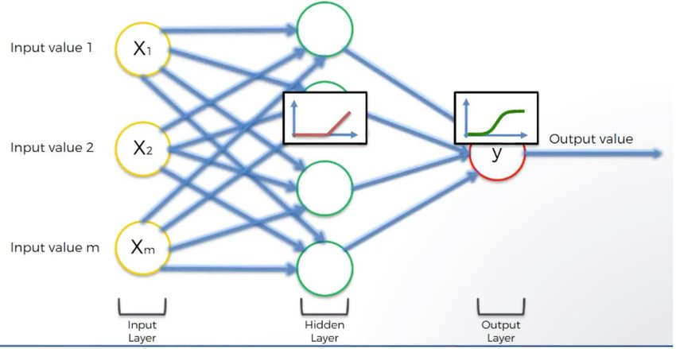

Slide 7
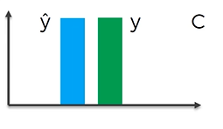
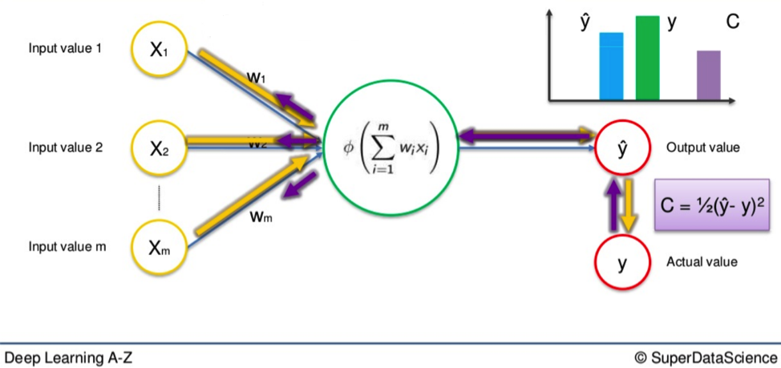
How Neural Networks Learn?

Slide 8
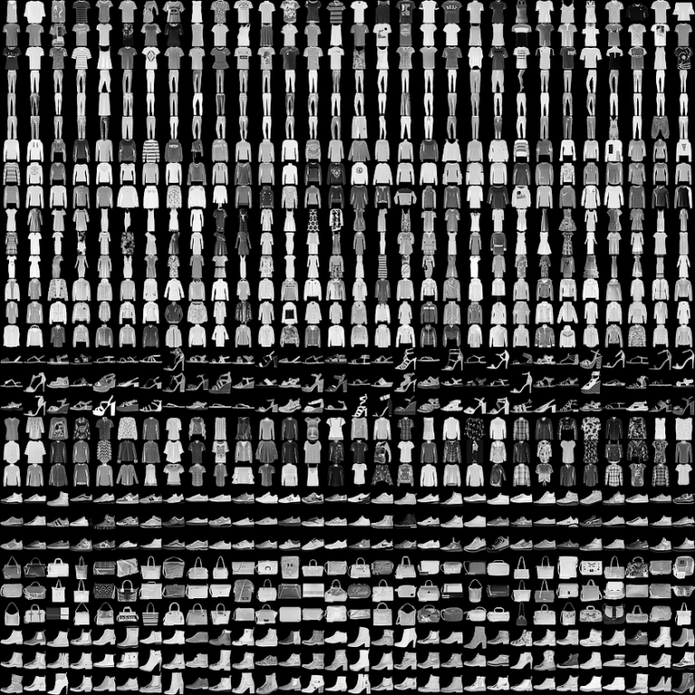
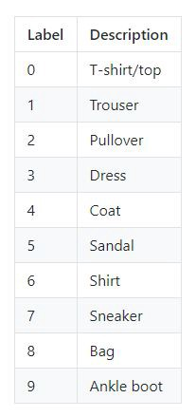
Fashion MNIST
There are 70,000 photos. Each of those images is 28x28 grayscale.

