Slide 1
Practical Computing Final Project
Kayla Evans

Slide 2
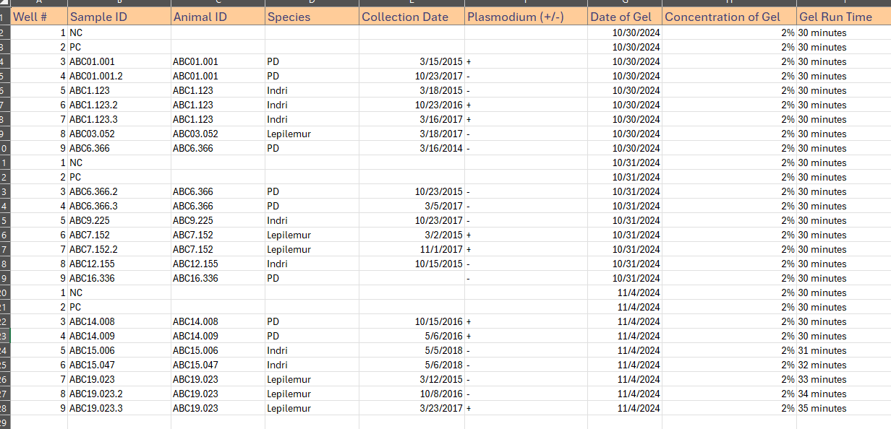

Slide 3
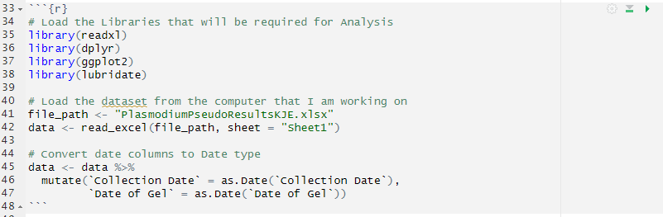
Getting Started

Slide 4
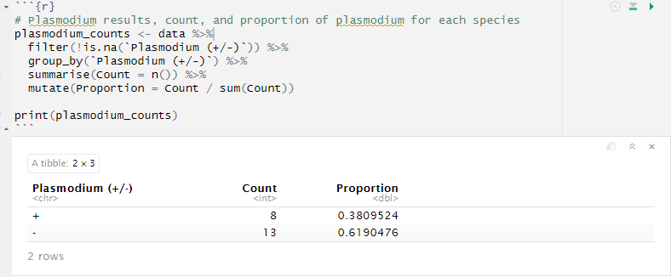
Data Analysis

Slide 5
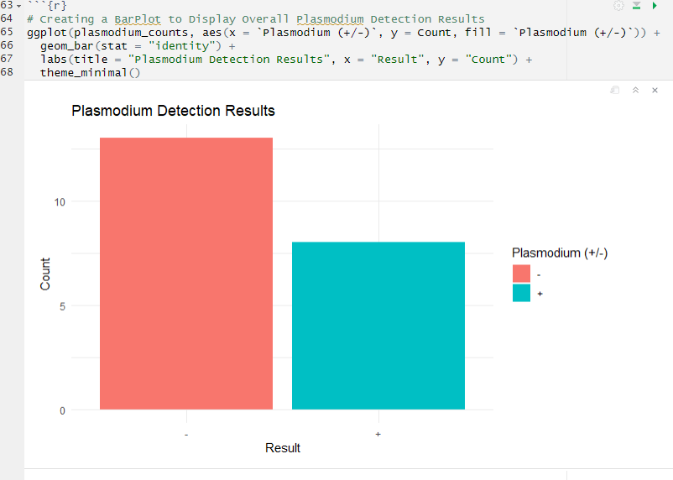
Creating a Bar Graph to Display Plasmodium Results

Slide 6
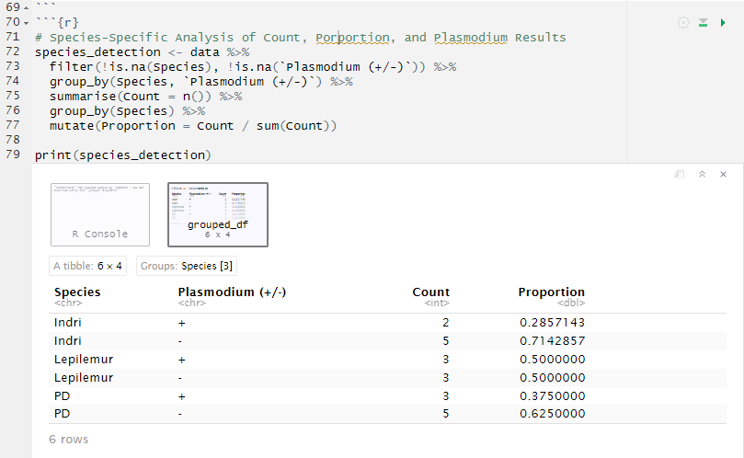
Species Specific Analysis

Slide 7
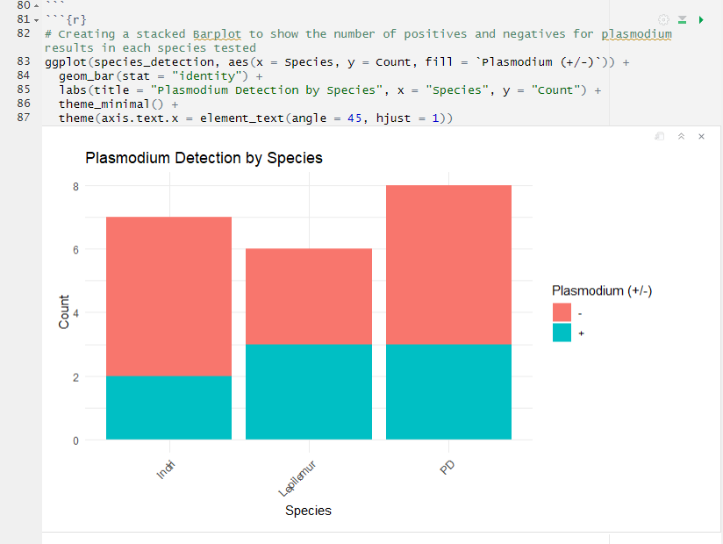
Number of Positives and Negatives by Species

Slide 8
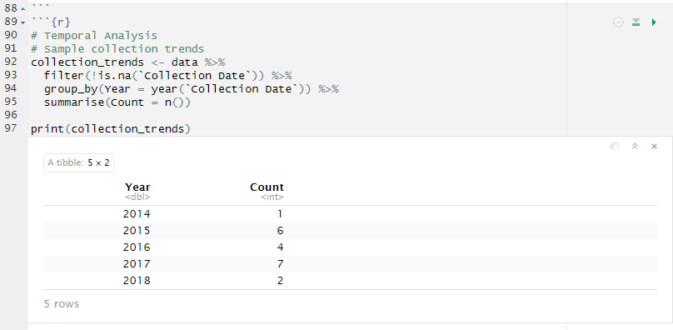
Temporal Analysis

