Slide 1
iLILA
Optical sensitivity
and weekly research updates
Kaylah McGowan
Week of [date]
01
Notes:
Reusable weekly research deck. Update the date. Slides 2–7 establish project context and reference work. Duplicate slides 8–15 as a dated weekly block. Slide 16 contains the update workflow and references. Existing figures come from the supplied PDF and do not represent new calculations.

Slide 2
Research objective
Reverse engineer the requirements for the sensitivity and science SNR targets
Required outputs
Central unresolved question
Optical response
Noise budget and coupling functions
Sensitivity curve
SNR for defined science cases
What seismic motion reaches the readout, and how much can iLILA tolerate while meeting the science goals?
A matching reference curve is the starting point for testing achievable performance.
02
Notes:
Source: iLILA Optical Sensitivity Project Plan, current teal revision, and Kaylah’s clarified project objective in this conversation. Seismic coupling is a primary workstream.

Slide 3
Model configurations
Separate the bench hardware, the 1 km instrument and the later cavity study
Configuration | Purpose | Parameters to track
Laboratory Michelson | Validate propagation and readout | 1550 nm rerun Beam radius definition to confirm
1 km iLILA | Sensitivity, coupling and SNR | No arm cavities Mission wavelength to confirm
LILA Observatory | Later cavity extension | Cavity geometry, losses and mechanical configuration
Proposal reference: 10⁻¹⁵ m/√Hz over 1–100 mHz. Treat it as a preliminary requirement.
03
Notes:
Sources: August 2026 LILA Templeton proposal and current project plan. Supplied September 15 Optical Modeling Overview PDF, slides 3 and 9, distinguishes 1064 nm mission/noise-study assumptions from the 1550 nm bench rerun. Excluding arm cavities does not exclude separately specified laser-stabilization or mode-cleaning cavities.

Slide 4
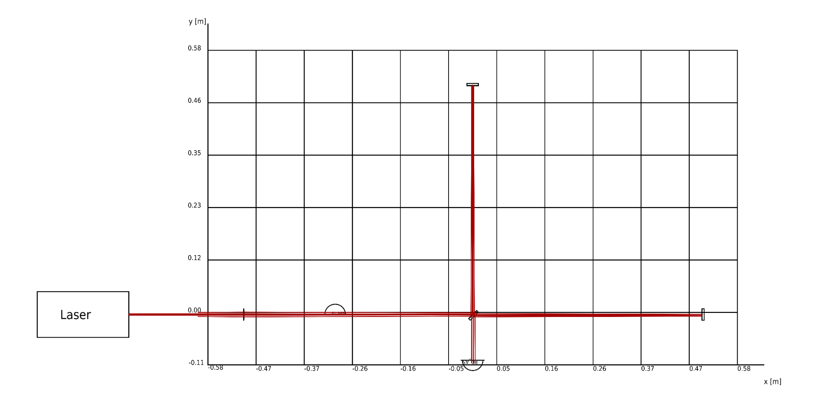
Existing Michelson layout
Reference result from the September 15 optical modeling presentation
Next validation: operating point, readout calibration and displacement response.
04
Notes:
Source: supplied Presentation - Optical Modeling Overview.pdf, Fintrace model slides. Figure reused as a reference image, not regenerated. The attached fixed Python runner calls simple_michelson.yaml, which was not among the attachments. Recover the matching YAML before reproducing the model.

Slide 5
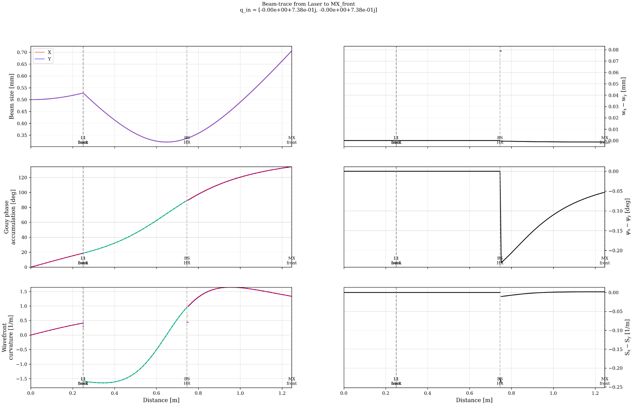
Existing Gaussian beam diagnostics
Reference X-arm trace, with beam size, Gouy phase and wavefront curvature
Model context
Existing 1064 nm
configuration
Next comparison
1550 nm bench rerun
with documented inputs
[Add run ID after reproduction]
05
Notes:
Source: extracted X-arm trace from Presentation - Optical Modeling Overview.pdf. The X/Y plot legends refer to transverse beam components, not the two interferometer arms. The supplied run_michelson_gouy_fixed(1).py requests beamsize, gouy, curvature and astigmatic differences for MX and MY traces. This slide does not claim a fresh execution.

Slide 6
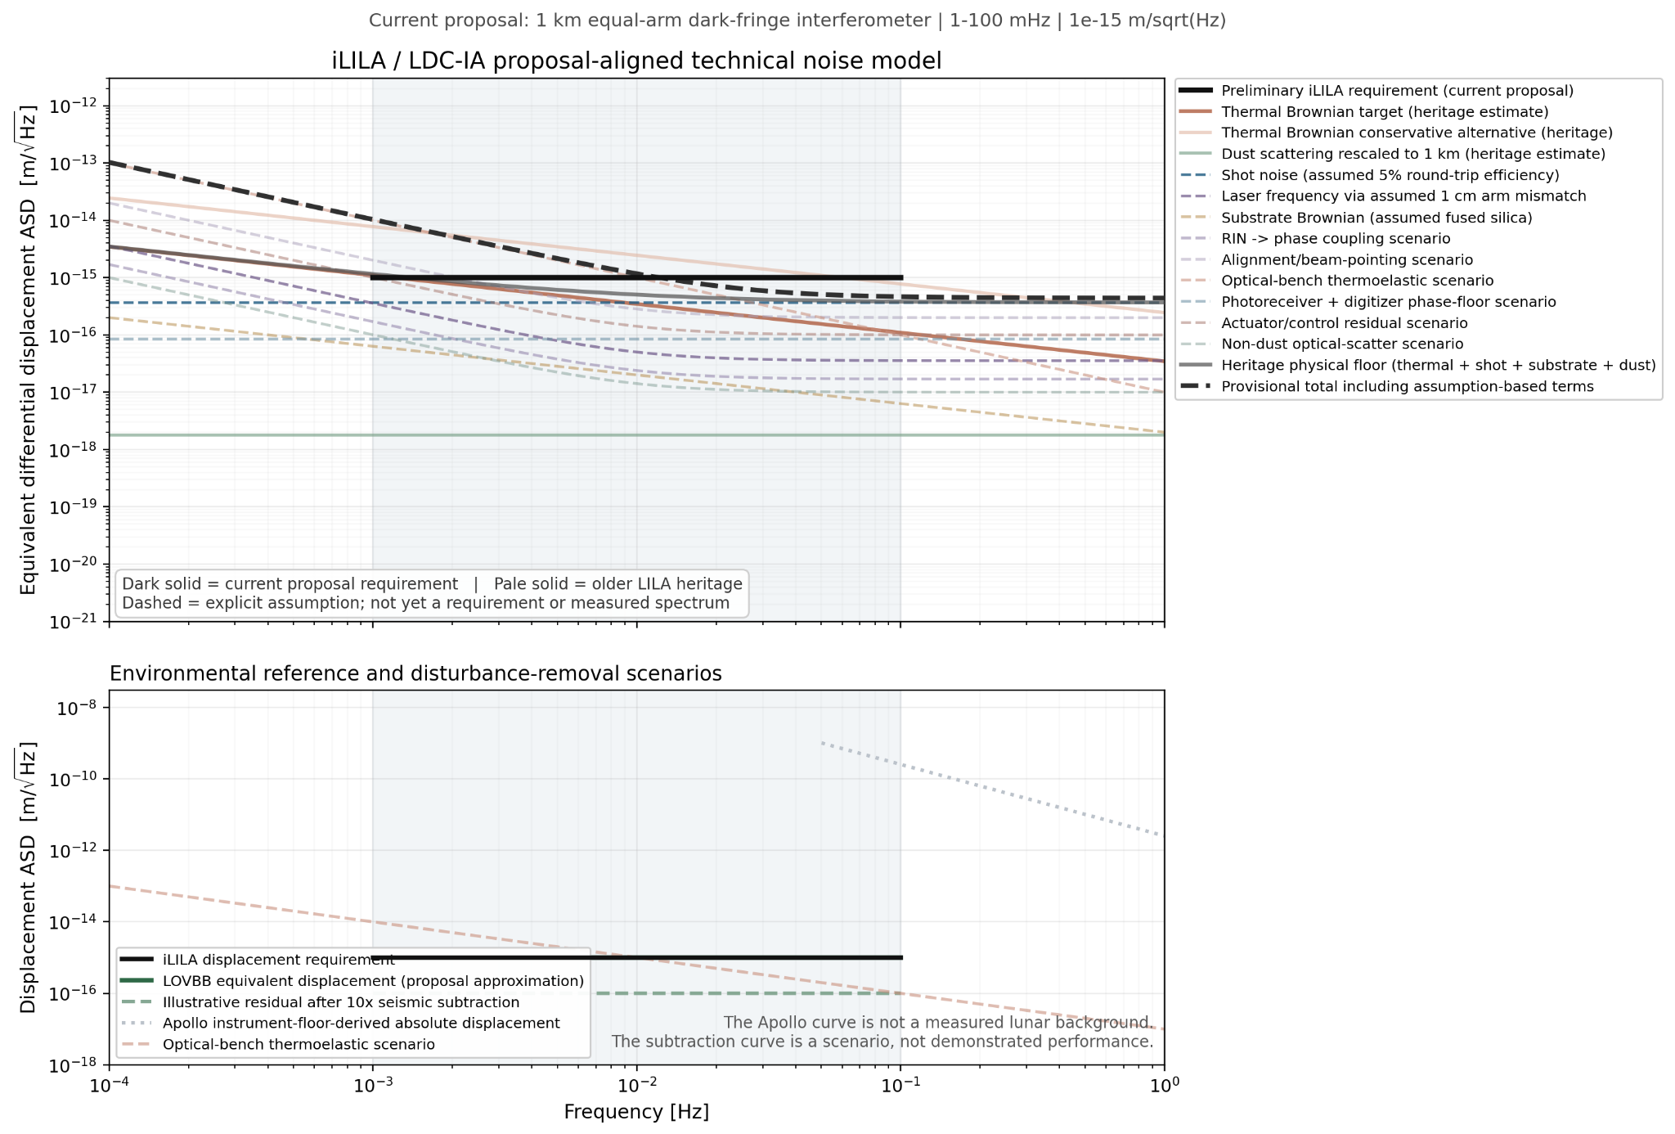
Preliminary noise study
Archived scenario from the existing presentation
Status
Assumed coupling
and noise scenarios
Seismic limitation
Sensor-floor and subtraction
curves need validation
Replace assumptions with validated inputs and transfer functions.
06
Notes:
Source: Presentation - Optical Modeling Overview.pdf, preliminary noise study. Original figure retained as an image. The Apollo instrument-floor-derived curve is not a measurement of the lunar background. The illustrated subtraction residual is not demonstrated performance. The plotted component assumptions do not establish a closed seismic budget.

Slide 7
Research sequence
Stages advance when the required model or evidence is ready
Stage | Main work | Reviewable output
1 | Reference curves and science cases | Assumptions and SNR requirements
2 | Optical response and link budget | Validated model and received power
3 | Noise and seismic coupling | Component budget and uncertainty
4 | Lunar response and inverse limits | SNR and allowable seismic residual
5 | Mitigation tests and integration | Requirements and remaining gaps
07
Notes:
Source: current project plan. These are ordered research stages, not fixed deadlines. Seismic input discovery and coupling mapping begin in Stage 1 alongside optical work. CAD follows sufficiently stable beam geometry. Gaussian modes with Remmy, Volker’s optical review, Teviet’s response/noise reference, potential dust work with Phoenix, and Remington’s APRA inputs remain part of the plan.

Slide 8
Weekly update
Week of [date] Model or run [ID]
Main result
Changes since last week
[One finding supported by this week’s plots]
[Parameters, model terms or data added]
Largest uncertainty
Decision needed
[Unresolved coupling or missing input]
[Specific question for the group]
08
Notes:
Duplicate slides 8–15 for each week and preserve previous dated blocks. Use only the slides relevant to that meeting. Keep plot source paths, code version, configuration version and references in speaker notes.

Slide 9
Optical model update
Week of [date] Configuration [bench / 1 km iLILA]
[ Optical layout or response plot ]
Insert plot here
Change
[Parameter or model change]
Validation
[Analytic or numerical check]
Remaining issue
[Calibration or hardware input]
Result: [main finding and its implication]
09
Notes:
Weekly template. Duplicate this slide and replace bracketed fields. Delete the plot placeholder and insert a PNG or SVG without stretching it. Keep axis labels, units and legend readable. Record run date, configuration file, code version, parameter changes and source data here. No new result is asserted by this template.

Slide 10
Noise and coupling register
Each term needs an input spectrum and a path to equivalent displacement
Noise input | Coupling path | Evidence / assumption | Next check
Laser frequency | Arm mismatch and readout | [Spectrum / transfer function] | [Action]
Thermal | Optics, bench and mounts | [Materials / temperature PSD] | [Action]
Seismic | Ground, supports and optics | [PSD / coherence / mechanics] | [Action]
Pointing / scatter | Alignment and parasitic paths | [Jitter / geometry / loss] | [Action]
Readout / controls | Electronics and feedback | [Measurements / model] | [Action]
Additional terms: [RIN, dust, radiation-related mechanisms or other identified couplings]
10
Notes:
Editable weekly register. Duplicate rows or split into more slides when needed. For each coupling record input units, ASD or PSD convention, output calibration, frequency dependence, source, correlation assumptions and uncertainty. Keep cross-spectra for correlated sources. This is an inventory to complete, not a claim that all terms have been modeled.

Slide 11
Noise budget update
Week of [date] Output convention [differential displacement ASD]
[ Component noise curves and total ]
Insert plot here
Dominant term
[Source and frequency band]
Target gap
[Amount above or below target]
Model confidence
[Validated / assumed / unknown]
Result: [main finding and its implication]
11
Notes:
Weekly template. Duplicate this slide and replace bracketed fields. Delete the plot placeholder and insert a PNG or SVG without stretching it. Keep axis labels, units and legend readable. Record run date, configuration file, code version, parameter changes and source data here. No new result is asserted by this template.

Slide 12
Seismic coupling update
Week of [date] Ground motion, station coherence and support response
[ Input spectrum or coupling function ]
Insert plot here
[ Residual noise or SNR impact ]
Insert plot here
Assumptions: [ground PSD, coherence, mount response and geometry]
Constraint or next measurement: [allowable residual and missing evidence]
12
Notes:
Primary uncertainty slide. Model translation and rotation at corner and end stations with cross-spectra. Propagate through regolith, anchors, supports and optical transfer functions. Keep GW-driven lunar deformation in the signal response. Treat quake-excited modes according to the science channel. Include sensor noise and signal-preservation checks before claiming subtraction. Source: project plan and Creighton et al., https://arxiv.org/abs/2508.18437.

Slide 13
Sensitivity against the reference
Week of [date] Reference [paper / version] Configuration [ID]
[ Target, reproduced curve and current prediction ]
Insert plot here
Quantity
[Displacement ASD / strain ASD]
Lunar response
[Model, modes and assumptions]
Main difference
[Coupling or design change]
Result: [main finding and its implication]
13
Notes:
Weekly template. Duplicate this slide and replace bracketed fields. Delete the plot placeholder and insert a PNG or SVG without stretching it. Keep axis labels, units and legend readable. Record run date, configuration file, code version, parameter changes and source data here. No new result is asserted by this template.

Slide 14
Science SNR review
Week of [date] Shared assumptions [observation time, geometry and response model]
Science case | Source / distance | Band / duration | Required SNR | Predicted SNR
[Case 1] | [Parameters] | [Values] | [Threshold] | [Result]
[Case 2] | [Parameters] | [Values] | [Threshold] | [Result]
[Case 3] | [Parameters] | [Values] | [Threshold] | [Result]
Limiting noise: [term] Required improvement: [level or coupling reduction]
14
Notes:
Define source waveform, distance, orientation, observation time, integration band and one-sided PSD convention. For lunar-mode detection specify excitation amplitude and damping. For GW detection include the calibrated lunar response. Numerical SNRs and thresholds remain blank until supplied or calculated. Record integration convergence and treatment of narrow resonances.

Slide 15
Decisions and next week
Week of [date]
Action or decision | Owner | Needed by | Evidence of completion
[Highest-priority action] | [Name] | [Date] | [Plot / model / measurement]
[Second action] | [Name] | [Date] | [Deliverable]
[Decision to resolve] | [Name] | [Date] | [Documented choice]
Meeting takeaway: [decision, implication and immediate next step]
15
Notes:
Use specific owners only after agreement. Potential coordination: Gaussian modes with Remmy, optical review with Volker, updated sensitivity and lunar response with Teviet, dust scattering with Phoenix, APRA inputs for Remington. Keep AJRC logistics separate unless a concrete deliverable is required.

Slide 16
Weekly workflow and references
Reference page for maintaining the deck
Weekly workflow
Reference material
Duplicate slides 8–15 as a dated block.
Replace plot fields and update tables.
Record model versions in notes.
Keep prior weeks for comparison.
Optical Modeling Overview
Kaylah McGowan, 15 September 2026
Creighton et al., arXiv:2508.18437
Panning et al., arXiv:2509.15452
Finesse manual and Siegman, Lasers
Pending inputs: Teviet’s numerical curves and mode table, exact Joseph paper, and readout choice.
16
Notes:
References: current iLILA Optical Sensitivity Project Plan; supplied Presentation - Optical Modeling Overview.pdf; supplied run_michelson_gouy_fixed(1).py; https://arxiv.org/abs/2508.18437; https://arxiv.org/abs/2509.15452; https://finesse.ifosim.org/docs/latest/; https://pypi.org/project/gwinc/; Siegman, A. E., Lasers, University Science Books (1986); Kogelnik and Li, Laser Beams and Resonators, https://doi.org/10.1364/AO.5.001550. Confirm current paper versions before adopting numerical sensitivity assumptions.

Slide 17
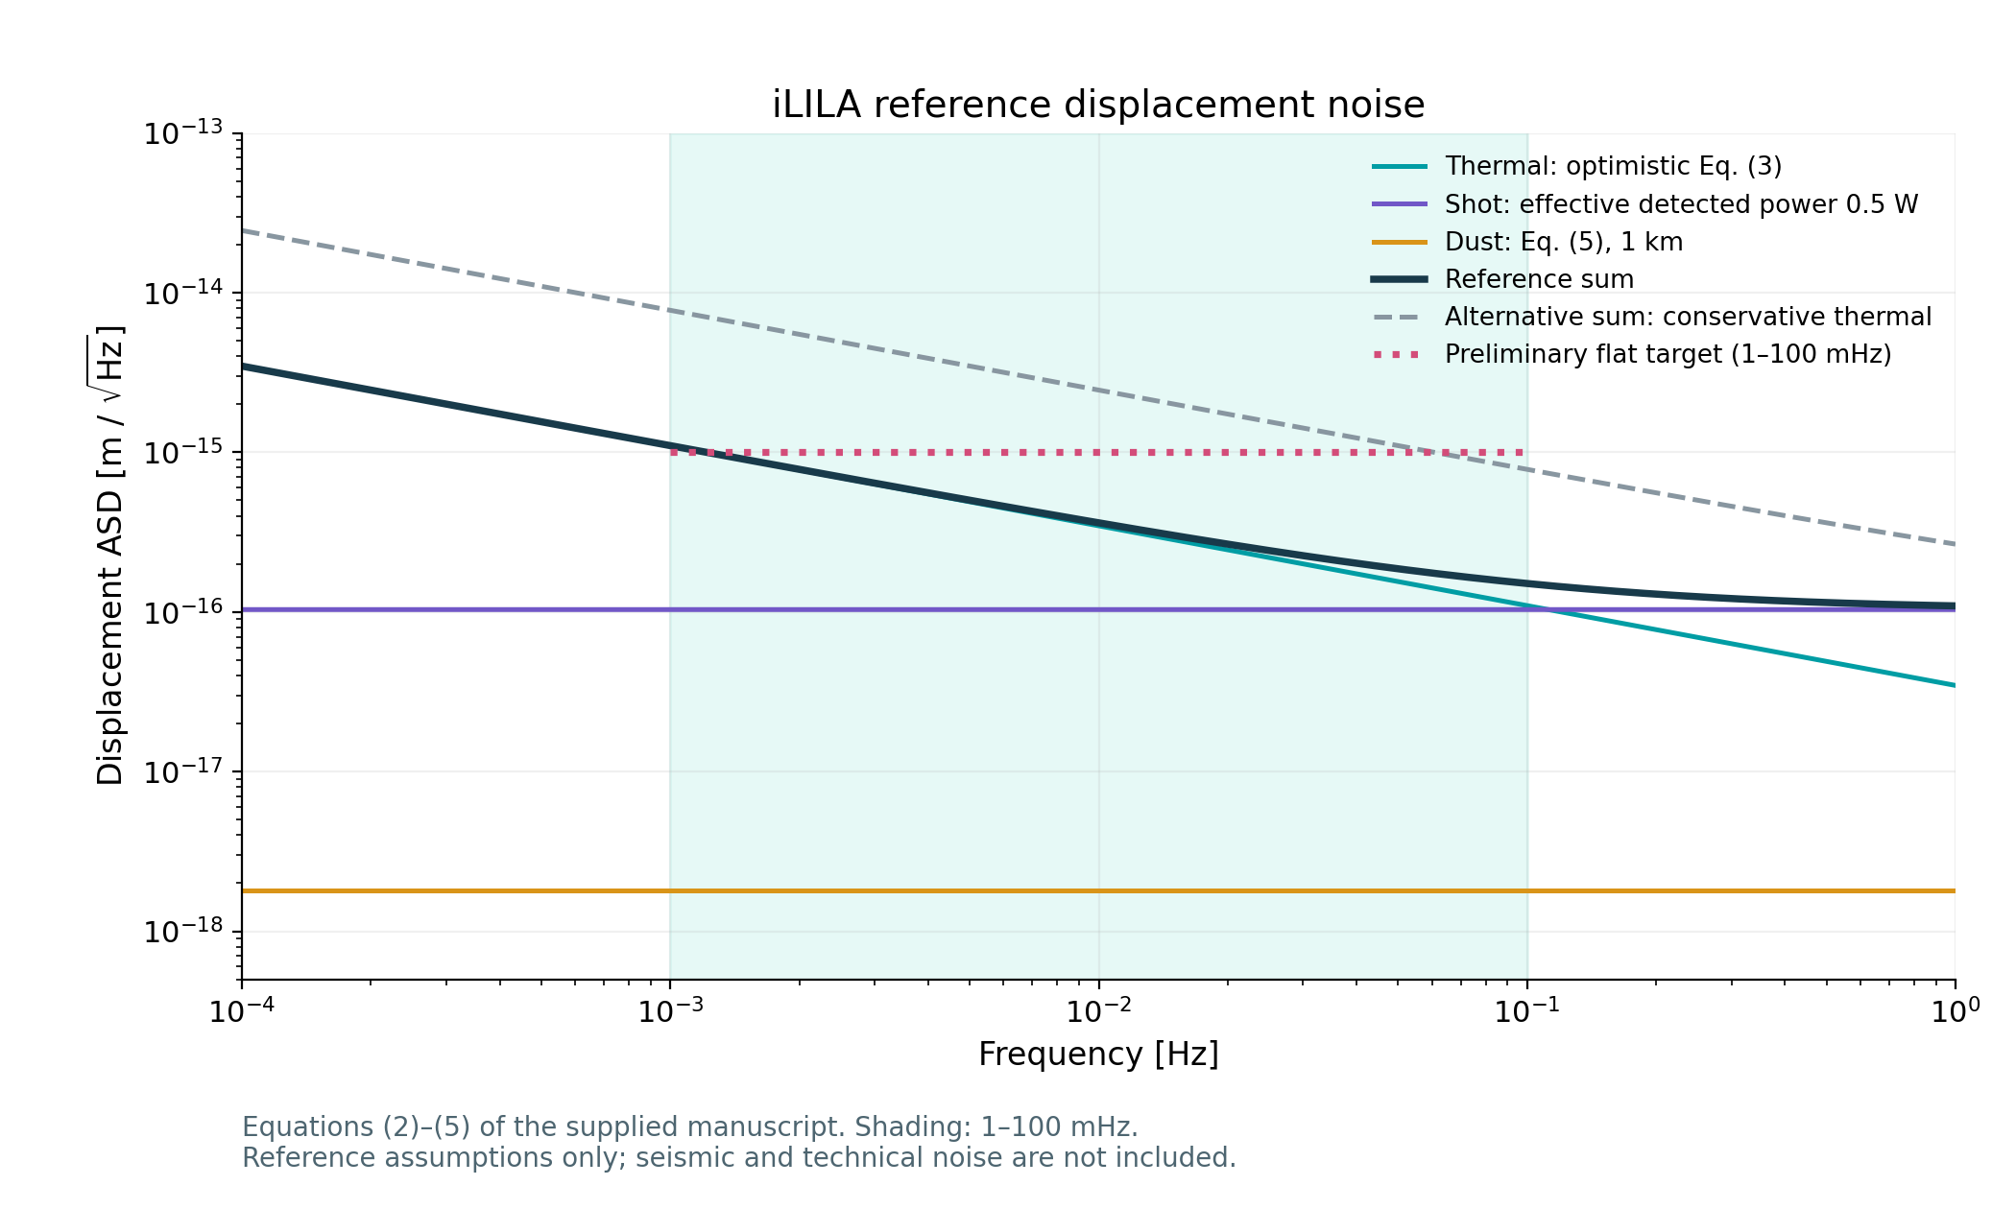
Reference noise near the 1 mHz target
24 September 2026 1 km arms, 1064 nm, 300 K, effective detected power 0.5 W
At 1 mHz
1.10 × 10⁻¹⁵ m/√Hz
Reference sum
Preliminary target
1.00 × 10⁻¹⁵ m/√Hz
Reference ≈10% above
Reference scope
Thermal, shot and dust
Optimistic thermal case
Seismic and technical noise remain unmodeled.
17
Notes:
Calculation dated 24 September 2026. Source: supplied Creighton et al., Fundamental Noise and Gravitational-Wave Sensitivity of the Laser Interferometer Lunar Antenna (LILA), LILAL-noise.pdf, Eqs. (2)–(5). Executed source: iLILA_Reference_Noise_and_Allowance.ipynb. At 0.001 Hz, thermal ASD 1.095445e-15 m/sqrt(Hz), shot ASD 1.0348e-16, dust ASD 1.788854e-18, independent PSD sum ASD 1.100321e-15. The 0.5 W value is effective eta P, an interpretation of the manuscript photodiode power to confirm. The 1e-15 flat target is the preliminary project-plan target, distinct from the paper characteristic-strain curve. This reproduces selected equations, not a validated full noise budget or exact digitized figure match. Confirm the paper displacement coordinate against hardware calibration before assigning requirements. Original scientific plot embedded unchanged. The notebook contains editable calculation and plotting code.

Slide 18
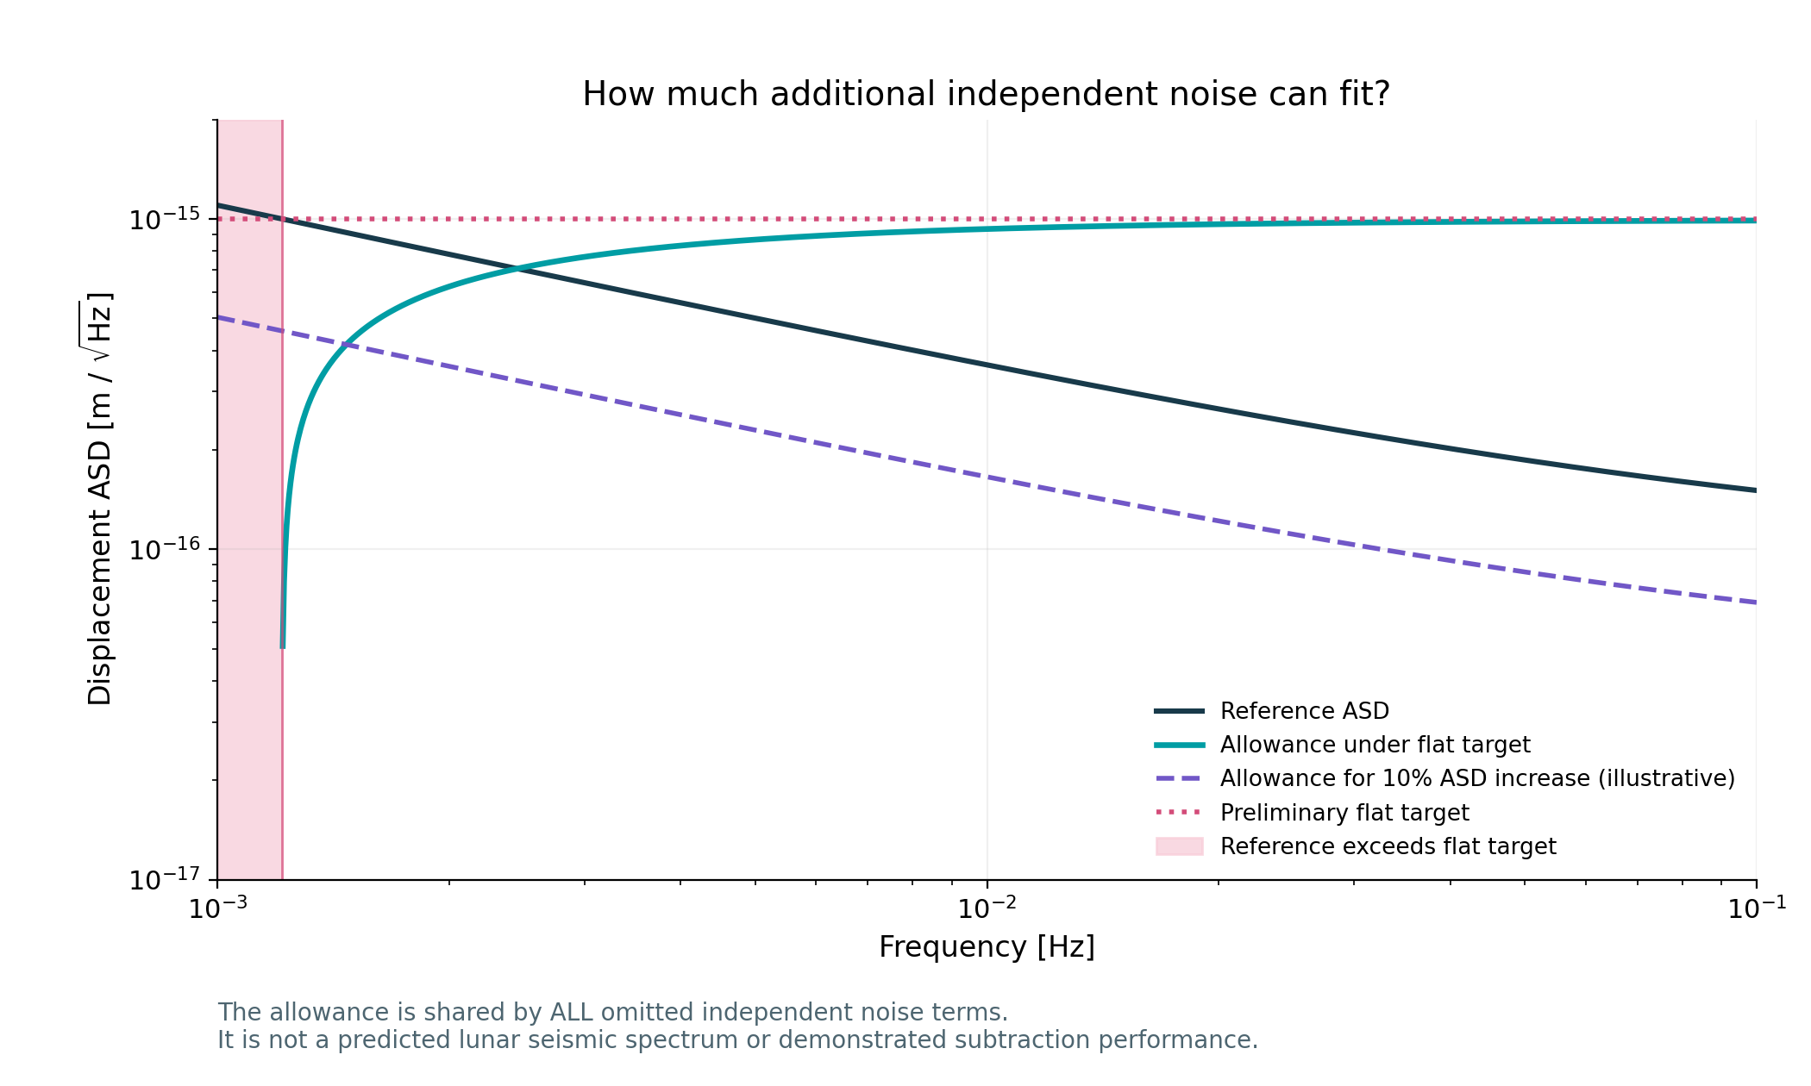
Allowance for additional independent noise
24 September 2026 Remaining PSD = target PSD − reference PSD
Flat target boundary
No positive allowance
below ≈1.213 mHz
Shared allowance
Seismic, laser and all other omitted terms share the remainder.
Illustrative tolerance
10% higher total ASD permits extra ASD of 0.458 × reference.
Next calculation: frequency noise versus arm mismatch.
18
Notes:
Source: supplied LILAL-noise.pdf Eqs. (2)–(5) and executed iLILA_Reference_Noise_and_Allowance.ipynb. For independent terms in a common coordinate, remaining PSD = target ASD squared minus known PSD sum. Negative margins are infeasible, not zero-valued requirements. Optimistic flat-target crossing is 1.212994 mHz for the adopted reference parameters. At 10 mHz, reference ASD 3.6154e-16 and additional ASD ceiling 9.3236e-16 m/sqrt(Hz). At 100 mHz those are 1.5070e-16 and 9.8858e-16 respectively. The purple curve uses an illustrative total ASD multiplier g=1.10, giving sqrt(g^2−1)=0.458258 times the reference ASD for all added independent noise. This tolerance is not an approved requirement or a seismic prediction. Correlated disturbances require cross spectra. Lunar response, science targets and SNR are still needed. Original scientific plot embedded unchanged. Notebook retains editable calculation and plotting code.

Slide 19
iLILA weekly findings
1 October 2026 Kaylah McGowan Analytic calculation review
Reference budget
Laser frequency noise
At 1 mHz, the optimistic reference is 1.10 × 10⁻¹⁵ m/√Hz, about 10% above the preliminary flat target.
Arm mismatch sets the frequency-noise coupling. We calculated conditional ceilings across 1–100 mHz.
Readout alternatives
Current limits
Direct, balanced homodyne and single-tone heterodyne remain open as hypothetical designs.
Finesse validation, detector measurements, lunar response and science SNR remain pending.
The following plots retain separate assumptions for the 1064 nm lunar reference and 1550 nm bench example.
19
Notes:
Source: iLILA_Reference_Noise_and_Allowance.ipynb, version 2, executed on 24 September 2026 and reviewed for the 1 October update. This week reviews the available calculations rather than claiming new measured performance. The flat 1e-15 m/sqrt(Hz) displacement target comes from the preliminary project plan and differs from characteristic strain. All numerical readout comparisons use hypothetical ideal detectors. No seismic suppression or lunar seismic amplitude has been assigned. APRA informs a bench alternative only.

Slide 20
Reference noise near the 1 mHz target
1 October review 1 km, 1064 nm, 300 K, effective detected power ηP = 0.5 W
At 1 mHz
1.10 × 10⁻¹⁵ m/√Hz
Reference sum
Preliminary target
1.00 × 10⁻¹⁵ m/√Hz
Reference ≈10% above
Reference scope
Thermal, shot and dust
Optimistic thermal case
Seismic and technical noise remain unmodeled.
20
Notes:
Source: iLILA_Reference_Noise_and_Allowance.ipynb, version 2, executed on 24 September 2026 and reviewed for the 1 October update. Supplied LILAL-noise.pdf, Eqs. (2)–(5). Optimistic thermal, shot and dust PSDs sum independently. At 1 mHz: thermal 1.095445e-15, shot 1.0348e-16, dust 1.788854e-18, total 1.100321e-15 m/sqrt(Hz). The conservative thermal alternative gives a larger total and is not added to the optimistic case. ηP=0.5 W is the adopted effective-power interpretation of the manuscript, pending convention confirmation. Coordinate and optic multiplicity must be reconciled before hardware requirements. The plotted curve excludes seismic and technical terms.

Slide 21
Allowance for additional independent noise
1 October review Remaining PSD = target PSD − reference PSD
Flat target boundary
No positive allowance
below ≈1.213 mHz
Shared allowance
Seismic, laser and all other omitted terms share the remainder.
Illustrative tolerance
10% higher total ASD permits extra ASD of 0.458 × reference.
All omitted independent terms share this allowance.
21
Notes:
Source: iLILA_Reference_Noise_and_Allowance.ipynb, version 2, executed on 24 September 2026 and reviewed for the 1 October update. For independent terms in the same coordinate, additional PSD equals target ASD squared minus the known PSD sum. Negative margins are infeasible. Crossing of the flat 1e-15 target is 1.212994 mHz. At 10 mHz the reference is 3.6154e-16 and the flat-target extra ASD ceiling is 9.3236e-16 m/sqrt(Hz). A separate illustrative 10% total-ASD tolerance gives sqrt(1.1^2-1)=0.458258 times the reference ASD for all added noise. This envelope is not an approved requirement. Correlated terms require cross spectra.

Slide 22
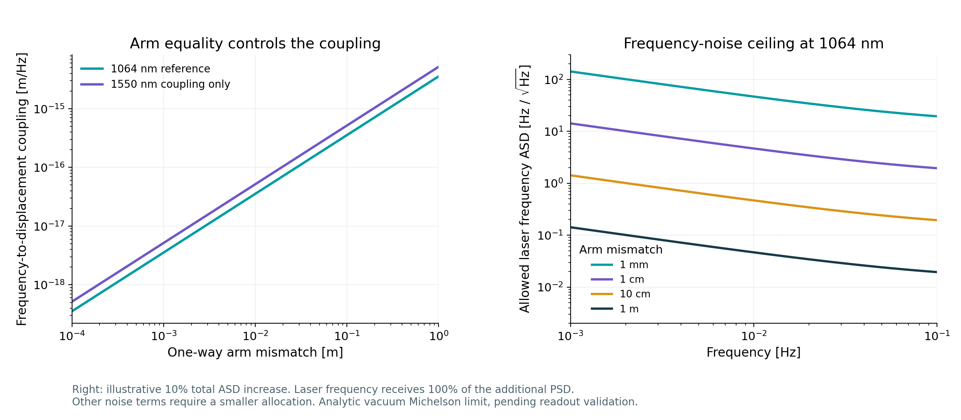
Laser frequency noise and arm mismatch
1 October 2026 Ideal vacuum Michelson Hₓν = ΔL / ν₀
At 10 mHz and 1064 nm: a 1 cm mismatch permits 4.67 Hz/√Hz in the illustrated envelope.
This ceiling assigns all additional PSD to frequency noise. Other terms need a smaller allocation.
22
Notes:
Source: iLILA_Reference_Noise_and_Allowance.ipynb, version 2, executed on 24 September 2026 and reviewed for the 1 October update. Notebook cells 16–20. A_x,nu = abs(ΔL/nu0) A_nu, with x one-way differential displacement and ΔL static one-way arm mismatch. The right plot uses a 10% total-ASD envelope around the reference, not the flat target. At 10 mHz the available extra ASD is 1.6568e-16 m/sqrt(Hz). Assigning 100% to laser noise gives 4.668 Hz/sqrt(Hz) at 1 cm, 0.4668 at 10 cm, and 46.68 at 1 mm. A PSD allocation b scales the frequency ceiling by sqrt(b). The 1550 nm line on the left compares coupling only, not lunar performance. Nonlinear derivative and ratio checks passed. Finesse remains pending. Coupling reference: Chia and Vajente, LIGO-T1400509-v1, Eq. (1), https://dcc.ligo.org/public/0115/T1400509/001/Optimization%20of%20Michelson%20Interferometer%20Signals%20in%20Crackle%20Noise%20Detection.pdf .

Slide 23
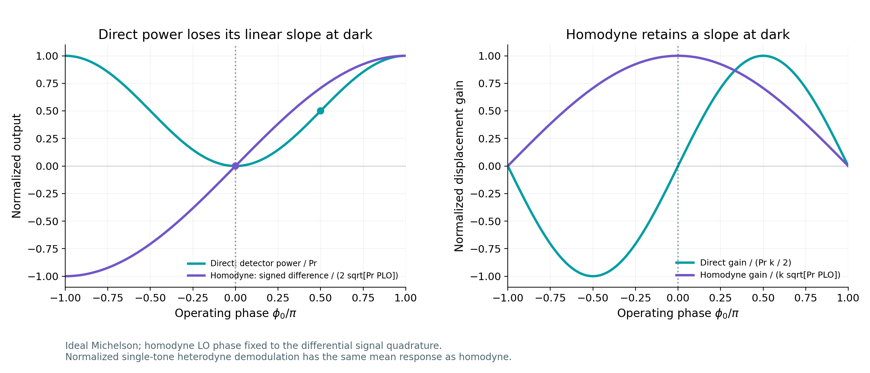
Readout response near the dark fringe
1 October 2026 Direct intensity and balanced homodyne Ideal optical response
Direct intensity has zero linear gain at exact dark. Homodyne retains a calibrated slope.
All three ideal readouts keep the same laser-frequency coupling for a given arm mismatch.
23
Notes:
Source: iLILA_Reference_Noise_and_Allowance.ipynb, version 2, executed on 24 September 2026 and reviewed for the 1 October update. Notebook cells 22–28. APRA source: apra_Interferometer - V1.pdf, p.3 layout, p.6 collimator, p.8 isolator and p.9 APD410C. The drawing shows one detector and no separate LO or demodulation chain. Inference: direct intensity is the closest match to the supplied drawing. It does not confirm the operating point. P_D=Pr sin²(phi/2), phi=4pi x/lambda. A balanced homodyne uses a phase-aligned LO and the difference of two detector powers, D_H=2 sqrt(Pr P_LO) sin(phi/2). The displayed curves hold common optical phase fixed. The specified single-tone heterodyne after calibrated real-quadrature demodulation has the same mean signal response. Centered nonlinear differences and RF demodulation checks passed. LO/reference noise, imperfect visibility, controls and electronics are absent. Finesse validation remains pending. Finesse BHD description: https://finesse.ifosim.org/docs/latest/api/finesse.detectors.bhd_detector.html .

Slide 24
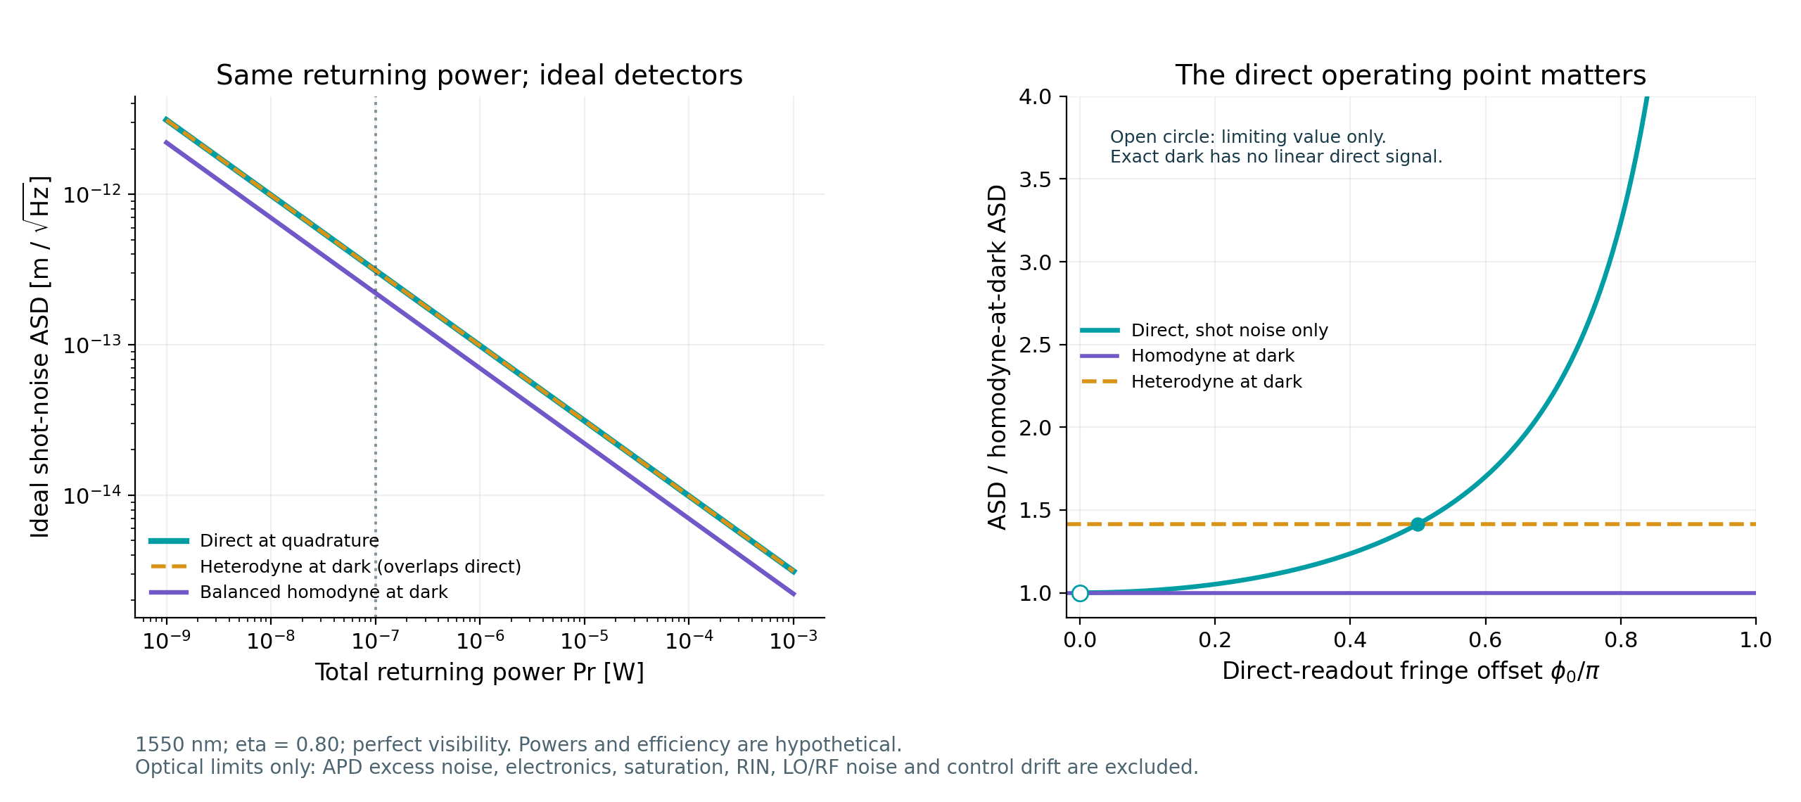
Ideal shot noise depends on the readout
1 October 2026 1550 nm Hypothetical η = 0.80 Equal returning power
At 100 nW: direct quadrature and single-tone heterodyne give 3.12 × 10⁻¹³ m/√Hz.
Balanced homodyne at dark gives 2.21 × 10⁻¹³ m/√Hz. Actual APD noise remains unknown.
24
Notes:
Source: iLILA_Reference_Noise_and_Allowance.ipynb, version 2, executed on 24 September 2026 and reviewed for the 1 October update. Notebook cells 22–31. Pr is total returned power available across both ideal Michelson outputs before quantum efficiency, not launch power or the power on one direct photodiode. The numerical example has Pr=100 nW, eta=0.8, lambda=1550 nm, and additional homodyne LO power 100 nW. Ideal unity-gain detectors, perfect visibility, no squeezing. Single-port direct at quadrature gives 2 sqrt(h nu/(eta Pr))/k, homodyne at dark gives sqrt(2) sqrt(h nu/(eta Pr))/k, k=4pi/lambda. The selected single-tone real-quadrature heterodyne doubles noise PSD relative to homodyne. Its sqrt(2) ASD penalty is topology-specific. Balanced homodyne is about 29% lower in ASD than this direct quadrature case, not universally better than all direct schemes. The direct shot-only limit approaching dark equals the ideal homodyne limit, but exact dark has zero direct linear gain. Actual APD multiplication excess noise, dark/electronic noise, saturation, RIN, LO/RF noise and drift are excluded. Power sweeps are not approved APD operating ranges. Do not add this hypothetical shot noise to the existing reference shot term or mix the 1550 nm bench comparison into the lunar reference without reconciling conventions.

Slide 25
Next calculations and missing inputs
1 October 2026 Kaylah McGowan Analytic calculation review
Optical validation
Detector and laser inputs
Run direct and homodyne cases in Finesse. Compare displacement and laser-frequency gains with the analytic benchmarks.
Confirm returned power, visibility and APD gain. Obtain detector noise and laser-frequency spectra for the relevant bands.
Seismic coupling
Lunar response and SNR
Specify ground-motion spectra, station coherence and support response. Retain cross spectra where motion is correlated.
Obtain the numerical mode table and response convention. Then evaluate explicit source, distance and observation-time cases.
Both readout branches remain open. Current results establish conditional limits rather than achievable instrument sensitivity.
25
Notes:
Source: iLILA_Reference_Noise_and_Allowance.ipynb, version 2, executed on 24 September 2026 and reviewed for the 1 October update. These are proposed next tasks, not claimed completions. No owners or dates have been assigned. Analytic seismic geometry checks only: c=(1,-1,-1,1), Sx=c Su c-dagger. Equal uncorrelated coordinates give 4 Su while common rigid translation cancels. Neither a lunar input amplitude nor subtraction factor has been assigned. Need frequency/Q data, complex mode sum, geometry and GW response conventions to convert displacement into strain, then an explicit source and observation setup for SNR. When replacing reference readout terms, avoid double counting shot noise.

