Slide 1
Student Placement Prediction
Kayla Tucker

Slide 2
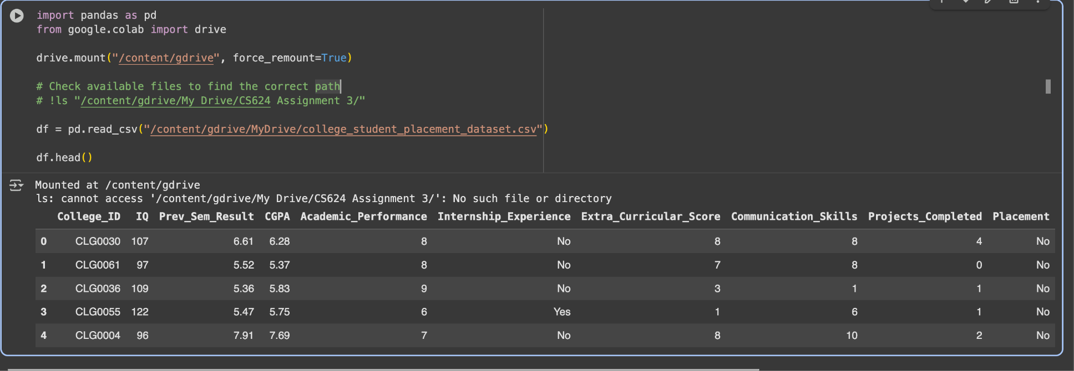
Data Loading
Used College Student Placement Factors Dataset from Kaggle.
Loaded dataset consists of 10,000 student records.
File opened smoothly and fits entirely in memory.
No sampling or partitioning was necessary.
Simple to explore and visualize the full dataset all at once.

Slide 3
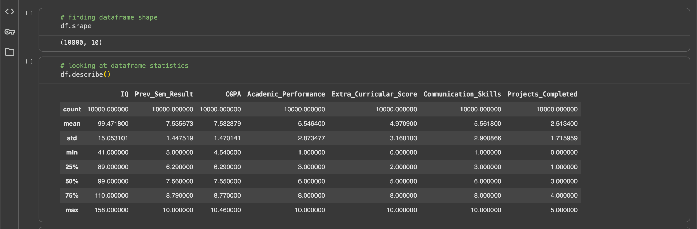
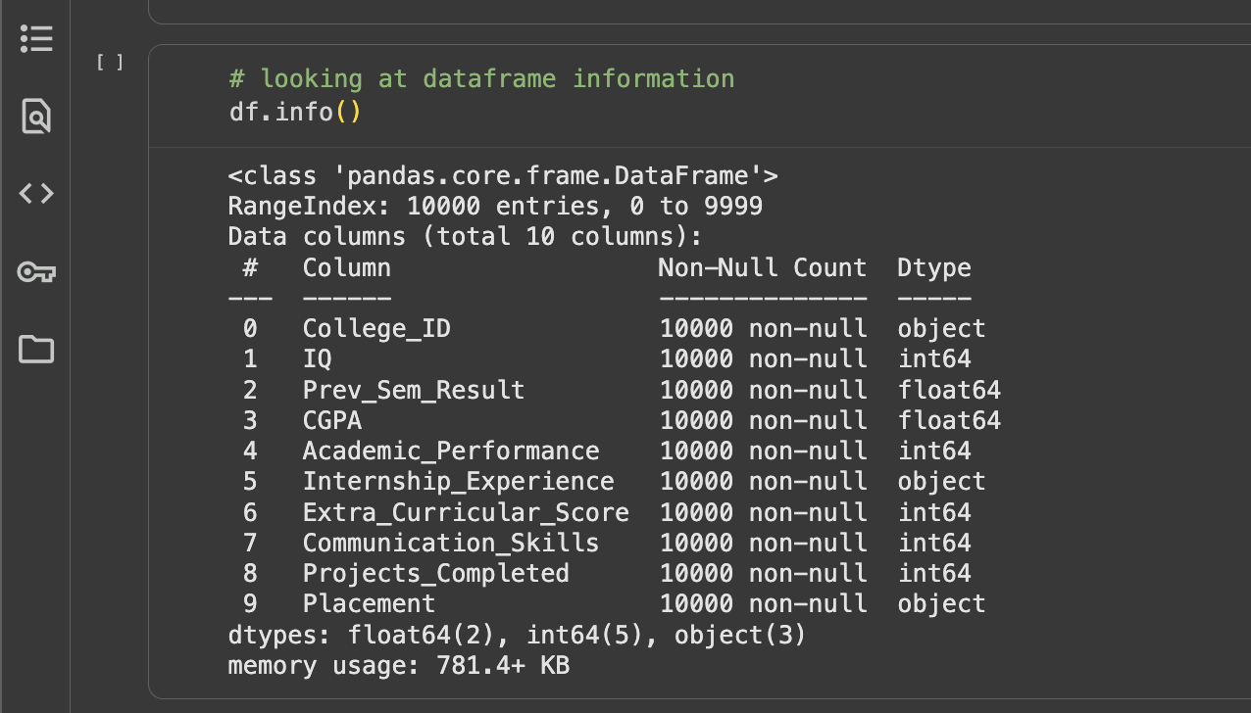
Initial Data Analysis
Dataset is tabular and multivariate.
Columns include both numerical and categorical student academic and placement data.
No null or missing values; data types consistent.
Identified class imbalance: 83% not placed, 17% placed.

Slide 4
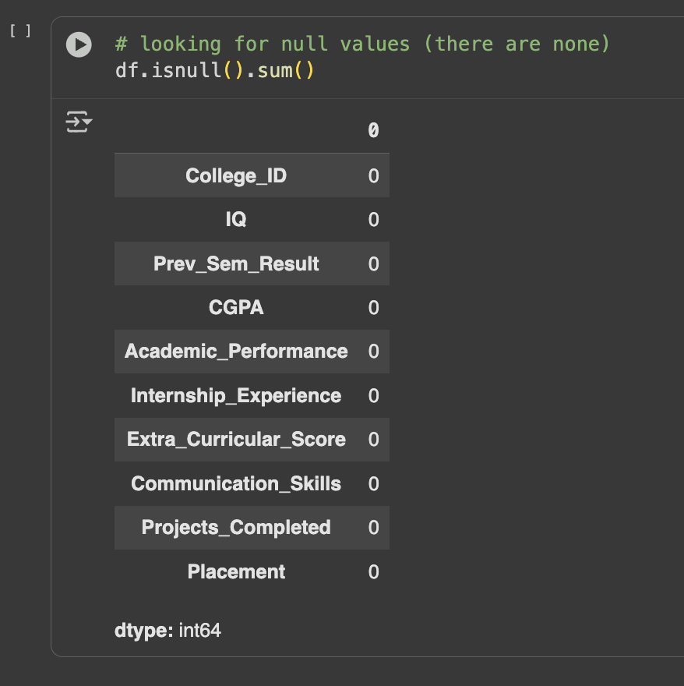
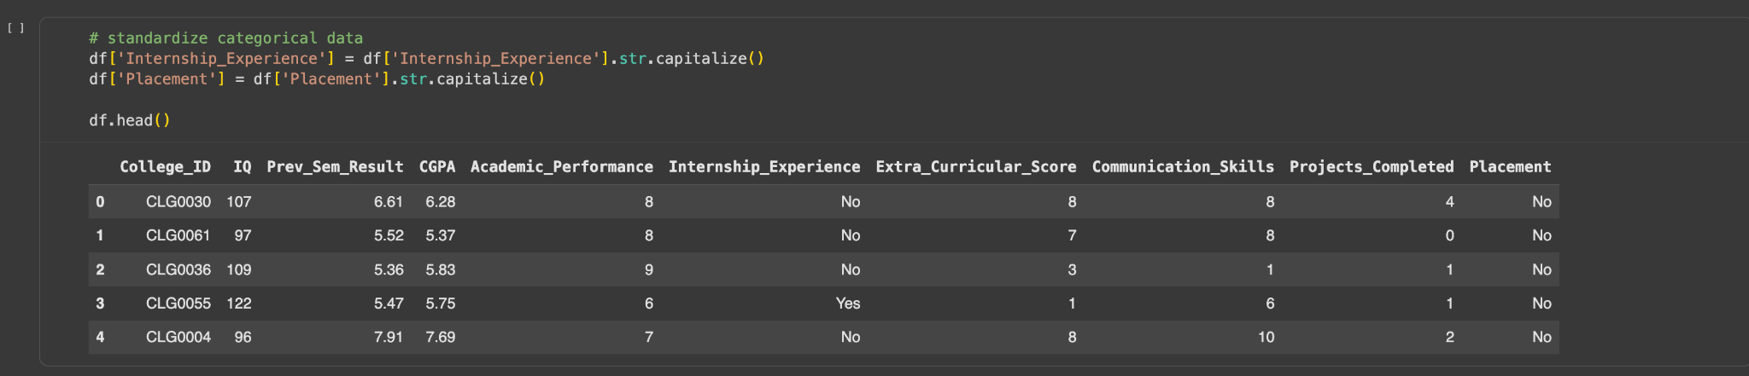
Data Cleaning
Standardized categorical values (e.g., Yes/No capitalization).
Verified no missing, duplicate, or inconsistent data.
Outlier check with boxplots showed all numeric columns were within normal ranges.
No removal or changes required.

Slide 5
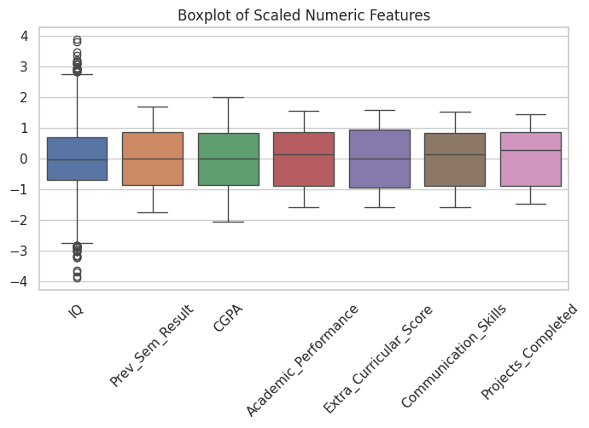
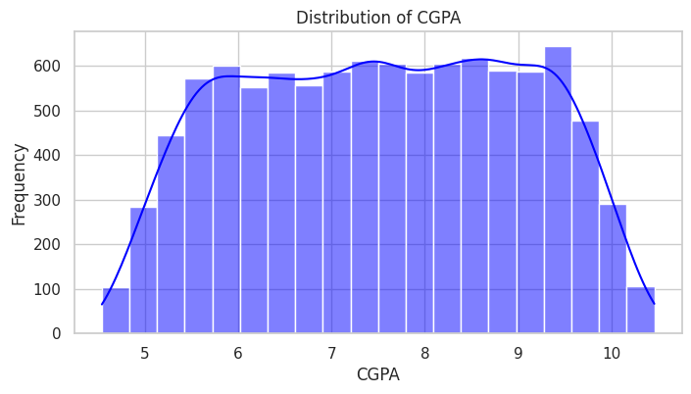
Data Visualizations - Distribution & Boxplot

Slide 6
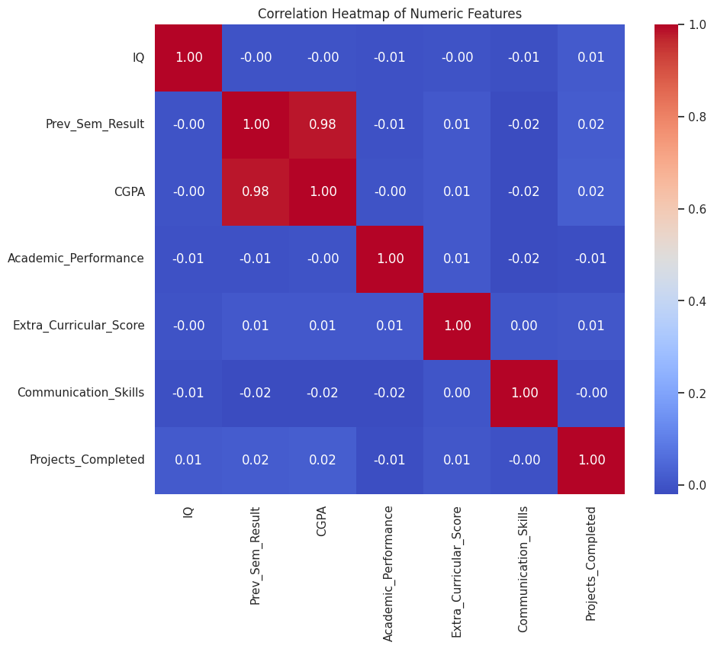
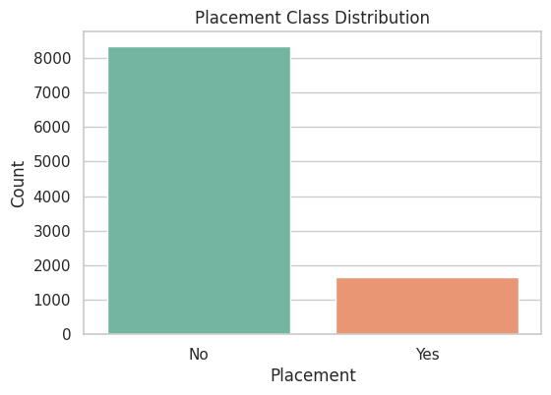
Data Visualizations - Correlation Heatmap & Count plot

Slide 7
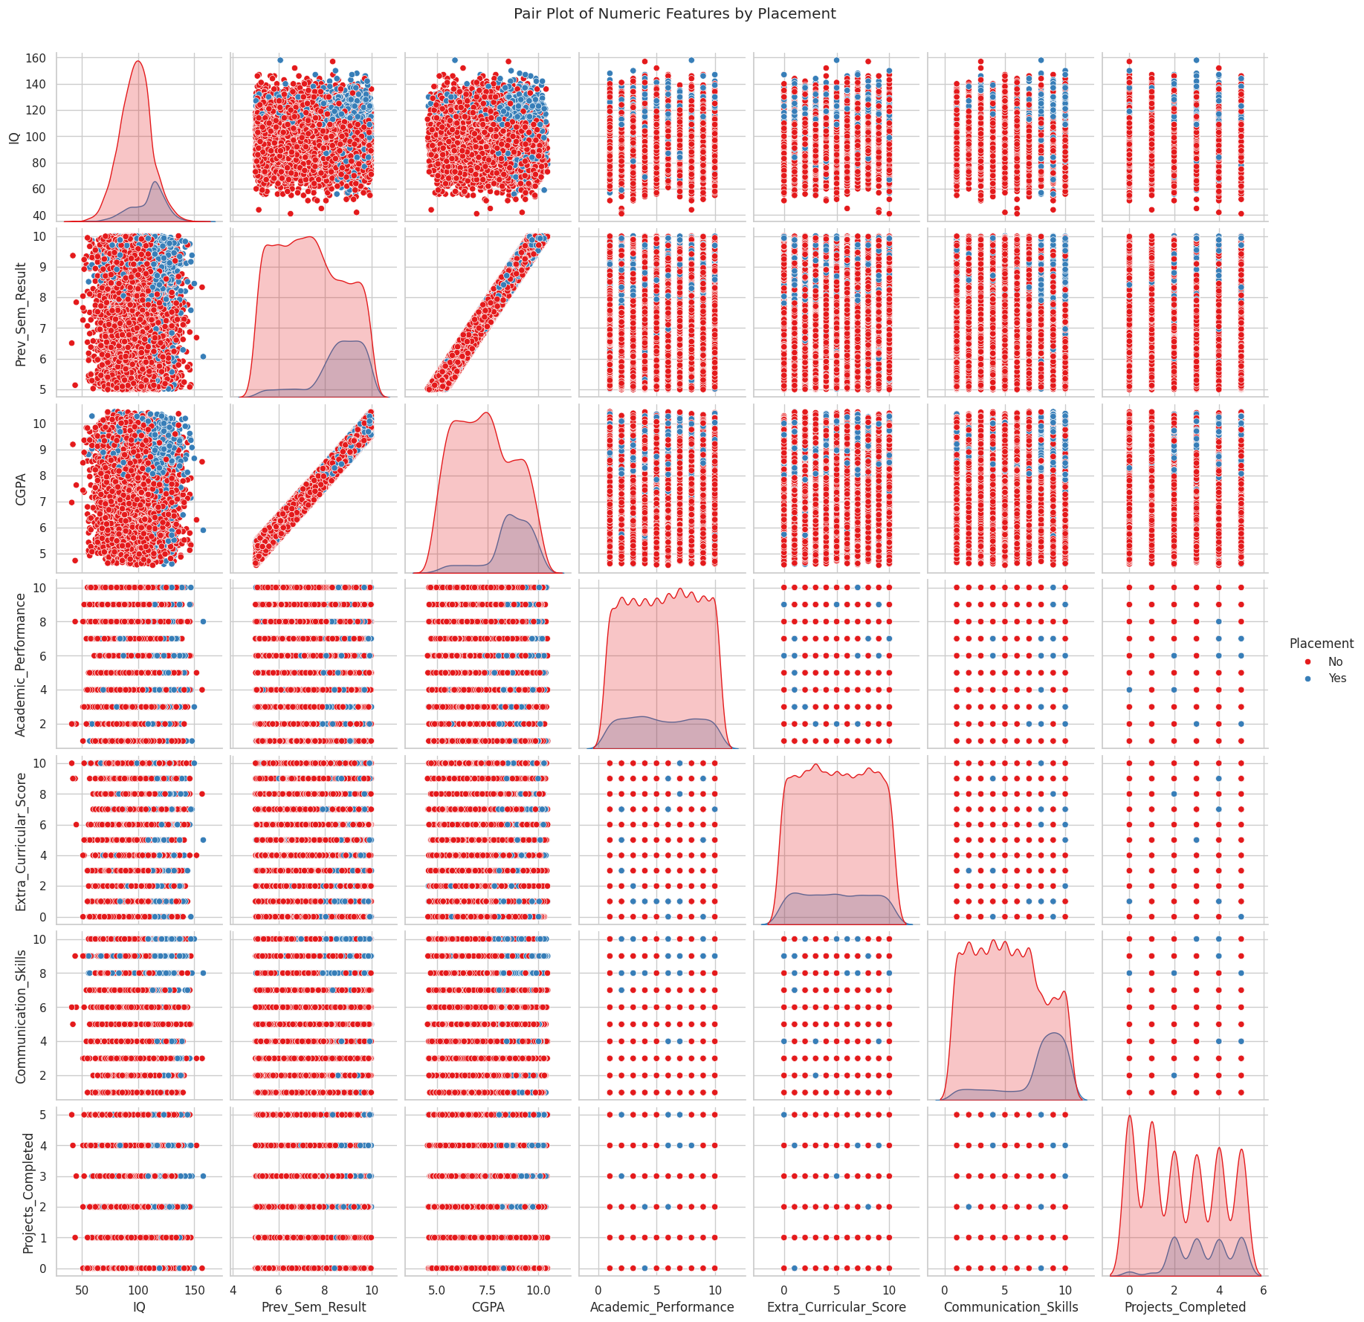
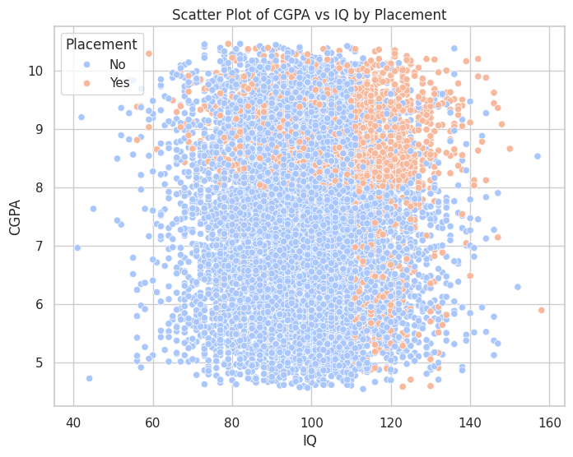
Data Visualizations - Scatterplot & Pair plot

Slide 8
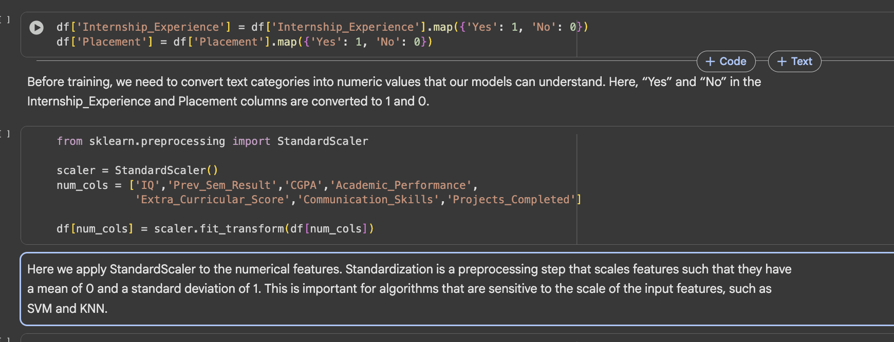
Feature Engineering
Categorical variables converted to binary encoding (Yes=1, No=0).
All numeric features standardized (mean ≈ 0, std ≈ 1) for model compatibility.
No feature selection or PCA needed due to manageable feature count.
Preprocessing visually confirmed with plots and summary stats.

Slide 9
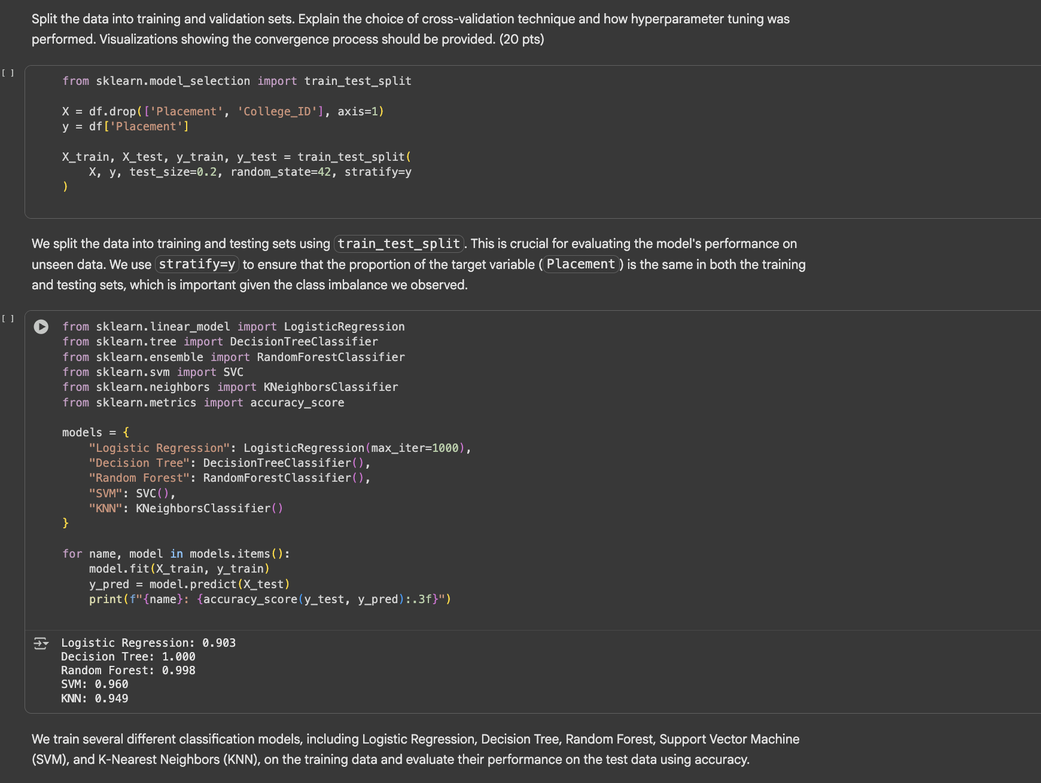
Training
Stratified split: 80% training, 20% testing.
Multiple models tested; Random Forest and SVM tuned further.
Used 5-fold stratified cross-validation and GridSearchCV for tuning.
Best performing model: Random Forest (accuracy ≈ 0.9998); SVM tuned to ≈ 0.966.
Plotted validation curves and grid search results for convergence evidence.

Slide 10
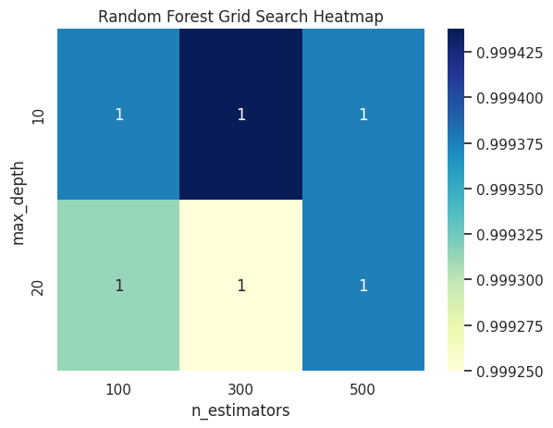
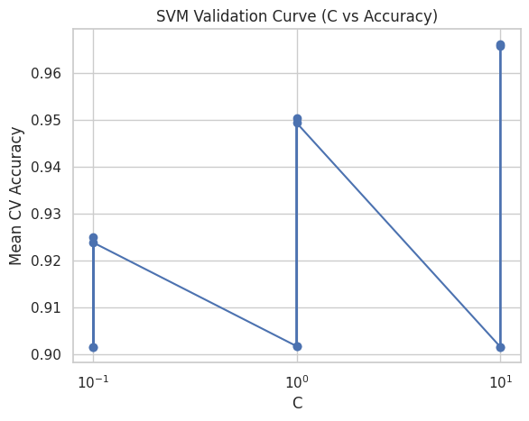
SVM Validation Curve & Random Forest Grid Search Heatmap

Slide 11
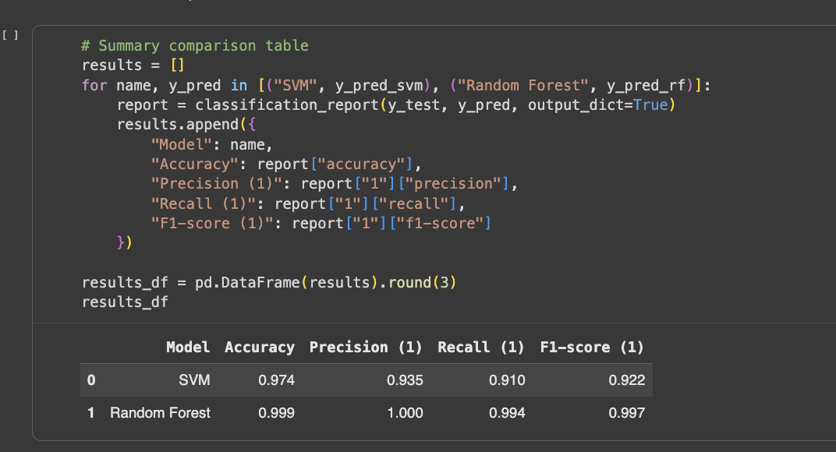
Performance Evaluation
Evaluation metrics: accuracy, precision, recall, F1-score.
SVM: 97.4% accuracy, 0.935 precision, 0.910 recall (Placed).
Random Forest: ≈100% accuracy, 1.000 precision, 0.997 recall, F1=0.998.
Confusion matrices confirm Random Forest’s reliable performance.
Random Forest consistently outperformed SVM across all metrics.

Slide 12
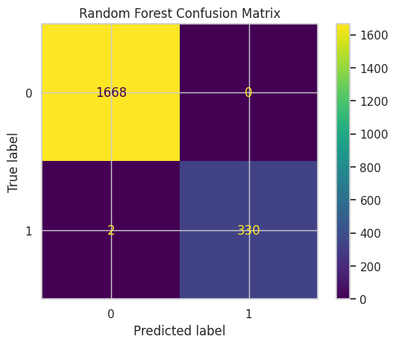
SVM Confusion Matrix

Slide 13
Conclusion
Random Forest achieved the strongest results due to effective ensemble learning and capturing complex relationships.
Main predictors: CGPA, previous semester result, and communication skills.
SVM occasionally underperforms in recall.
Limitation: Class imbalance and metric redundancy may inflate scores.
Future work: Test gradient boosting, class rebalancing, validation on new data for robustness.

