Slide 1
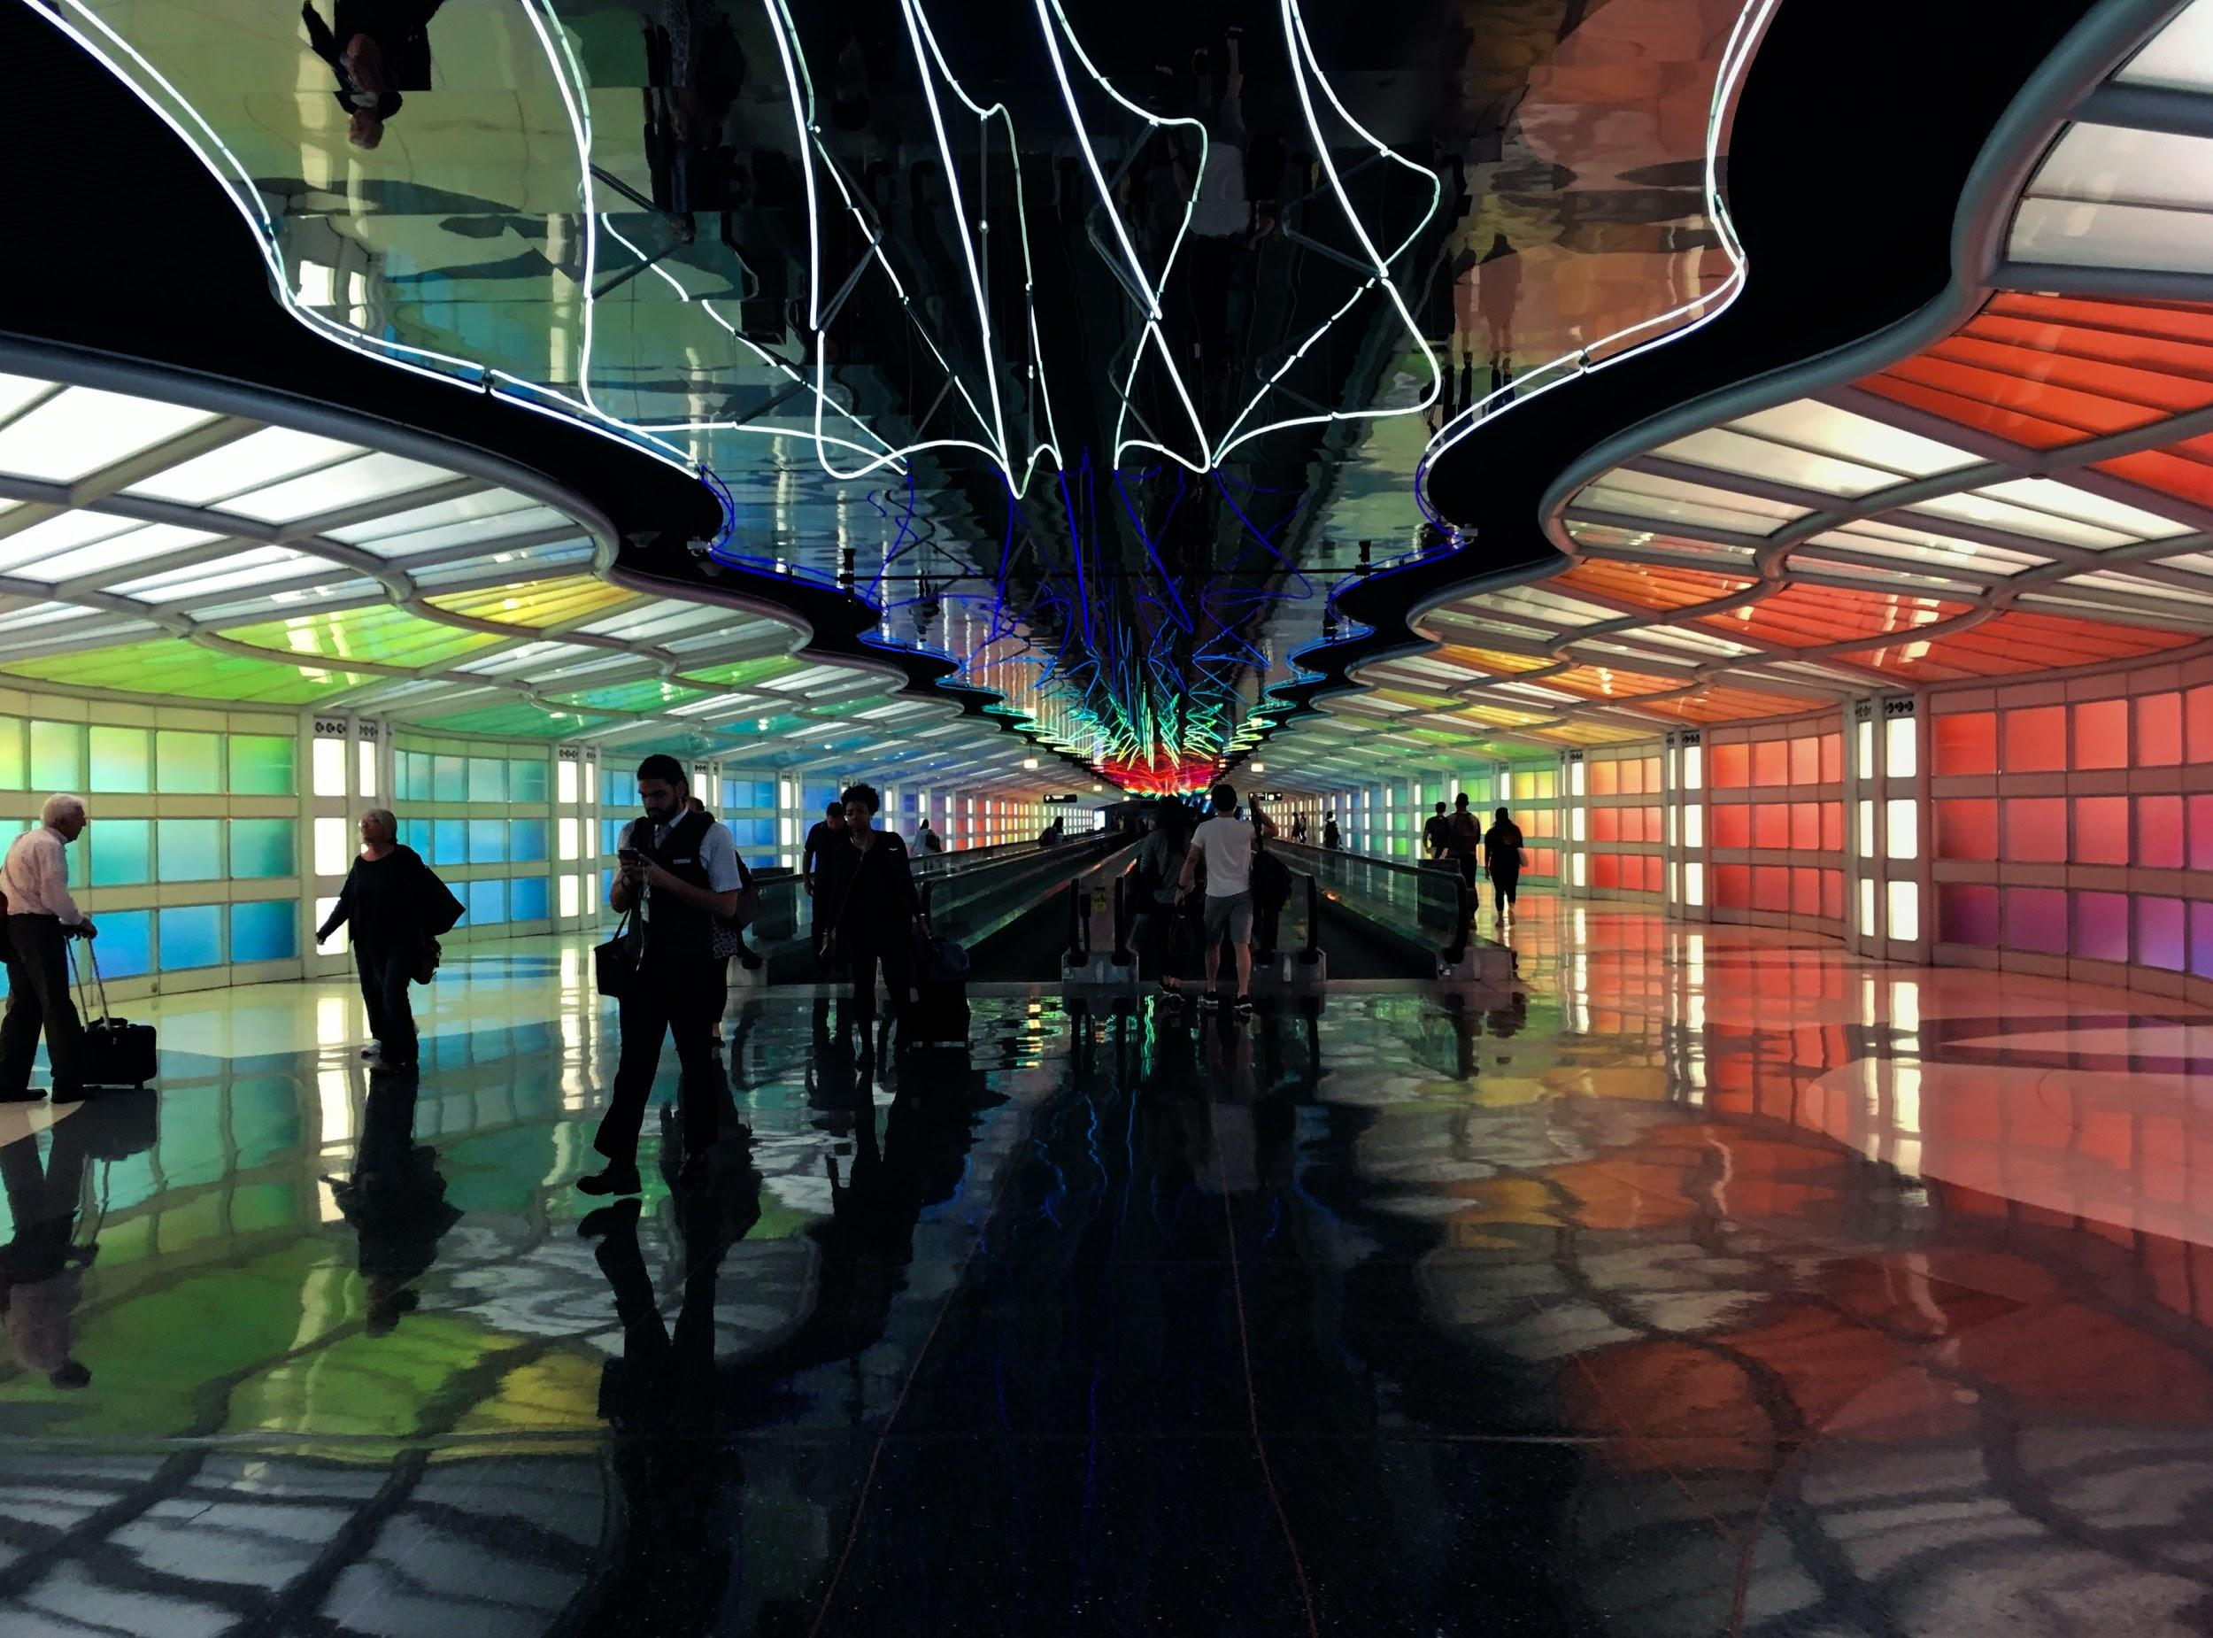
Predicting Delays at ORD
Junette Lee, Kayla Macaione, and Alli Patnoe

Slide 2
The (Obvious) Problem
...you get to O’Hare according to your own standards of what’s ‘on time’ for a flight, you’re going through the tunnel to Terminal C, and you walk briskly to your gate, only to see the red notification of ‘delayed’ on the flight board...
We set out to predict flight delays using machine learning — scikit-learn — to better inform travel choices
Notes:
Kayla

Slide 3
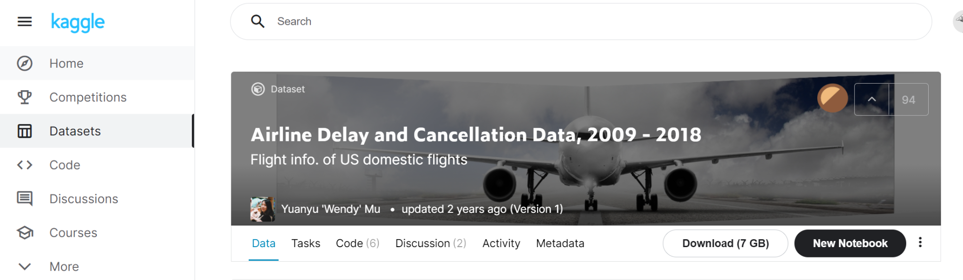
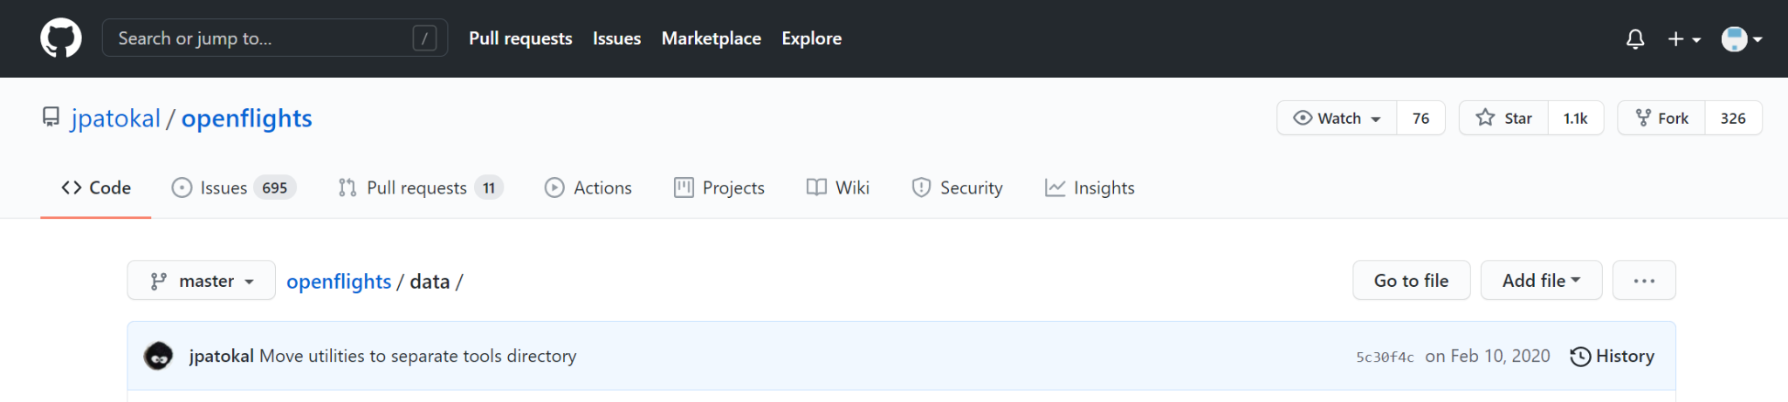
Our Data
FL_DATE
OP_CARRIER
OP_CARRIER_FL_NUM
ORIGIN
DEST
CRS_DEP_TIME
DEP_TIME
DEP_DELAY
TAXI_OUT
WHEELS_OFF
WHEELS_ON
TAXI_IN
CRS_ARR_TIME
ARR_TIME
ARR_DELAY
CANCELLED
CANCELLATION_CODE
DIVERTED
CRS_ELAPSED_TIME
ACTUAL_ELAPSED_TIME
AIR_TIME
DISTANCE
CARRIER_DELAY
WEATHER_DELAY
NAS_DELAY
SECURITY_DELAY
LATE_AIRCRAFT_DELAY
country_code
airport_name
airport_code4
airport_code3
longitude
latitude
We used CSV files from Kaggle with airline delay and cancellation data for 2009-2018, along with airport codes and geographic data from GitHub
Notes:
Alli

Slide 4
Preparation
Merging datasets and narrowing scope | Delayed criteria | Reducing model input to 5 attributes | Creating input file to populate the app
ORD only 2017-2018 Domestic only | Flight > 0 minutes late = Delayed Flight < 0 minutes late = Not Delayed | Date, Departure time, Distance, and Destination latitude/longitude | File with airport attributes to populate the app
+2,000,000 rows
26 columns
+550,000 rows
5 columns
+161 rows
5 columns
Notes:
Alli

Slide 5
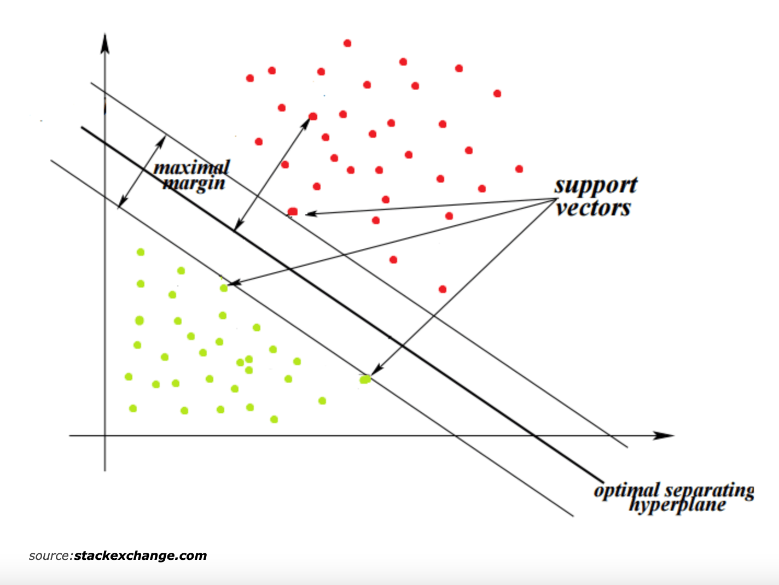
Our Machine Learning Model
We leveraged a scikit-learn Linear SVC (Support Vector Classifier) model to fit to and train our data with target outputs of ‘Delayed’ and ‘Not Delayed’
Based on 1,000 examples to train the model, achieved ~65% test accuracy
Increasing inputs to 10,000 and up didn’t increase accuracy
Notes:
Why did we choose?
Binary output
The objective of a Linear SVC (Support Vector Classifier) is to fit to the data provided, returning a "best fit" hyperplane that divides or categorizes your data. From there, after getting the hyperplane, you can feed features to your classifier to see what the "predicted" class is.

Slide 6






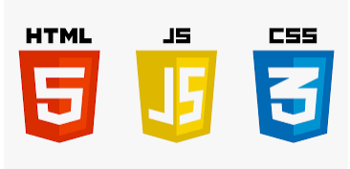

Our Application
Used to provide live predictions
Notes:
Junette
dataset from kaggle
google colab = collaborate on ETL, initial load of on cloud
Picking is a way to Pickling is a way to convert a python object (list, dict, etc.) into a character stream - used to serialize our model so we can pass user input
The pickle module implements binary protocols for serializing and de-serializing a Python object structure.
“Pickling” is the process whereby a Python object hierarchy is converted into a byte stream, and “unpickling” is the inverse operation, whereby a byte stream (from a binary file or bytes-like object) is converted back into an object hierarchy.
Pickling (and unpickling) is alternatively known as “serialization”, “marshalling,” 1 or “flattening”

Slide 7
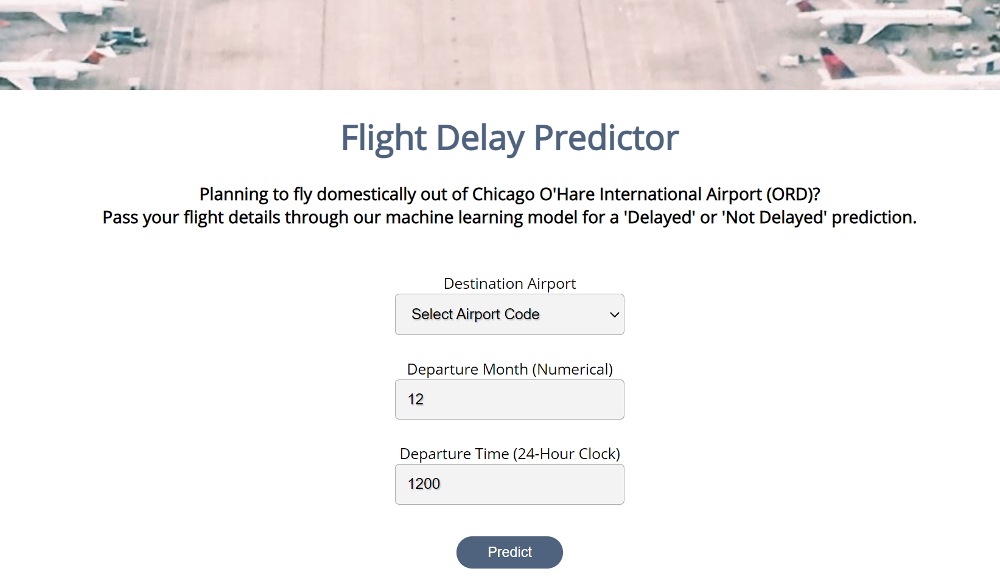
Our Application
Notes:
Junette

Slide 8
Future State
Connecting historical real weather data and adding expected weather outcomes
Adding more components of a delay — arrival delays, type of delay, and cancellation
Beyond O’Hare and domestic travel
Improving overall accuracy
Notes:
Everyone
Alli (weather), Kayla (more components), and then Junette (remaining)
considering unknown nature of flight delays, we accepted 65% as reasonable accuracy

