Slide 1
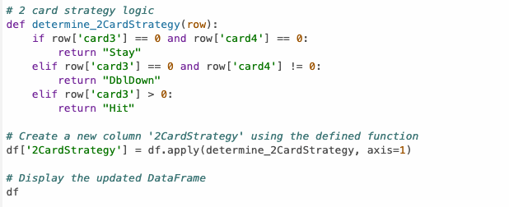
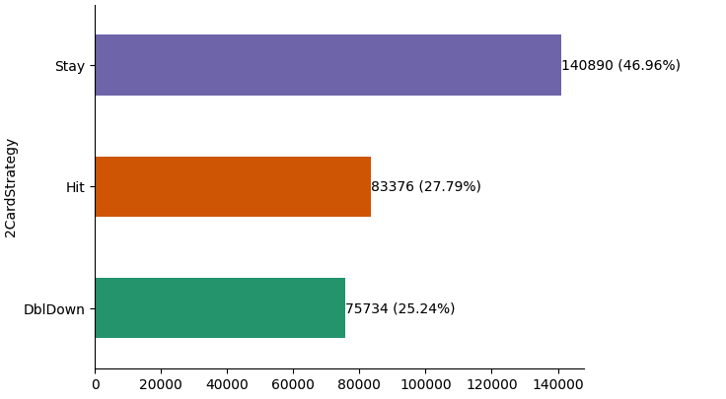

Should I Hit or Should I Stay?
Google Collab Ipython Notebook to create new calculations leveraging the original data set. Calculations included the logic that players used depending on the sum of their cards and the number of hits they requested.
Import dependencies such as
import pandas as pd
import tensorflow as tf
From matplotlib import pyplot as plt
Import seaborn as sns

