Slide 1
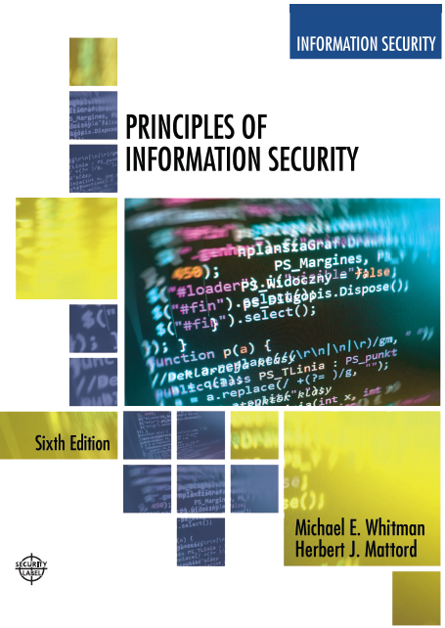

Principles of Information Security
Sixth Edition
Chapter 6
Security Technology: Access Controls, Firewalls and VPNs
Copyright © 2018 Cengage. May not be copied, scanned, or duplicated, in whole or in part, except for use as permitted in a license distributed with a certain product or service or otherwise on a password-protected website for classroom use.

Slide 2
Learning Objectives (1 of 2)
Upon completion of this material, you should be able to:
Discuss the role of access control in information systems, and identify and discuss the four fundamental functions of access control systems
Define authentication and explain the three commonly used authentication factors
Describe firewall technologies and the various categories of firewalls
Notes:
Learning Objectives
Upon completion of this material, you should be able to:
Discuss the important role of access control in computer-based information systems, and identify and discuss widely-used authentication factors
Describe firewall technology and the various approaches to firewall implementation
Identify the various approaches to control remote and dial-up access by authenticating and authorizing users

Slide 3
Learning Objectives (2 of 2)
Discuss the various approaches to firewall implementation
Identify the various approaches to control remote and dial-up access by authenticating and authorizing users
Describe virtual private networks (VPNs) and discuss the technology that enables them

Slide 4
Introduction
Technical controls are essential in enforcing policy for many IT functions that are not under direct human control.
Technical control solutions, when properly implemented, improve an organization’s ability to balance the objectives of making information readily available and preserving the information’s confidentiality and integrity.
Notes:
Introduction
Technical controls are essential in enforcing policy for many IT functions not under direct human control
When properly implemented, technical control solutions improve an organization’s ability to balance objectives of making information readily available and preserving information’s confidentiality and integrity

Slide 5
Access Control (1 of 2)
Access control: A selective method by which systems specify who may use a particular resource and how they may use it.
Mandatory access controls (MACs): A required, structured data classification scheme that rates each collection of information as well as each user.
Discretionary access controls (DACs): Access controls that are implemented at the discretion or option of the data user.
Nondiscretionary controls: Access controls that are implemented by a central authority.
Notes:
Access Control
Access control: method by which systems determine whether and how to admit a user into a trusted area of the organization
Mandatory access controls (MACs): use data classification schemes
Discretionary access controls (DACs): allows users to control and possibly provide access to information/resources at their disposal
Nondiscretionary controls: strictly-enforced version of MACs that are managed by a central authority

Slide 6
Access Controls (2 of 2)
In general, all access control approaches rely on the following four mechanisms, which represent the four fundamental functions of access control systems:
Identification: I am a user of the system.
Authentication: I can prove I’m a user of the system.
Authorization: Here’s what I can do with the system.
Accountability: You can track and monitor my use of the system.

Slide 7
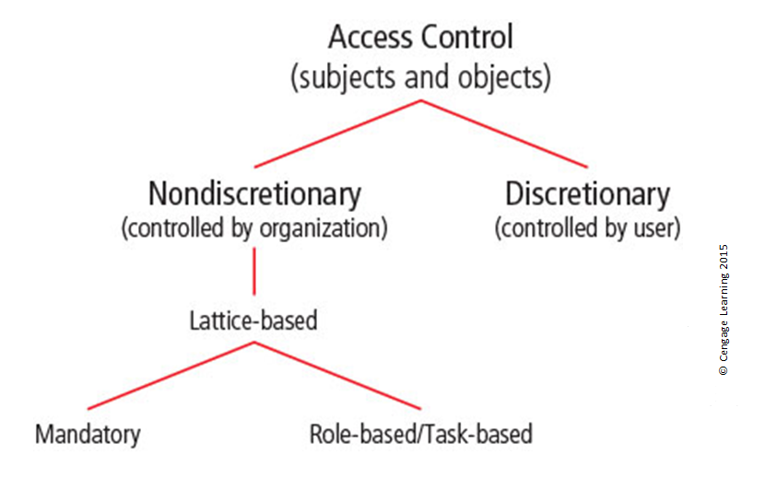
Figure 6-1 Access control approaches

Slide 8
Identification
Identification: The access control mechanism that requires the validation and verification of an unauthenticated entity’s purported identity.
Identifiers can be composite identifiers, concatenating elements—department codes, random numbers, or special characters—to make them unique.
Most organizations use a single piece of unique information, such as a complete name or the user’s first initial and surname.
Notes:
Identification
Identification: mechanism whereby unverified entities seeking access to a resource (supplicants) provide a label by which they are known to the system
Identifiers can be composite identifiers, concatenating elements -department codes, random numbers, or special characters- to make them unique
Some organizations generate random numbers

Slide 9
Authentication (1 of 2)
Authentication: The access control mechanism that requires the validation and verification of an unauthenticated entity’s purported identity.
Authentication factors
Something you know
Password: a private word or a combination of characters that only the user should know
Passphrase: a series of characters, typically longer than a password, from which a virtual password is derived
Notes:
Authentication
Authentication: the process of validating a supplicant’s purported identity
Authentication factors
Something a supplicant knows
Password: a private word or combination of characters that only the user should know
Passphrase: a series of characters, typically longer than a password, from which a virtual password is derived

Slide 10
Authentication (2 of 2)
Something you have
Dumb card: ID or ATM card with magnetic stripe
Smart card: contains a computer chip that can verify and validate information
Synchronous tokens
Asynchronous tokens
Something you are
Relies upon individual characteristics
Strong authentication
Notes:
Authentication
Authentication factors (cont’d.)
Something a supplicant has
Dumb card: ID or ATM card with magnetic stripe
Smart card: contains a computer chip that can verify and validate information
Synchronous tokens
Asynchronous tokens
Something a supplicant is
Relies upon individual characteristics
Strong authentication

Slide 11
Authorization
Authorization: The access control mechanism that represents the matching of an authenticated entity to a list of information assets and corresponding access levels.
Authorization can be handled in one of three ways:
Authorization for each authenticated user
Authorization for members of a group
Authorization across multiple systems
Authorization credentials, also called authorization tickets, are issued by an authenticator and are honored by many or all systems within the authentication domain.
Notes:
Authorization
Authorization: the matching of an authenticated entity to a list of information assets and corresponding access levels
Authorization can be handled in one of three ways
Authorization for each authenticated user
Authorization for members of a group
Authorization across multiple systems
Authorization tickets

Slide 12
Accountability
Accountability: The access control mechanism that ensures all actions on a system—authorized or unauthorized—can be attributed to an authenticated identity. Also known as auditability.
Accountability is most often accomplished by means of system logs and database journals, and the auditing of these records.
Systems logs record specific information.
Logs have many uses.
Notes:
Accountability
Accountability (auditability): ensures that all actions on a system—authorized or unauthorized—can be attributed to an authenticated identity
Most often accomplished by means of system logs and database journals, and the auditing of these records
Systems logs record specific information
Logs have many uses

Slide 13
Biometrics
Approach based on the use of measurable human characteristics/traits to authenticate identity.
Only fingerprints, retina of eye, and iris of eye and DNA are considered truly unique.
Evaluated on false reject rate, false accept rate, and crossover error rate.
Highly reliable/effective biometric systems are often considered intrusive by users.
Notes:
Biometrics
Approach based on use of measurable human characteristics/traits to authenticate identity
Only fingerprints, retina of eye, and iris of eye considered truly unique
Evaluated on false reject rate, false accept rate, and crossover error rate
Highly reliable/effective biometric systems often considered intrusive by users

Slide 14
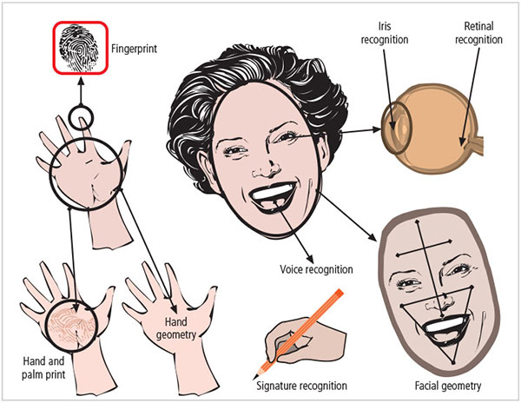
Figure 6-5 Biometric recognition characteristics

Slide 15
Table 6-1 Ranking of Biometric Effectiveness and Acceptance (1 of 2)
Biometrics | University | Uniqueness | Permanence | Collectability | Performance | Acceptability | Circumvention
Face | H | L | M | H | L | H | L
Fadal Thermogram | H | H | L | H | M | H | H
Fingerprint | M | H | H | M | H | M | H
Hand Geometry | M | M | M | H | M | M | M
Hand Vein | M | M | M | M | M | M | H
Eye: Iris | H | H | H | M | H | H | H

Slide 16
Table 6-1 Ranking of Biometric Effectiveness and Acceptance (2 of 2)
Biometrics | University | Uniqueness | Permanence | Collectability | Performance | Acceptability | Circumvention
Eye: Retina | H | H | M | L | H | L | H
DNA | H | H | H | L | H | L | L
Odor and Scent | H | H | H | L | L | M | L
Voice | M | L | L | M | L | H | L
Signature | L | L | L | H | L | H | L
Keystroke | L | L | L | M | L | M | M
Gait | M | L | L | H | L | H | M
Note: In the table, H = High, M = Medium, and L = Low. From multiple sources.

Slide 17
Access Control Architecture Models (1 of 3)
Illustrate access control implementations and can help organizations quickly make improvements through adaptation.
Trusted computing base (TCB)
Part of TCSEC Rainbow Series
Used to enforce security policy (rules of system configuration)
Biggest challenges include covert channels
Storage channels
Timing channels
Notes:
Access Control Architecture Models
Illustrate access control implementations, can help organizations quickly make improvements through adaptation
Trusted computing base (TCB)
Part of Rainbow Series
Used to enforce security policy (rules of system configuration)
Biggest challenges include covert channels
Storage channels
Timing channels

Slide 18
Access Control Architecture Models (2 of 3)
ITSEC: An international set of criteria for evaluating computer systems
Compares Targets of Evaluation (ToE) to detailed security function specifications
The common criteria
Considered successor to both TCSEC and ITSEC
Bell-LaPadula confidentiality model
State machine reference model
Uses “no read up, no write down” principle
Notes:
Access Control Architecture Models
ITSEC: international set of criteria for evaluating computer systems
Compares Targets of Evaluation (ToE) to detailed security function specifications
The Common Criteria
Considered successor to both TCSEC and ITSEC
Bell-LaPadula Confidentiality Model
Model of an automated system able to manipulate its state or status over time
Biba Integrity Model
Based on “no write up, no read down” principle

Slide 19
Access Control Architecture Models (3 of 3)
Biba integrity model
Designed to prevent corruption of higher integrity entities
Based on “no write up, no read down” principle
Clark-Wilson integrity model
No changes by unauthorized subjects
No unauthorized changes by authorized subjects
Maintenance of internal and external consistency
Graham-Denning access control model
Composed of set of objects, set of subjects, and set of rights
Notes:
Access Control Architecture Models
Clark-Wilson Integrity Model
no changes by unauthorized subjects,
no unauthorized changes by authorized subjects,
maintenance of internal and external consistency
Graham-Denning Access Control Model
Composed of set of objects, set of subjects, and set of rights
Harrison-Ruzzo-Ullman Model
Defines method to allow changes to access rights and addition/removal of subjects/objects
Brewer-Nash Model (Chinese Wall)
Designed to prevent conflict of interest between two parties

Slide 20
Firewalls
In information security, a combination of hardware and software that filters or prevents specific information from moving between the outside (untrusted) network and the inside (trusted) network.
May be:
Separate computer system
Software service running on existing router or server
Separate network containing supporting devices
Notes:
Firewalls
Prevent specific types of information from moving between an untrusted network(the Internet) and a trusted network (organization’s internal network)
May be:
Separate computer system
Software service running on existing router or server
Separate network containing supporting devices

Slide 21
Firewalls Processing Modes
Processing modes by which firewalls can be categorized:
Packet filtering
Application layer proxy
MAC layer firewalls
Hybrids
Notes:
Firewall Processing Modes
Five processing modes by which firewalls can be categorized:
Packet filtering
Application gateways
Circuit gateways
MAC layer firewalls
Hybrids

Slide 22
Packet-Filtering Firewalls (1 of 2)
Packet-filtering firewalls examine the header information of data packets.
Most often based on the combination of:
IP source and destination address
Direction (inbound or outbound)
Transmission Control Protocol (TCP) or User Datagram Protocol (UDP) source and destination port requests
Simple firewall models enforce rules designed to prohibit packets with certain addresses or partial addresses from passing through the device.
Notes:
Packet Filtering Firewalls
Packet filtering firewalls examine header information of data packets
Most often based on combination of:
IP source and destination address
Direction (inbound or outbound)
Transmission Control Protocol (TCP) or User Datagram Protocol (UDP) source and destination port requests
Simple firewall models enforce rules designed to prohibit packets with certain addresses or partial addresses from passing through device

Slide 23
Packet-Filtering Firewalls (2 of 2)
Three subsets of packet-filtering firewalls:
Static filtering requires that filtering rules be developed and installed within the firewall
Dynamic filtering allows firewall to react to an emergent event and update or create rules to deal with that event
Stateful packet inspection (SPI) firewalls keep track of each network connection between internal and external systems using a state table
Notes:
Packet-Filtering Firewalls (cont’d.)
Three subsets of packet filtering firewalls:
Static filtering: requires that filtering rules be developed and installed within the firewall
Dynamic filtering: allows firewall to react to emergent event and update or create rules to deal with event
Stateful inspection: firewalls that keep track of each network connection between internal and external systems using a state table

Slide 24
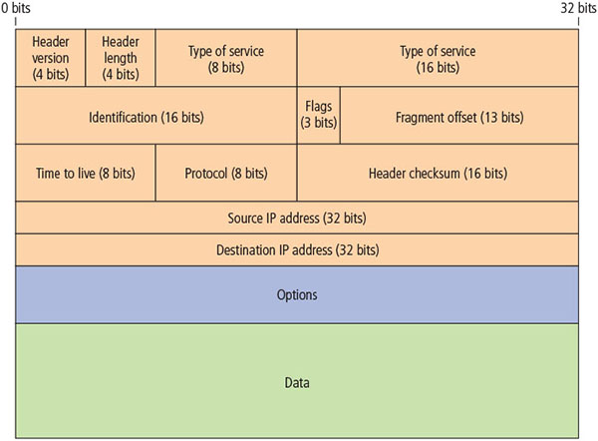
Figure 6-7 IP packet structure

Slide 25
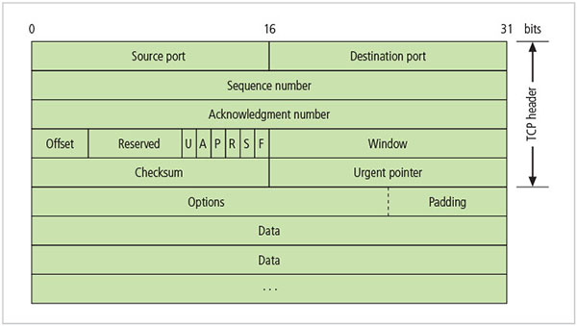
Figure 6-8 TCP packet structure

Slide 26
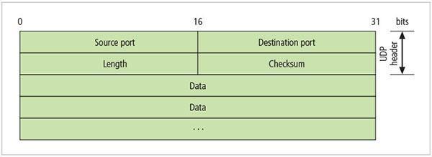
Figure 6-9 UDP datagram structure

Slide 27
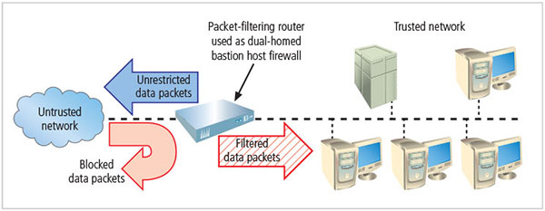
Figure 6-10 Packet-filtering router

Slide 28
Table 6- 2 Sample Firewall Rule and Format
Source Address | Destination Address | Service (e.g. HTTP, SMTP, FTP) | Action (Allow or Deny)
172.16x.x | 10.10.x.x | Any | Deny
192.168.x.x | 10.10.10.25 | HTTP | Allow
192.168.0.1 | 10.10.10.10 | FTP | Allow

Slide 29
Table 6-3 State Table Entries
Source Address | Source Port | Destination Address | Destination Port | Time Remaining (in seconds) | Total Time (in seconds) | Protocol
192.168.2.5 | 1028 | 10.10.10.7 | 80 | 2,275 | 3,600 | TCP

Slide 30
Application Layer Proxy Firewall (1 of 3)
A device capable of functioning both as a firewall and an application layer proxy server.
Since proxy servers are often placed in unsecured area of the network (e.g., DMZ), they are exposed to higher levels of risk from less trusted networks.
Additional filtering routers can be implemented behind the proxy firewall, further protecting internal systems.
Notes:
Application Gateways
Frequently installed on a dedicated computer; also known as a proxy server
Since proxy server is often placed in unsecured area of the network (e.g., DMZ), it is exposed to higher levels of risk from less trusted networks
Additional filtering routers can be implemented behind the proxy server, further protecting internal systems

Slide 31
Firewall Processing Modes (2 of 3)
MAC layer firewalls
Designed to operate at media access control sublayer of network’s data link layer
Make filtering decisions based on specific host computer’s identity
MAC addresses of specific host computers are linked to access control list (ACL) entries that identify specific types of packets that can be sent to each host; all other traffic is blocked
Notes:
MAC Layer Firewalls
MAC layer firewalls
Designed to operate at media access control sublayer of network’s data link layer
Make filtering decisions based on specific host computer’s identity
MAC addresses of specific host computers are linked to access control list (ACL) entries that identify specific types of packets that can be sent to each host; all other traffic is blocked

Slide 32
Firewall Processing Modes (3 of 3)
Hybrid firewalls
Combine elements of other types of firewalls, that is, elements of packet filtering and proxy services, or of packet filtering and circuit gateways
Alternately, may consist of two separate firewall devices; each a separate firewall system, but connected to work in tandem
Enables an organization to make security improvement without completely replacing existing firewalls
Include the Next Generation Firewall (NGFW) and Unified Threat Management (UTM) devices
Notes:
Hybrid Firewalls
Hybrid firewalls
Combine elements of other types of firewalls; i.e., elements of packet filtering and proxy services, or of packet filtering and circuit gateways
Alternately, may consist of two separate firewall devices; each a separate firewall system, but connected to work in tandem
Enables organization to make security improvement without completely replacing existing firewalls

Slide 33
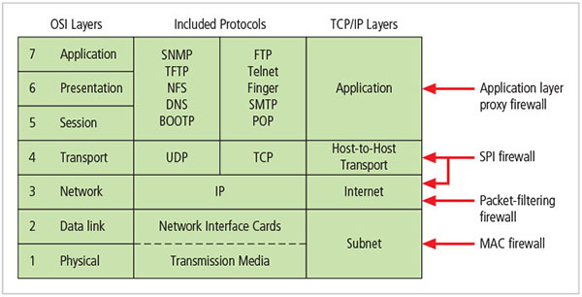
Figure 6-11 Firewall types and protocol models

Slide 34
Firewall Architectures (1 of 5)
Firewall devices can be configured in several network connection architectures.
Best configuration depends on three factors:
Objectives of the network
Organization’s ability to develop and implement architectures
Budget available for function
Three common architectural implementations of firewalls: single bastion hosts, screened host, and screened subnet (with DMZ).

Slide 35
Firewall Architectures (2 of 5)
Single bastion hosts
Commonly referred to as sacrificial host, as it stands as sole defender on the network perimeter
Usually implemented as a dual-homed host, which contains two network interface cards (NICs): one that is connected to external network and one that is connected to internal network
Implementation of this architecture often makes use of network address translation (NAT), creating another barrier to intrusion from external attackers
Notes:
Dual-Homed Host Firewalls
Bastion hosts
Commonly referred to as sacrificial host, as it stands as sole defender on the network perimeter
Contains two network interface cards (NICs): one connected to external network, one connected to internal network
Implementation of this architecture often makes use of network address translation (NAT), creating another barrier to intrusion from external attackers

Slide 36
Firewall Architectures (3 of 5)
Screened host architecture
Combines packet-filtering router with a separate, dedicated firewall such as an application proxy server
Allows router to prescreen packets to minimize the traffic/load on internal proxy
Requires an external attack to compromise two separate systems before the attack can access internal data
Notes:
Screened Subnet Firewalls (with DMZ)
Screened subnet firewalls (with DMZ)
Is the dominant architecture used today
Commonly consists of two or more internal bastion hosts behind packet filtering router, with each host protecting trusted network:
Connections from outside or untrusted network routed through external filtering router
Connections from outside or untrusted network are routed into and out of routing firewall to separate network segment known as DMZ
Connections into trusted internal network allowed only from DMZ bastion host servers

Slide 37
Firewall Architectures (4 of 5)
Screened subnet architecture (with DMZ)
Is the dominant architecture used today
Commonly consists of two or more internal firewalls behind packet-filtering router, with each protecting a trusted network:
Connections from outside or untrusted network are routed through external filtering router.
Connections from outside or untrusted network are routed into and out of routing firewall to separate the network segment known as DMZ.
Connections into trusted internal network are allowed only from DMZ bastion host servers.
Notes:
Screened Subnet Firewalls (with DMZ)
Screened subnet firewalls (with DMZ)
Is the dominant architecture used today
Commonly consists of two or more internal bastion hosts behind packet filtering router, with each host protecting trusted network:
Connections from outside or untrusted network routed through external filtering router
Connections from outside or untrusted network are routed into and out of routing firewall to separate network segment known as DMZ
Connections into trusted internal network allowed only from DMZ bastion host servers

Slide 38
Firewall Architectures (5 of 5)
Screened subnet performs two functions:
Protects DMZ systems and information from outside threats
Protects the internal networks by limiting how external connections can gain access to internal systems
Another facet of DMZs: creation of extranets
Notes:
Firewall Architectures (cont’d.)
Screened subnet performs two functions:
Protects DMZ systems and information from outside threats
Protects the internal networks by limiting how external connections can gain access to internal systems
Another facet of DMZs: extranets

Slide 39
Table 6-4 Reserved Nonroutable Address Ranges
Classful Description | Usable Addresses | From | To | CIDR Mask | Decimal Mask
Class A or 24 Bit | ̴̴ 16.5 million | 10.0.0.0 | 10.255.255.255 | /8 | 255.0.0.0
Class B or 20 Bit | ̴̴ 1.05 million | 172.16.0.0 | 172.31.255.255 | /12 or /16 | 255.240.0.0 or 255.255.0.0
Class C or 16 Bit | ̴̴ 65,500 | 192.168.0.0 | 192.168.255.255 | /16 or /24 | 255.240.0.0 or 255.255.0.0
IPv6 Space | ̴̴ 65,500 sets of 18.45 quintillion (18.45 X 10¹⁸) | fc00:/7, where the first 7 digits are fixed (1111 1 10x), followed by a 10-digit organization ID, then 4 digits of subnet ID and 16 digits of host ID. ((F]]C or D] xx:xxxx:xxxx:yyyy:zzzz:zzzz:zzzz:zzzz). | fc00:/7, where the first 7 digits are fixed (1111 1 10x), followed by a 10-digit organization ID, then 4 digits of subnet ID and 16 digits of host ID. ((F]]C or D] xx:xxxx:xxxx:yyyy:zzzz:zzzz:zzzz:zzzz). | fc00:/7, where the first 7 digits are fixed (1111 1 10x), followed by a 10-digit organization ID, then 4 digits of subnet ID and 16 digits of host ID. ((F]]C or D] xx:xxxx:xxxx:yyyy:zzzz:zzzz:zzzz:zzzz). | fc00:/7, where the first 7 digits are fixed (1111 1 10x), followed by a 10-digit organization ID, then 4 digits of subnet ID and 16 digits of host ID. ((F]]C or D] xx:xxxx:xxxx:yyyy:zzzz:zzzz:zzzz:zzzz).
Note: that CIDR stands for classless inter- domain routing.
Source: Internet Engineering Task Force, RFC 1466 (http://tools.ietf.orglhtmllrfc1466).18

Slide 40
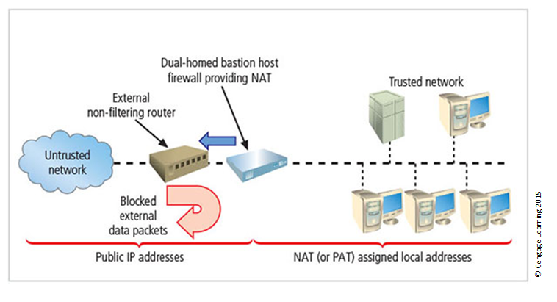
Figure 6-16 Dual-homed bastion host firewall

Slide 41
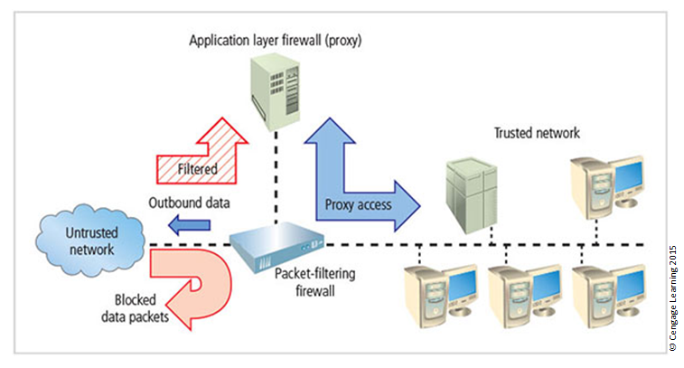
Figure 6-17 Screened host architecture

Slide 42
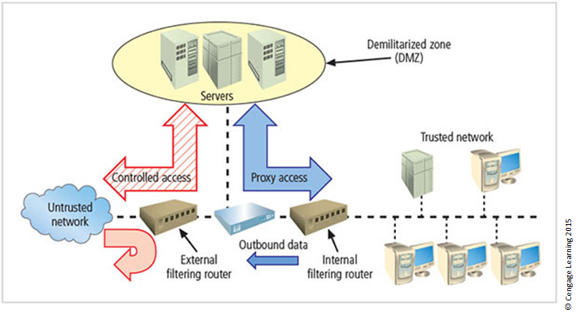
Figure 6-18 Screened subnet (DMZ)

Slide 43
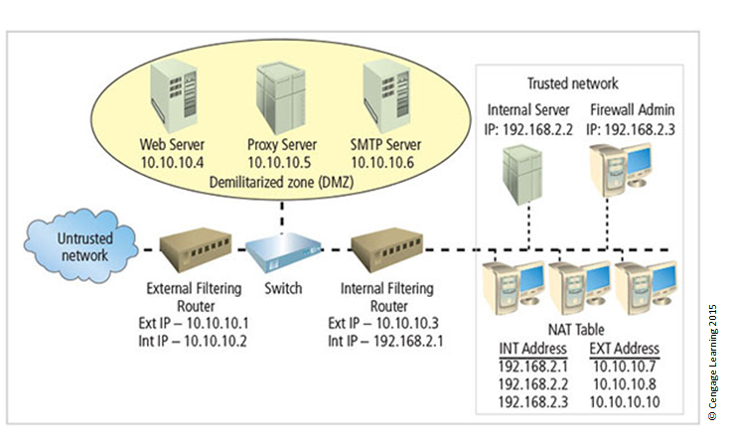
Figure 6-19 Example network configuration

Slide 44
Selecting the Right Firewall (1 of 2)
When selecting the firewall, consider the following factors:
Which type of firewall technology offers the right balance between protection and cost for the needs of the organization?
What features are included in the base price? What features are available at extra cost? Are all cost factors known?
Notes:
Selecting the Right Firewall
When selecting firewall, consider a number of factors:
What firewall technology offers right balance between protection and cost for needs of organization?
Which features are included in base price and which are not?
Ease of setup and configuration? How accessible are staff technicians who can configure the firewall?
Can firewall adapt to organization’s growing network?
Second most important issue is cost

Slide 45
Selecting the Right Firewall (2 of 2)
How easy is it to set up and configure the firewall? Does the organization have staff on hand that are trained to configure the firewall, or would the hiring of additional employees be required?
Can the firewall adapt to the growing network in the target organization?
Most important factor is provision of required protection
Second most important issue is cost

Slide 46
Configuring and Managing Firewalls (1 of 4)
The organization must provide for the initial configuration and ongoing management of firewall(s)
Each firewall device must have its own set of configuration rules regulating its actions
Firewall policy configuration is usually complex and difficult
Configuring firewall policies is both an art and a science
When security rules conflict with the performance of business, security often loses
Notes:
Configuring and Managing Firewalls
Organization must provide for initial configuration and ongoing management of firewall(s)
Each firewall device must have own set of configuration rules regulating its actions
Firewall policy configuration is usually complex and difficult
Configuring firewall policies is both an art and a science
When security rules conflict with the performance of business, security often loses

Slide 47
Configuring and Managing Firewalls (2 of 4)
Best practices for firewalls
All traffic from the trusted network is allowed out.
Firewall device is never directly accessed from public network.
Simple Mail Transport Protocol (SMTP) data are allowed to pass through firewall.
Internet Control Message Protocol (ICMP) data are denied.
Notes:
Best practices for firewalls
All traffic from trusted network is allowed out
Firewall device never directly accessed from public network
Simple Mail Transport Protocol (SMTP) data allowed to pass through firewall
Internet Control Message Protocol (ICMP) data denied
Telnet access to internal servers should be blocked
When Web services offered outside firewall, HTTP traffic should be blocked from reaching internal networks
All data not verifiably authentic should be denied

Slide 48
Configuring and Managing Firewalls (3 of 4)
Telnet access to internal servers should be blocked.
When Web services are offered outside the firewall, HTTP traffic should be blocked from reaching internal networks.
All data that are not verifiably authentic should be denied.
Firewall rules
Firewalls operate by examining data packets and performing comparison with predetermined logical rules.
Notes:
Firewall Rules
Firewall rules
Firewalls operate by examining data packets and performing comparison with predetermined logical rules
Logic based on set of guidelines most commonly referred to as firewall rules, rule base, or firewall logic
Most firewalls use packet header information to determine whether specific packet should be allowed or denied

Slide 49
Configuring and Managing Firewalls (4 of 4)
The logic is based on a set of guidelines most commonly referred to as firewall rules, rule base, or firewall logic.
Most firewalls use packet header information to determine whether a specific packet should be allowed or denied.

Slide 50
Table 6-5 Well – Known Port Numbers
Port Number | Protocol
7 | Echo
20 | File Transfer [Default Data] (FTP)
21 | File Transfer [Control] (FTP)
23 | Telnet
25 | Simple Mail Transfer Protocol (SMTP)
53 | Domain Name System (DNS)
80 | Hypertext Transfer Protocol (HTTP)
110 | Post Office Protocol version 3 (POP3)
161 | Simple Network Management Protocol (SNMP)

Slide 51
Table 6-16 External Filtering Firewall Inbound Interface Rule Set
Rule # | Source Address | Source port | Destination Address | Destination Port | Action
1 | 10.10.10.0 | Any | Any | Any | Deny
2 | Any | Any | 10.10.10.1 | Any | Deny
3 | Any | Any | 10.10.10.2 | Any | Deny
4 | 10.10.10.1 | Any | Any | Any | Deny
5 | Any | Any | Any | Any | Deny
6 | Any | Any | 10.10.10.0 | >1023 | Allow
7 | Any | Any | 10.10.10.6 | 25 | Allow
8 | Any | Any | 10.10.10.0 | 7 | Deny
9 | Any | Any | 10.10.10.0 | 23 | Deny
10 | Any | Any | 10.10.10.4 | 80 | Allow
11 | Any | Any | Any | Any | Deny
Notes:
Note that the rule allowing responses to internal communications comes first (appearing in Table 6-16 as Rule #1), followed by the four rules prohibiting direct communications to or from the firewall (Rules #2 through 5 in Table 6-16). After this comes the rule stating that all outgoing internal communications are allowed, followed by the rules governing access to the SMTP server and denial of Ping, Telnet access, and access to the HTTP server. If heavy traffic to the HTTP server is expected, move the HTTP server rule closer to the top (for example, into the position of Rule #2), which would expedite rule processing for external communications. The final rule in Table 6-16 denies any other types of communications.

Slide 52
Table 6-16 External Filtering Firewall Outbound Interface Rule Set
Rule # | Source Address | Source port | Destination Address | Destination Port | Action
1 | 10.10.10.12 | Any | 10.10.10.0 | Any | Allow
2 | Any | Any | 10.10.10.1 | Any | Deny
3 | Any | Any | 10.10.10.2 | Any | Deny
4 | 10.10.10.1 | Any | Any | Any | Deny
5 | 10.10.10.2 | Any | Any | Any | Deny
6 | 10.10.10.0 | Any | Any | Any | Allow
7 | Any | Any | Any | Any | Deny
Notes:
Note the similarities and differences in the two rule sets. The internal filtering router/firewall rule set, shown in Table 6-17, has to both protect against traffic and allow traffic from the internal network (192.168.2.0). Most of the rules in Table 6-17 are similar to those in Table 6-16: allowing responses to internal communications (Rule #1); denying communications to/from the firewall itself (Rules #2 through 5); and allowing all outbound internal traffic (Rule #6). Note that there is no permissible traffic from the DMZ systems, except as in Rule #1. Why isn’t there a comparable rule for the 192.168.2.1 subnet? Because this is an unrouteable network, external communications are handled by the NAT server, which maps internal (192.168.2.0) addresses to external (10.10.10.0) addresses. This prevents a hacker from compromising one of the internal boxes and accessing the internal network with it. The exception is the proxy server (Rule #7 in Table 6-17), which should be very carefully configured. If the organization does not need the proxy server, as in cases where all externally accessible services are provided from machines in the DMZ, then Rule #7 is not needed. Note that there are no Ping and Telnet rules in Table 6-17. This is because the external firewall filters these external requests out. The last rule, Rule #8, provides cleanup.

Slide 53
Content Filters
A software program or hardware/software appliance that allows administrators to restrict content that comes into or leaves a network
Essentially a set of scripts or programs restricting user access to certain networking protocols/Internet locations
Primary purpose to restrict internal access to external material
Most common content filters restrict users from accessing non-business Web sites or deny incoming spam
Notes:
Content Filters
Software filter—not a firewall—that allows administrators to restrict content access from within a network
Essentially a set of scripts or programs restricting user access to certain networking protocols/Internet locations
Primary purpose to restrict internal access to external material
Most common content filters restrict users from accessing non-business Web sites or deny incoming spam

Slide 54
Protecting Remote Connections
Installing Internetwork connections requires leased lines or other data channels; these connections are usually secured under the requirements of a formal service agreement.
When individuals seek to connect to an organization’s network, a more flexible option must be provided.
Options such as virtual private networks (VPNs) have become more popular due to the spread of Internet.
Notes:
Protecting Remote Connections
Installing Internetwork connections requires leased lines or other data channels; these connections are usually secured under requirements of formal service agreement
When individuals seek to connect to organization’s network, more flexible option must be provided
Options such as virtual private networks (VPNs) have become more popular due to spread of Internet

Slide 55
Remote Access (1 of 5)
Unsecured, dial-up connection points represent a substantial exposure to attack.
Attacker can use a device called a war dialer to locate the connection points.
War dialer: automatic phone-dialing program that dials every number in a configured range and records number if a modem picks up.
Some technologies (Kerberos; RADIUS systems; TACACS; CHAP password systems) have improved the authentication process.
Notes:
Dial-Up
Unsecured, dial-up connection points represent a substantial exposure to attack
Attacker can use device called a war dialer to locate connection points
War dialer: automatic phone-dialing program that dials every number in a configured range and records number if modem picks up
Some technologies (RADIUS systems; TACACS; CHAP password systems) have improved authentication process

Slide 56
Remote Access (2 of 5)
RADIUS, Diameter, and TACACS
Systems that authenticate user credentials for those trying to access an organization’s network via dial-up
Remote Authentication Dial-In User Service (RADIUS) centralizes responsibility for user authentication in a central RADIUS server
Diameter: emerging alternative derived from RADIUS
Terminal Access Controller Access Control System (TACACS) validates user’s credentials at centralized server (like RADIUS); based on client/server configuration
Notes:
RADIUS, TACACS, and Diameter
Systems that authenticate user credentials for those trying to access an organization’s network via dial-up
Remote Authentication Dial-In User Service (RADIUS): centralizes responsibility for user authentication in a central RADIUS server
Diameter: emerging alternative derived from RADIUS
Terminal Access Controller Access Control System (TACACS): validates user’s credentials at centralized server (like RADIUS); based on client/server configuration

Slide 57
Remote Access (3 of 5)
Kerberos
Provides secure third-party authentication
Uses symmetric key encryption to validate individual user to various network resources
Keeps database containing private keys of clients/servers
Consists of three interacting services:
Authentication server (AS)
Key Distribution Center (KDC)
Kerberos ticket granting service (TGS)
Notes:
Securing Authentication with Kerberos
Kerberos
Provides secure third-party authentication
Uses symmetric key encryption to validate individual user to various network resources
Keeps database containing private keys of clients/servers
Consists of three interacting services:
Authentication server (AS)
Key Distribution Center (KDC)
Kerberos ticket granting service (TGS)

Slide 58
Remote Access (4 of 5)
Kerberos
Provides secure third-party authentication
Uses symmetric key encryption to validate individual user to various network resources
Keeps database containing private keys of clients/servers
Consists of three interacting services:
Authentication server (AS)
Key Distribtion Center (KDC)
Kerberos ticket granting service (TGS)
Notes:
Securing Authentication with Kerberos
Kerberos
Provides secure third-party authentication
Uses symmetric key encryption to validate individual user to various network resources
Keeps database containing private keys of clients/servers
Consists of three interacting services:
Authentication server (AS)
Key Distribution Center (KDC)
Kerberos ticket granting service (TGS)

Slide 59
Remote Access (5 of 5)
SESAME
Secure European System for Applications in a Multivendor Environment (SESAME) is similar to Kerberos
User is first authenticated to authentication server and receives token
Token is then presented to a privilege attribute server as proof of identity to gain a privilege attribute certificate
Uses public key encryption, adds sophisticated access control features, more scalable encryption systems, improved manageability, auditing features, and options for delegation of responsibility for allowing access
Notes:
SESAME
Secure European System for Applications in a Multivendor Environment (SESAME) is similar to Kerberos
User is first authenticated to authentication server and receives token
Token then presented to privilege attribute server as proof of identity to gain privilege attribute certificate
Uses public key encryption; adds sophisticated access control features; more scalable encryption systems; improved manageability; auditing features; and option for delegation of responsibility for allowing access

Slide 60
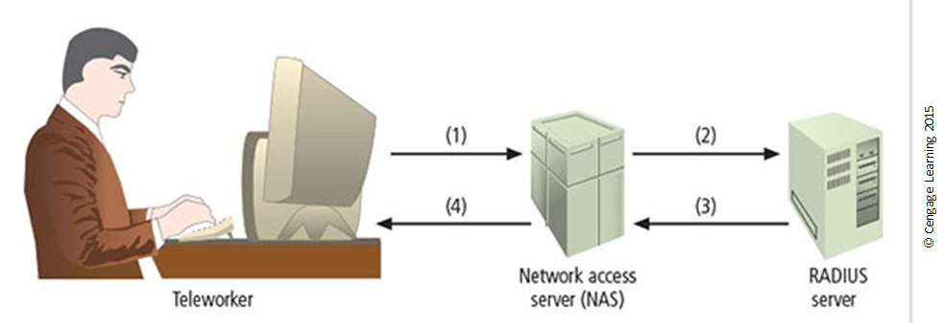
Figure 6-20 RADIUS configuration
Remote worker dials NAS and submits username and password
NAS passes username and password to RADIUS server
RADIUS server approves or rejects request and provides access authorization
NAS provides access to authorized remote worker

Slide 61
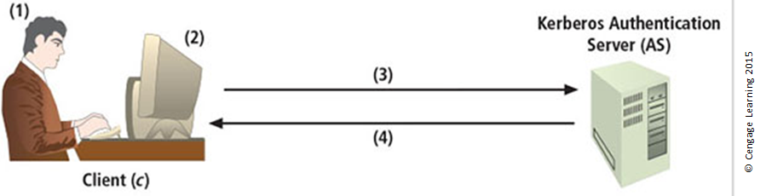
Figure 6-21 Kerberos login (1 of 2)

Slide 62
Figure 6-21 Kerberos login (2 of 2)
User logs into client machine (c)
Client machine encrypts password to create client key (Kc)
Client machine sends clear request to Kerberos Authentication Server (AS)
Kerberos AS returns ticket consisting of:
Client/TGS session key for future communications between client and TGS [Kc,TGS], encrypted with the client's key
Ticket granting ticket (TGT). The TGT contains the client name, client address, ticket valid times, and the client/TGS session key, all encrypted in the TGS' private key

Slide 63
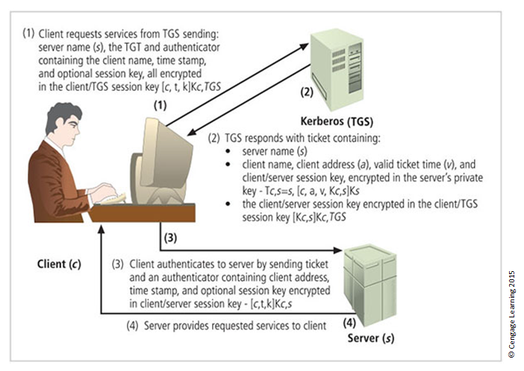
Figure 6-22 Kerberos request for services

Slide 64
Virtual Private Networks (VPNs) (1 of 4)
Private and secure network connection between systems; uses data communication capability of unsecured and public network
Securely extends organization’s internal network connections to remote locations
Three VPN technologies defined:
Trusted VPN
Secure VPN
Hybrid VPN (combines trusted and secure)
Notes:
Virtual Private Networks (VPNs)
A VPN is a private and secure network connection between systems that uses the data communication capability of an unsecured and public network.
VPNs are commonly used to extend securely an organization’s internal network connections to remote locations beyond the trusted network.
The VPNC defines three VPN technologies:
A trusted VPN, or VPN, uses leased circuits from a service provider and conducts packet switching over these leased circuits.
Secure VPNs use security protocols and encrypt traffic transmitted across unsecured public networks like the Internet.
A hybrid VPN combines the two, providing encrypted transmissions (as in secure VPN) over some or all of a trusted VPN network.
A VPN that proposes to offer a secure and reliable capability while relying on public networks must address:
Encapsulation of incoming and outgoing data, wherein the native protocol of the client is embedded within the frames of a protocol that can be routed over the public network, as well as be usable by the server network environment.
Encryption of incoming and outgoing data to keep the data contents private while in transit over the public network but usable by the client and server computers and/or the local networks on both ends of the VPN connection.
Authentication of the remote computer and, perhaps, the remote user as well. Authentication and the subsequent authorization of the user to perform specific actions are predicated on accurate and reliable identification of the remote system and/or user.

Slide 65
Virtual Private Networks (VPNs) (2 of 4)
VPN must accomplish:
Encapsulation of incoming and outgoing data
Encryption of incoming and outgoing data
Authentication of remote computer and perhaps remote user as well
In most common implementation, it allows the user to turn Internet into a private network
Notes:
Virtual Private Networks (VPNs) (continued)
VPN must accomplish:
Encapsulation of incoming and outgoing data
Encryption of incoming and outgoing data
Authentication of remote computer and perhaps remote user as well
In most common implementation, allows user to turn Internet into a private network

Slide 66
Virtual Private Networks (VPNs) (3 of 4)
Transport mode
Data within IP packet are encrypted, but header information is not
Allows user to establish secure link directly with remote host, encrypting only data contents of packet
Two popular uses:
End-to-end transport of encrypted data
Remote access worker connects to an office network over Internet by connecting to a VPN server on the perimeter
Notes:
Transport Mode
Transport mode
Data within IP packet is encrypted, but header information is not
Allows user to establish secure link directly with remote host, encrypting only data contents of packet
Two popular uses:
End-to-end transport of encrypted data
Remote access worker connects to office network over Internet by connecting to a VPN server on the perimeter

Slide 67
Virtual Private Networks (VPNs) (4 of 4)
Tunnel mode
Establishes two perimeter tunnel servers to encrypt all traffic that will traverse an unsecured network
Entire client package encrypted and added as data portion of packet from one tunneling server to another
Primary benefit to this model is that an intercepted packet reveals nothing about the true destination system
Example of tunnel mode VPN: Microsoft’s Internet Security and Acceleration (ISA) Server
Notes:
Tunnel mode
Establishes two perimeter tunnel servers to encrypt all traffic that will traverse unsecured network
Entire client package encrypted and added as data portion of packet from one tunneling server to another
Primary benefit to this model is that an intercepted packet reveals nothing about true destination system
Example of tunnel mode VPN: Microsoft’s Internet Security and Acceleration (ISA) Server

Slide 68
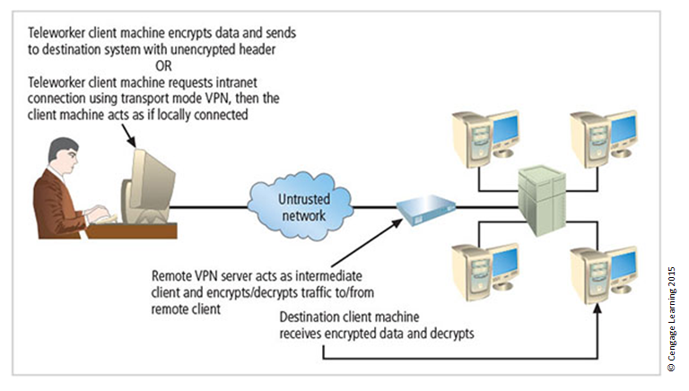
Figure 6-23 Transport mode VPN

Slide 69
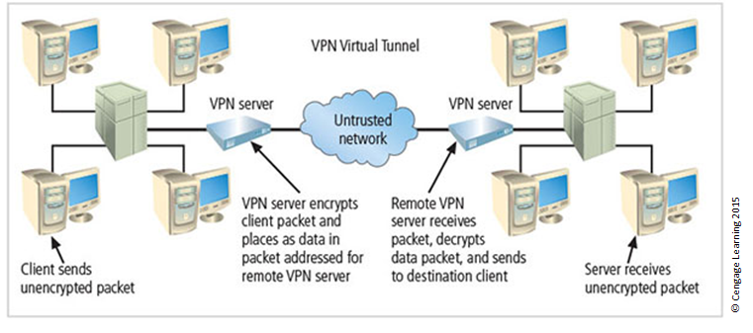
Figure 6-24 Tunnel mode VPN

Slide 70
Summary (1 of 2)
Access control is a process by which systems determine if and how to admit a user into a trusted area of the organization.
All access control approaches rely on identification, authentication, authorization, and accountability.
A firewall is any device that prevents a specific type of information from moving between the outside network, known as the untrusted network, and the inside network, known as the trusted network.
Firewalls can be categorized into four groups: packet filtering, MAC layers, application gateways, and hybrid firewalls.

Slide 71
Summary (2 of 2)
Packet-filtering firewalls can be implemented as static filtering, dynamic filtering, and stateful inspection firewalls.
The three common architectural implementations of firewalls are single bastion hosts, screened hosts, and screened subnets.
Dial-up protection mechanisms help secure organizations that use modems for remote connectivity.
VPNs enable remote offices and users to connect to private networks securely over public networks.

