Slide 1
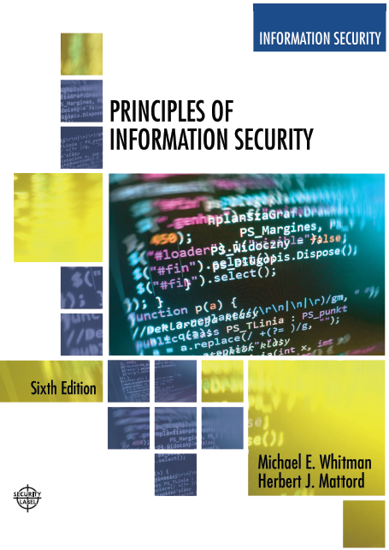

Principles of Information Security
Sixth Edition
Chapter 8
Cryptography
Copyright © 2018 Cengage. May not be copied, scanned, or duplicated, in whole or in part, except for use as permitted in a license distributed with a certain product or service or otherwise on a password-protected website for classroom use.

Slide 2
Learning Objectives
Upon completion of this material, you should be able to:
Chronicle the most significant events and discoveries in the history of cryptology
Explain the basic principles of cryptography
Describe the operating principles of the most popular cryptographic tools
List and explain the major protocols used for secure communications
Notes:
Learning Objectives
Upon completion of this material, you should be able to:
Chronicle the most significant events and discoveries in the history of cryptology
Explain the basic principles of cryptography
Describe the operating principles of the most popular cryptographic tools
List and explicate the major protocols used for secure communications

Slide 3
Introduction
Cryptology: the field of science that encompasses cryptography and cryptanalysis.
Cryptanalysis: the process of obtaining the plaintext message from a ciphertext message without knowing the keys used to perform the encryption.
Cryptography: the process of making and using codes to secure information.
Notes:
Introduction
Cryptology: science of encryption; encompasses cryptography and cryptanalysis
Cryptography involves making and using codes to secure messages
Cryptanalysis involves cracking or breaking encrypted messages back into their unencrypted origins
.

Slide 4
Foundations of Cryptology
Cryptology has an extensive and multicultural history.
All popular Web browsers use built-in encryption features for secure e-commerce applications.
Restrictions on the export of cryptosystems began after World War II.
Notes:
Foundations of Cryptology
Cryptology has an extensive and multicultural history
All popular Web browsers use built-in encryption features for secure e-commerce applications
Restrictions on the export of cryptosystems began after WWII

Slide 5
Terminology (1 of 2)
Algorithm
Bit stream cipher
Block cipher
Cipher or cryptosystem
Ciphertext/Cryptogram
Code
Decipher
Decrypt
Notes:
Foundations of Cryptology
Cryptology has an extensive and multicultural history
All popular Web browsers use built-in encryption features for secure e-commerce applications
Restrictions on the export of cryptosystems began after WWII

Slide 6
Terminology (2 of 2)
Encipher
Encrypt
Key/Cryptovariable
Keyspace
Link encryption
Plaintext/Cleartext
Steganography
Work factor

Slide 7
Cipher Methods
Plaintext can be encrypted through:
Bit stream: each plaintext bit is transformed into a cipher bit one bit at a time.
Block cipher: message is divided into blocks (e.g., sets of 8- or 16-bit blocks), and each is transformed into encrypted block of cipher bits using algorithm and key.
Notes:
Cipher Methods
Plaintext can be encrypted through bit stream or block cipher method
Bit stream: each plaintext bit transformed into cipher bit one bit at a time
Block cipher: message divided into blocks (e.g., sets of 8- or 16-bit blocks) and each is transformed into encrypted block of cipher bits using algorithm and key

Slide 8
Substitution Cipher
Substitutes or exchanges one value for another
Monoalphabetic substitution: only incorporates a single alphabet in the encryption process
Polyalphabetic substitution: incorporates two or more alphabets in the encryption process
Vigenère cipher: advanced type of substitution cipher that uses a simple polyalphabetic code; made up of 26 distinct cipher alphabets
Notes:
Substitution Cipher
Exchanges one value for another
Monoalphabetic substitution: uses only one alphabet during encryption process
Polyalphabetic substitution: more advanced; uses two or more alphabets
Vigenère cipher: advanced substitution cipher that uses simple polyalphabetic code; made up of 26 distinct cipher alphabets

Slide 9
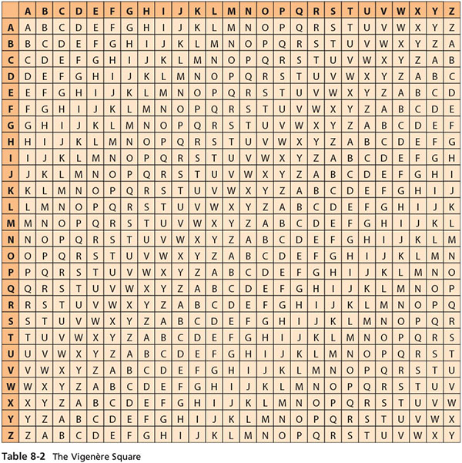
Table 8-2 The Vigenere square

Slide 10
Transposition Cipher
Also known as a permutation cipher; involves simply rearranging the values within a block based on an established pattern.
Can be done at the bit level or at the byte (character) level.
To make the encryption even stronger, the keys and block sizes can be increased to 128 bits or more.
Notes:
Transposition Cipher Method
Simple to understand, but if properly used, produces ciphertext that is difficult to decipher
Rearranges values within a block to create ciphertext
Can be done at the bit level or at the byte (character) level
To make the encryption even stronger, the keys and block sizes can be increased to 128 bits or more
Uses block padding method to facilitate algorithm

Slide 11
Exclusive OR (XOR)
A function within Boolean algebra used as an encryption function in which two bits are compared.
If the two bits are identical, the result is a binary 0.
If the two bits are not identical, the result is a binary 1.
Very simple to implement and simple to break; should not be used by itself when organization is transmitting/storing sensitive data.
Notes:
Exclusive OR (XOR)
Function of Boolean algebra; two bits are compared and binary result generated
If two bits are identical, result is binary 0
If two bits not identical, result is binary 1
Very simple to implement and simple to break; should not be used by itself when organization is transmitting/storing sensitive data

Slide 12
Table 8-3 XOR Table
First bit | Second bit | result
0 | 0 | 0
0 | 1 | 1
1 | 0 | 1
1 | 1 | 0

Slide 13
Table 8-3 Example XOR Encryption
Text value | Binary value
CAT as bits | 0 1 0 0 0 0 1 1 0 1 0 0 0 0 0 1 0 1 0 1 0 1 0 0
VVV as key | 0 1 0 1 0 1 1 0 0 1 0 1 0 1 1 0 0 1 0 1 0 1 1 0
Cipher | 0 0 0 1 0 1 0 1 0 0 0 1 0 1 1 1 0 0 0 0 0 0 1 0

Slide 14
Vernam Cipher
A cryptographic technique developed at AT&T and known as the “one-time pad.”
This cipher uses a set of characters for encryption operations only one time and then discards it.
To perform:
The pad values are added to numeric values that represent the plaintext that needs to be encrypted
Each character of the plaintext is turned into a number and a pad value for that position is added
The resulting sum for that character is then converted back to a ciphertext letter for transmission
If the sum of the two values exceeds 26, then 26 is subtracted from the total
Notes:
Vernam Cipher
Developed at AT&T Bell Labs
Uses set of characters once per encryption process
To perform:
The pad values are added to numeric values that represent the plaintext that needs to be encrypted
Each character of the plaintext is turned into a number and a pad value for that position is added
The resulting sum for that character is then converted back to a ciphertext letter for transmission
If the sum of the two values exceeds 26, then 26 is subtracted from the total

Slide 15
Book-Based Ciphers
Uses text from a predetermined book as a key to decrypt a message.
Book cipher: ciphertext consists of a list of codes representing page, line, and word numbers of plaintext word.
Running key cipher: uses a book for passing the key to cipher similar to Vigenère cipher; sender provides encrypted message with sequence of numbers from predetermined book to be used as an indicator block.
Template cipher: involves use of hidden message in book, letter, or other message; requires page with specific number of holes cut into it.
Notes:
Book-Based Ciphers
Uses text in book as key to decrypt a message
Book cipher: ciphertext consists of list of codes representing page, line, and word numbers of plaintext word
Running key cipher: uses a book for passing key to cipher similar to Vigenère cipher; sender provides encrypted message with sequence of numbers from predetermined book to be indicator block
Template Cipher: involves use of hidden message in book, letter, or other message; requires page with specific number of holes cut into it.

Slide 16
Hash Functions
Mathematical algorithms that create a message summary or digest to confirm message identity and integrity
Convert variable-length messages into a single fixed-length value
Message authentication code (MAC) may be attached to a message
Used in password verification systems to store passwords and confirm the identity of the user
Notes:
Hash Functions
Mathematical algorithms used to confirm specific message identity and that no content has changed
Hash algorithms: public functions that create hash value
Use of keys not required
Message authentication code (MAC), however, may be attached to a message
Used in password verification systems to confirm identity of user

Slide 17
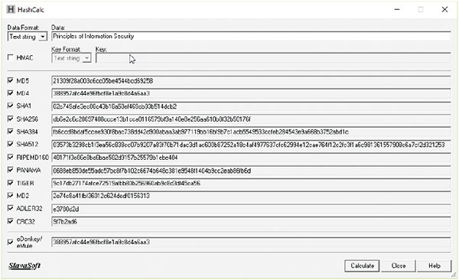
Figure 8-4 Various hash values
Source: SlavaSoft HashCalc.

Slide 18
Cryptographic Algorithms
Often grouped into two broad categories, symmetric and asymmetric.
Today’s popular cryptosystems use a combination of both symmetric and asymmetric algorithms.
Symmetric and asymmetric algorithms are distinguished by the types of keys used for encryption and decryption operations.
Notes:
Cryptographic Algorithms
Often grouped into two broad categories, symmetric and asymmetric
Today’s popular cryptosystems use combination of both symmetric and asymmetric algorithms
Symmetric and asymmetric algorithms distinguished by types of keys used for encryption and decryption operations

Slide 19
Symmetric Encryption (1 of 2)
A cryptographic method in which the same algorithm and “secret” are used both to encipher and decipher the message; also known as private-key encryption.
Can be programmed into fast computing algorithms and executed quickly.
Both sender and receiver must possess the same secret key.
If either copy of the key is compromised, an intermediate can decrypt and read messages without sender/receiver knowledge.
Notes:
Symmetric Encryption
Symmetric encryption indicates that the same key, also known as a secret key, is used to conduct both the encryption and decryption of the message.
Symmetric encryption methods can be extremely efficient, requiring minimal processing to either encrypt or decrypt the message.
The problem is that both the sender and the receiver must own the encryption key.
If either copy of the key is compromised, an intermediate can decrypt and read the messages.
One of the challenges of symmetric key encryption is getting a copy of the key to the receiver, a process that must be conducted out-of-band to avoid interception.

Slide 20
Symmetric Encryption Encryption (2 of 2)
Data Encryption Standard (DES): one of the most popular symmetric encryption cryptosystems.
64-bit block size; 56-bit key
Triple DES (3DES): created to provide security far beyond DES.
Advanced Encryption Standard (AES): developed to replace both DES and 3DES
Adopted by NIST in November 2001 as the federal standard for encrypting non-classified information
Notes:
Symmetric Encryption
Data Encryption Standard (DES): one of most popular symmetric encryption cryptosystems
64-bit block size; 56-bit key
Adopted by NIST in 1976 as federal standard for encrypting non-classified information
Triple DES (3DES): created to provide security far beyond DES
Advanced Encryption Standard (AES): developed to replace both DES and 3DES

Slide 21

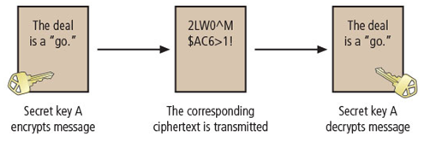
Figure 8-5 Example of symmetric encryption
Rachel at ABC corp. generates a secret key. She must somehow get it to Alex at XYZ corp. out of band. Once Alex has it, Rachel can use it to encrypt messages, and Alex can use it to decrypt and read them.

Slide 22
Asymmetric Encryption
A cryptographic method that incorporates mathematical operations involving two different keys (commonly known as the public key and the private key) to encipher or decipher a message.
Either key can be used to encrypt a message, but then the other key is required to decrypt it.
Also known as public-key encryption.
Uses two different but mathematically related keys
Either key can encrypt or decrypt a message
If Key A encrypts a message, only Key B can decrypt
Greatest value when one key serves as a private key and the other serves as a public key
RSA algorithm was the first public-key encryption algorithm developed/published for commercial use.
Notes:
Asymmetric Encryption
Also known as public-key encryption
Uses two different but related keys
Either key can encrypt or decrypt message
If Key A encrypts message, only Key B can decrypt
Greatest value when one key serves as private key and the other serves as public key
RSA algorithm was first public-key encryption algorithm developed/published for commercial use

Slide 23
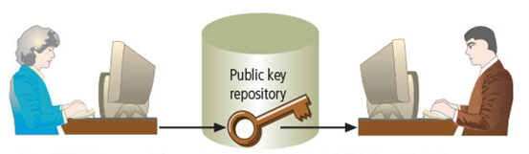
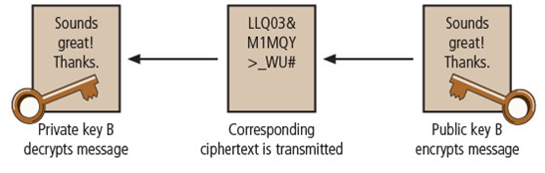
Figure 8-6 Example of asymmetric encryption
Alex at XYZ corp. wants to send a message to Rachel at ABC corp. Rachel stores her public key where it can be accessed by anyone. Alex retrieves Rachel’s key and uses it to create ciphertext that can be decrypted only by Rachel’s private key, which only she has. To respond, Rachel gets Alex’s public key to encrypt her message.

Slide 24
Encryption Key Size
When deploying ciphers, the size of the cryptovariable or key is very important.
The strength of many encryption applications and cryptosystems is measured by key size.
For cryptosystems, the security of encrypted data is not dependent on keeping the encrypting algorithm secret.
Cryptosystem security depends on keeping some or all of elements of cryptovariable(s) or key(s) secret.
Notes:
Encryption Key Size
When deploying ciphers, size of cryptovariable or key is very important
Strength of many encryption applications and cryptosystems measured by key size
For cryptosystems, security of encrypted data is not dependent on keeping encrypting algorithm secret
Cryptosystem security depends on keeping some or all of elements of cryptovariable(s) or key(s) secret

Slide 25
Table 8-5 Encryption key power (1 of 3)
It is estimated that to crack an encryption key using a brute force attack, a computer needs to perform a maximum of 2^k operations (2k guesses), where k is the number of bits in the key. In reality, the average estimated time to crack is half that time.
The estimated average time to crack is based on a 2015-era PC with an Intel i7-6700k Quad core CPU performing 207.23 Dhrystone GIPS (billion instructions per second) at 4.0 GHz**
Key Length (Bits) | Maximum Number of Operations (Guesses) | Maximum Time to Crack | Estimated Average Time to Crack
16 | 65,536 | 0.0000003 seconds | 0.00000016 seconds
24 | 16,777,216 | 0.00008 seconds | 0.00004 seconds
32 | 4,294,967,296 | 0.02 seconds | 0.01 seconds
56 | 7.E+16 | 4.02 days | 2.01 days
64 | 2.E+19 | 42.93 years | 21.47 years
128 | 3.E+38 | 19,005,227,625,557,100, 000,000 years | 9,502,613,812,778,540, 000,000 years

Slide 26
Table 8-5 Encryption key power (2 of 3)
Key Length (Bits) | Maximum Number of Operations (Guesses) | Maximum Time to Crack | Estimated Average Time to Crack
256 | 1.E+77 | 6,467,143,840,295,770, 000,000,000,000,000, 000,000,000,000,000, 000,000,000,000,000 years | 3,233, 571,920,147,890,000, 000,000,000,000,000, 000,000,000,000,000, 000,000,000,000 years
512 | 1.E+154 | 748,844,096, 666,088,000,000,000,000, 000,000,000,000,000,000, 000,000,000,000,000,000, 000,000,000,000,000,000, 000,000,000,000,000,000, 000,000,000,000,000,000, 000,000,000,000,000,000, 000 years | 374,422,048, 333,044,000,000,000,000, 000,000,000,000,000,000, 000,000,000,000,000,000, 000,000,000,000,000,000, 000,000,000,000,000,000, 000,000,000,000,000,000, 000,000,000,000,000,000, 000 years

Slide 27
Table 8-5 Encryption key power (3 of 3)
**Note: The authors acknowledge that this benchmark is based on a very specific application test and that the results are not generalizable. However, these calculations are shown to illustrate the relative difference between key length strength rather than to accurately depict time to crack. Even using the much more conservative TechSpot 7-zip benchmark, which clocked this CPU at 25,120
MIPS (or 25.12 GIPS), the estimated average time to crack would only be approximately 8.25 times slower than the numbers shown, resulting in an average time to crack of 16.6 days, as opposed to the 2.01 days shown above for a 56-bit key length. Some new 2016-era CPUs are approximately twice as fast as the version shown here on the 7-zip benchmarks, but they do not include Dhrystone benchmarks (such as the Intel Core i7-6950X with 10 cores/20 threads).
Source: www.techspot.com/review/1187-intel-core-i7-6950x-broadwell-e/page4.html.

Slide 28
Cryptographic Tools
Potential areas of use include:
Ability to conceal the contents of sensitive messages
Verify the contents of messages and the identities of their senders
Tools must embody cryptographic capabilities so that they can be applied to the everyday world of computing.
Notes:
Cryptographic Tools
Potential areas of use include:
Ability to conceal the contents of sensitive messages
Verify the contents of messages and the identities of their senders
Tools must embody cryptographic capabilities so that they can be applied to the everyday world of computing

Slide 29
Public-Key Infrastructure (PKI) (1 of 2)
Integrated system of software, encryption methodologies, protocols, legal agreements, and third-party services enabling users to communicate securely
PKI systems based on public-key cryptosystems
PKI protects information assets in several ways:
Authentication
Integrity
Privacy
Authorization
Nonrepudiation
Notes:
PKI
Integrated system of software, encryption methodologies, protocols, legal agreements, and third-party services enabling users to communicate securely
PKI systems based on public-key cryptosystems
PKI protects information assets in several ways:
Authentication
Integrity
Privacy
Authorization
Nonrepudiation

Slide 30
Public-Key Infrastructure (PKI) (2 of 2)
Typical PKI solution protects the transmission and reception of secure information by integrating:
A certificate authority (CA)
A registration authority (RA)
Certificate directories
Management protocols
Policies and procedures
Notes:
PKI
Typical PKI solution protects the transmission and reception of secure information by integrating:
A certificate authority (CA)
A registration authority (RA)
Certificate directories
Management protocols
Policies and procedures

Slide 31
Digital Signatures
Created in response to rising the need to verify information transferred via electronic systems.
Asymmetric encryption processes used to create digital signatures.
Nonrepudiation: the process that verifies the message was sent by the sender and thus cannot be refuted.
Digital Signature Standard (DSS) is the NIST standard for digital signature algorithm usage by federal information systems. DSS is based on a variant of the ElGamal signature scheme.
Notes:
Digital Signatures
Created in response to rising need to verify information transferred via electronic systems
Asymmetric encryption processes used to create digital signatures
Nonrepudiation: the process that verifies the message was sent by the sender and thus cannot be refuted
Digital Signature Standard (DSS)

Slide 32
Digital Certificates
Electronic document/container file containing key value and identifying information about entity that controls key.
Digital signature attached to certificate’s container file certifies file’s origin and integrity.
Different client-server applications use different types of digital certificates to accomplish their assigned functions.
Distinguished name (DN): uniquely identifies a certificate entity.

Slide 33
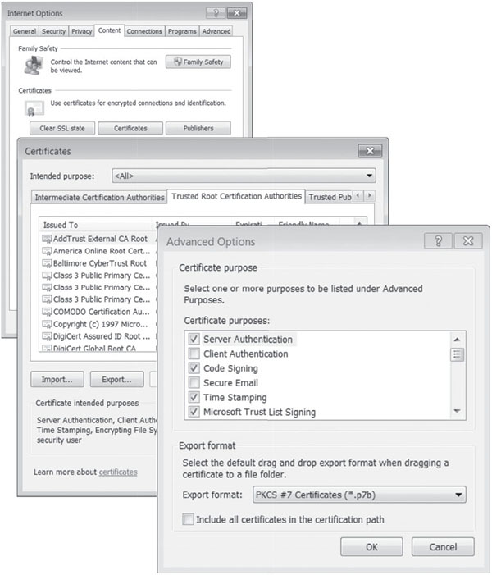
Figure 8-7 Digital signature in Windows Internet Explorer
Source: Windows Internet Explorer.

Slide 34
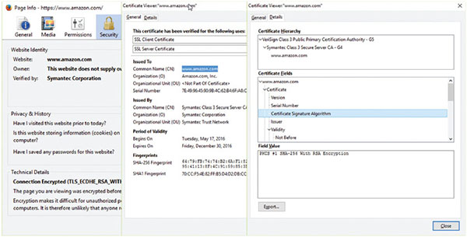
Figure 8-8 Example digital certificate
Source: Amazon.com.

Slide 35
Table 8-6 X.509 v3 Certificate Structure (1of 2)
X.509 v3 Certificate Structure
Version
Certificate Serial Number
• Algorithm ID • Algorithm ID • Parameters
Issuer Name
• Validity • Not Before • Not After
Subject Name
Subject Public-Key Information • Public-Key Algorithm • Parameters • Subject Public Key
Issuer Unique Identifier (Optional)

Slide 36
Table 8-6 X.509 v3 Certificate Structure (2 of 2)
Subject Unique Identifier (Optional)
Extensions (Optional) • Type • Criticality • Value
Certificate Signature Algorithm
Certificate Signature
Source: Stallings, W. Cryptography and Network Security, Principles and Practice.

Slide 37
Hybrid Cryptography Systems
Except with digital certificates, pure asymmetric key encryption is not widely used.
Asymmetric encryption is more often used with symmetric key encryption, as part of a hybrid system.
Diffie-Hellman Key Exchange method:
Most common hybrid system
Provides foundation for subsequent developments in public-key encryption
Notes:
Hybrid Cryptography Systems
Except with digital certificates, pure asymmetric key encryption not widely used
Asymmetric encryption more often used with symmetric key encryption, as part of a hybrid system
Diffie-Hellman Key Exchange method:
Most common hybrid system
Provides foundation for subsequent developments in public-key encryption

Slide 38

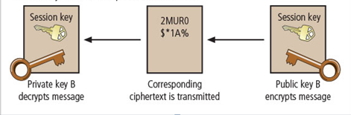
Figure 8-9 Example of hybrid encryption
Rachel at ABC corp. stores her public key where it can be accessed. Alex at XYZ corp. retrieves it and uses it to encrypt his session (symmetric) key. He sends it to Rachel, who decrypts Alex’s session key with her private key, and then uses Alex’s session key for short-term private communications.

Slide 39
Steganography
The process of hiding messages; for example, hiding a message within the digital encoding of a picture or graphic so that it is almost impossible to detect that the hidden message even exists
Also known as the art of secret writing
Has been used for centuries
Most popular modern version hides information within files that contain digital pictures or other images
Some applications hide messages in .bmp, .wav, .mp3, and .au files, as well as in unused space on CDs and DVDs
Notes:
Steganography
“Art of secret writing”
Has been used for centuries
Most popular modern version hides information within files that contain digital pictures or other images
Some applications hide messages in .bmp, .wav, .mp3, and .au files, as well as in unused space on CDs and DVDs

Slide 40
Protocols for Secure Communications
Most of the software currently used to protect the confidentiality of information are not true cryptosystems.
They are applications to which cryptographic protocols have been added.
Particularly true of Internet protocols.
As the number of threats to the Internet grew, so did the need for additional security measures.
Notes:
Protocols for Secure Communications
Most of the software currently used to protect the confidentiality of information are not true cryptosystems
They are applications to which cryptographic protocols have been added
Particularly true of Internet protocols
As the number of threats to the Internet grew, so did the need for additional security measures

Slide 41
Securing Internet Communication with S-HTTP and SSL
Secure Sockets Layer (SSL) protocol: developed by Netscape; uses public-key encryption to secure channel over public Internet.
Secure Hypertext Transfer Protocol (S-HTTP): extended version of Hypertext Transfer Protocol; provides for encryption of individual messages between client and server across Internet.
S-HTTP is the application of SSL over HTTP
Allows encryption of information passing between computers through protected and secure virtual connection
Notes:
Securing Internet Communication with S-HTTP and SSL
Secure Sockets Layer (SSL) protocol: uses public key encryption to secure channel over public Internet
Secure Hypertext Transfer Protocol (S-HTTP): extended version of Hypertext Transfer Protocol; provides for encryption of individual messages between client and server across Internet
S-HTTP is the application of SSL over HTTP
Allows encryption of information passing between computers through protected and secure virtual connection

Slide 42
Securing E-mail with S/MIME, PEM, and PGP
Secure Multipurpose Internet Mail Extensions (S/MIME): builds on Multipurpose Internet Mail Extensions (MIME) encoding format and uses digital signatures based on public-key cryptosystems.
Privacy Enhanced Mail (PEM): proposed as standard to use 3DES symmetric key encryption and RSA for key exchanges and digital signatures.
Pretty Good Privacy (PGP): uses IDEA Cipher for message encoding.
Notes:
Securing E-mail
A number of encryption cryptosystems have been adapted in an attempt to inject some degree of security into e-mail, a notoriously unsecured medium.
S/MIME builds on the Multipurpose Internet Mail Extensions (MIME) encoding format by adding encryption and authentication through digital signatures based on public key cryptosystems.
Privacy Enhanced Mail (PEM) was proposed by the Internet Engineering Task Force (IETF) as a standard to function with the public-key cryptosystems.
PEM uses 3DES symmetric key encryption and RSA for key exchanges and digital signatures.
Pretty Good Privacy (PGP) was developed by Phil Zimmerman and uses the IDEA Cipher, a 128-bit symmetric key block encryption algorithm with 64-bit blocks for message encoding.
IDEA performs eight rounds on 16-bit sub-blocks using algebraic calculations.
PGP also uses RSA for symmetric key exchange and for digital signatures.
Secure Multipurpose Internet Mail Extensions (S/MIME): builds on Multipurpose Internet Mail Extensions (MIME) encoding format and uses digital signatures based on public-key cryptosystems
Privacy Enhanced Mail (PEM): proposed as standard to use 3DES symmetric key encryption and RSA for key exchanges and digital signatures
Pretty Good Privacy (PGP): uses IDEA Cipher for message encoding

Slide 43
Securing Web Transactions with SET, SSL, and S-HTTP
Secure Electronic Transactions (SET): developed by MasterCard and VISA in 1997 to protect against electronic payment fraud.
Uses DES to encrypt credit card information transfers.
Provides security for both Internet-based credit card transactions and credit card swipe systems in retail stores.
Notes:
Securing Web Transactions with SET, SSL, and S-HTTP
Secure Electronic Transactions (SET): developed by MasterCard and VISA in 1997 to protect against electronic payment fraud
Uses DES to encrypt credit card information transfers
Provides security for both Internet-based credit card transactions and credit card swipe systems in retail stores

Slide 44
Securing Wireless Networks with WEP and WPA
Wired Equivalent Privacy (WEP): early attempt to provide security with the 8002.11 network protocol.
Wi-Fi Protected Access (WPA and WPA2): created to resolve issues with WEP.
Next Generation Wireless Protocols: Robust Secure Networks (RSN), AES–Counter Mode CBC MAC Protocol (CCMP).
Bluetooth can be exploited by anyone within approximately 30 foot range, unless suitable security controls are implemented.

Slide 45
Table 8-9 WEP Versus WPA
 | WEP | WPA
Encryption | Broken by scientists and hackers | Overcomes all WEP shortcomings
 | 40-bit key | 128-bit key
 | Static key- the same value is used by everyone on the network | Dynamic keys-each user is assigned a key per session with additional keys calculated for each pocket
 | Manual key distribution-each key is typed by hand into each device | Automatic key distribution
Authentication | Broken; used WEP key itself for Authentication | Improved user authentication, using stronger 802. 1X and EAP
Source: www.wi-fi.org/files/wp_8_WPA%20Security_4-29-03.pdf.

Slide 46
Securing TCP/IP with IPSec and PGP (1 of 2)
Internet Protocol Security (IPSec): an open-source protocol framework for security development within the TCP/IP family of protocol standards.
IPSec uses several different cryptosystems
Diffie-Hellman key exchange for deriving key material between peers on a public network
Public-key cryptography for signing the Diffie-Hellman exchanges to guarantee identity
Bulk encryption algorithms for encrypting the data
Digital certificates signed by a certificate authority to act as digital ID cards

Slide 47
Securing TCP/IP with IPSec and PGP (2 of 2)
Pretty Good Privacy (PGP): hybrid cryptosystem designed in 1991 by Phil Zimmermann
Combined best available cryptographic algorithms to become open source de facto standard for encryption and authentication of e-mail and file storage applications
Freeware and low-cost commercial PGP versions are available for many platforms
PGP security solution provides six services: authentication by digital signatures, message encryption, compression, e-mail compatibility, segmentation, key management
Notes:
PGP
Pretty Good Privacy (PGP): hybrid cryptosystem designed in 1991 by Phil Zimmermann
Combined best available cryptographic algorithms to become open source de facto standard for encryption and authentication of e-mail and file storage applications
Freeware and low-cost commercial PGP versions are available for many platforms
PGP security solution provides six services: authentication by digital signatures; message encryption; compression; e-mail compatibility; segmentation; key management

Slide 48
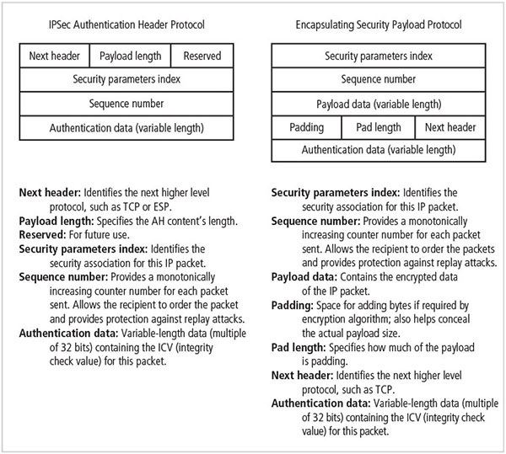
Figure 8-10 IPSec headers

Slide 49
Summary (1 of 5)
Encryption is the process of converting a message into a form that is unreadable to unauthorized people.
The science of encryption, known as cryptology, encompasses cryptography (making and using encryption codes) and cryptanalysis (breaking encryption codes).
Two basic processing methods are used to convert plaintext data into encrypted data—bit stream and block ciphering.

Slide 50
Summary (2 of 5)
The other major methods used for scrambling data include substitution ciphers, transposition ciphers, the XOR function, the Vigenère cipher, and the Vernam cipher.
The strength of many encryption applications and cryptosystems is determined by key size.
Hash functions are mathematical algorithms that generate a message summary, or digest, that can be used to confirm the identity of a specific message, and confirm that the message has not been altered.

Slide 51
Summary (3 of 5)
Most cryptographic algorithms can be grouped into two broad categories: symmetric and asymmetric. Most popular cryptosystems combine the two.
Public-key infrastructure (PKI) is an integrated system of software, encryption methodologies, protocols, legal agreements, and third-party services. PKI includes digital certificates and certificate authorities.
Digital signatures are encrypted messages that are independently verified by a central facility, and which provide nonrepudiation.

Slide 52
Summary (4 of 5)
Steganography is the hiding of information. It is not properly a form of cryptography, but is similar in that it is used to protect confidential information while in transit.
S-HTTP (Secure Hypertext Transfer Protocol), Secure Electronic Transactions (SET), and SSL (Secure Sockets Layer) are protocols designed to enable secure communications across the Internet.
IPSec is the protocol used to secure communications across any IP-based network, such as LANs, WANs, and the Internet.

Slide 53
Summary (5 of 5)
Secure Multipurpose Internet Mail Extensions (S/MIME), Privacy Enhanced Mail (PEM), and Pretty Good Privacy (PGP) are protocols that are used to secure e-mail.
Wireless networks require their own cryptographic protection. Originally protected with WEP and WPA, most modern Wi-Fi networks are now protected with WPA2.

