Slide 1
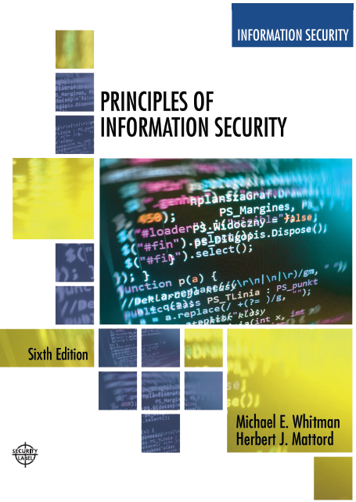

Principles of Information Security
Sixth Edition
Chapter 12
Information Security Maintenance
Copyright © 2018 Cengage. May not be copied, scanned, or duplicated, in whole or in part, except for use as permitted in a license distributed with a certain product or service or otherwise on a password-protected website for classroom use.

Slide 2
Learning Objectives (1 of 2)
Upon completion of this material, you should be able to:
Discuss the need for ongoing maintenance of the information security program
List the recommended security management models
Define a model for a full maintenance program
Identify the key factors involved in monitoring the external and internal environment
Describe how planning, risk assessment, vulnerability assessment, and remediation tie into information security maintenance
Notes:
Learning Objectives
Upon completion of this material you should be able to:
Discuss the need for the ongoing maintenance of the information security program
List the recommended security management models
Define a model for a full maintenance program
Identify the key factors involved in monitoring the external and internal environment
Describe how planning, risk assessment, vulnerability assessment, and remediation tie into information security maintenance
Explain how to build readiness and review procedures into information security maintenance
Define digital forensics, and describe the management of the digital forensics function
Describe the process of acquiring, analyzing, and maintaining potential evidentiary material

Slide 3
Learning Objectives (2 of 2)
Explain how to build readiness and review procedures into information security maintenance
Discuss digital forensics and describe how to manage it
Describe the process of acquiring, analyzing, and maintaining potential evidentiary material
Notes:
Learning Objectives
Upon completion of this material you should be able to:
Discuss the need for the ongoing maintenance of the information security program
List the recommended security management models
Define a model for a full maintenance program
Identify the key factors involved in monitoring the external and internal environment
Describe how planning, risk assessment, vulnerability assessment, and remediation tie into information security maintenance
Explain how to build readiness and review procedures into information security maintenance
Define digital forensics, and describe the management of the digital forensics function
Describe the process of acquiring, analyzing, and maintaining potential evidentiary material

Slide 4
Introduction
Organizations should avoid overconfidence after improving their information security profile.
Organizational changes that may occur include:
Acquisition of new assets, emergence of new vulnerabilities, shifting business priorities, partnerships form or dissolve, employee hire and turnover
If a program is not adequately adjusting, it may be necessary to begin the cycle again.
If an organization creates adjustable procedures and systems, the existing security improvement program can continue to work well.
Notes:
Introduction
Organizations should avoid overconfidence after improving their information security profile
Organizational changes that may occur include:
Acquisition of new assets; emergence of new vulnerabilities; shifting business priorities; partnerships form or dissolve; employee hire and turnover
If program is not adequately adjusting, may be necessary to begin cycle again
If organization creates adjustable procedures and systems, existing security improvement program can continue to work well

Slide 5
Security Management Maintenance Models
Management model must be adopted to manage and operate the ongoing security program.
Models are frameworks that structure the tasks of managing particular set of activities or business functions.
Notes:
Security Management Models
To assist the information security community to manage and operate the ongoing security program, a management model must be adopted.
In general, management models are frameworks that structure the tasks of managing a particular set of activities or business functions.

Slide 6
NIST SP 800-100 Information Security Handbook: A Guide for Managers (1 of 6)
This provides managerial guidance for establishing and implementing an information security program.
There are 13 areas of information security management presented
Provides for specific monitoring activities for each task.
Tasks should be done on an ongoing basis.
Not all issues are negative.
Information security governance
Agencies should monitor the status of their programs to ensure:
Ongoing information security activities are providing appropriate support
Notes:
NIST SP 800-100 Information Security Handbook
Provides managerial guidance for establishing and implementing an information security program
There are thirteen areas of information security management presented
Provides for specific monitoring activities for each task
Tasks should be done on an ongoing basis
Not all issues are negative
Information security governance
Agencies should monitor the status of their programs to ensure:
Ongoing information security activities providing appropriate support

Slide 7
NIST SP 800-100 Information Security Handbook: A Guide for Managers (2 of 6)
Policies and procedures are current
Controls are accomplishing their intended purpose
System Development Life Cycle: the overall process of developing, implementing, and retiring information systems through a multistep process.
Awareness and training
Tracking system should capture key information on program activities.
Tracking compliance involves assessing the status of the program
Security policies must continue to evolve
Notes:
Policies and procedures are current
Controls are accomplishing their intended purpose
System Development Life Cycle: the overall process of developing, implementing, and retiring information systems through a multistep process

Slide 8
NIST SP 800-100 Information Security Handbook: A Guide for Managers (3 of 6)
Capital planning and investment control
Departments required to allocate funding toward highest-priority investments
Designed to facilitate the expenditure of agency funds
Interconnecting systems
The direct connection of two or more information systems for sharing data and other information resources
Can expose the participating organizations to risk
If one of the connected systems is compromised, interconnection could be used as conduit
Notes:
Interconnecting systems
The direct connection of two or more information systems for sharing data and other information resources
Can expose the participating organizations to risk
If one of connected systems compromised, interconnection could be used as conduit

Slide 9
NIST SP 800-100 Information Security Handbook: A Guide for Managers (4 of 6)
Performance measures
Metrics should be used for monitoring the performance of information security controls
Six-phase iterative process
Security planning
One of the most crucial ongoing responsibilities in security management
Information technology contingency planning
Consists of a process for recovery and documentation of procedures
Notes:
Performance measures
Metrics should be used for monitoring performance of information security controls
Six phase iterative process
Security planning
One of the most crucial ongoing responsibilities in security management
Information technology contingency planning
Consists of a process for recovery and documentation of procedures

Slide 10
NIST SP 800-100 Information Security Handbook: A Guide for Managers (5 of 6)
Risk management
Ongoing effort
Tasks include performing risk identification, analysis, and management
Certification, accreditation, and security assessments
An essential component of any security program
The status of security controls is checked regularly
Auditing: the review of a system’s use to determine if misuse/malfeasance has occurred
Notes:
Risk management
Ongoing effort
Tasks include performing risk identification, analysis, and management
Certification, accreditation, and security assessments
An essential component of any security program
The status of security controls is checked regularly
Auditing: the review of a system’s use to determine if misuse/malfeasance has occurred

Slide 11
NIST SP 800-100 Information Security Handbook: A Guide for Managers (6 of 6)
Security services and products acquisition
Incident response: incident response life cycle
Configuration (or change) management: manages the effects of changes in configurations, five-step process
Notes:
Security services and products acquisition
Incident response: incident response life cycle
Configuration (or change) management: manages the effects of changes in configurations, 5 step process

Slide 12
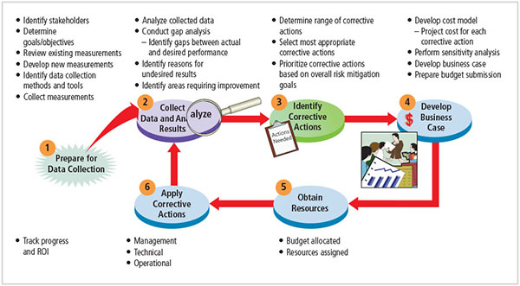
Figure 12-1 Information security measurement program implementation
Source: NIST SP 800-55 Rev. 1.

Slide 13
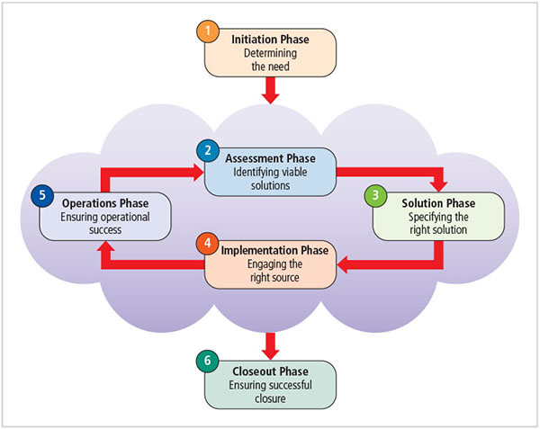
Figure 12-2 Conversion strategies
Source: NIST SP 800-35

Slide 14
The Security Maintenance Model
Designed to focus the organizational effort on maintaining systems
Recommended maintenance model based on five subject areas:
External monitoring
Internal monitoring
Planning and risk assessment
Vulnerability assessment and remediation
Readiness and review
Notes:
The Security Maintenance Model
Designed to focus organizational effort on maintaining systems
Recommended maintenance model based on five subject areas:
External monitoring
Internal monitoring
Planning and risk assessment
Vulnerability assessment and remediation
Readiness and review

Slide 15
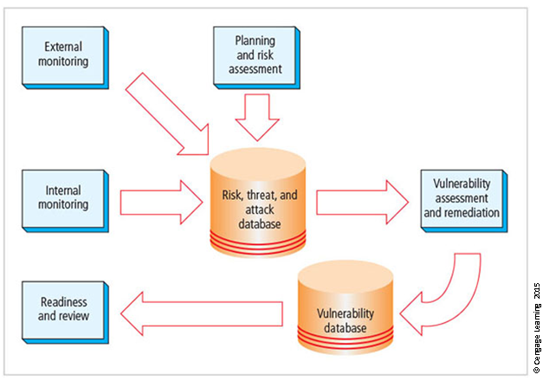
Figure 12-4 The maintenance model

Slide 16
Monitoring the External Environment (1 of 7)
Objective to provide early awareness of new and emerging threats, threat agents, vulnerabilities, and attacks so the organization can mount an effective defense.
Entails collecting intelligence from data sources and giving that intelligence context and meaning for use by organizational decision makers.
Data sources
Acquiring threat and vulnerability data is not difficult
Turning data into information decision makers can use is the challenge
Notes:
Monitoring the External Environment
Objective to provide early awareness of new and emerging threats, threat agents, vulnerabilities, and attacks so organization can mount an effective defense
Entails collecting intelligence from data sources and giving that intelligence context and meaning for use by organizational decision makers

Slide 17
Monitoring the External Environment (2 of 7)
External intelligence comes from vendors, computer emergency response teams (CERTs), public network sources, or membership sites
Regardless of where or how external monitoring data are collected must be analyzed in the context of the organization’s security environment to be useful
Monitoring, escalation, and incident response
Function of external monitoring process is to monitor activity, report results, and escalate warnings
Monitoring process has three primary deliverables:
Notes:
Monitoring, Escalation, and Incident Response
Function of external monitoring process is to monitor activity, report results, and escalate warnings
Monitoring process has three primary deliverables:

Slide 18
Monitoring the External Environment (3 of 7)
Specific warning bulletins issued when developing threats and specific attacks pose measurable risk to the organization
Periodic summaries of external information
Detailed intelligence on highest risk warnings
Data collection and management
Over time, external monitoring processes should capture information about external environment in appropriate formats
External monitoring collects raw intelligence, filters for relevance, assigns a relative risk impact, and communicates to decision makers in time to make a difference
Notes:
Monitoring, Escalation, and Incident Response
Specific warning bulletins issued when developing threats and specific attacks pose measurable risk to organization
Periodic summaries of external information
Detailed intelligence on highest risk warnings

Slide 19
Monitoring the External Environment (4 of 7)
Primary goal is an informed awareness of state of organization’s networks, systems, and security defenses.
Internal monitoring accomplished by:
Inventorying network devices and channels, IT infrastructure and applications, and information security infrastructure elements
Leading the IT governance process
Real-time monitoring of IT activity
Monitoring the internal state of the organization’s networks and systems
Notes:
Monitoring the Internal Environment
Primary goal is informed awareness of state of organization’s networks, systems, and security defenses
Internal monitoring accomplished by:
Inventorying network devices and channels, IT infrastructure and applications, and information security infrastructure elements
Leading the IT governance process
Real-time monitoring of IT activity
Monitoring the internal state of the organization’s networks and systems

Slide 20
Monitoring the External Environment (5 of 7)
Network characterization and inventory
Organizations should have/maintain carefully planned and fully populated inventory of network devices, communication channels, and computing devices
Once characteristics are identified, they must be carefully organized and stored using a mechanism (manual or automated) that allows timely retrieval and rapid integration of disparate facts
Notes:
Network Characterization and Inventory
Organizations should have/maintain carefully planned and fully populated inventory of network devices, communication channels, and computing devices
Once characteristics identified, they must be carefully organized and stored using a mechanism (manual or automated) that allows timely retrieval and rapid integration of disparate facts

Slide 21
Monitoring the External Environment (6 of 7)
Making intrusion detection and prevention systems work
The most important value of raw intelligence provided by the intrusion detection system (IDS) is providing indicators of current or imminent vulnerabilities
Log files from IDS engines can be mined for information
Another IDS monitoring element is traffic analysis
Analyzing attack signatures from unsuccessful system attacks can identify weaknesses in various security efforts

Slide 22
Monitoring the External Environment (7 of 7)
Detecting differences
Difference analysis: procedure that compares current state of network segment against known previous state of same segment
Unexpected differences between the current state and the baseline state could indicate trouble
Notes:
Detecting Differences
Difference analysis: procedure that compares current state of network segment against known previous state of same segment
Unexpected differences between the current state and the baseline state could indicate trouble

Slide 23
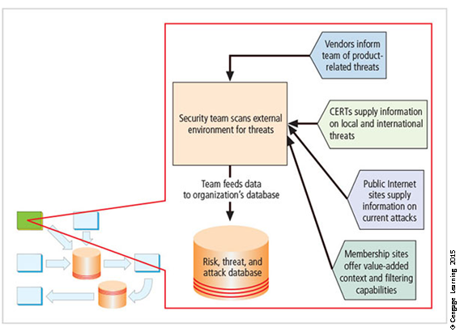
Figure 12-4 External monitoring

Slide 24
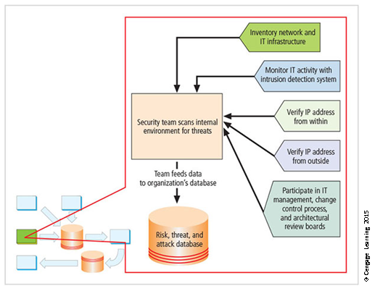
Figure 12-6 Internal monitoring

Slide 25
Planning and Risk Assessment (1 of 4)
Primary objective is to keep a lookout over the entire information security program.
Primary objective is accomplished by identifying and planning ongoing information security activities that further reduce risk.
Primary objectives
Establishing a formal information security program review process
Instituting formal project identification, selection, planning, and management processes
Notes:
Planning and Risk Assessment
Primary objective is to keep lookout over entire information security program
Accomplished by identifying and planning ongoing information security activities that further reduce risk

Slide 26
Planning and Risk Assessment (2 of 4)
Coordinating with IT project teams to introduce risk assessment and review for all IT projects
Integrating a mindset of risk assessment throughout the organization
Information security program planning and review
Periodic review of ongoing information security program and planning for enhancements and extensions is recommended
It should examine future IT needs of organization and its impact on information security
Notes:
Information Security Program Planning and Review
Periodic review of ongoing information security program and planning for enhancements and extensions is recommended
Should examine future IT needs of organization and impact on information security
A recommended approach takes advantage of the fact most organizations have annual capital budget planning cycles and manage security projects as part of that process

Slide 27
Planning and Risk Assessment (3 of 4)
A recommended approach takes advantage of the fact that most organizations have annual capital budget planning cycles and manage security projects as part of that process
Large projects should be broken into smaller projects for several reasons
Smaller projects tend to have more manageable impacts on networks and users
Larger projects tend to complicate the change control process in the implementation phase
Shorter planning, development, and implementation schedules reduce uncertainty
Notes:
Information Security Program Planning and Review
A recommended approach takes advantage of the fact most organizations have annual capital budget planning cycles and manage security projects as part of that process
Planning and Risk Assessment
Large projects should be broken into smaller projects for several reasons
Smaller projects tend to have more manageable impacts on networks and users
Larger projects tend to complicate change control process in implementation phase
Shorter planning, development, and implementation schedules reduce uncertainty

Slide 28
Planning and Risk Assessment (4 of 4)
Most large projects can easily be broken down into smaller projects, giving more opportunities to change direction and gain flexibility
Security risk assessments
A key component for driving security program change is risk assessment (RA)
RA identifies and documents the risk that a project, process, or an action introduces to the organization and offers suggestions for controls
Information security group coordinates the preparation of many types of RA documents
Notes:
Planning and Risk Assessment
Most large projects can easily be broken down into smaller projects, giving more opportunities to change direction and gain flexibility

Slide 29
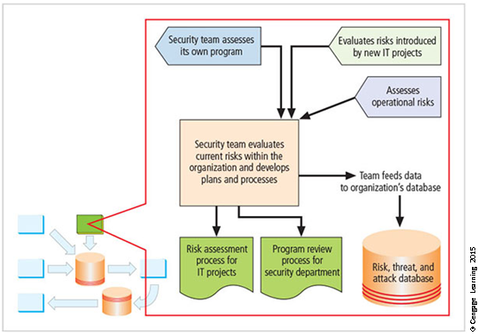
Figure 12-7 Planning and risk assessment

Slide 30
Vulnerability Assessment and Remediation (1 of 11)
Primary goal: identification of specific, documented vulnerabilities and their timely remediation
Accomplished by:
Using vulnerability assessment procedures
Documenting background information and providing tested remediation procedures for vulnerabilities
Tracking vulnerabilities from the time they are identified
Communicating vulnerability information to owners of vulnerable systems
Reporting on the status of vulnerabilities
Ensuring that the proper level of management is involved
Notes:
Vulnerability Assessment and Remediation
Primary goal: identification of specific, documented vulnerabilities and their timely remediation
Accomplished by:
Using vulnerability assessment procedures
Documenting background information and providing tested remediation procedures for vulnerabilities
Tracking vulnerabilities from the time they are identified
Communicating vulnerability information to owners of vulnerable systems
Reporting on the status of vulnerabilities
Ensuring the proper level of management is involved

Slide 31
Vulnerability Assessment and Remediation (2 of 11)
Process of identifying and documenting specific and provable flaws in the organization’s information asset environment.
Five following vulnerability assessment processes can help many organizations balance intrusiveness of vulnerability assessment with the need for a stable and effective production environment.
Penetration testing
A level beyond vulnerability testing
Is a set of security tests and evaluations that simulate attacks by a malicious external source (hacker)
Notes:
Vulnerability Assessment and Remediation
Process of identifying and documenting specific and provable flaws in organization’s information asset environment
Five following vulnerability assessment processes can help many organizations balance intrusiveness of vulnerability assessment with need for stable and effective production environment

Slide 32
Vulnerability Assessment and Remediation (3 of 11)
Penetration test (pen test): usually performed periodically as part of a full security audit
Can be conducted one of two ways: black box or white box
Internet vulnerability assessment
Designed to find and document vulnerabilities present in an organization’s public network
Steps in the process include:
Planning, scheduling, and notification
Target selection
Test selection
Notes:
Internet Vulnerability Assessment
Designed to find and document vulnerabilities present in organization’s public network
Steps in the process include:
Planning, scheduling, and notification
Target selection
Test selection
Scanning
Analysis
Record keeping

Slide 33
Vulnerability Assessment and Remediation (4 of 11)
Scanning
Analysis
Record keeping
Intranet vulnerability assessment
It is designed to find and document the selected vulnerabilities likely present on the internal network
Attackers are often internal members of the organization, affiliates of business partners, or automated attack vectors (such as viruses and worms)
This assessment is usually performed against critical internal devices with a known, high value by using selective penetration testing
Notes:
Intranet Vulnerability Assessment
Designed to find and document selected vulnerabilities likely present on the internal network
Attackers are often internal members of organization, affiliates of business partners, or automated attack vectors (such as viruses and worms)
This assessment is usually performed against critical internal devices with a known, high value by using selective penetration testing
Steps in process almost identical to steps in Internet vulnerability assessment

Slide 34
Vulnerability Assessment and Remediation (5 of 11)
Steps in the process are almost identical to the steps in the Internet vulnerability assessment
Platform security validation
It is designed to find and document vulnerabilities that may be present because misconfigured systems are in use within the organization
These misconfigured systems fail to comply with company policy or standards
Fortunately, automated measurement systems are available to help with the intensive process of validating the compliance of platform configuration with policy

Slide 35
Vulnerability Assessment and Remediation (6 of 11)
Wireless vulnerability assessment
It is designed to find and document vulnerabilities that may be present in wireless local area networks of the organization
Since attackers from this direction are likely to take advantage of any flaw, assessment is usually performed against all publicly accessible areas using every possible wireless penetration testing approach
Notes:
Wireless Vulnerability Assessment
Designed to find and document vulnerabilities that may be present in wireless local area networks of organization
Since attackers from this direction are likely to take advantage of any flaw, assessment is usually performed against all publicly accessible areas using every possible wireless penetration testing approach

Slide 36
Vulnerability Assessment and Remediation (7 of 11)
Documenting vulnerabilities
Vulnerability database should provide details about reported vulnerability as well as a link to the information assets
Low cost and ease of use make relational databases a realistic choice
Vulnerability database is an essential part of effective remediation
Notes:
Documenting Vulnerabilities
Vulnerability database should provide details about reported vulnerability as well as a link to the information assets
Low-cost and ease of use makes relational databases a realistic choice
Vulnerability database is an essential part of effective remediation

Slide 37
Vulnerability Assessment and Remediation (8 of 11)
Remediating vulnerabilities
Objective is to repair flaw causing a vulnerability instance or remove the risk associated with vulnerability
As last resort, informed decision makers with proper authority can accept risk
Important to recognize that building relationships with those who control information assets is key to success
Success depends on the organization adopting team approach to remediation, in place of cross-organizational push and pull
Notes:
Remediating Vulnerabilities
Objective is to repair flaw causing a vulnerability instance or remove risk associated with vulnerability
As last resort, informed decision makers with proper authority can accept risk
Important to recognize that building relationships with those who control information assets is key to success
Success depends on organization adopting team approach to remediation, in place of cross-organizational push and pull

Slide 38
Vulnerability Assessment and Remediation (9 of 11)
Acceptance or transference of risk
In some instances, risk must be either simply acknowledged as part of the organization’s business process or transferred to another organization via insurance
Management must be assured that decisions made to accept risk or buy insurance were made by properly informed decision makers
Information security must make sure the right people make risk assumption decisions with complete knowledge of the impact of the decision
Notes:
Acceptance or Transference of Risk
In some instances, risk must either simply be acknowledged as part of organization’s business process or transferred to another organization via insurance
Management must be assured that decisions made to accept risk or buy insurance were made by properly informed decision makers
Information security must make sure the right people make risk assumption decisions with complete knowledge of the impact of the decision

Slide 39
Vulnerability Assessment and Remediation (10 of 11)
Threat removal
In some circumstances, threats can be removed without repairing vulnerability
Other vulnerabilities may be mitigated by inexpensive controls
Vulnerability repair
Best solution in most cases is to repair the vulnerability
Applying patch software or implementing a workaround often accomplishes this
Most common repair is the application of a software patch
Notes:
Threat removal
In some circumstances, threats can be removed without repairing vulnerability
Other vulnerabilities may be mitigated by inexpensive controls
Vulnerability repair
Best solution in most cases is to repair vulnerability
Applying patch software or implementing a workaround often accomplishes this
Most common repair is application of a software patch

Slide 40
Vulnerability Assessment and Remediation (11 of 11)
Primary goal is to keep the information security program functioning as designed and continuously improving.
Accomplished by:
Policy review
Program review
Rehearsals
Notes:
Readiness and Review
Primary goal is to keep information security program functioning as designed and continuously improving
Accomplished by:
Policy review
Program review
Rehearsals

Slide 41
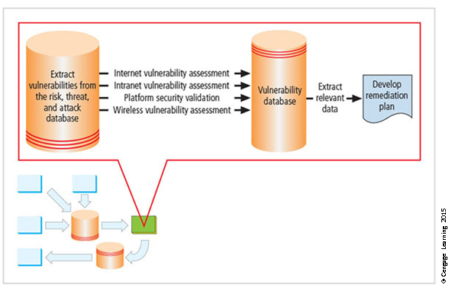
Figure 12-8 Vulnerability assessment and remediation

Slide 42
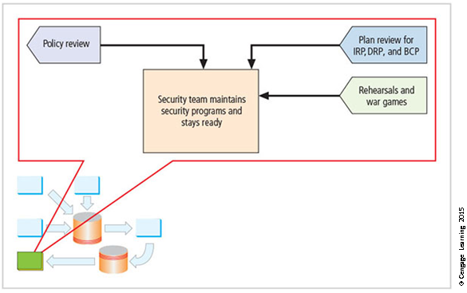
Figure 12-9 Readiness and review

Slide 43
Digital Forensics (1 of 2)
Used to document what happened during attack on assets and how attack occurred
Based on the field of traditional forensics
Involves preservation, identification, extraction, documentation, and interpretation of digital media for evidentiary and/or root-cause analysis
Evidentiary material (EM): any item or information that applies to an organization’s legal or policy-based case
Notes:
Digital Forensics
Used to document what happened during attack on assets and how attack occurred
Based on the field of traditional forensics
Involves preservation, identification, extraction, documentation, and interpretation of digital media for evidentiary and/or root cause analysis
Evidentiary material (EM): any item or information that applies to an organization’s legal or policy-based case

Slide 44
Digital Forensics (2 of 2)
Used for two key purposes:
To investigate allegations of digital malfeasance
To perform root-cause analysis
Organization chooses one of two approaches:
Protect and forget (patch and proceed): defense of data and systems that house, use, and transmit it
Apprehend and prosecute (pursue and prosecute): identification and apprehension of responsible individuals, with additional attention to collection and preservation of potential EM that might support administrative or criminal prosecution
Notes:
Digital Forensics
Used for two key purposes:
To investigate allegations of digital malfeasance
To perform root cause analysis
Organization chooses one of two approaches:
Protect and forget (patch and proceed): defense of data and systems that house, use, and transmit it
Apprehend and prosecute (pursue and prosecute): identification and apprehension of responsible individuals, with additional attention to collection and preservation of potential EM that might support administrative or criminal prosecution

Slide 45
The Digital Forensics Team
Most organizations
Cannot sustain a permanent digital forensics team
Collect data and outsource analysis
Information security group personnel should be trained to understand and manage the forensics process to avoid contamination of potential EM.
Expertise can be obtained by training.
Notes:
The Digital Forensics Team
Most organizations
Cannot sustain a permanent digital forensics team
Collect data and outsource analysis
Information security group personnel should be trained to understand and manage the forensics process to avoid contamination of potential EM
Expertise can be obtained by training

Slide 46
Affidavits and Search Warrants
Affidavit
Sworn testimony that certain facts are in the possession of the investigating officer; can be used to request a search warrant
The facts, the items, and the place must be specified
When an approving authority signs the affidavit, it becomes a search warrant, giving permission to
Search for EM at a specified location
Seize specific items for official examination
Notes:
Affidavits and Search Warrants
Affidavit
Sworn testimony that certain facts are in the possession of the investigating officer; can be used to request a search warrant
The facts, the items, and the place must be specified
When an approving authority signs the affidavit it becomes a search warrant, giving permission to:
Search for EM at a specified location
Seize specific items for official examination

Slide 47
Digital Forensics Methodology
All investigations follow the same basic methodology
Identify relevant EM
Acquire (seize) the evidence without alteration or damage
Take steps to assure that the evidence is at every step verifiably authentic and is unchanged from the time it was seized
Analyze the data without risking modification or unauthorized access
Report the findings to the proper authority
Notes:
Digital Forensics Methodology
All investigations follow the same basic methodology
Identify relevant EM
Acquire (seize) the evidence without alteration or damage
Take steps to assure that the evidence is at every step verifiably authentic and is unchanged from the time it was seized
Analyze the data without risking modification or unauthorized access
Report the findings to the proper authority

Slide 48
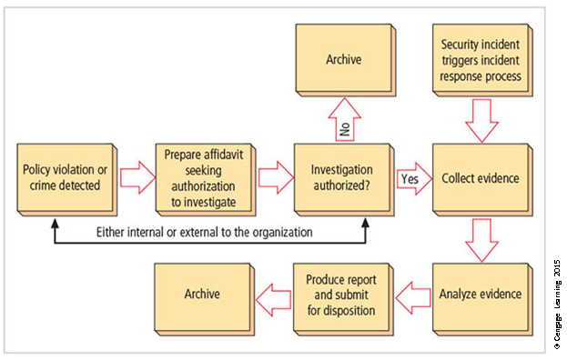
Figure 12-10 The digital forensics process

Slide 49
Evidentiary Procedures
Strong procedures for handling potential evidentiary material can minimize the probability of an organization losing a legal challenge.
Organizations should develop specific procedures, along with guidance for effective use.
The policy document should be supported by a procedures manual.
Notes:
Evidentiary Procedures
Strong procedures for handling potential evidentiary material can minimize the probability of an organization’s losing a legal challenge
Organizations should develop specific procedures, along with guidance for effective use
Should be supported by a procedures manual

Slide 50
Summary
Maintenance of the information security program is essential
Security management models assist in planning for ongoing operations
It is necessary to monitor the external and internal environment
Planning and risk assessment are the essential parts of information security maintenance
Need to understand how vulnerability assessment and remediation tie into information security maintenance
Need to understand how to build readiness and review procedures into information security maintenance
Digital forensics and management of digital forensics function

