Slide 1


Cracking the Kroger Code
Leveraging Data for Smarter Promotions and Coupons

Slide 2
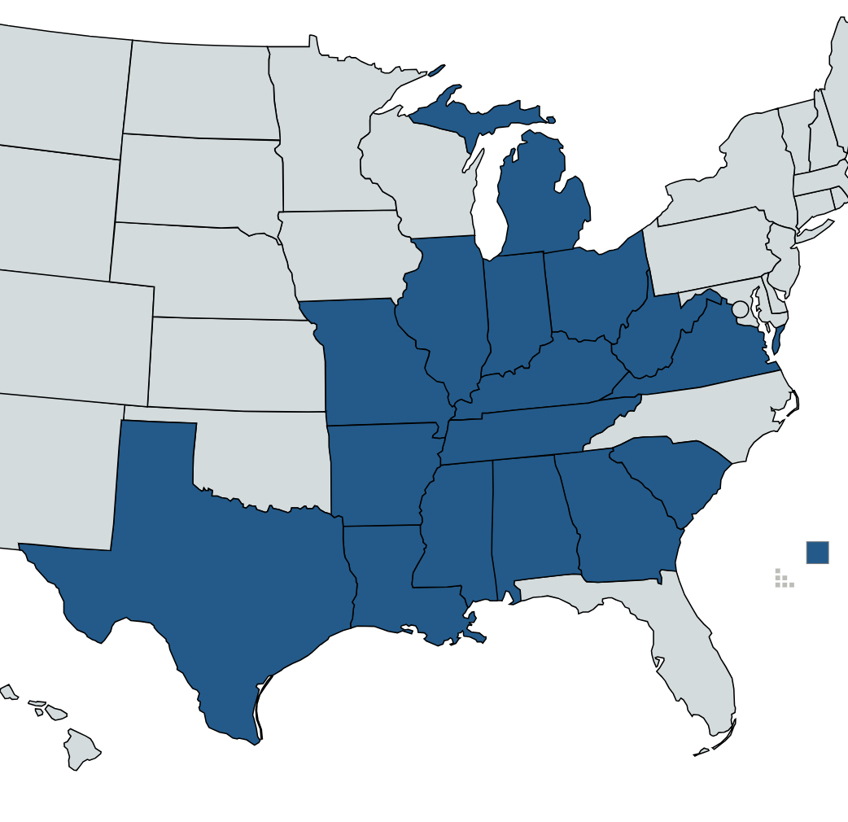
Strategic Identifications:
In regard to enhancing Kroger sales, there are additional factors to focus on besides price. This presentation will provide an in-depth analysis of Kroger’s previous sales on a national scale and incorporate fact-based suggestions to increase sales without decreasing revenue. This presentation will analyze the impact of company campaigns, coupons, promotions, and product placement on sales based on season. Target objectives, as well as relevant retail store information, will be incorporated into the presentation for guidance to allow an individual to make a well-informed decision regarding restructuring to boost sales. The vision of the presentation is to ensure that the cost of suggestions does not harm the profit margin or decrease Kroger’s liquidity.
27 Campaigns
116,204 Coupons Sent
2,102 Coupons Utilized
1.81% Coupon Redemption Rate Among:
457 individual stores
2,102 households
32 departments
304 Product Categories
Revenue
Brand Loyalty
Increase Units
Expenses
Promotions Based on Season
Department Restructure
Campaign Frequency
Kroger locations by state

Slide 3
Primary Data Identifications
Type A
Type B
Type C
3%
15%
82%
Utilization of each coupon type of the overall total
Leading Displays | Leading Mailers
0. No Display | L. Wrap Back Feature
5. Rear-End Cap | D. Front Page Feature
3. Front-End Cap | H. Wrap Front Feature
1. Store Front | C. Interior Page Line Item
7. In-Aisle | J. Wrap Interior Coupon
0
5
3
1
7
Type A: 16 Coupons based on prior customer purchases
Type B: Coupons based on the campaign
Type C: Coupons based on the campaign
L
D
H
C
J
B
B
B
A
B
B/B
A
C
C
B
A
B
C
B/B
B
C
B
B
A
C
B
C
B
B
B
Nov. 2016
Jan. 2017
March 2017
June 2017
Oct. 2017
Dec. 2017
[Indicates time of campaign and type]

Slide 4

Analyzed Recommendations:
Increase Type A Campaigns
Type A campaigns are the best-performing campaign type based on utilization volume. Type A coupons are 81.73% of the overall utilization total. From the supporting data, only 9,827 out of 155,848 baskets use at least one coupon. Type A campaigns occur quarterly and last for around one and a half months. Increasing the frequency of customized coupons would enhance units sold and produce customer loyalty. A bi-quarterly approach would produce anywhere from 30% to 38% unit increase.
Based on the analyzed data, increasing Type A coupons that are primarily coupon discounts supported by the manufacturer would be the best strategic approach. Coupon discount matches should be the secondary focus to increase, to ensure units do not harm profit.

Slide 5

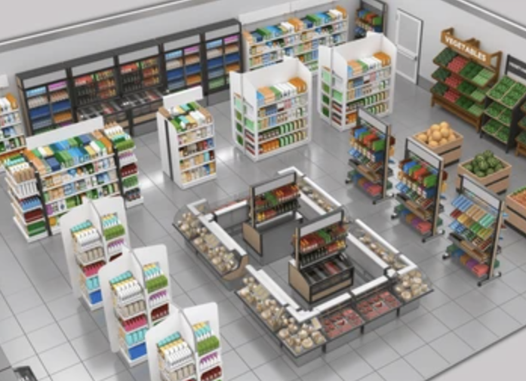










Analyzed Recommendations:
Reconstruct Promotional Placements
Low-Performing Items Based on Sales Value:
Best Performing Display Location:
An additional strategic approach is restructuring poorly performing items into high-performing display locations. High-performing items do not need to be restructured because the items are already utilized. Focusing on low-performing items offers a greater chance to improve results. This strategy will draw customers' attention to a wider demographic of items. This approach has to be tailored to each department to prevent inadequate execution. This strategy allows the possibility to incorporate low-performing items into high-performing mailer locations. Targeting underperforming products to rotate seasonally would provide a realistic execution.
Notes:
season

Slide 6
Analyzed Recommendation
Promote National-Brand Products
National-Brand Products
Private-Label Products
Based on the Product category of our analysis, there should be a greater emphasis on promoting national-brand products. National-brand has a sales value of almost 2 million greater than private-label, and accounts for 71.745% of overall revenue. However, individual private-label products are on promotion 76% more often than national-brand products.
85.04% of products fall under national-brands. For national brands, 7.96% of transactions occur for products under promotion, whereas for private-label brands 7.29% of transactions occur for products under promotion. Generally, promotions for national-brand products are more effective than private-label promotions due to the impact on sales.
Incorporating more promotions on national-brand products in relevant, reliable display and mailer locations would attract more consumers and greater sales.
Decreasing Kroger’s inventory of private-label products could additionally be beneficial to prevent overstock or waste of products. Incorporating promotions of private-label products would result in a loss of revenue due to higher demand for national-brand products. The enhancement of sales from private-label promotions would not exceed the current revenue of national-brand products.

Slide 7





Summer
2 Type A Campaigns
Increase National Labels
Fall
2 Type A Campaigns
Department Restructure
Winter
2 Type A Campaigns
Increase National Labels
Spring
2 Type A Campaigns
Department Restructure
Strategic Approach
To have a feasible execution, we suggest implementing the strategy via a seasonal approach. Product transactions and sales vary by season, due to school fluctuations and holidays. Each season should gradually incorporate strategic recommendations to prevent poor execution. For proper strategy results, the strategy should be incorporated via a seasonal structure for a 3–5-year period. We advise the continuous implementation of broad coupons (Type B and Type C), but utilizing Type A.

Slide 8
Based on the supporting data and information from the strategic identifications, we propose these three cohesive recommendations that will aim to increase customer activity and generate more sales.
Conclusions
Increase Type A Campaigns
Reconstruct Promotional Placements
Increase National-Brand Product Promotions
Type A: Demonstrated the highest coupon utilization volume, enabling customers to apply targeted discounts aligned with their purchase behavior.
Department Reconstruct: Identifies underperforming products for strategic review and optimization. Supports the continued placement of top-performing products to maximize sales potential.
Increase National-Brand Promotions: Sales Revenue from national brands exceeded that of private label products, indication a strong opportunity to prioritize national brand promotions in flyers and coupon campaigns.
Strategic Approach
Seasonal Variation Timeline
3-5 Year Scope

