Slide 1
Challenge 4: Preventing Melanomas
Team Members:
Kaylee Molin
Joel Noble
Ashlesha Gill
Gavin Pikes

Slide 2
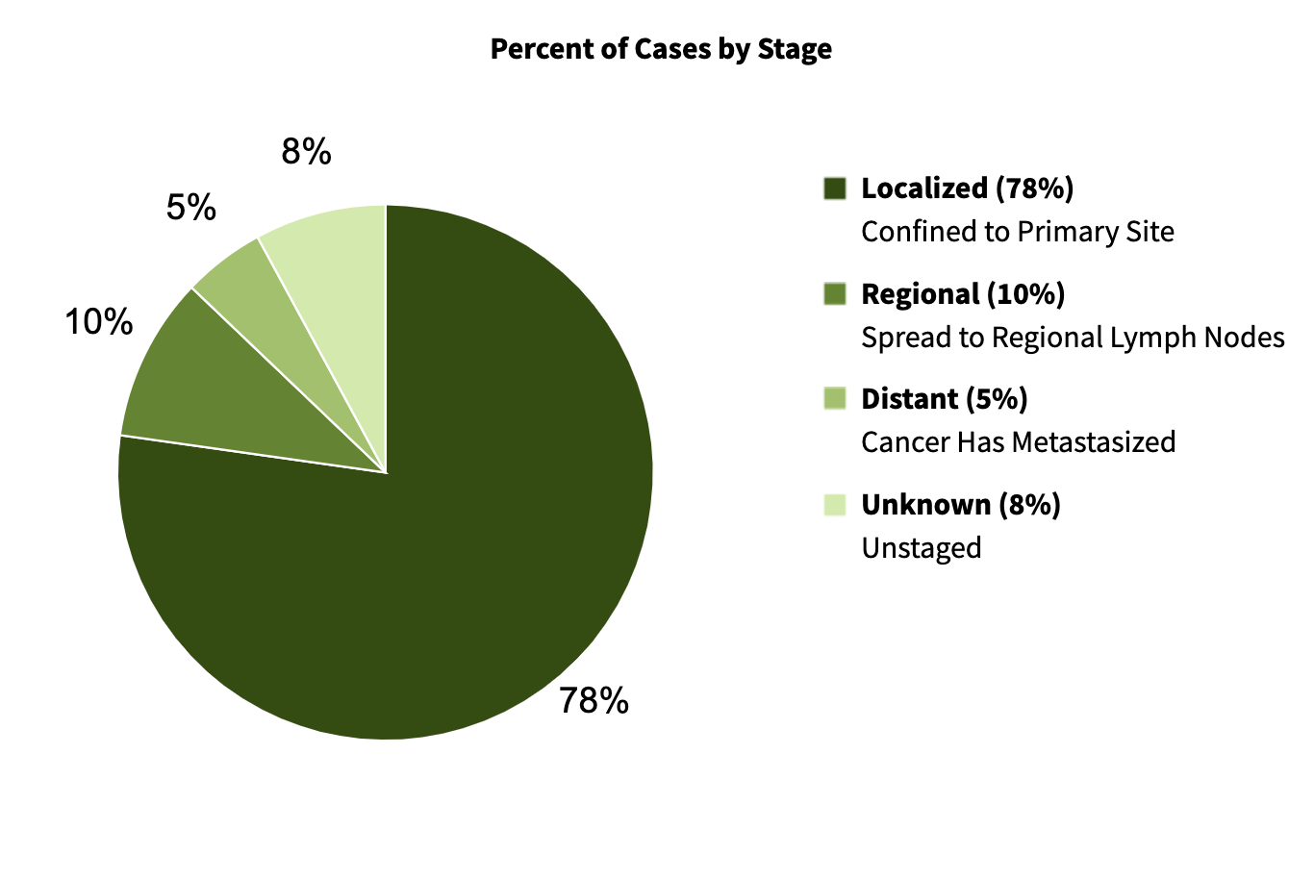
Melanoma- Scope
Statistics (Australia)
Very prevalent
17,756 diagnosed in 2022 making up 11% of all cancer diagnoses
Most cases are localised.

Slide 3
Clinical Workflow
Biopsy performed (within 2 weeks of initial GP consult)
and sent to pathology lab
Biopsy results
Medical check up
(In 1 week, typically back logged to few weeks)
Once stage is determined, treatment begins.
Visit to GP, Dermatologist.
Biopsy
Breslow thickness, Clark level, etc. assessed. Additional tests for lymph node involvement may be required.
Treatment
Melanoma can become life-threatening in as little as 6 weeks and, if untreated, it can spread to other parts of the body.

Slide 4
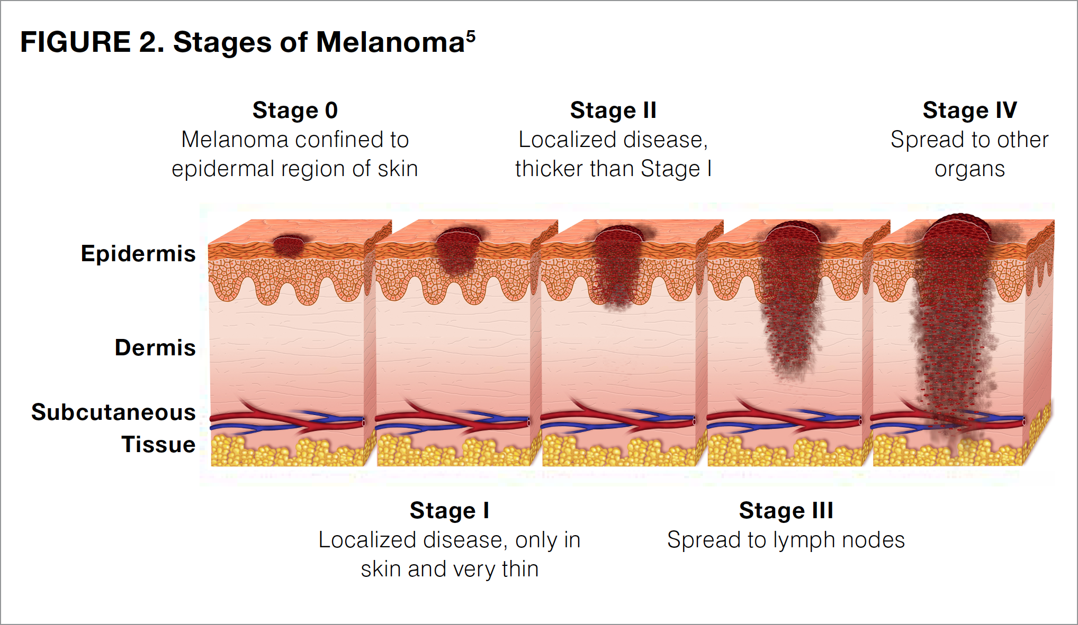
How is Melanoma staged?
Breslow thickness (T)
Clarke level (T)
Ulceration (T)
Tumour size (T)
Mitoses (T)
Involvement of lymph nodes (N)
spread to other organs (M) (metastasis)
Significant correlation between T stage and the N and M stages.

Slide 5
Our model can accurately differentiate between stage 1 and stage 2 melanoma using just Breslow and Clark level

Slide 6
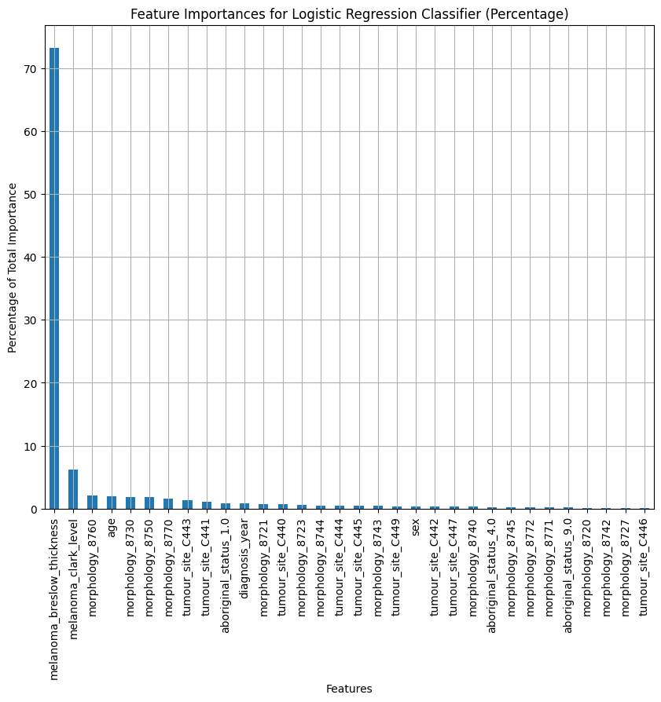
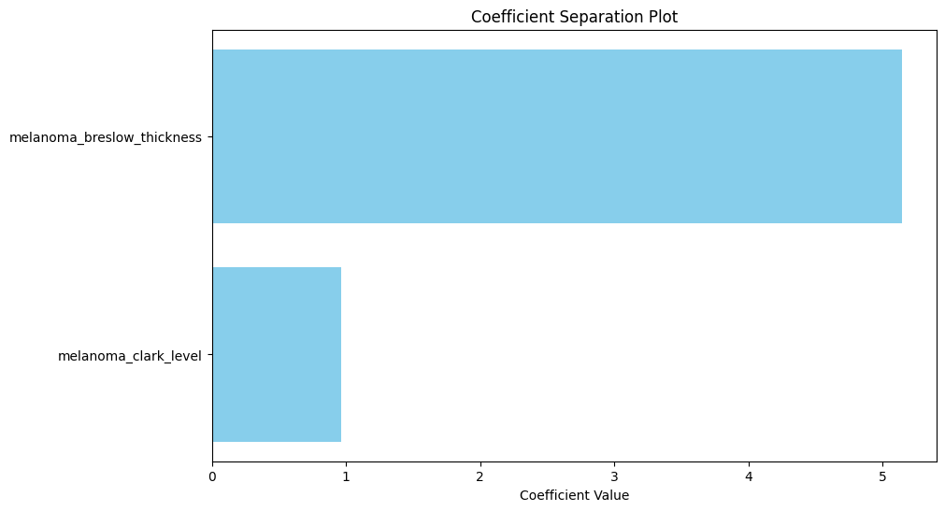
Evaluation of Machine learning model -1
01
02
03
Our teaching method
You can describe the topic of the section here
Meet our teachers
Feature Importance (Identifies key features influencing predictions):
One standout feature signifies its strong influence.
Coefficient Plot (One standout feature signifies its strong influence):
Highlights the relative importance of each feature.
* No Breslow/Clark data provided for stages 3 and 4.

Slide 7
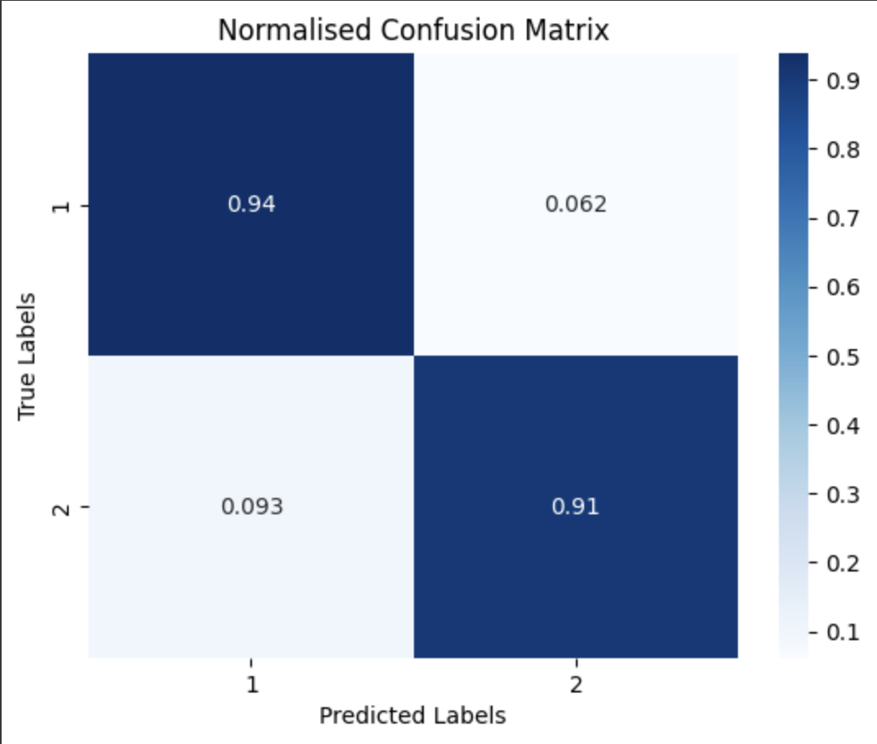
Evaluation of Machine learning model -2
Confusion Matrix (High diagonal values indicate accurate predictions):
Visualizes the accuracy of your model's predictions.

Slide 8
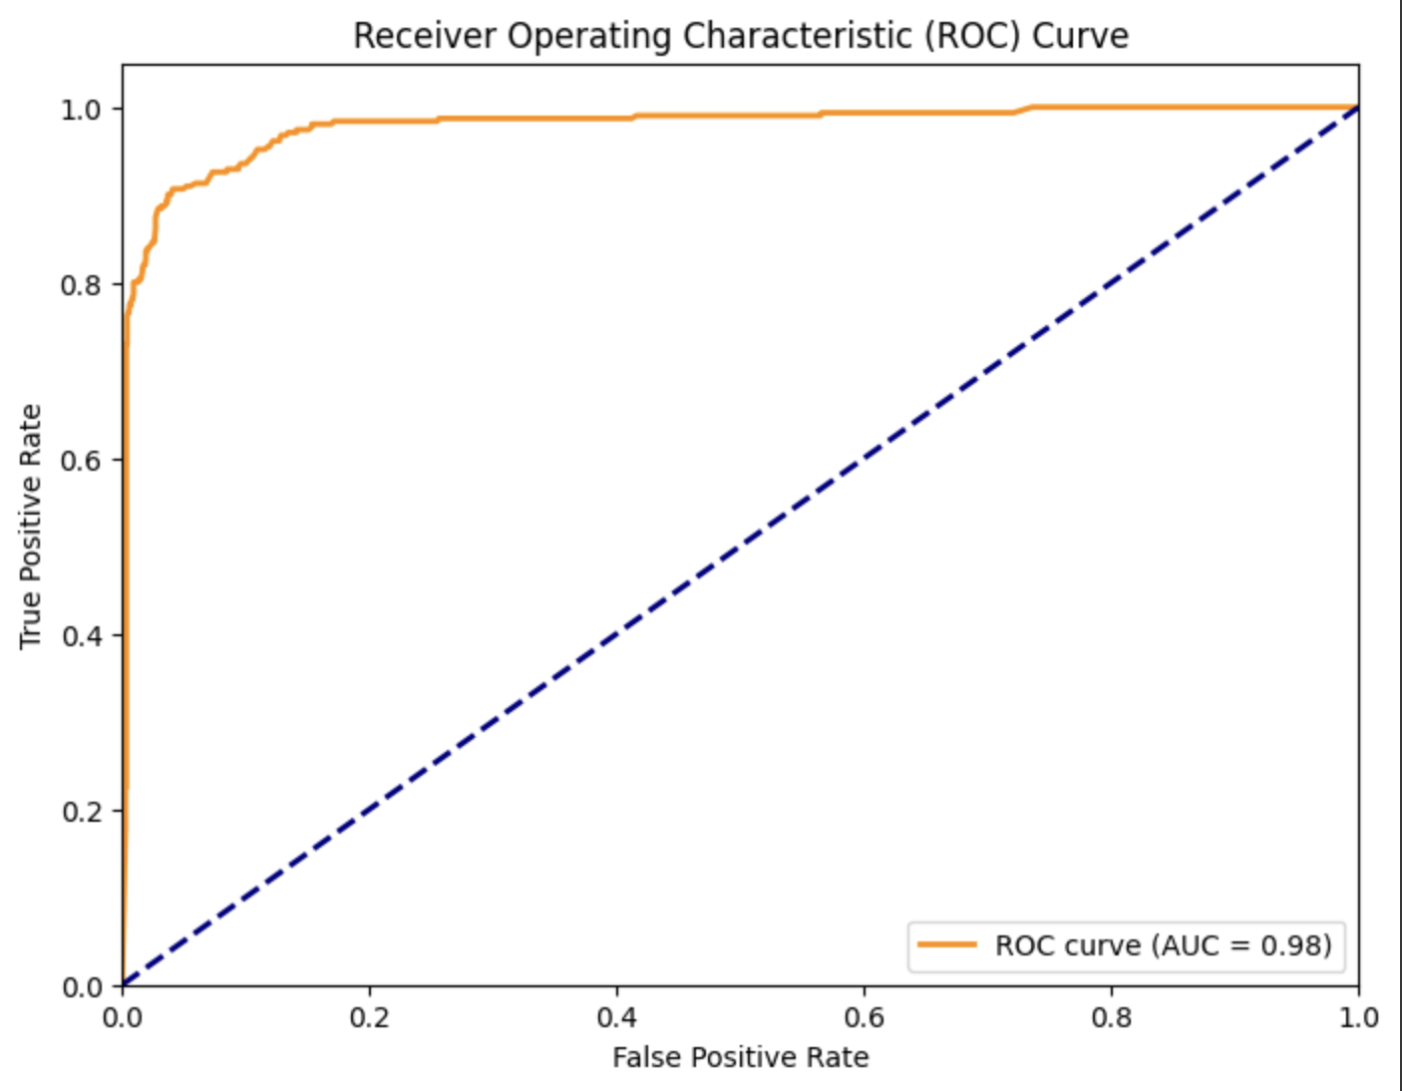
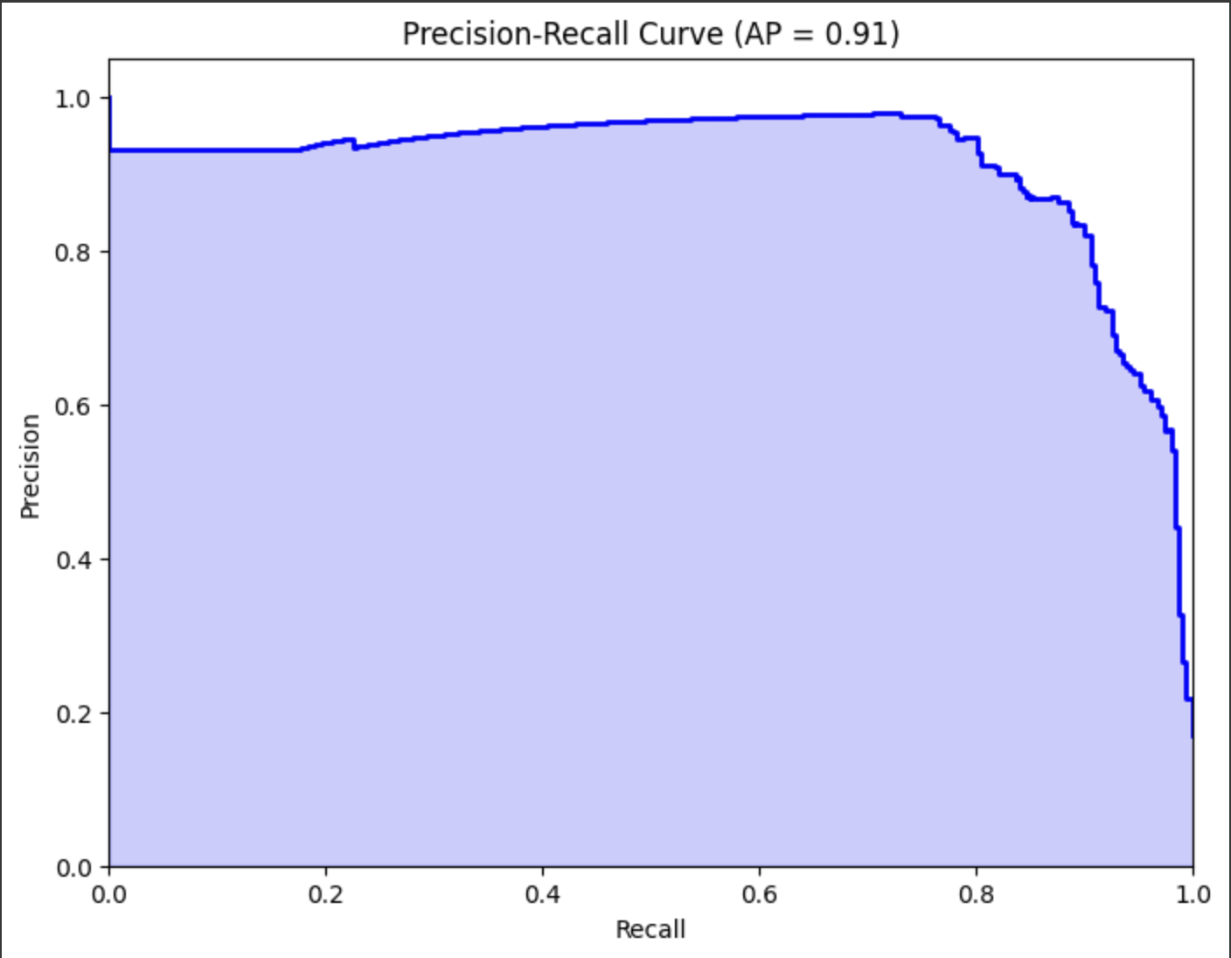
Evaluation of Machine learning model -3
Precision-Recall Curve:
Precision (Accuracy of positive predictions)
Recall (Ability to capture relevant instances)
Aesthetically pleasing curve with a large area means few errors in positive predictions.
ROC Curve:
Large area indicates effective distinction between positive and negative cases.
Evaluates a model's ability to distinguish between different classes of data.

Slide 9
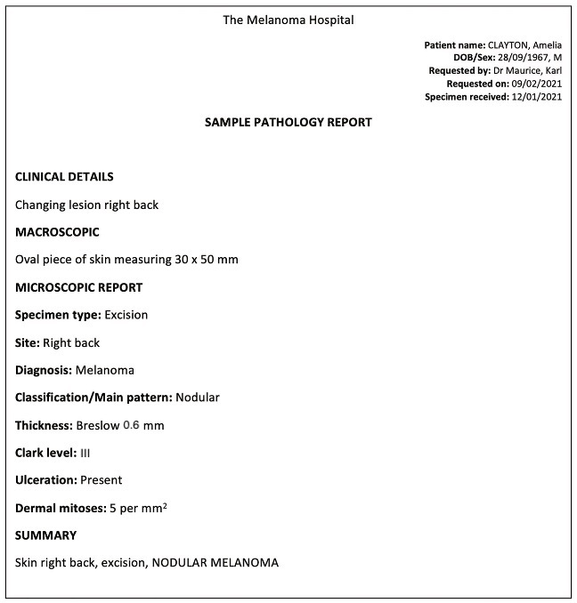


This model can:
Expedite higher risk patients to treatment
Reduce patient wait times from biopsy to preliminary diagnosis
Aid in treatment planning
Patient counselling

