Slide 1
hackathon

Slide 2
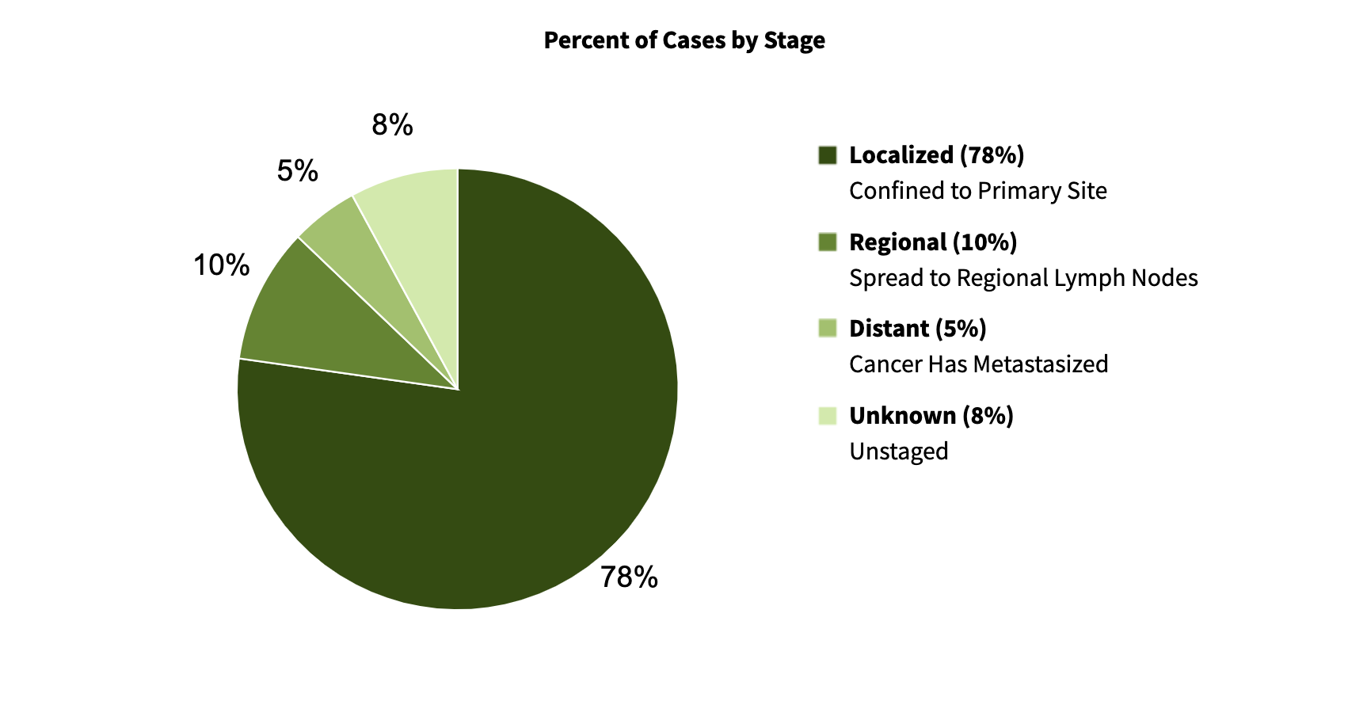
Melanoma - Scope
High prevalence in Australia
17,756 diagnosed in 2022 making up 11% of all diagnoses
Most cases are localised
Notes:
https://www.canceraustralia.gov.au/cancer-types/melanoma/statistics#:~:text=It%20is%20estimated%20that%20it,8%2C941%20males%20and%206%2C403%20females)
https://seer.cancer.gov/statfacts/html/melan.html.

Slide 3
Patient Journey
Patient detects suspicious spot
GP
Dermatologist (low grade)
Biposy which is sent to pathology lab
Pathologist take measurements
Cancer staging
Decisions for treatment based on stage

Slide 4
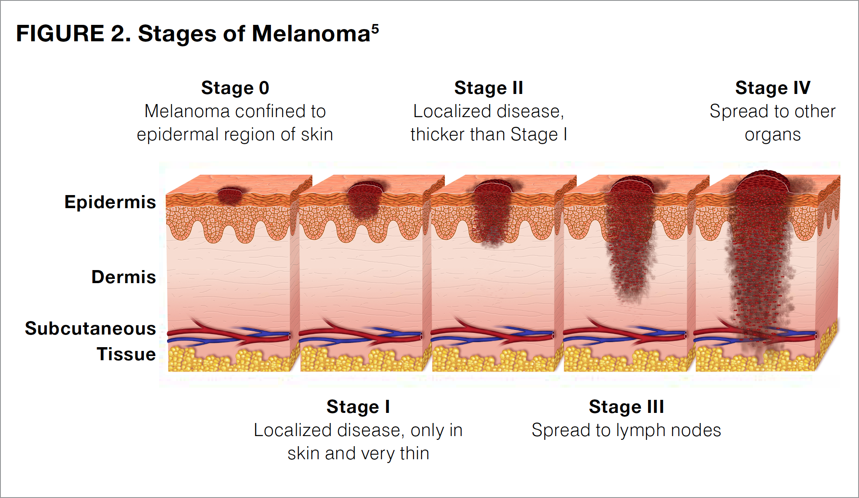
How is melanoma staged?
Breslow thickness
Clarke level
Ulceration
Tumour size
Mitoses
Involvement of lymph nodes
spread to other organs (metastasis)
Additional imaging
Notes:
https://melanoma.org.au/wp-content/uploads/2021/10/PATHOLOGY_and_STAGING_FA.pdf
https://conquer-magazine.com/issues/special-issues/the-journey-through-stage-iii-melanoma-a-guide-for-patients

Slide 5
Our Solution
Staging melanoma based only on Breslow and Clarke score only with very high accuracy (stages 1 and 2)
Notes:
https://conquer-magazine.com/issues/special-issues/the-journey-through-stage-iii-melanoma-a-guide-for-patients

Slide 6
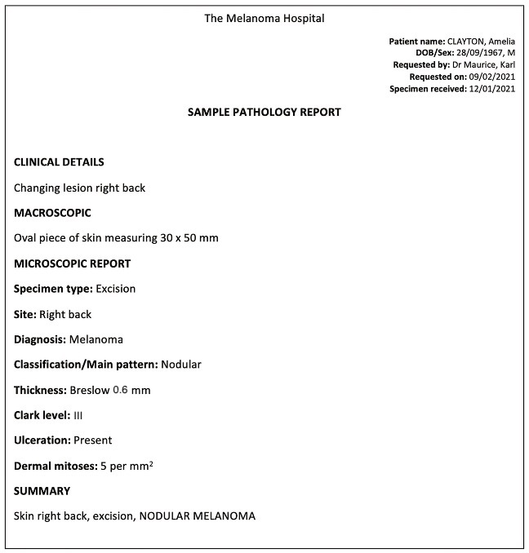
No staging yet

Slide 7
Time in between biopsy and diagnosis
https://www.ncbi.nlm.nih.gov/pmc/articles/PMC4212669/
“If melanoma is suspected, a biopsy or excision should be done within 2 weeks of the initial GP consult, and results provided to the patient within 1 week of the biopsy. “
Typically back logged resulting in up to a few weeks
Notes:
https://www.cancer.org.au/assets/pdf/melanoma-quick-reference-guide

