Slide 1
Equifax 2017 Data Breach

Slide 2

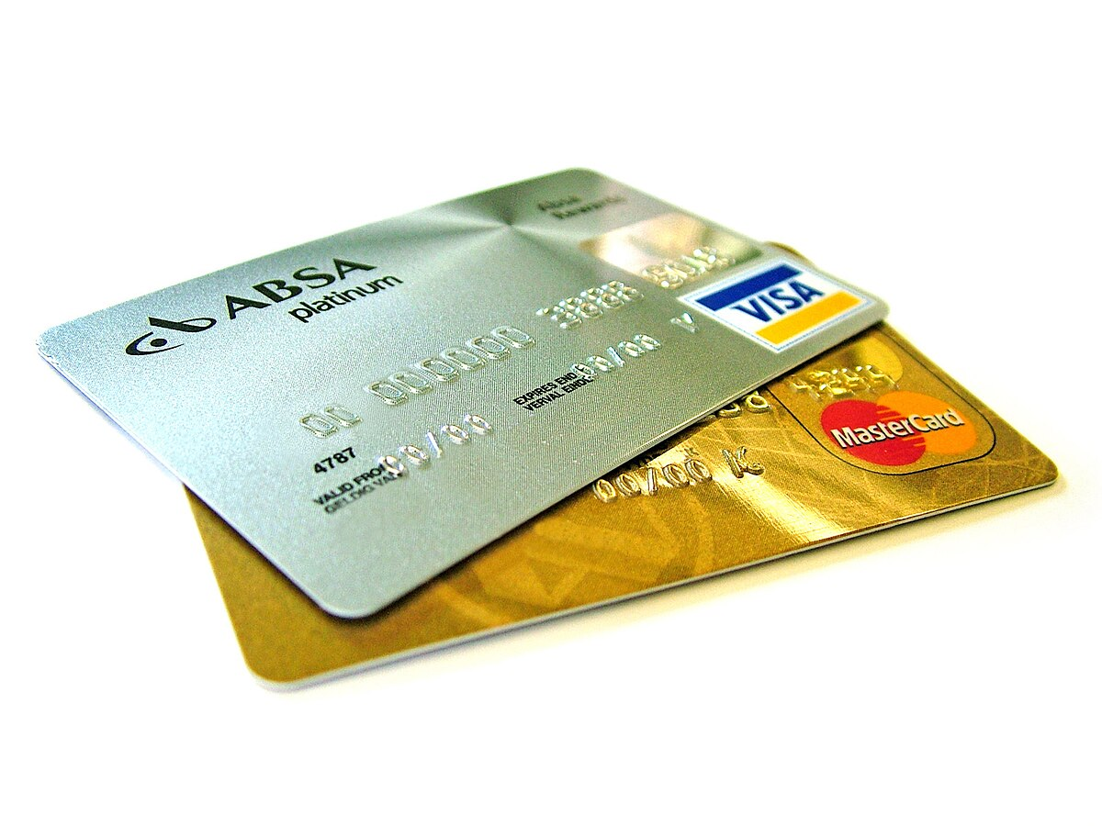
Imagine waking up to
You just committed tax fraud?
A credit card you didn’t apply for?

Slide 3
Possible if someone stole your personal data!
On 7 Sep 2017, credit reporting agency Equifax announced 145 million+ people’s personal information may have been compromised
Attack started in May 2017, went undetected until 29 Jul 2017
Information accessed included:
First/last names, SSN, birthdates, addresses, driver’s license numbers

Slide 4
What went wrong? Apache Struts 2 Vulnerability CVE-2017-5638
Apache Struts2: Web application framework used by Equifax
Attackers can send a malicious header to the server
Struts evaluates special expressions on server
Allows Remote Code Execution: Attackers can get full control of server
Can be triggered without authentication
CVSS Score: 10.0

Slide 5
What went wrong? Apache Struts 2 Vulnerability CVE-2017-5638
Vulnerable Component: Jakarta Multipart parser used by Struts2 for handling file uploads
Parser fails to properly sanitize input in the Content-Type/Disposition/Length HTTP headers
Incorrect exception handling and error-message generation during file-upload
Attack Vector:
Attacker sends a specially crafted HTTP request with a malicious Content-Type header (#cmd=string)
Struts2 uses OGNL expressions to process the header
Malicious expression is evaluated as server-side code, giving the attacker the ability to execute arbitrary commands

Slide 6
How could it have been mitigated?
Update to patched Struts2 versions

Slide 7
How could it have been mitigated? Input Sanitisation
Sanitise user input and reject suspicious headers containing OGNL patterns

Slide 8
Vulnerable Servers may still exist!!
Using Google, we can search for servers that may still be vulnerable, even today
intitle:”Struts Problem Report” intext:development mode is enabled.”
Results will be servers that have generated a Struts Problem Report, and are in development mode, making them more likely to be vulnerable

Slide 9
What went wrong? OS Security
Remote Code Execution allowed attackers to:
Execute OS commands
Enumerate System
Data Exfiltration
Allowing attackers to steal personal data

Slide 10
How could it have been mitigated? Endpoint Monitoring
Detect if suspicious commands are used or sensitive file access
Equifax did not make use of Endpoint Monitoring Tools

Slide 11
What went wrong? Bad encryption
Attackers discovered plaintext credentials stored in file shares and used them to move deeper into other systems
Some of the personal info was encrypted, but reports indicated weak key management or improperly protected encryption keys

Slide 12
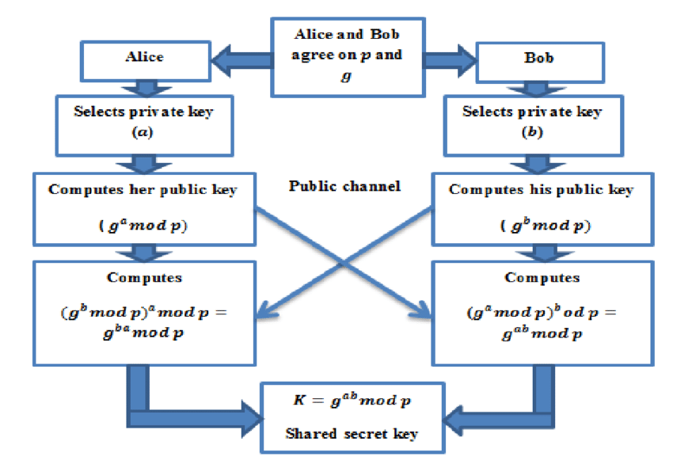
How could it have been mitigated? Better Encryption
Eg. Diffie-Hellman Key Exchange:
2 parties can securely establish a shared secret key over an insecure public channel

Slide 13
What went wrong? Expired TLS Certification
TLS certificates secure data in transit between clients and servers by encrypting traffic and verifying the server’s identity
Modern security systems inspect encrypted traffic for suspicious behavior (like data exfiltration)
Equifax’s servers had expired TLS certification: Security Systems cannot inspect traffic
Attackers sent sensitive data over HTTPS undetected

Slide 14
How could it have been mitigated?
Always maintain valid TLS certificates
active monitoring for expired or untrusted certificates
Combine TLS inspection with endpoint monitoring to detect suspicious traffic

