Slide 1







2019 Stack Overflow Developer Survey
Kaylie Malone
05-24-2024

Slide 2



OUTLINE
Executive Summary
Introduction
Methodology
Results
Visualization – Charts
Dashboard
Discussion
Findings & Implications
Conclusion
Appendix

Slide 3

EXECUTIVE SUMMARY
Data contextualization and analysis.
Methodology description.
Data Gathering
Data Analysis
Data visualizations
Results presentation (supported with graphs and trends.)
Discussion of overall findings and implications.
Final conclusions of the research.

Slide 4

INTRODUCTION
Stack Overflow’s annual Developer Survey is the largest and most comprehensive survey of programmers worldwide.
The results do not represent the entire developer community.
Nearly 90,000 developers participated.
The survey identifies trends to predict the future direction of developers.
It provides a characterization of developers around the globe.

Slide 5

METHODOLOGY
Collect survey data & explore its content.
Web Scraping
APIs
Request library
Data Wrangling
Exploratory Data Analysis
Analyzing data distribution
Handling outliers and Correlations
Data Visualization.
Highlight distribution of data, relationships, the composition and comparison data.
Dashboards.

Slide 6
RESULTS

Slide 7
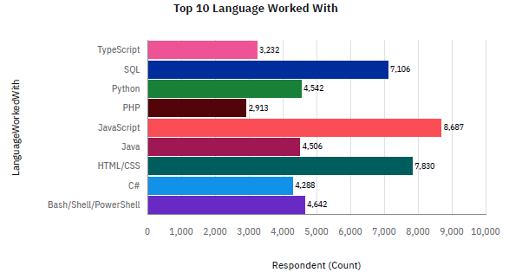
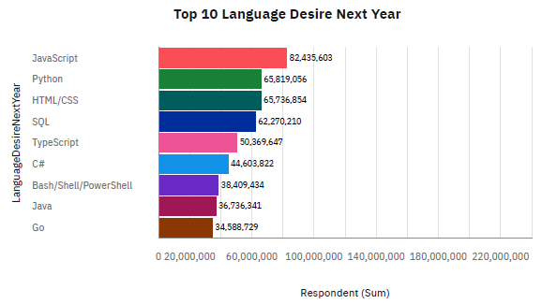
PROGRAMMING LANGUAGE TRENDS
Current Year
Next Year

Slide 8
PROGRAMMING LANGUAGE TRENDS - FINDINGS & IMPLICATIONS
Findings
JavaScript remains the leading language.
Python is a close second as its becoming more popular.
SQL is a tried-and-true language but isn’t used as frequently as it once was.
Implications
Python has a simple programming syntax, efficient commands, and its own built-in libraries and applications. Because of this, and its fast-growing usage, it may eventually surpass JavaScript.

Slide 9
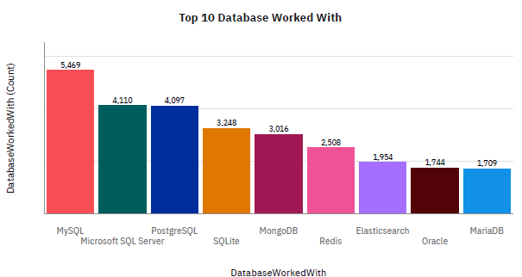
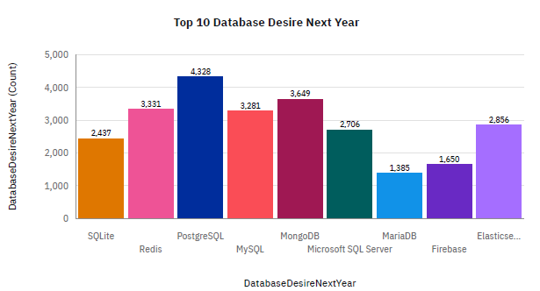
DATABASE TRENDS
Current Year
Next Year

Slide 10
DATABASE TRENDS - FINDINGS & IMPLICATIONS
Findings
PostgreSQL is the most used database.
Less interest in MySQL, SQLite, and Microsoft SQL Server.
Increasing interest in MongoDB, as it’s now the second most used database.
Implications
PostgreSQL and MongoDB are becoming increasingly popular.
Microsoft SQL, MySQL, and SQLite are losing market popularity.

Slide 11

DASHBOARD
https://github.com/kayliemalone/capstone_project/blob/main/Dashboards%20-%20IBM%20Cognos%20-%20Project.pdf

Slide 12
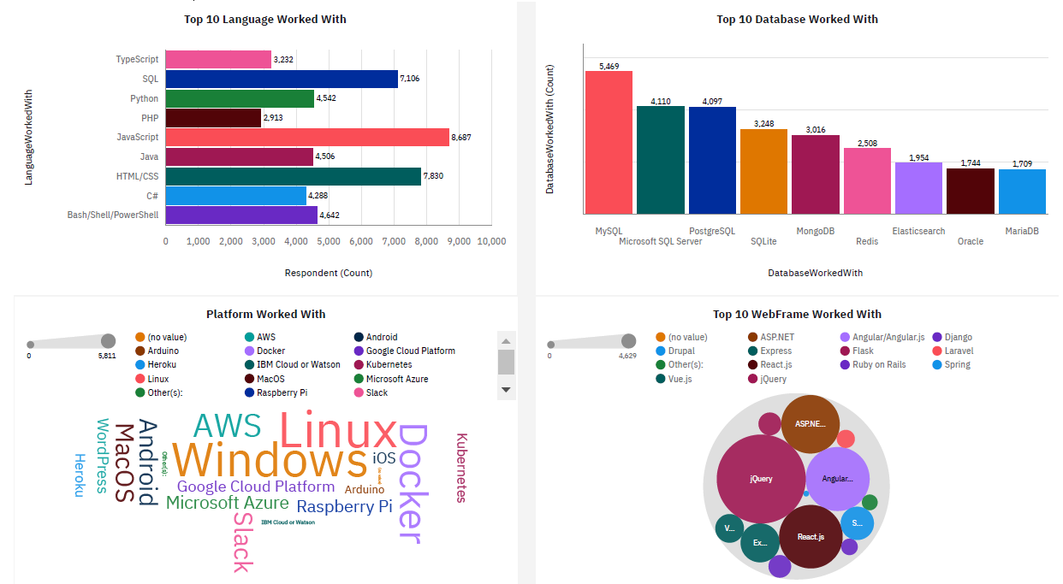
CURRENT TECHNOLOGY USAGE

Slide 13
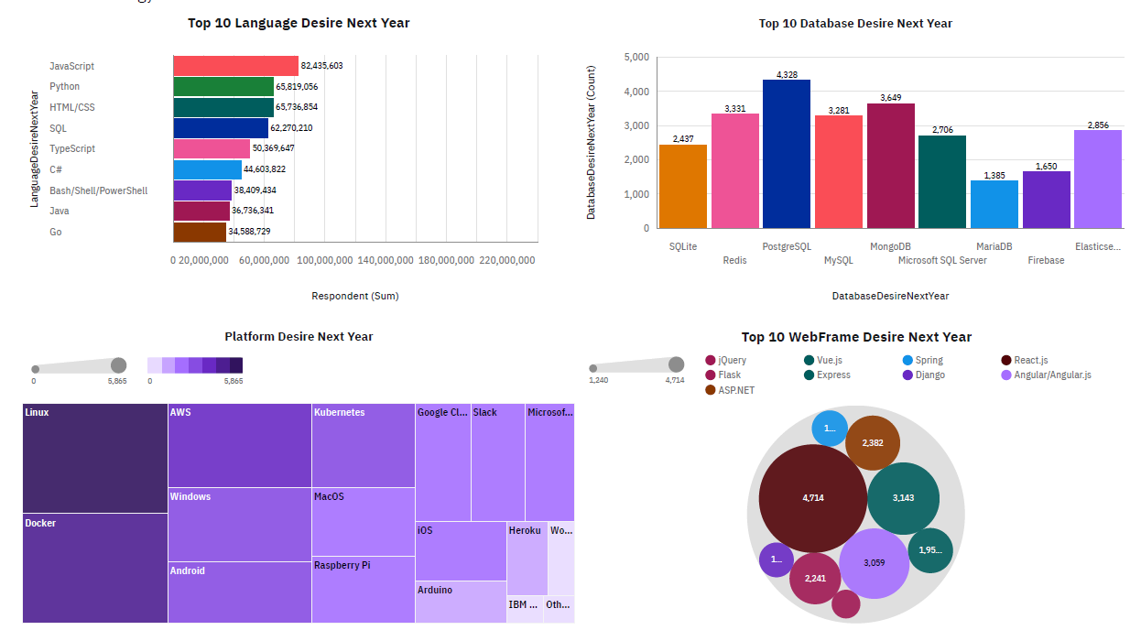
FUTURE TECHNOLOGY TREND

Slide 14
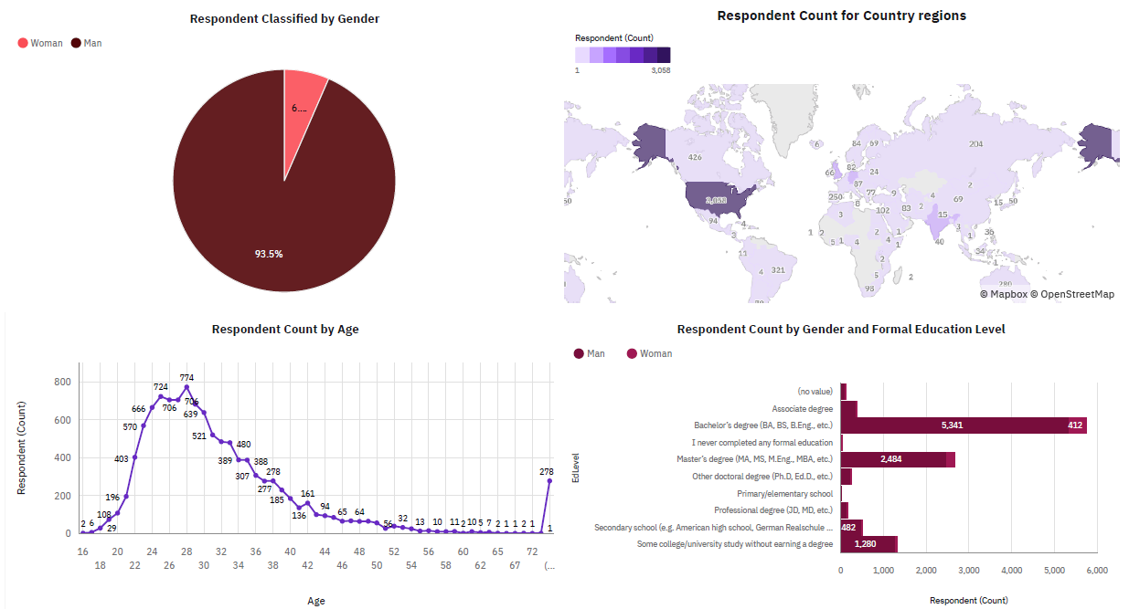
DEMOGRAPHICS

Slide 15
DISCUSSION

Slide 16
OVERALL FINDINGS & IMPLICATIONS
Findings
JavaScript is the most used language.
PostgreSQL and MongoDB are the top 2 most used databases.
Over 90% of the developers are men.
The majority live in the U.S. and have a Bachelor’s degree.
Implications
The use of Python is ever-growing, it may eventually surpass JavaScript.
Microsoft SQL, MySQL, and SQLite are losing ground in the market.

Slide 17

CONCLUSION
Developers possess distinct characteristics that set them apart.
Understanding the popularity trends of various tools, platforms, and languages is crucial.
Efforts are needed to increase accessibility to this labor market in developing countries.

Slide 18

APPENDIX
Include any relevant additional charts, or tables that you may have created during the analysis phase.

Slide 19
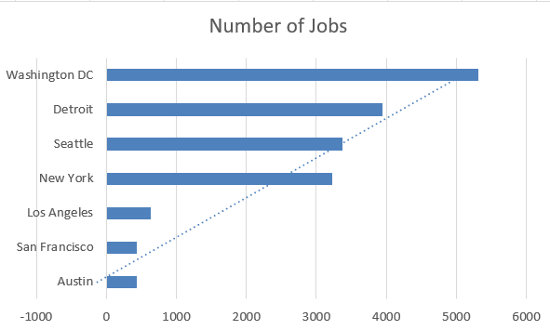
JOB POSTINGS

Slide 20
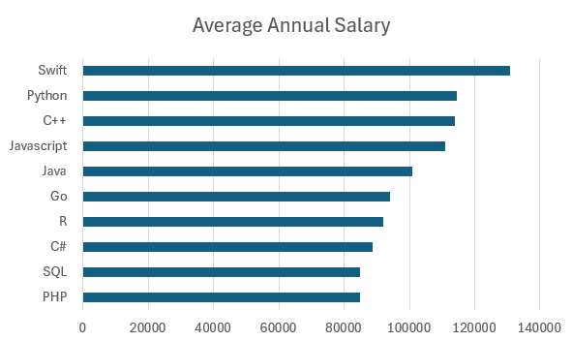
POPULAR LANGUAGES

