Slide 1

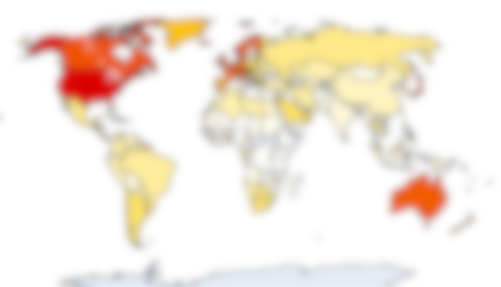
SCIENTIFIC DISCOVERY
A “LEARNING FROM DATA" PRESENTATION:
Predicting GDP Using Socioeconomic Indicators: A Machine Learning Approach
ECM3420
BY KAYLUM SMITH
MIRJAM NILSSON​

Slide 2
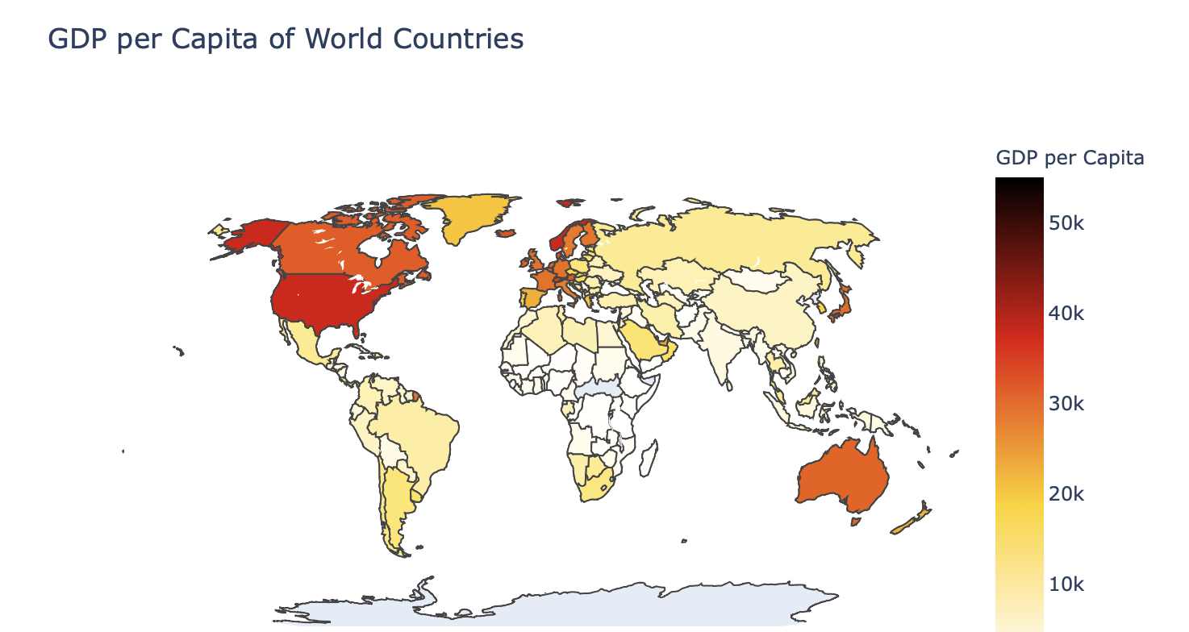
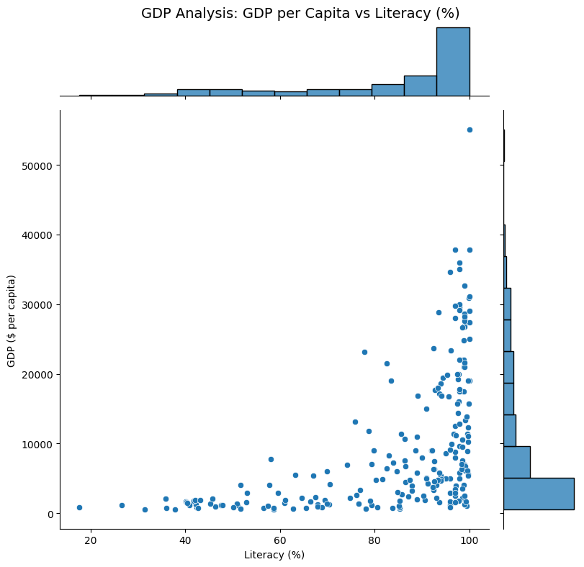
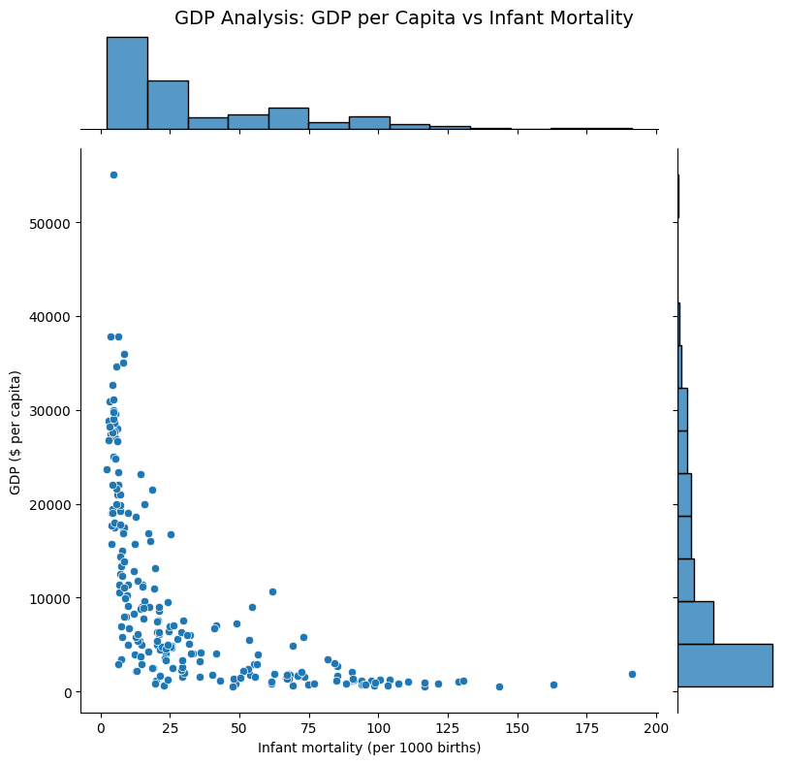
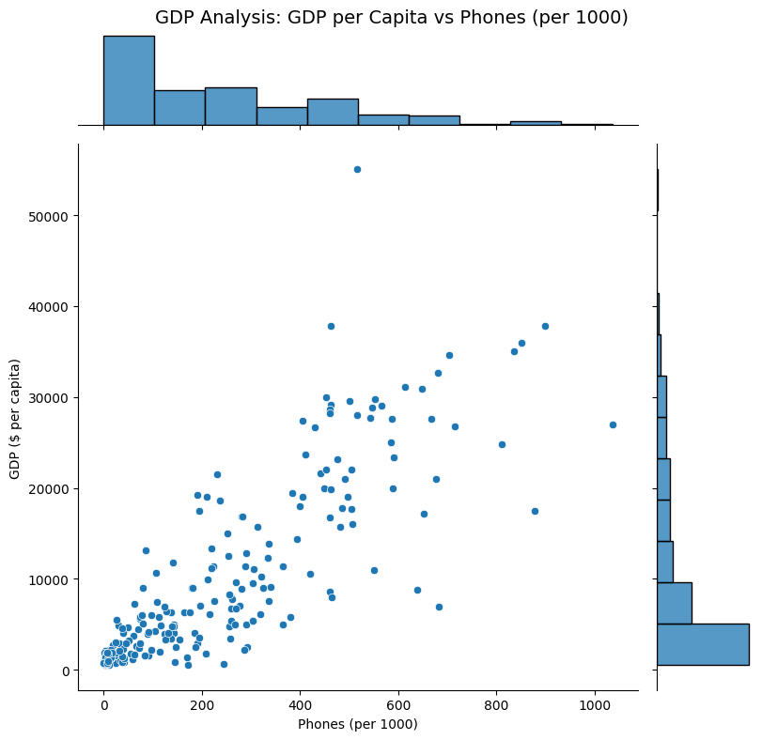
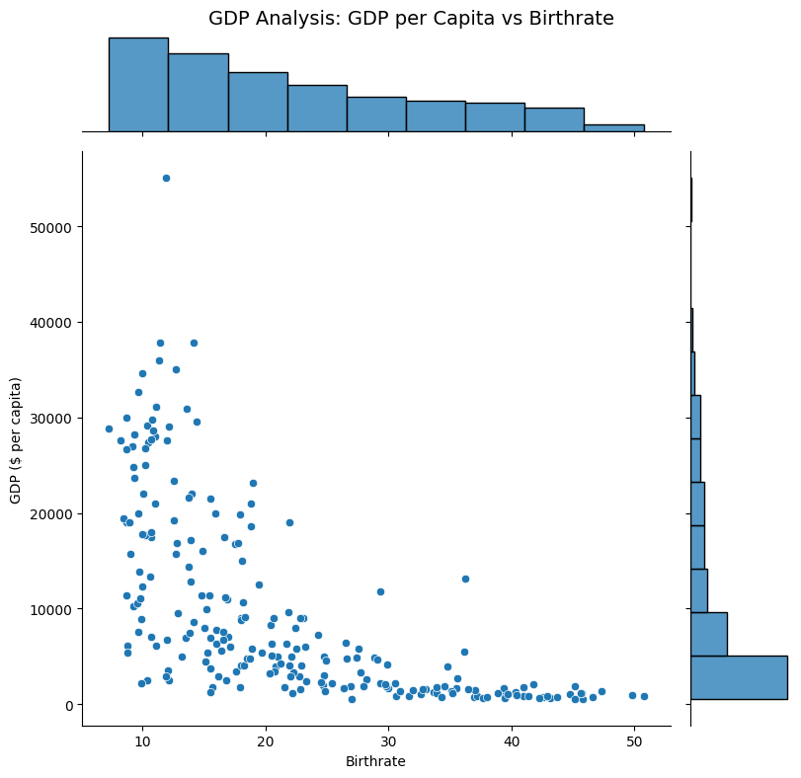

SCIENTIFIC DISCOVERY
2
Can GDP per capita be predicted using socioeconomic and environmental indicators?
Why it matters:
1. Economic Planning and Policy Development
Budget Allocation, Policy Evaluation, Economic Stability
2. Business Decision-Making
Market Analysis, Investment Strategy Risk Management
3. Targeting Development Goals
Poverty Reduction, Global Benchmarks, Regional Planning
Research Question
Figure 1
Figure 2.
Figure 3.
Figure 4.
Figure 5.
MIRJAM NILSSON​
Data from dataset “countries of the world”

Slide 3
SCIENTIFIC DISCOVERY
3
Source: Kaggle - "Countries of the World" dataset.
Size: 228 rows (countries) × 26 columns (features).
Key Features: Literacy (%), Phones (per 1000), Birthrate, Net Migration
Target Variable: GDP ($ per capita).
Preprocessing Steps: 1. Missing data , 2. Scaling and Standardization , 3. Outlier Removal , 4. Logical Consistency Checks
Source of the data: Kaggle: https://www.kaggle.com/datasets/fernandol/countries-of-the-world/data
Data Preprocessing
Pop. Density (per sq. mi.) | Coastline (coast/area ratio) | Net migration | Infant mortality (per 1000 births) | GDP ($ per capita)
48,0 | 0,00 | 23,06 | 163,07 | 700
124,6 | 1,26 | -4,93 | 21,52 | 4500
13,8 | 0,04 | -0,39 | 31 | 6000
290,4 | 58,29 | -20,71 | 9,27 | 8000
Pop. Density (per sq. mi.) | Coastline (coast/area ratio) | Net migration | Infant mortality (per 1000 births) | GDP ($ per capita)
29 | 49.59 | -4.86 | 7.54 | 6900
18.2 | 14.53 | 0 | 19 | 2500
92.5 | 39.22 | 0 | 7.35 | 3400
454.2 | 92.31 | 0 | 20.03 | 1100
Figure 6.
Figure 7.
MIRJAM NILSSON​

Slide 4
SCIENTIFIC DISCOVERY
4
Content:
Regression Models:
Linear Regression: Baseline for simplicity and interpretability.
Ridge Regression: Addresses multicollinearity with regularisation.
Random Forest Regression: Captures nonlinear relationships.
Evaluation Metrics:
R²: Measures variance explained.
Mean Squared Error (MSE): Penalizes larger errors.
Clustering (Secondary):
Grouped features to explore relationships and assist regression tasks.
Methodology
Data processing and cleaning
Setup input features and output feature
Implementing regression models
Analysing and tuning Hyper-parameters
Clustering
MIRJAM NILSSON​

Slide 5
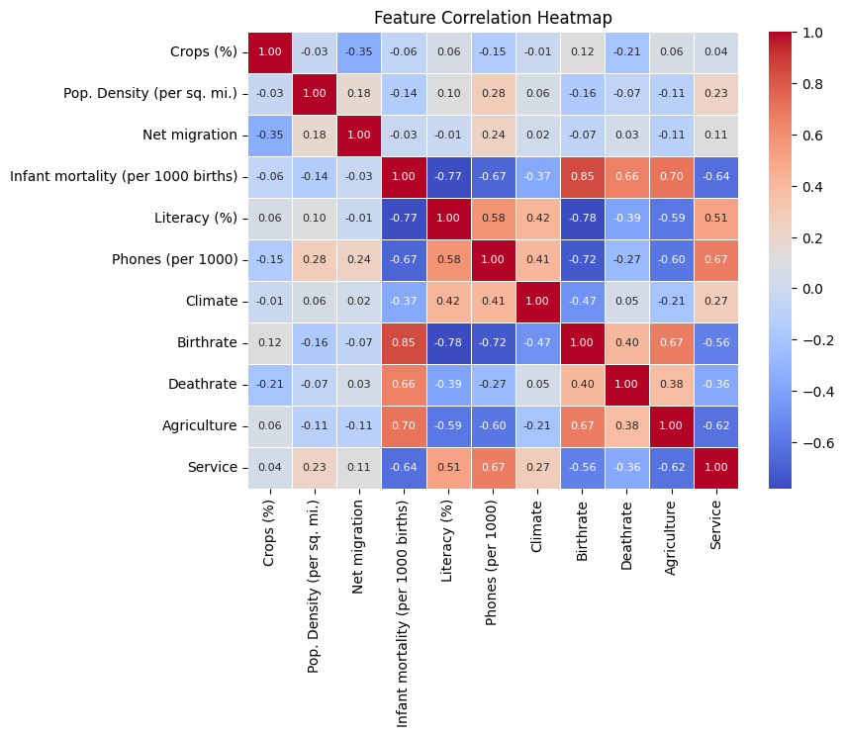
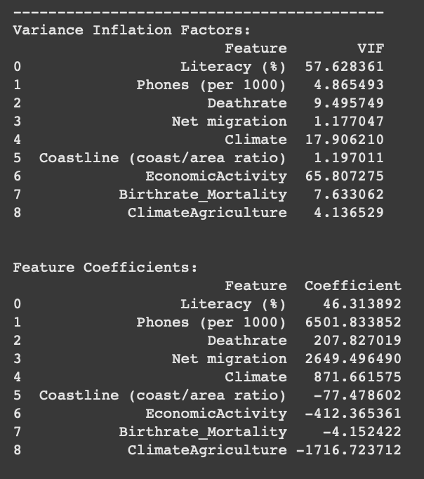
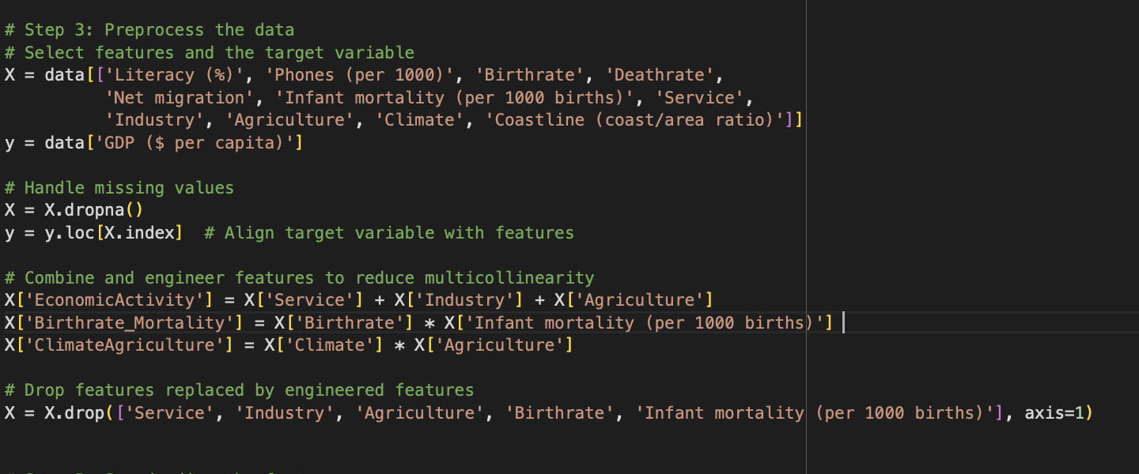
SCIENTIFIC DISCOVERY
5
Content:
Feature Engineering:
Combined economic sectors into economic-activity.
Created interaction terms (Birthrate_Mortality, ClimateAgriculture).
Multicollinearity:
VIF analysis identified redundant features.
Dropped high-VIF features (e.g., Service, Industry, Agriculture).
Scaling:
Standardised features using “StandardScaler”.
Feature grouping and hyperparameter tunning
Figure 9.
Figure 10.
MIRJAM NILSSON​
Figure 8.

Slide 6
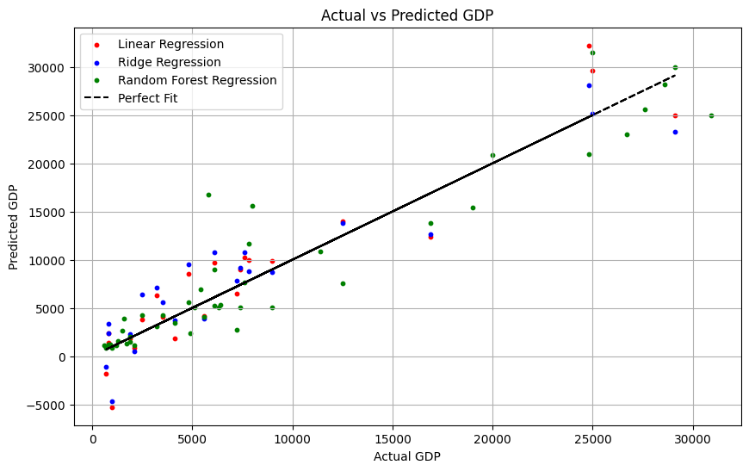
Data Analysis and Results
Conclusion
Graphs suggest that random forest regression outperforms linear and ridge regression, especially for high GDP values and non-linear relationships.
Random Forest is likely the best model for this task because it can capture non-linear relationships and adapt to a wider range of GDP values.

Slide 7

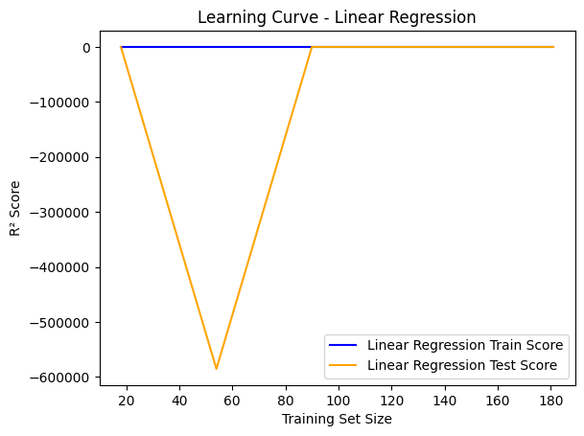
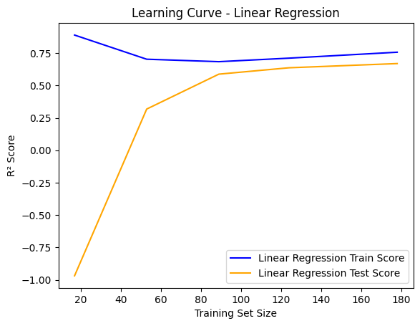
Linear Regression Results
Characteristics:
Training score starts high (~R² = 0.75) and stabilizes around R² = 0.7 as more data is added.
Test score begins very low (negative R²) but improves steadily, converging with the training score.
Conclusion:
The learning curve reflects normal behaviour, with additional data improving generalization.
Interpretation:
Initial overfitting occurs with small training sets, leading to poor test performance.
As training size increases, the model generalizes better, and both scores converge.
Before
After
Figure 12.
Figure 13.

Slide 8

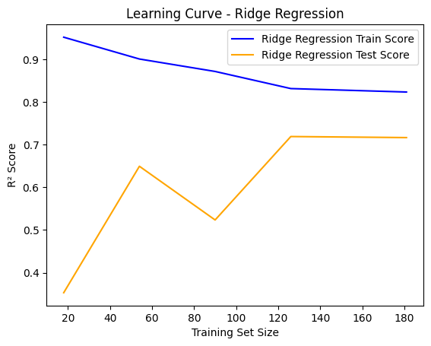
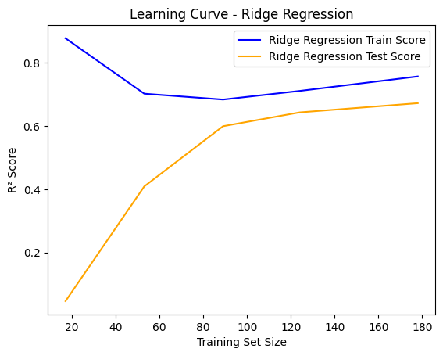
Ridge Regression Results
Characteristics:
Training score starts high (~R² = 0.85) and decreases slightly with more data.
Test score begins low (~R² = 0.2) but steadily improves, converging with the training score (~R² = 0.65).
Conclusion:
The Ridge Regression learning curve shows stable performance, benefiting from larger datasets.
Interpretation:
Initial overfitting occurs with small training sets, leading to poor test performance.
As training size increases, the model generalizes better, and both scores converge.
Before
After
Figure 14.
Figure 15.

Slide 9

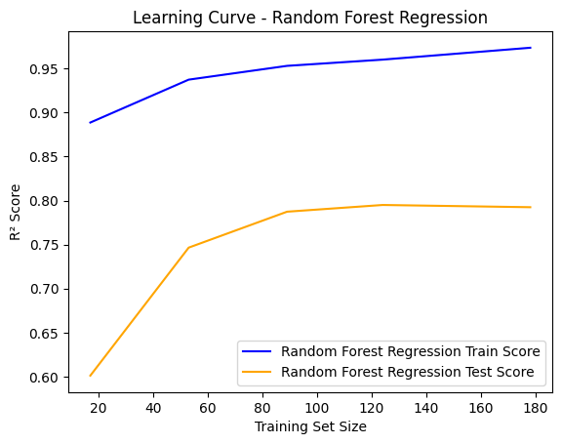
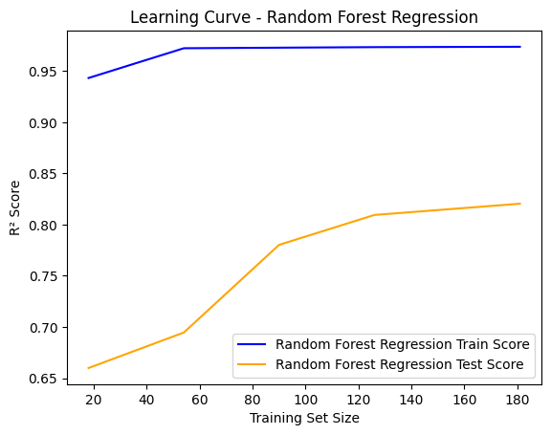
Data Analysis and Results
Characteristics:
Training score remains consistently high (~R² = 0.95) as data increases, indicating minimal error.
Test score starts lower (~R² = 0.65) but steadily improves with more data.
Conclusion:
Random Forest shows strong performance with minimal overfitting and excellent generalization, benefiting from sufficient data.
Interpretation:
Random Forest performs well, with consistent training scores and improving test scores, reducing overfitting and enhancing generalization.
Before
After
Figure 16.
Figure 17.

Slide 10

SCIENTIFIC DISCOVERY
10
Dataset Limitations:
Small dataset size: Only 228 rows, which limits generalizability.
Lack of important features: Missing data on factors like political stability or education quality, which could improve predictive accuracy.
Model Limitations:
Linear Regression:
Cannot capture non-linear relationships.
High mean squared error, reducing accuracy for more complex patterns.
Ridge Regression:
Limited by its linear nature, making it less effective for non-linear relationships.
Random Forest Regression:
Significant computational cost for hyperparameter tuning.
"Black-box" nature complicates interpretability and decision-making.
Metric Limitations:
GDP per capita as a target:
Narrow metric that doesn’t capture wealth distribution or quality of life.
General Trade-offs:
Balancing performance improvement with computational cost for Random Forest's hyperparameter tuning.
Limitations
MIRJAM NILSSON​

Slide 11
SCIENTIFIC DISCOVERY
11
Conclusions:
Linear Regression: Baseline; struggled with non-linear patterns and high error.
Ridge Regression: Addressed multicollinearity; limited by linearity.
Random Forest: Best performance; captured complexity but high computational cost.
Clustering: Improved interpretability and reduced multicollinearity; risk of oversimplification.
Key Insights: Socioeconomic indicators (e.g., literacy, birthrate, phone usage) strongly predict GDP.
Future Work:
Expand Features: Add political stability, education quality, healthcare spending.
Increase Data: Combine datasets to improve generalizability and robustness.
Explore Models: Test XGBoost, LightGBM for better performance.
Enhance Interpretability: Use SHAP values or feature importance for Random Forest.
Refine Imputation: Analyze impacts of missing data handling methods.
Combine Models: Experiment with ensemble techniques for improved accuracy.
Conclusions and Future Work
MIRJAM NILSSON​

Slide 12
SCIENTIFIC DISCOVERY
Thank You!
Have a Good Day.
BY KAYLUM SMITH
MIRJAM NILSSON​

