Slide 1
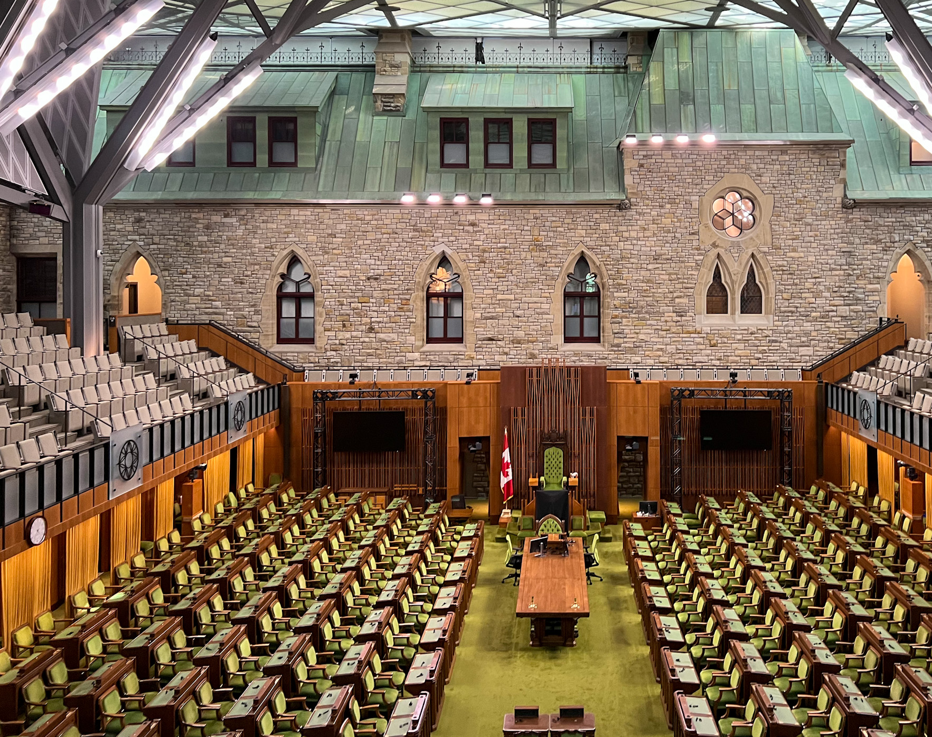
How Do Canadian MPs Talk About Education?
Kaylynn Driggers
Notes:
Hi everyone, I’m Kaylynn, and this project asks a pretty simple but politically interesting question: how do Canadian MPs talk about education in House of Commons debate?
Even though education authority is a provincial power in Canada, it still shows up regularly in federal parliamentary speech. So I wanted to know what how references to education were showing up.

Slide 2
Research Question
How do Canadian MPs talk about education in House of Commons debate?
More specifically, which education topics appear most often in federal speech, and how do those vary over time and across parties?
Notes:
My research question is: how do Canadian MPs talk about education in House of Commons debate? More specifically, which education topics appear most often in federal speech, and how do those vary over time and across parties? So this project is not just about whether education is mentioned. It is about the different ways education is being invoked politically.

Slide 3

Why study how federal MPs talk about education?
Education is primarily a provincial responsibility in Canada.
Even so, MPs still talk about education in House of Commons debate.
That suggests education is politically relevant at the national level, which makes it important for us to understand the ways in which it is invoked
Notes:
Education is primarily a provincial responsibility in Canada.
But even so, MPs still talk about education in the House of Commons.
That suggests education remains politically relevant at the federal level, even though formal policy authority is limited.
So, education might still serve some political purpose, even though federal MPs have no direct control over K–12 and postsecondary governance.

Slide 4
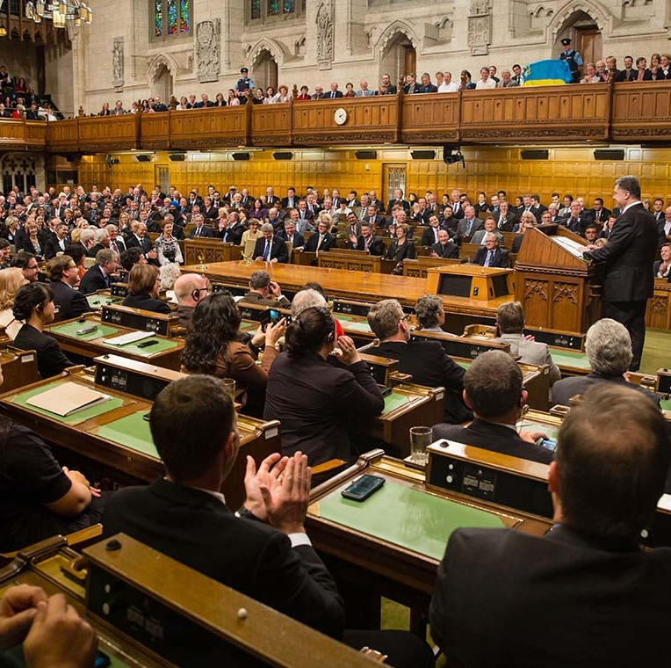
Data Collection
Source: Canadian House of Commons Hansard
Coverage: 1900 to 2019
Unit of analysis: individual MP speech
To build a manageable corpus, I sampled 100 rows from each speech file, which created a master sample of 1,312,018 speeches.
I then applied an education keyword filter, which gave me 60,833 education -related speeches
Metadata included: date, weekday, speaker, party
Notes:
My data comes from the Canadian House of Commons Hansard, covering 1900 to 2019. The unit of analysis is the individual MP speech. To build a manageable corpus, I sampled 100 rows from each speech file, which gave me a master sample of just over 1.3 million speeches. I then applied an education keyword filter, which reduced that to 60,833 education-related speeches. I also kept metadata like date, weekday, speaker, and party so I could compare patterns over time and across political actors.
Once I had the education subset, the next question was how to move from retrieval to classification.

Slide 5
Workflow
Sampled raw Hansard speech files
Applied education keyword filter (60,8333 speeches)
Hand coded a 200-speech validation sample
Compared hand coding to zero-shot labels
Analyze topic prevalence overall, over time, and by party
Built a master sample (1,312,018 speeches)
Built topic-specific training sets
Applied final classifiers
Notes:
And so, to outline the rest of my workflow after wrangling the data,
I created a 200-speech sample for hand-coding, compared those hand-coded labels to zero-shot labels.
And then I expanded the topic-specific training sets using topic-specific dictionaries, applied each topic-specific classifiers, which gave me the final predictions that I used to analyze the results.

Slide 6
How were speeches coded?
Category | Short description | Common keywords
Indigenous education | Schooling tied to Indigenous communities, reconciliation, and residential schools | Indigenous education, residential schools, reconciliation, First Nations, Inuit, Métis, on-reserve schools
Official languages and bilingualism | Schooling tied to English-French language rights and minority-language education | bilingualism, French immersion, minority-language schools, francophone, anglophone, language rights
Postsecondary affordability and access | Focus on the cost of college/university and barriers to attendance | tuition, student debt, grants, loans, affordability, access
Universities, research, and innovation | Postsecondary institutions as sites of research, science, and innovation | research funding, innovation, science, universities, research chairs, commercialization
Skills training and labour-market development | Education framed as workforce preparation and job readiness | skills training, apprenticeship, skilled trades, employability, upskilling, labour shortages
Early learning and childcare | Childcare and preschool discussed as part of early education and development | childcare, early learning, preschool, early childhood education, school readiness
Federalism, jurisdiction, and transfers | Education framed as an issue of authority, funding, and federal-provincial relations | jurisdiction, transfers, federal role, provincial responsibility, national standards, intergovernmental conflict
Speeches were coded across seven topic categories
as 1 = present, 0 = absent/unclear
Coding allowed overlap across topics
Ambiguous cases were coded conservatively using explicit inclusion/exclusion rules
Notes:
I coded speeches across seven topic categories: Indigenous education, official languages, affordability and access, universities and research, skills and training, early learning and childcare, and federalism and jurisdiction. I derived these categories from recurring themes in Canadian education policy research and debate, and refining after reading through some of the sample.
Each topic was coded as present or absent, I allowed overlap across topics, as some speeches referenced more than one type of education, and I did have some ambiguous case, which were coded conservatively, meaning if the topic was not clearly about the topic it was not considered relevant to that topic.
To make these a bit more concrete, here are a few examples from the strongest categories.
Official languages / minority-language schooling: Section 23 of the Charter is the obvious anchor here. Justice Canada’s Charterpedia explains that Section 23 is designed to preserve and promote minority-language communities through schooling and gives minority-language communities management and control rights; the McGill Law Journal article Education and Linguistic Security in the Charter is a classic legal-treatment of the same issue. Postsecondary affordability / student aid / access: The Council of Ministers of Education, Canada literature review frames affordability around tuition and student aid, and the ENAP student-aid review shows the core access literature revolves around loans, grants, and the impact of aid on enrollment and completion. Universities / research / innovation: Allan Tupper’s Modernizing Canada’s Research Universities argues that Ottawa became a dominant force in university research policy through programs like CFI, CIHR, and Canada Research Chairs, and the CIRST chapter on Canada’s university sector makes the same broader point: provinces govern higher education constitutionally, but research and development are a major channel of federal postsecondary involvement. Skills / training / labour-market development: The Canadian Public Policy article Training and Skills Development Policy Options for the Future treats labour-market training and skills development as a distinct policy field, and HEQCO’s skills reports show why skills discourse is regularly tied to employability, labour-market mismatch, and work-integrated preparation. Early learning / childcare: Martha Friendly’s work is a safe name to know here. She treats early childhood education and care as a long-running Canadian policy field shaped by uneven provincial development and federal fits and starts, while other Canadian work explicitly frames childcare as limited and structured by federalism

Slide 7
Examples
University Affordability/Access
“Does the minister not realize that besides doubling tuition fees, his reform helps to double students’ indebtedness...?”
Skills/Training:
“They voted against increased investments in job training. They have voted against every constructive measure: the Canada apprenticeship loan, the Canada job grant, and the incentive grant for new apprentices….”
Early Learning/Childcare:
“As a result of the early learning and childcare agreement signed with Ontario, Halton will receive 500 new spaces over the next three years. The childcare spaces will primarily be located in or near schools so that junior and senior kindergarten students can benefit from a seamless full day of learning and childcare….”
Notes:
Here are a few excerpts to illustrate how these topics actually appeared in the speeches.
I included examples from three of the strongest-performing categories: affordability, skills and training, and early learning.
These examples show what the coding actually looks like in practice.
In the affordability example, the key signal is student debt or tuition.
In the skills example, the focus is job training, apprenticeship, and workforce preparation.
In the early learning example, the speech explicitly links childcare and early learning to schools or child development.
So, when coding each speech I did not just look for whether education was being talked about in the general sense, but for any specific policy or topic.

Slide 8
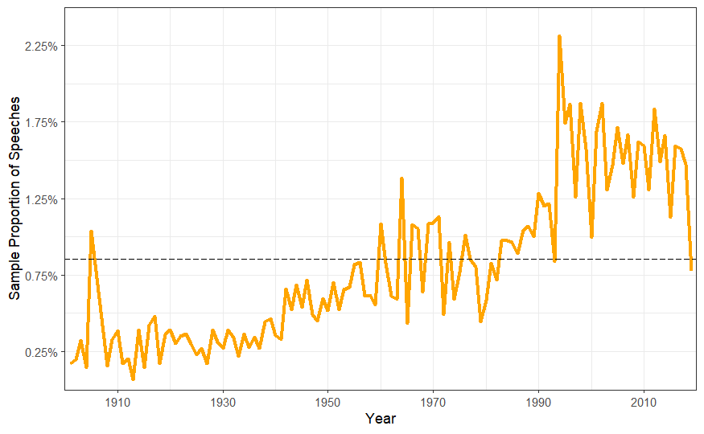
How does education show up in parliamentary speeches over time?
Notes:
Before breaking education talk into specific categories, I first looked at how often education appeared in the sampled Hansard corpus over time. Although the overall share of education related speeches is still fairly small, it rises over the century and becomes much more prominent in the late twentieth century, with noticeable spikes in certain periods.
So even before topic classification, this tells us that education’s salience in federal debate changes historically and maybe even over political contexts.

Slide 9
Results: Hand-Code/LLM zero-shot Validation
Education topic | Kappa | Alpha
Indigenous | 0.280 | 0.275
Language | 0.385 | 0.386
Affordability | 0.593 | 0.590
University research | 0.387 | 0.362
Skills / training | 0.606 | 0.606
Early learning / childcare | 0.664 | 0.665
Federalism | 0.296 | 0.293
Notes:
After looking at the overall trend, I wanted to know how reliable the topic labels were.
So I tested the agreement between my hand coding and the zero-shot model labels using Cohen’s kappa and Krippendorff’s alpha. As you can see, the overall pattern is mixed. Some categories performed more reliably than others. The strongest were affordability, skills and training, and early learning, while the other categories showed weaker agreement.
Which suggests that some ways of talking about education are easier to identify consistently than others, and points to the need for further refinement of my codebook.

Slide 10
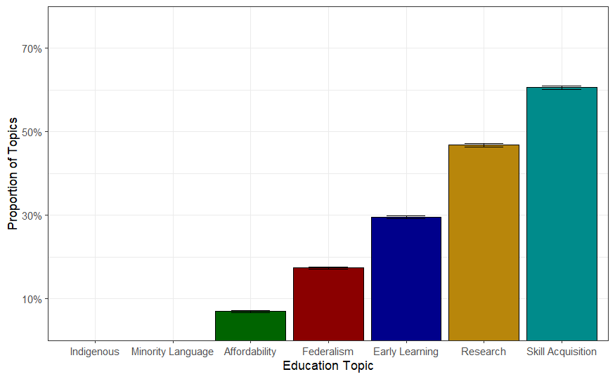
Results: Overall Topic Proportions
Notes:
So next, I looked at the overall proportions of each education topic in the classified corpus. The main takeaway here is that education is distributed across multiple recurring topic clusters. And again, the strongest and clearest patterns, at least in this version of the project, are in affordability, skills and training, and early learning.
A note on the minority language and Indigenous education topics, which were not captured by the AI coding, even though I saw speeches about this topic, which could suggest that these topics may be overlapping or are not distinct enough for the classifier to pick up on them consistently.

Slide 11
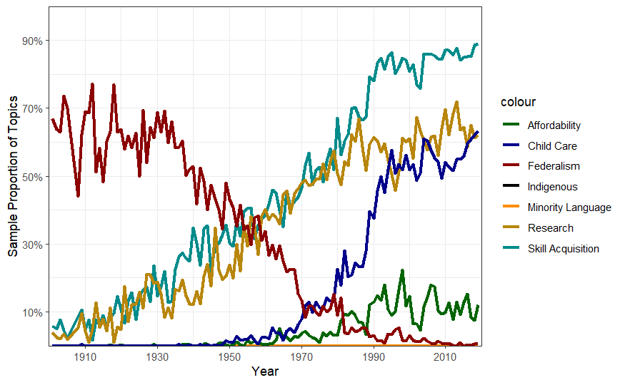
Results: Proportion of Topics Over Time
Notes:
What this shows is that the composition of education references changes over time. Different education topics become more or less prominent in different periods, which suggests that federal education discourse is politically contingent and responsive to political contexts, wherein certain aspects of education may be more salient.
Older parties appear to talk about federalism more (issues over control changed over time?)
One plausible interpretation of this is that discussions about authority over education decline, because the jurisdictional baseline in Canadian education is already settled. Over time, MPs may talk less about who has authority and more about specific policy issues like affordability, university research, childcare, or skills.

Slide 12
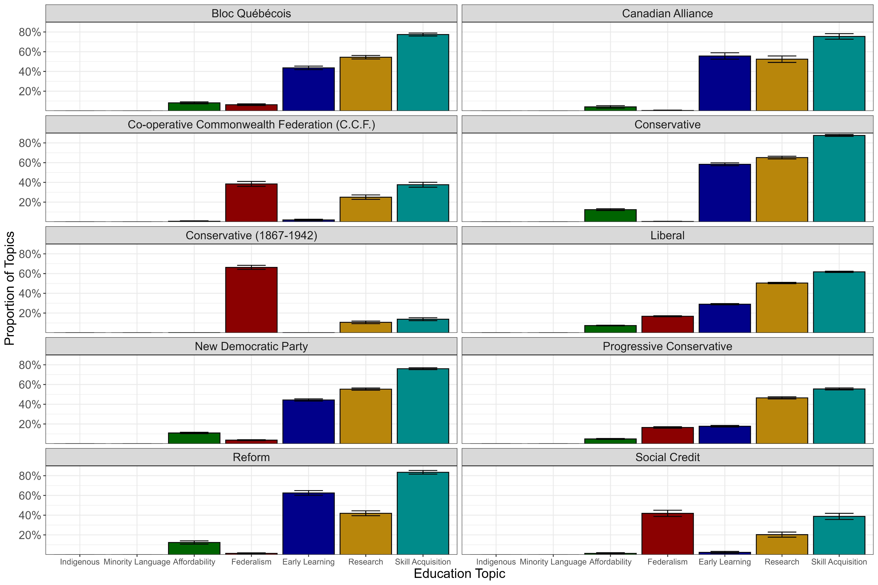
Results: Party Differences
Notes:
And lastly, I wanted to look for any party differences, both across time and across modern parties.
What I found particularly interesting was the older parties, the CCF, Social Credit, and the old Conservative parties were primarily talking about education through a federalism lens, which aligns with the general trend I pointed out in the previous figure.
Also interestingly, the modern Conservatives and Liberals parties appear to have real differences in how they talk about education. Conservatives appear somewhat higher than Liberals in early learning, university research, and skill acquisition, which suggests that federal education discourse differs by party, possibly due to strategic or agenda reasons.
Overall, though we can see that most parties tend to talk about skills acquisitions, early learning and child care, and university research when talking about education.

Slide 13
How do MPs talk about education?
Education appears through recurring topic clusters in parliamentary speech
In this project, the clearest patterns were affordability, skills/training, and early learning.
Topic prevalence also varies over time and across parties
Some education references fell outside of my codebook, which suggest that federal education discourse extends beyond the topics I’ve identified here
Notes:
So, this project offered some preliminary answers to my research question: how do MPS talk about education.
I’ve found that they talk about it through topic clusters, primarily affordability, skills and training, and early learning. These topics also vary by year and across parties, which suggests that there could be strategic or temporal dimensions to how education is discussed at the national level.
And finally, I also found that MPs reference education in ways that were not in the codebook I derived, including religion and schooling, immigration/international students, and general schooling governance from their provinces.

Slide 14
Next Steps
Refine the codebook and reconceptualize weaker categories
Improve or retrain topic-specific classifiers
Connect spikes in topic prevalence to historical and political events in Canadian history
Notes:
In future iterations of the project, I would like to further refine the codebook, focusing on either improving or removing those weaker categories
Which will then allow me to train or retrain new classifiers to identify additional speech categories
And lastly, I think it would be interesting to inspect those spikes in topic prevalace further and see whether there are any connections to historical political events in Canadian history.
So, now that I’ve identified some patterns in the Hansard speeches and created a workflow, I can use and refine, I can continue to map the ways in which in which MPs talk about education.

Slide 15
Thanks! Questions?
Notes:
Thank you, are there any questions?
Look at the federal vs the provincial speeches and look for coordination across parties and possibly operationalize
Policy and multilevel governance
Talk to alcantara about this
Minority education and indigenous education; can be expanded to compare with the states…brown vs board of education, civil rights act…map this and see what this says about education and race
Can even do every country
Subtopics as a research note? For a journal….
Include a general trend of the speeches in general in the final paper
Length of speech…
Tell him about the length of speech variable and he could give me the code to make it easier…
Taking the sample
Starting just at 60s, as the early speeches are not politically relevant
Maybe including the old parties are not interesting
Are they in question period or not and there is a column in the Hansard that tells this…
Control for this…

Slide 16
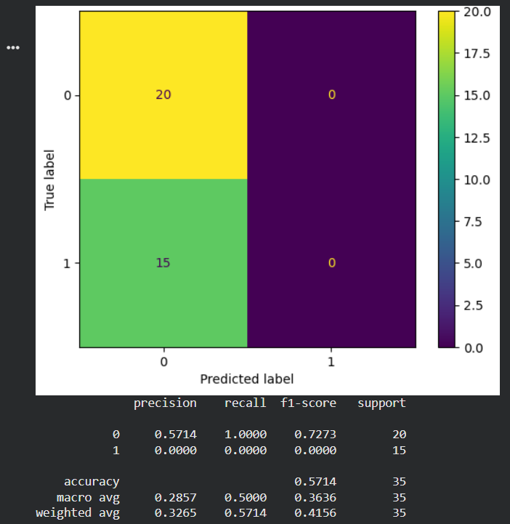
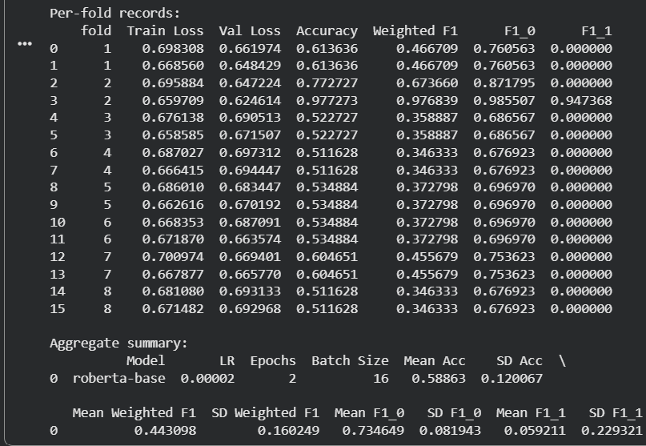
Indigenous, Appendix

Slide 17
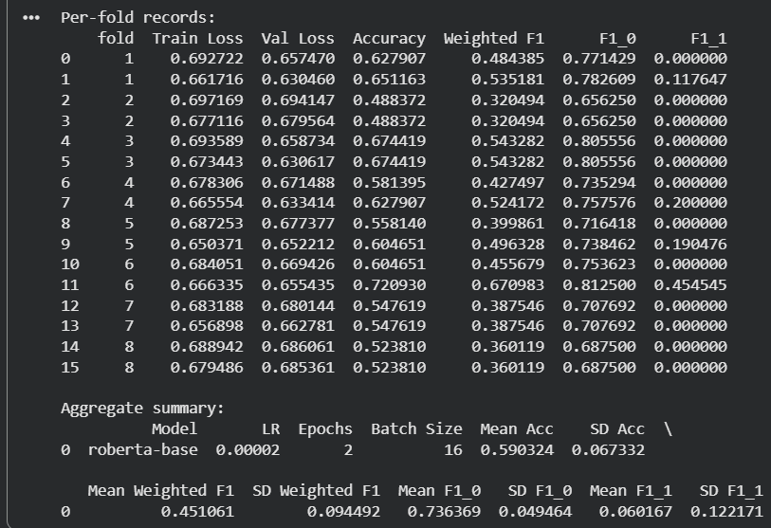
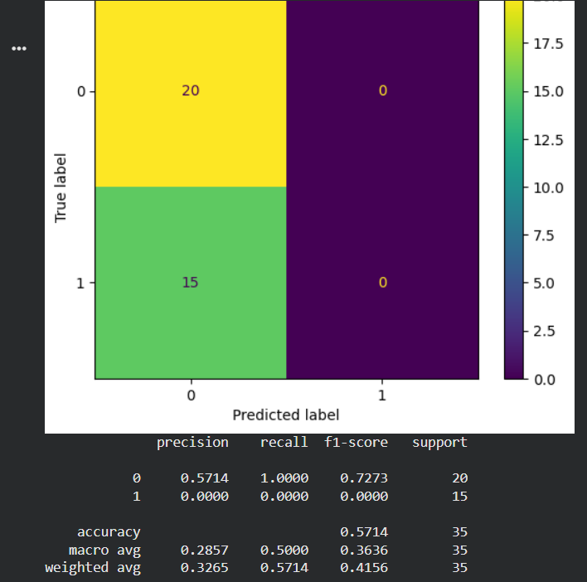
Language, Appendix

Slide 18
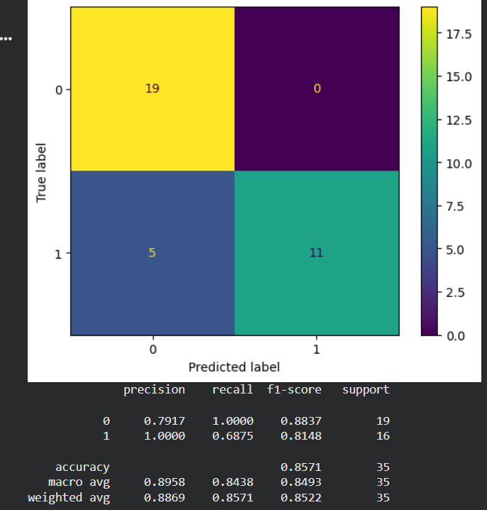
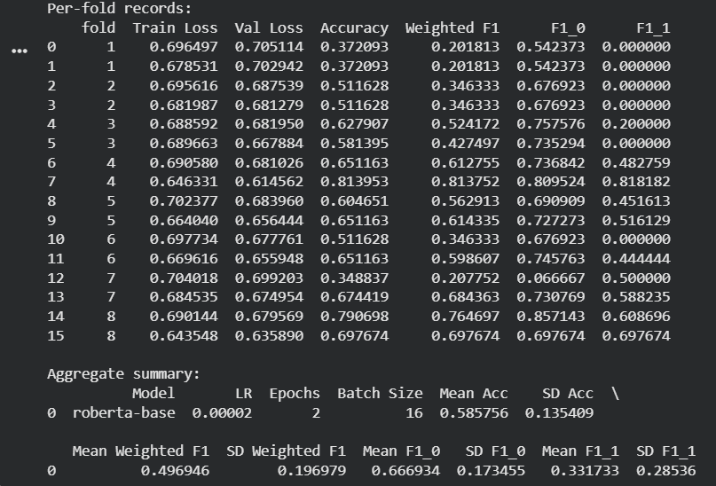
Education Affordability/Access, Appendix

Slide 19
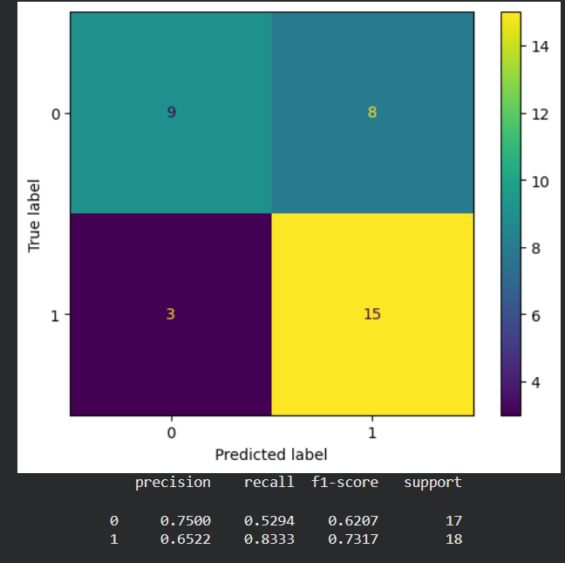
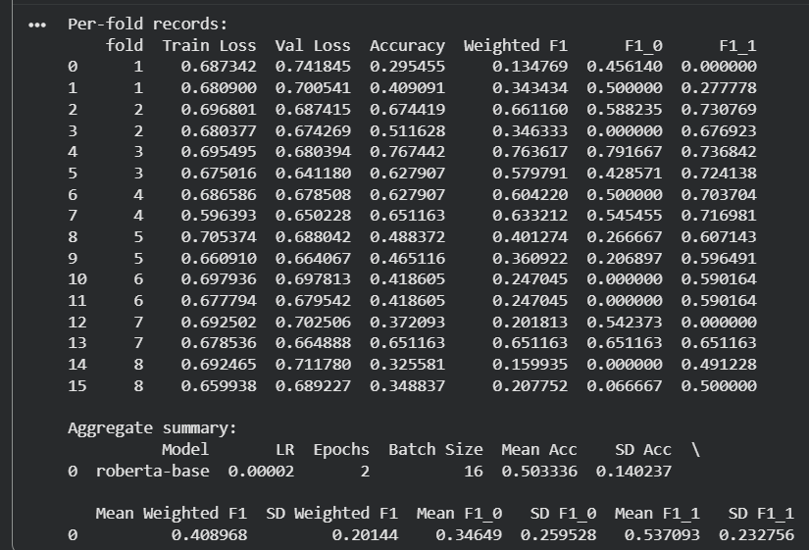
Skills, Appendix

Slide 20
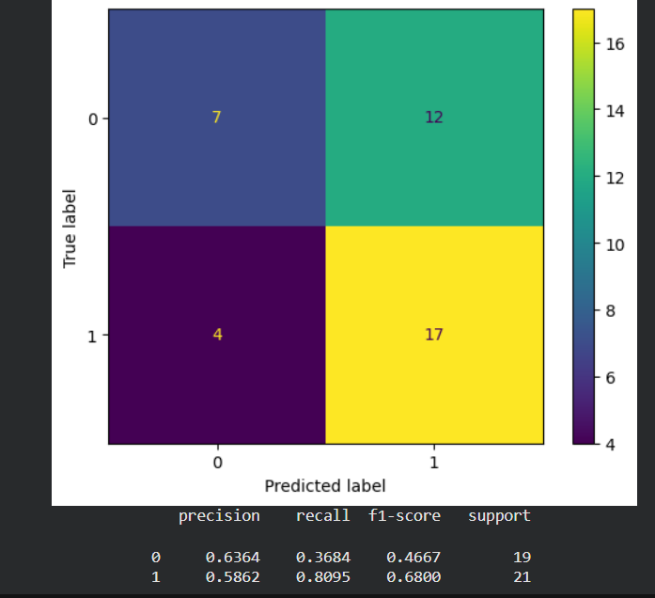
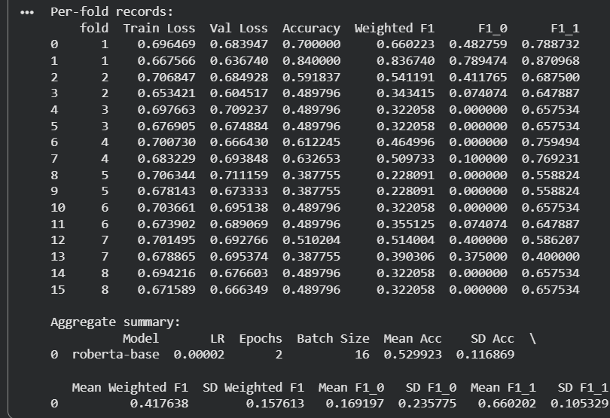
University Research, Appendix

Slide 21
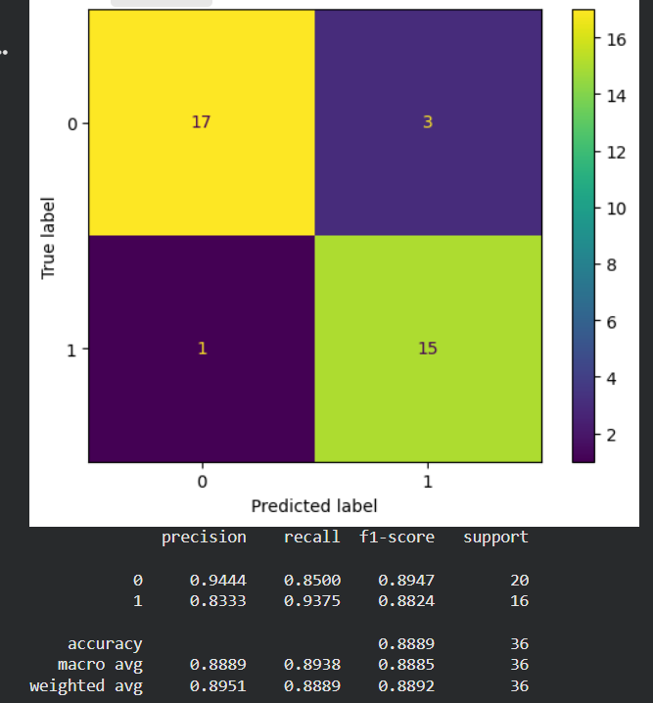
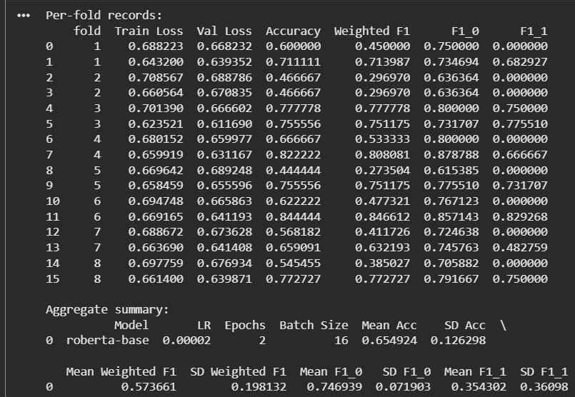
Early Learning/Child care, Appendix

Slide 22
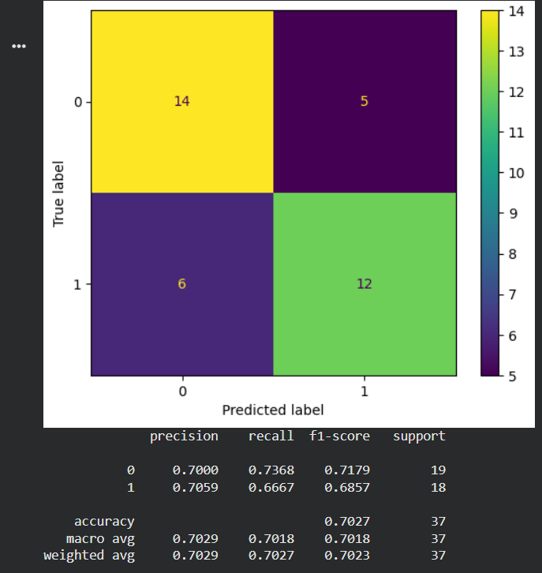
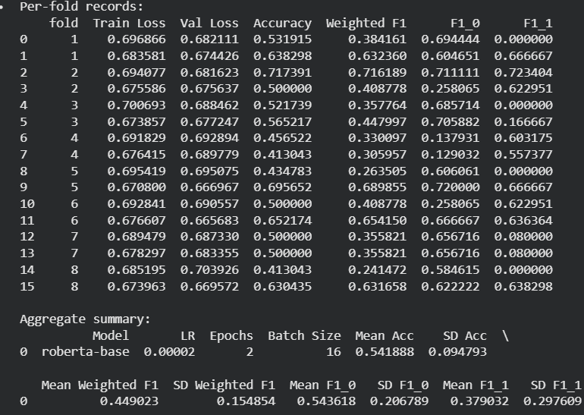
Federalism, Appendix

