Slide 1
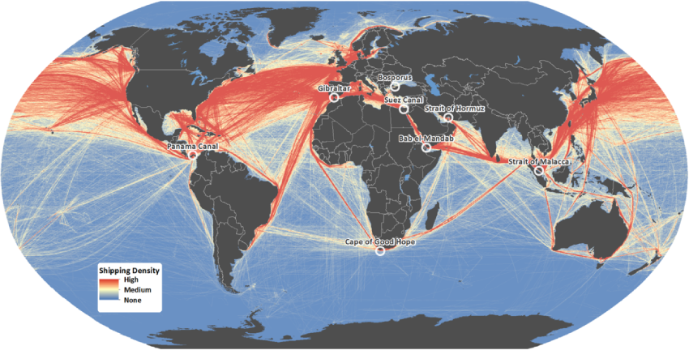
US Oil Imports
LTJG Turgut Kaymal (Turkish Navy)
Maj Javier Reyes (USMC)
Maj Aaron Ramert (USMC)
June 04, 2012
Notes:
Today we hope to provide you with some insight and hopefully new and interesting information regarding the worlds oil transportation network and specifically the U.S.’s use of the at network.
We hope you find this brief informative and at the very least entertaining as we stumble our way through it.

Slide 2
BLUF
Problem:
Due to political and civil instabilities, and natural disasters in different parts of the world. It is necessary to conduct a review and analysis of the resilience of the oil transportation network to ensure an uninterrupted and adequate flow of oil into the US.
Approach:
We approached the analysis by modeling the major transportation network with a simple minimum-cost-flow network that incorporates attacks against various edges.
Analysis of results:
The model verifies and supports other studies done with regard to the importance of world “chokepoints.” In summary, the top 3 principal strategic areas of importance were are Persian Gulf, Red Sea to Mediterranean, and Panama transit area.
Notes:
Problem:
Ensure we have grasp and understanding of our networks vulnerability to political, civil and natural disturbances.
Not necessarily about having a specific solution, but providing stimulating information to allow for development of strategic level plans that can range from diplomatic to military force dependent on the situation.
Results:
Developed simple minimum-cost flow model that incorporates attacks to help give insight to the problem.
Analysis Results:
As we’ll see, the model developed, given some simplifying assumptions, does a good job in providing meaningful insight to the issue.

Slide 3
Back-story
The US requires approximately 19 Million Barrels of oil per Day (MBD) and satisfies 48.6% of its consumption through domestic production (9.24 MBD.)
Of the remaining 52% of unsatisfied demand, half (5.03 MDB), is imported from the western hemisphere (Mexico, Venezuela, Canada)
The remaining 4.64 MBD are from oil exporting sources outside the western hemisphere.
Notes:
The US is able to provide for approximately ½ of it’s consumption requirement, leaving us to depend on the rest of the world’s suppliers to meet demand.
The general approach and world stance regarding access to petroleum resources is that “To ensure a constant and uninterrupted oil supply, the strategies of industrialized nations have been articulated by the use of military force…., economic incentives and uneasy alliances with oil producers, namely in the Persian Gulf. Access to this strategic location, especially Saudi Arabia, is likely to be the most important factor in contemporary energy geopolitics (Klare, 2001).
Additionally, during President Carter’s Presidential Inauguration and in his “Carter Doctrine” he states: An attempt by an outside force to gain control of the Persian Gulf region will be regarded as an assault on the vital interests of the United States of America, and such an assault will be repelled by any means necessary, including military force. (President Jimmy Carter, State of the Union Address, January 23, 1980).
Another interesting piece of information stated that the sum of “…commercial and government stockpiles, …once…in relatively inaccessible pools, and …now … in easily accessible salt caverns and storage tanks [31, 32]…” “…may help mitigate the economic impact of an oil supply disruption during a short-term disruption and potentially could replace every lost barrel for almost 8 months.”

Slide 4
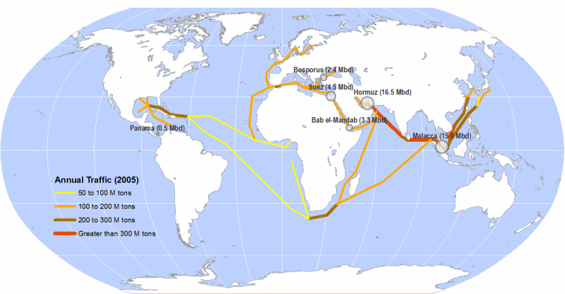
Back-story

Slide 5
Back-story
Notes:
- Shown in the graph are the proven oil reserves as stated by US Energy Information Administration (USEAI)

Slide 6
Network Model
Strategic Decision Makers Problem:
Determine the flexibility of the network taking into consideration such factors as:
Ability to leverage overall supply chain capacities.
Develop strategic precedence levels for chokepoints given expected results provided through modeling the system.
Notes:
Putting yourself in the Strategic decision makers place, what insight would we like to gain from the model?
Primarily we would like to know if an attack happens, how well can the network respond by leveraging our suppliers ability to increase their production capacities to offset an interdiction.
Second, provide a simple mental reference and prioritization of chokepoints based on results of the model.

Slide 7
Network Model
Network Abstraction:
Assumptions:
US demand will remain constant.
Foreign production of oil will have a small margin of growth. We allow for ~min(10%, amount to meet demand)
Increase only occurs after attacks
Crude and shipping prices will not change as the network is disrupted.
All shipments to the US are to the Gulf Coast.
All ships offload immediately.
An attack on any arc has an equal probability of success.
Notes:
In order to make this model manageable several assumptions had to be made. Some are obvious closely mirror reality while others were necessary to reduce the model to a manageable scale.
While there is a long term goal of reducing our dependence on foreign oil there are no major changes expected in the next 25 years.
We allow for countries
Some ships will anchor off shore and wait, betting on higher oil prices to maximize their profit.

Slide 8

Real World Basis for Model
Notes:
Our network is was based off of the physical path oil travels to get to the US.
This map shows the major shipping routes of the world and provides a frame of reference.
CLICK
We limited our sources to the top 13 suppliers, represented by the green dots
The nodes of the network are the intersections of the multiple routes the oil travels. They include chokepoints, pipelines, canals, and ports.
The edges are paths of the oil flow.
Click
When the map is removed the remaining network is actually quite simple.

Slide 9
END
(0,Demand,∞)
START
Notes:
To make our network complete we added the start node which connects to all of the green nodes (the oil producing countries)
CLICK
The US remains our end note
CLICK
To make this a min-cost flow problem we added the back arc. It has no cost, the lower bound is demand, and there is no upper bound.

Slide 10
Network Model
Measure of Effectiveness
Amount of oil imported to the US.
Cost of importing available oil to the US.
Obvious patterns of attack.
Scenario 1
Can attack any available arc
Scenario 2
Strait of Hormuz not able to be attacked
Strait of Hormuz
Saudi EW Pipeline
Turkish Straits
Bab El-Mandeb
Suez Canal
SuMed Pipeline
Panama Canal
Panama Pipeline
Straits of Malacca
Notes:
To determine the effectiveness of our model and the results it produced we looked at three things
Obvious patterns of attack. CLICK
Because of the immediate result of bullet three we also found it helpful to add some restrictions to attacks.
The first scenario was the basic model which I have been describing. I’ll steal some of Turgut’s thunder. It should be no surprise to anyone that the Strait of Hormuz is the most vital oil chokepoint in the world. This dominating fact made it difficult to gage the effects of the attacks elsewhere.
We found it helpful to run our model under a second scenario where the Strait of Hormuz could not be attacked. This did allowed us some more insight to the damage caused by attacks on the other arcs in our network.

Slide 11
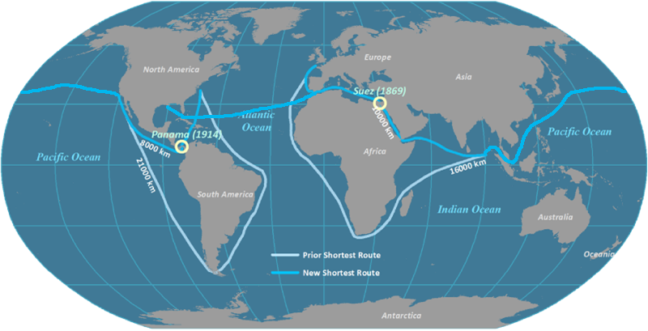
Modeling attacks on the network
Attack only arcs
Choke points are split into two nodes.
Each attack starts from base model (simultaneous attacks)
The edges have a cost, lower bound, and upper bound.
Strait of Hormuz
Saudi EW Pipeline
Turkish Straits
Bab El-Mandeb
Suez Canal
SuMed Pipeline
Panama Canal
Trans-Panama Pipeline
Straits of Malacca
Notes:
Our model only allows attacks to take place on edges, not on nodes. In order to keep canals and straits available for attack they were split up into two nodes. For example, the Suez Canal was broke up to become Suez North and Suez South. Attacking the connecting edge closes the canal.
Our model does not increase demand min(10%, demand shortfall) until after an attack. In this method we model simultaneous attacks. We do not model sequential attacks where a follow on attack takes the increased demand into account. This means that the attack locations produced are not nested. Every time the number of attacks is increased the process begins from the beginning looking at the base model.
Our edges have a cost. This cost is a shipping cost. The two methods investigated for this model were pipeline and oil tanker. It turns out that moving oil with tankers is only slightly more expensive than operating a pipeline for a given distance.
None of the edges have lower bounds.
Some of the edges have upper bounds. Pipelines and canals have published maximum capacities and some of the straits have estimated maximum capacities.

Slide 12
Mathematical Model
Network Abstraction using minimum-cost-flow network and simulating attacks against various edges.

Slide 13
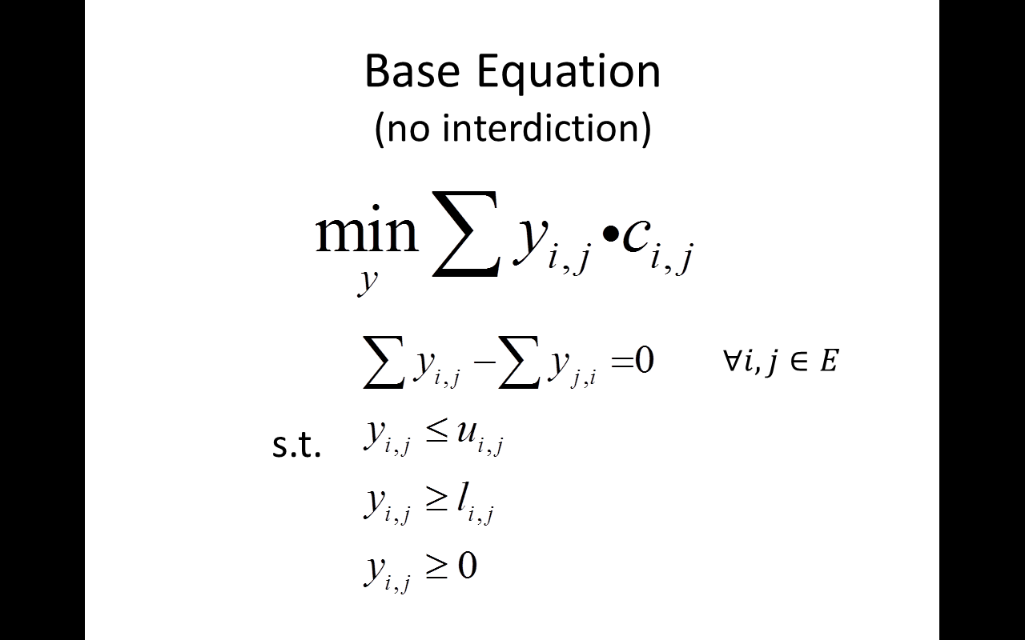
Base Equation (no interdiction)
Minimize the shipping cost
Meet demand
Dynamic capacities
Notes:
* In this model, we are trying to minimize the shipping costs, while satisfying the demand.
-We have upper limits (which are production capacities of the countries),
-In our model, the upper limits are dynamic, that is, after each attack the capacities increase (if needed)
- but, this increase will not exceed 10% which is the maximum amount that we assume each country can supply
-We have a lower limit, which is essentially the demand of US

Slide 14
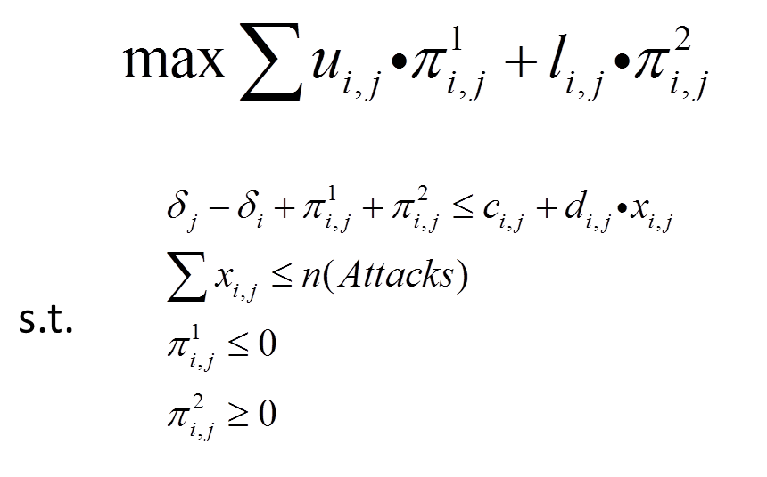
Dual Equation (with interdiction)
Choose where to attack
Minimize oil flow
Maximize shipping cost
Notes:
The attackers (terrorist, military forces of countries, pirates) want to disrupt the oil flow
They try to minimize the flow,
If cant, then they will try to maximize the costs.
They have number of options
We are going to see the affects of interdictions ( with up to 5 attacks)

Slide 15
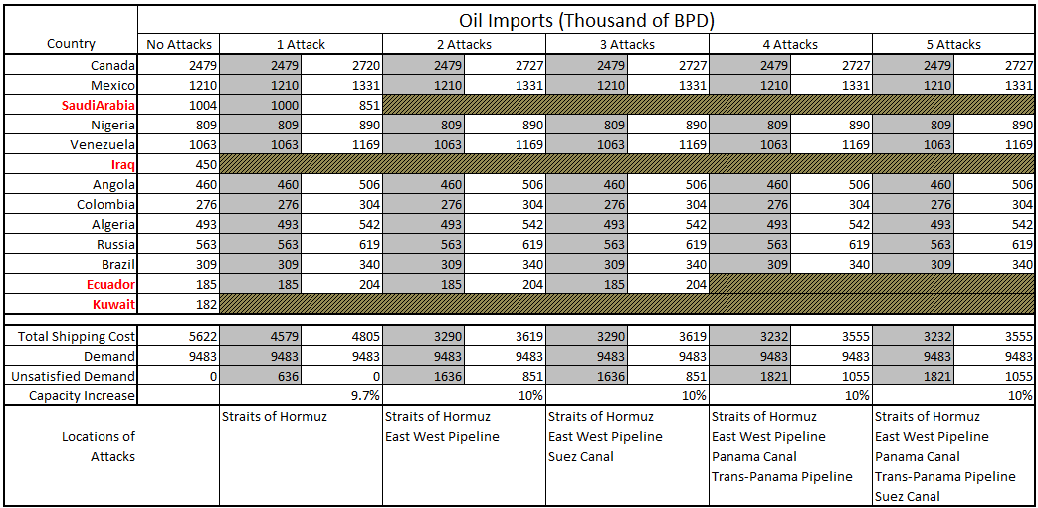
Analysis Scenario 1 Results
Notes:
Scenario 1 : Interdiction plan includes strait of Hormuz in the attack list
Define shaded/unshaded column
-shaded: results of the model with the current capacities
-unshaded:new capacities based on dynamic increase.
-mention below bullets
-Each attack causes an unsatisfied demand
-US buys more oil from other countries to meet the demand.
-The best attack plan is shown above
-For the first attack, which to the strait of Hormuz, it works
-With two or more attacks, the interdiction plan works and they cut-off some amount of the transportation
-After 4 attacks, the attacker can only

Slide 16
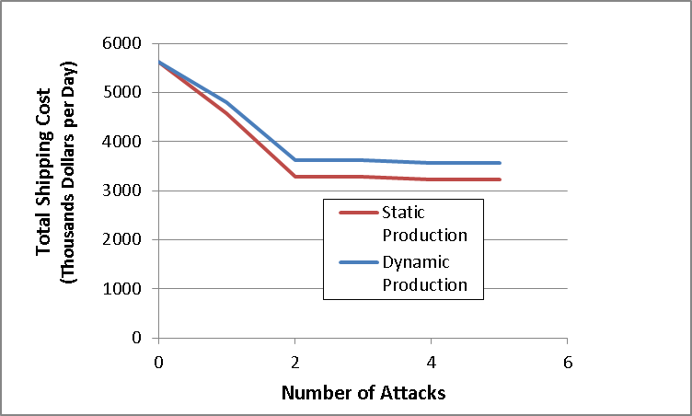
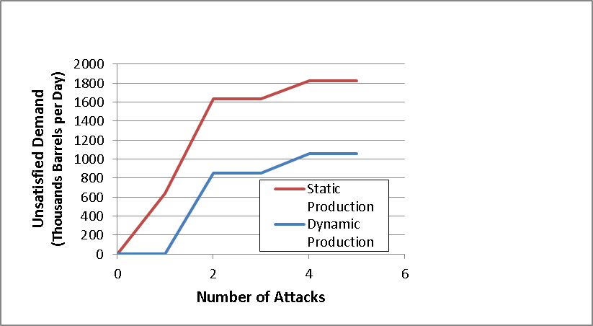
Analysis Scenario 1: Operator Resilience Curves
Total Shipping cost decrease
The interdiction plan worked in terms of increasing unsatisfied demand
With 1 attack and dynamic production, US can still meet its demand
Wıth 2 or more attacs, 10% increase in capacity did not help at all
Notes:
-Shipping costs decrease because US has unsatisfied demand
-The interdiction forced US to buy less, as a result they pay less for the shipping
-The attack plan with the dynamic production in play worked

Slide 17
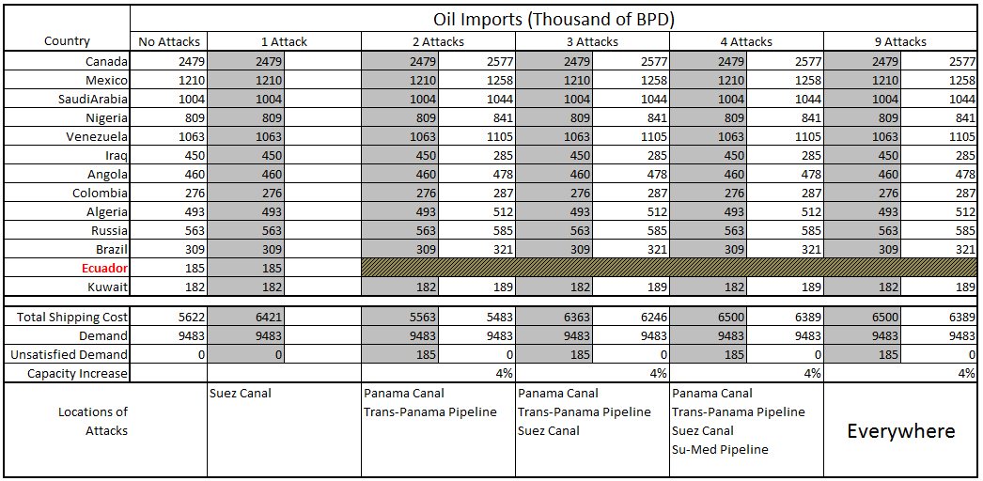
Analysis Scenario 2 Results
All possible arcs
Notes:
Scenario 2 : Interdiction without strait of Hormuz in play
- Many possibilities like: US takes military measurements, old enemies – new friends
-1 attack: does not affect oil imports, but increases the cost
-Attackers choose to attack Suez Canal
-2 attacks: Now, they have chance to cut-off import from a country – ECUADOR
-Ecuador uses Panama Canal or the pipeline there.
More than 4 attacks do not have an affect to the network

Slide 18
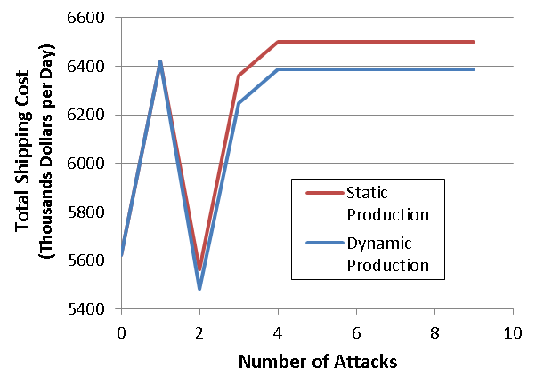
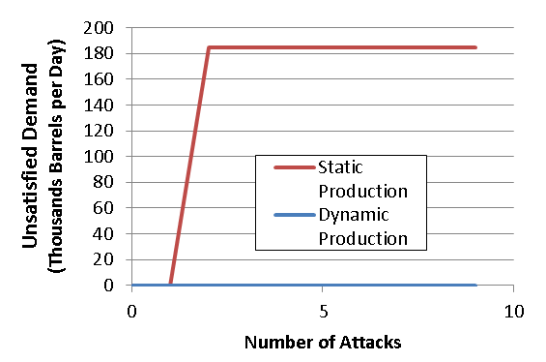
Analysis Scenario 2: Operator Resilience Curves
Totalshipping cost fluctuates
4% Capacity increase is enough to meet demand

Slide 19
Conclusion
United States can withstand an attack on the Strait of Hormuz in the short term.
When the strait and the east-west pipeline are attacked the middle east is no longer a viable source of oil and the US can not satisfy oil demand.
As long as the Strait of Hormuz remains open all other attacks are a nuisance, and drive up prices, but demand is met.
You crazy Americans

Slide 20
Summary
The location of the attacks were as expected and show that the Strait of Hormuz is the most strategic target.
The results provide insight on potential flexibility and expected consequences in disruption of flow due to attacks.
Insight for policy and decision makers for ways ahead to add resiliency, flexibility, and alternative means to power the country.
Notes:
As we saw during the analysis for the two scenarios. It was made clear that the Strait of Hormuz is currently a critical point in the network that would cause great disruption.
However, the news isn’t as bad as some may have thought considering my previous statement about world stock piles.
We saw that given an attack on the straits, the US comes up about 10% shy of it’s stated demand; given suppliers can meet an 10% increase in production capacity. Also for the 2nd scenario where the Straits became a highly hardened target, we saw that the damage was in terms of cost vice demand.
Finally, we would hope that these results would help policy makers to actively pursue and adopt actions to provide add resilience to the network in order to avoid armed conflict. For example, develop and foster cooperative engagements with Canada and Venezuela with their large reserves, increase domestic production capacity, and more aggressively pursue alternative efforts to power the country while trying to be good stewards of the planet.

Slide 21
Questions?

Slide 22
THE FUTURE?

Slide 23
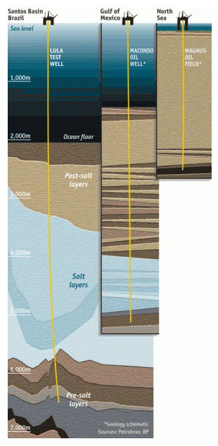
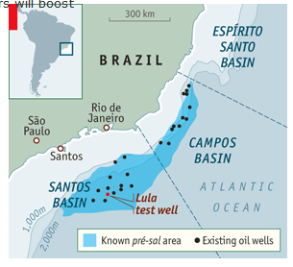
Brazil
Finds off the coast of Brazil in 2007 have increased their calculated oil reserves from 20 billion barrels to 50 billion barrels. Brazil is poised to move from the 11th largest oil producer to the 5th by 2020. But…
They are some of the deepest in the world
The North Sea
8,300 feet (1.5 miles)
The Gulf of Mexico
16,400 feet (3 miles)
Santos Basin
21,300 feet (4 miles)

Slide 24
Brazil
Pedro Cordeiro of Bain & Company, a consultancy, says all this makes developing the pré-sal a national commitment comparable to that of the Apollo programme. In terms of cost it is actually a good bit larger. Apollo cost less than $200 billion in today’s dollars; the total bill was a few percent of America’s annual GDP at the time. Ten years’ aggressive development of the pré-sal could take a trillion dollars, around half of Brazil’s 2010 GDP.
The Economist, 5 Nov 2011
http://www.economist.com/node/21536570

Slide 25
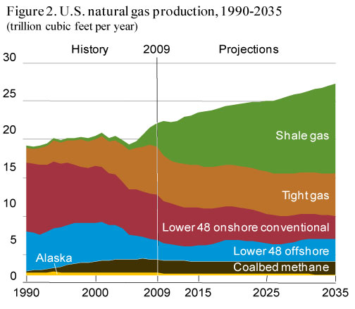
Domestic Natural Gas Production

Slide 26
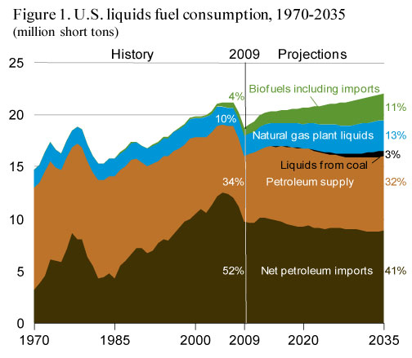
Projected US Consumption

Slide 27
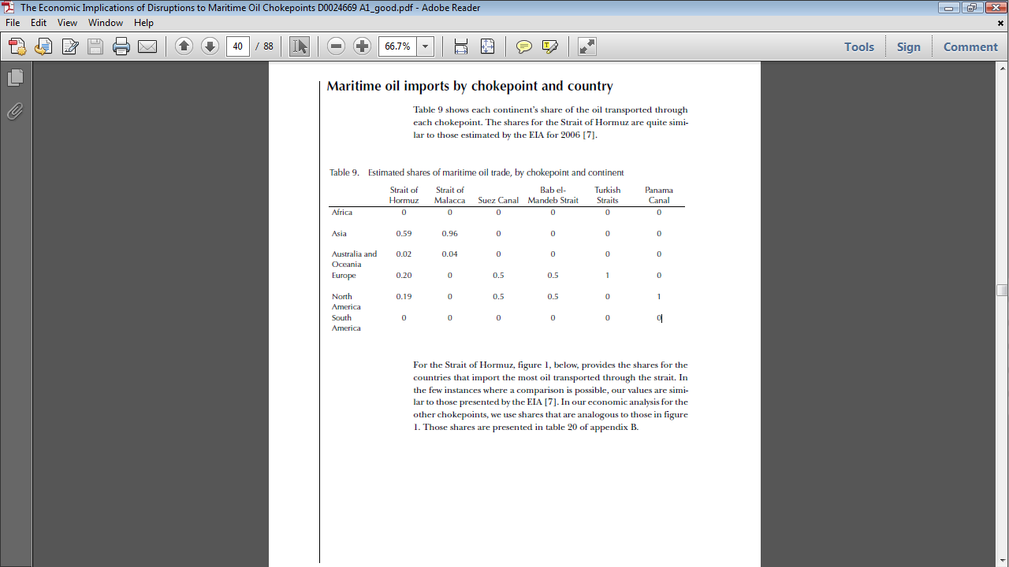

Slide 29
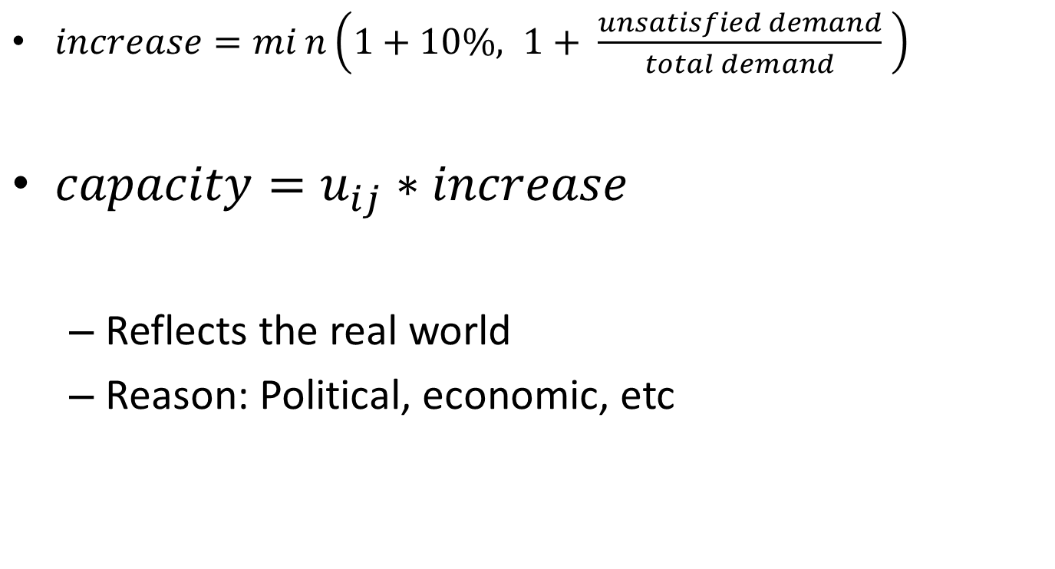
Dynamic Capacities
$increase=min\left(1+10\%, 1+ \frac{unsatisfied demand}{total demand} \right)$
$capacity=u_{ij}∗increase$
Reflects the real world
Reason: Political, economic, etc

