Slide 1
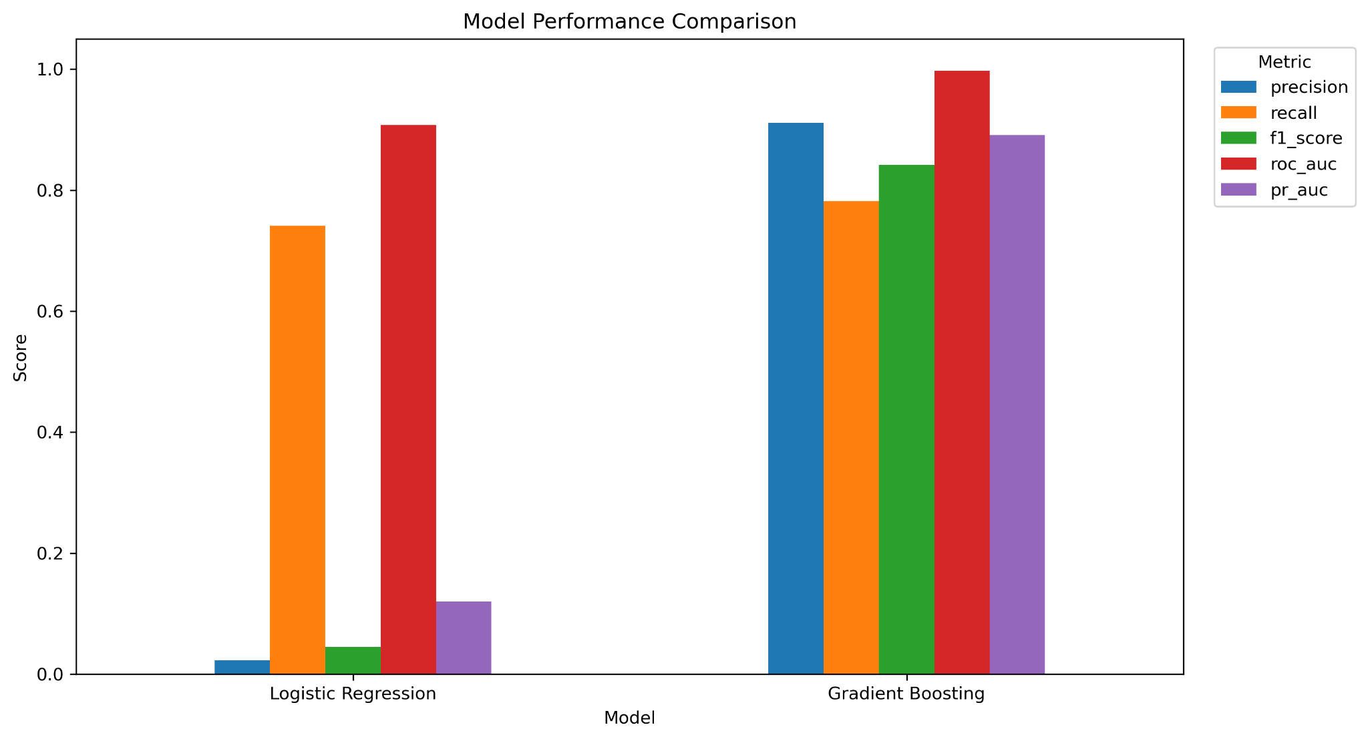
FraudShield BI
Quantifying the Impact of False Positives in Credit Card Fraud Detection
MIS581 Capstone | Business Intelligence and Data Analytics
91.14%
163
Gradient boosting precision at 0.50
False positives at 0.50
False positives create a hidden “tax” through review workload, customer friction, and missed business opportunities.
Atta Febri-Yeboah
Colorado State University Global
Dr. Jamia Mills | July 2026
Notes:
Good day, my name is Atta Febri-Yeboah. My capstone project is FraudShield BI: Quantifying the Impact of False Positives in Credit Card Fraud Detection. The main idea behind this project is that fraud prevention should not only be judged by how much fraud it catches. It also needs to be judged by how much unnecessary disruption it creates for legitimate customers. In this presentation, I will summarize the business problem, the dataset, the methods, the model results, the threshold and cost analysis, and how the Power BI dashboard turns the findings into a decision-support tool.

Slide 2
PROJECT PURPOSE
Business Problem: Fraud Controls Can Create Customer Friction
The practical challenge
Fraud systems must identify suspicious activity quickly.
Overly aggressive controls can block or review legitimate customers.
False positives can increase manual reviews, call volume, customer frustration, and lost transaction value.
Accuracy alone can hide these tradeoffs in highly imbalanced fraud data.
FraudShield BI reframes fraud detection as a business decision:
Model choice + threshold choice → fraud prevention, customer friction, review workload, and cost.
False Positive Tax
A business-readable estimate of the cost created when legitimate transactions are incorrectly flagged.
Notes:
The business problem I studied is the tension between fraud protection and customer experience. A fraud model can look effective if it catches suspicious activity, but if it creates too many false positives, it can also create a hidden cost. Those costs may include manual review, customer service contact, declined purchases, and reduced customer trust. My project calls this the False Positive Tax because it is a cost that may not be visible if the organization only focuses on model accuracy.

Slide 3
STUDY FOCUS
Research Questions and Hypotheses
RQ1
How does changing the fraud threshold affect false positives, fraud detection, and estimated False Positive Tax?
H01 rejected
RQ2
Which transaction characteristics and model outputs are associated with false-positive decisions?
H02 rejected
RQ3
How can BI dashboards and scenario analysis support fraud-prevention decisions?
H03 rejected
Analytical approach: confusion matrices, threshold analysis, precision–recall metrics, chi-square tests, Mann-Whitney U tests, cost-scenario analysis, and Power BI reporting.
Notes:
The project was guided by three research questions. First, I studied how changing the classification threshold affected false positives, fraud detection, and estimated cost. Second, I examined which transaction characteristics were associated with false positives. Third, I evaluated how a dashboard and scenario analysis could help decision-makers compare fraud prevention with customer friction. The analysis led to rejection of all three null hypotheses because the data showed meaningful changes across thresholds, transaction segments, and cost scenarios.

Slide 4
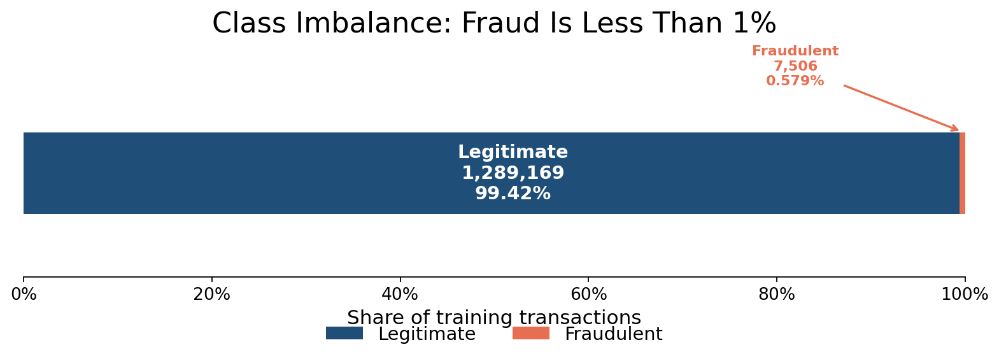
DATA FOUNDATION
Dataset, Research Design, and Ethical Boundaries
1,296,675
555,719
0.579%
training records
testing records
training fraud rate
Design choices
Ethical guardrails
Quantitative secondary analysis using a simulated Kaggle/Sparkov transaction dataset.
Pre-split train/test files used; production work should add validation and holdout samples.
Predictors included amount, hour, age, city population, distance, category, and gender.
No employer records, customer accounts, or internal fraud rules were used.
Direct identifiers and high-cardinality fields were excluded from modeling.
Dashboard is positioned as decision support, not fully automated production approval.
Source: Kaggle Credit Card Transactions Fraud Detection Dataset; final paper data summary.
Notes:
The dataset came from the Kaggle credit card transactions fraud detection dataset, which was generated using Sparkov and contains simulated transaction records. I used the training file with 1,296,675 records and the testing file with 555,719 records. The fraud rate in the training data was only about 0.579 percent, which confirmed that this was a highly imbalanced classification problem. The supplied train/test files were practical for the capstone, but a production version should also use a validation sample and an untouched holdout sample for threshold selection and final confirmation. Ethically, I did not use employer data, real customer data, or internal fraud procedures. I also excluded direct identifiers such as credit card number, names, transaction number, street address, and merchant name.

Slide 5
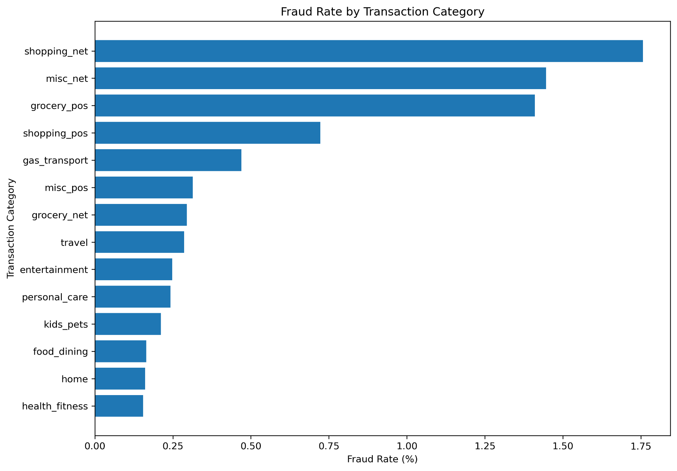
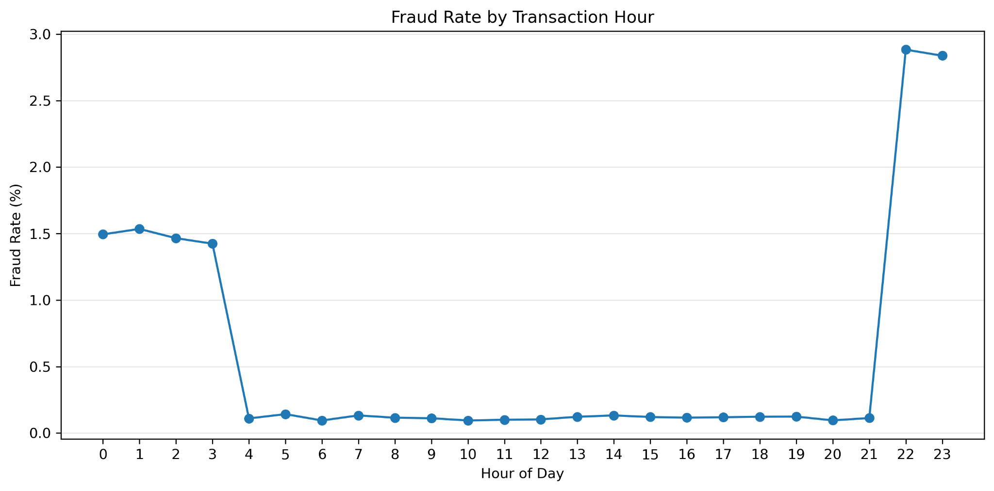
EDA RESULTS
Exploratory Findings: Fraud Patterns Were Segment-Specific
Key pattern: online shopping, miscellaneous online, and grocery POS had the highest fraud rates. Fraud also rose sharply during late-night hours.
Notes:
The exploratory analysis showed that fraud was not evenly distributed. Some transaction categories had much higher fraud rates than others. Online shopping, miscellaneous online transactions, and grocery point-of-sale transactions were among the highest categories. Time of day also mattered. The fraud rate increased sharply around 10:00 p.m. and 11:00 p.m., while most daytime hours were much lower. These patterns helped support the idea that transaction characteristics are important when evaluating fraud and false-positive decisions.

Slide 6
PREDICTIVE PERFORMANCE
Model Comparison: Gradient Boosting Was the Clear Winner
Default 0.50 threshold
67,204
163
logistic false positives
gradient boosting false positives
2.31%
91.14%
logistic precision
gradient boosting precision
At the same threshold, gradient boosting detected more fraud and reduced false positives by 67,041 compared with logistic regression.
Notes:
I compared class-weighted logistic regression with histogram-based gradient boosting. Logistic regression was useful as an interpretable baseline, but at the default 0.50 threshold it produced 67,204 false positives and only 2.31 percent precision. Gradient boosting performed much better. It produced only 163 false positives, with 91.14 percent precision, 78.18 percent recall, and an F1-score of 84.17 percent. This was one of the strongest findings in the project.

Slide 7
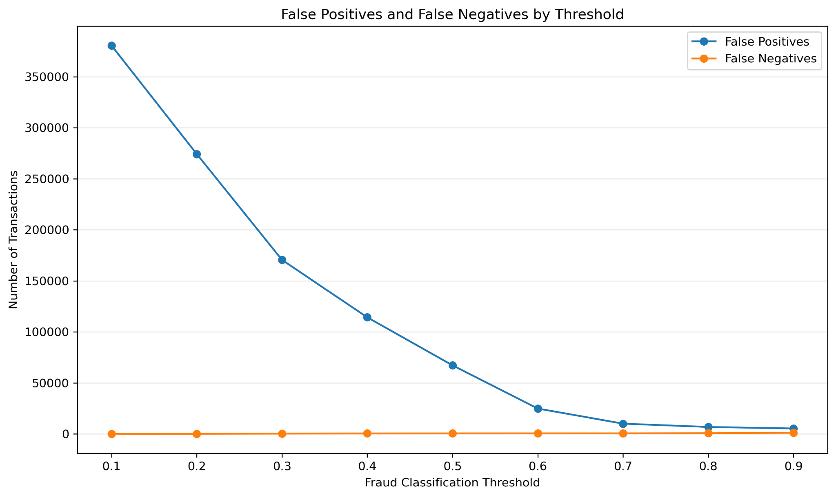
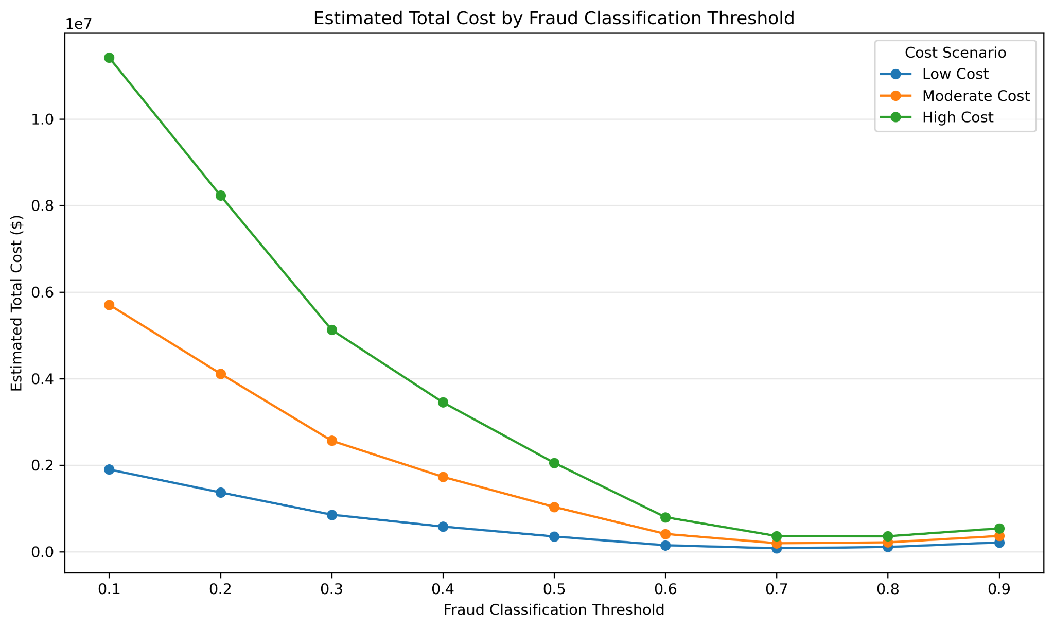
DECISION TRADEOFF
Threshold Analysis: The Cutoff Is a Business Decision
Lower thresholds catch more fraud but can increase false positives. Higher thresholds reduce alerts but may miss more fraud. The preferred threshold depends on cost, customer friction, and review capacity.
Notes:
Threshold analysis was important because the default 0.50 cutoff is not automatically the best business choice. For logistic regression, increasing the threshold from 0.50 to 0.70 reduced false positives from 67,204 to 10,062, while true positives declined from 1,589 to 1,546. Gradient boosting had better separation, so it could use a lower threshold to catch more fraud without producing the same level of false-positive burden. This shows that threshold selection is not a minor technical detail. It directly affects review workload, customer friction, fraud capture, and cost.

Slide 8
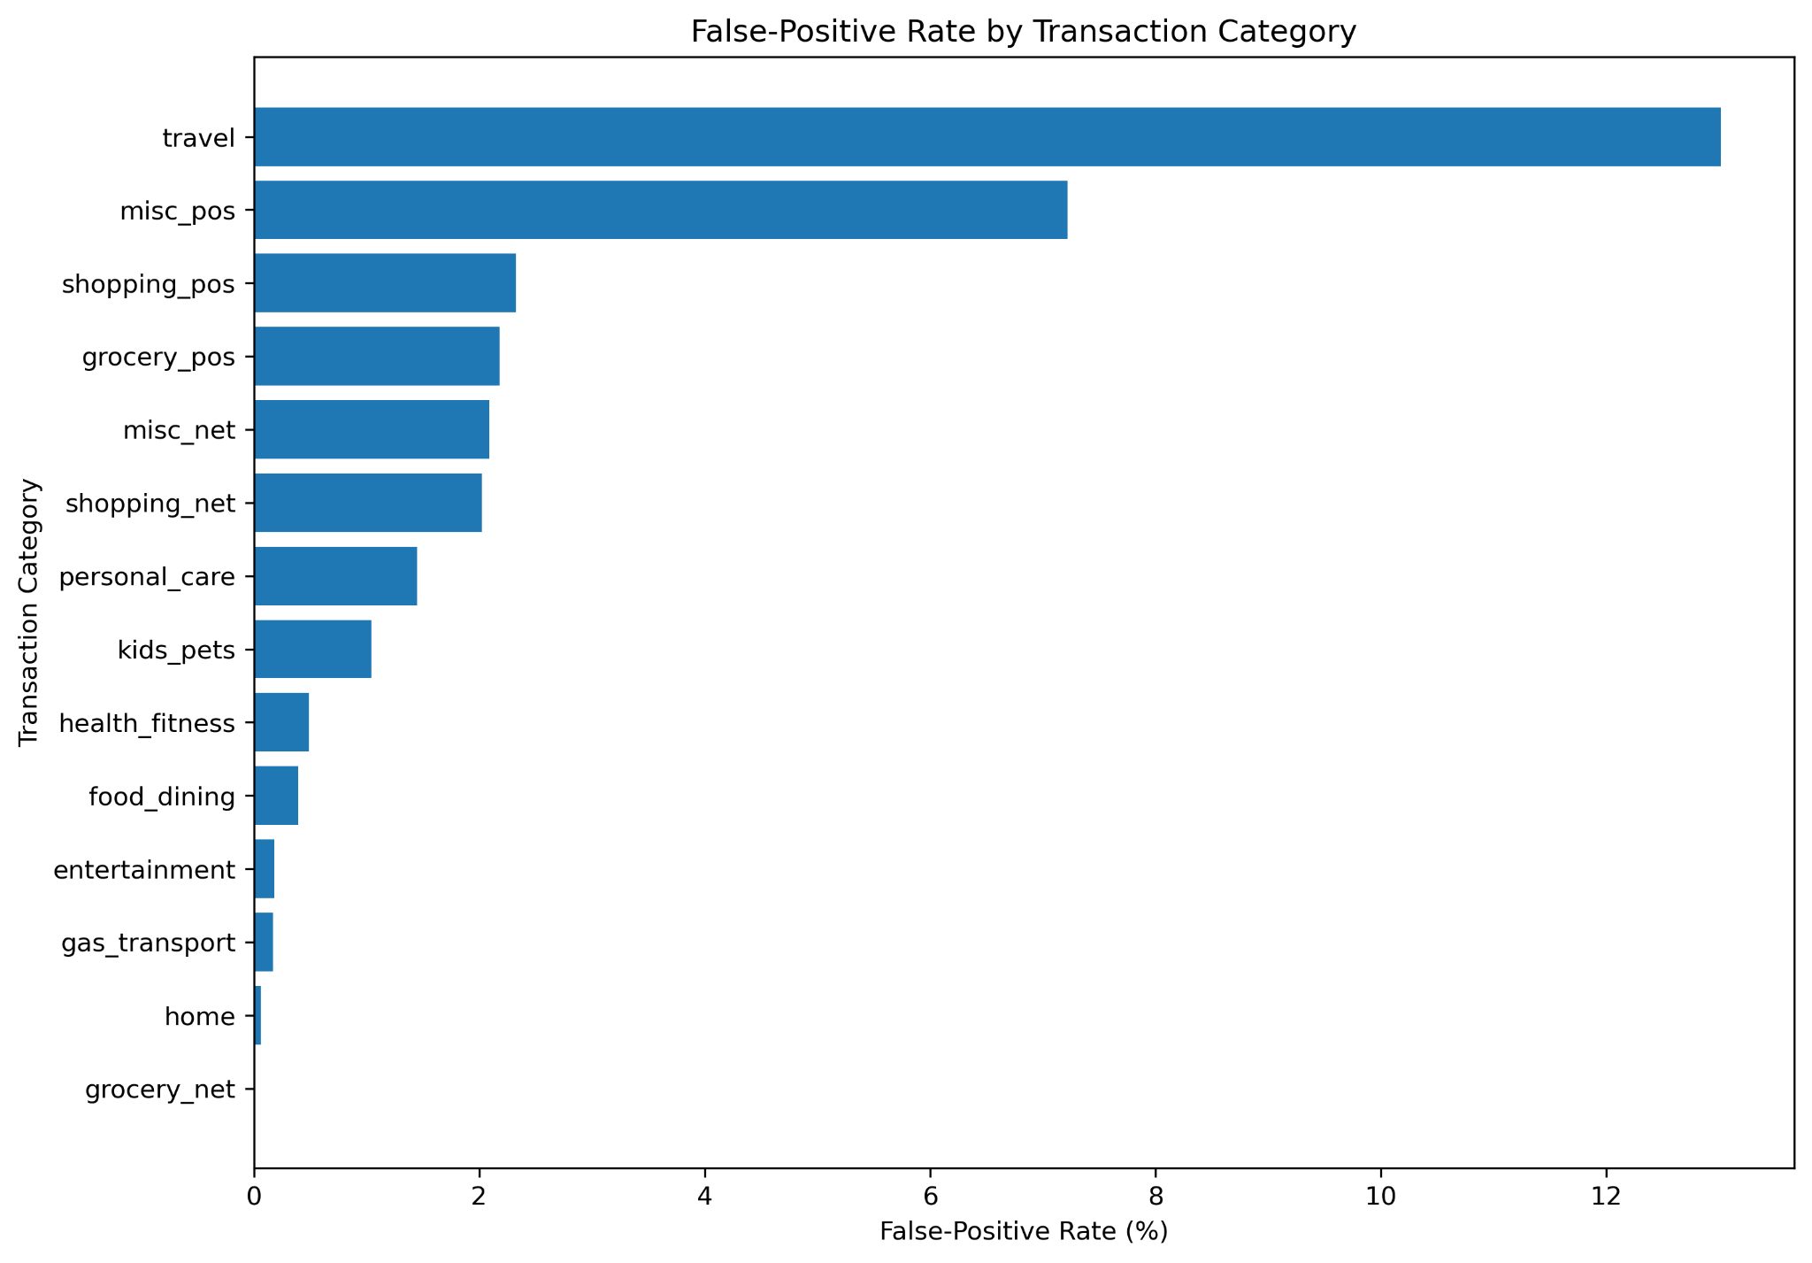
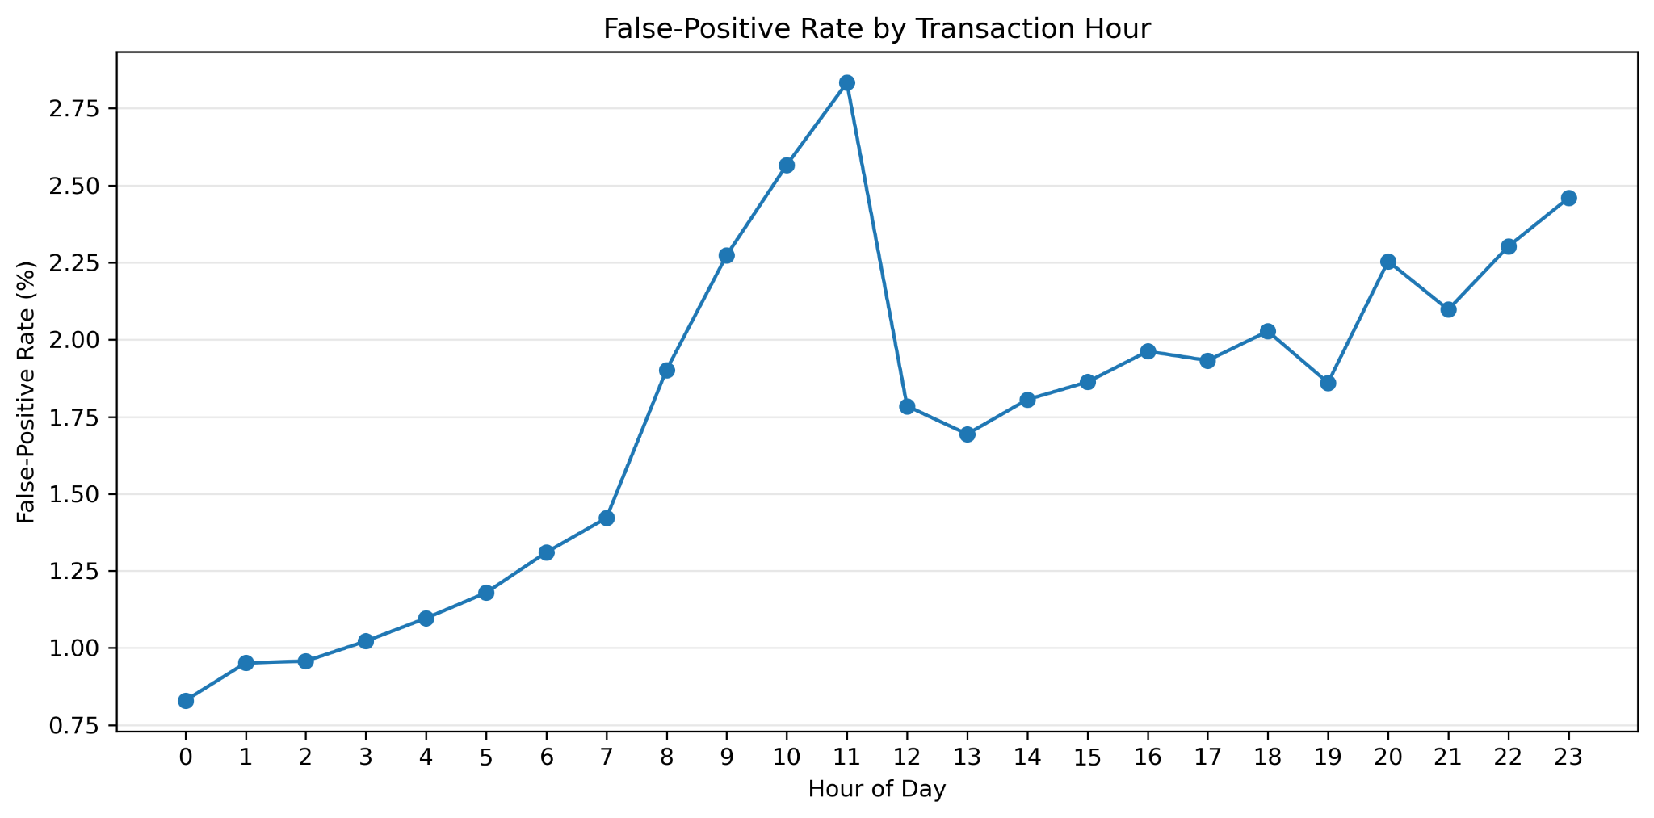
FALSE-POSITIVE DEEP DIVE
False-Positive Impact: The Burden Was Not Evenly Distributed
Operational takeaway: travel had the highest false-positive rate (13.02%), and 11 a.m. had the highest hourly false-positive rate (2.83%). High-impact segments may need step-up authentication instead of automatic decline.
Notes:
The false-positive analysis showed that false positives were not evenly distributed across legitimate transactions. Travel transactions had the highest false-positive rate, at about 13.02 percent. Miscellaneous point-of-sale transactions were also high. False-positive transactions had a much higher average amount than correctly approved transactions. This matters because a false positive on a travel purchase may create more customer frustration than a routine transaction. The recommendation is not simply to flag fewer transactions, but to manage high-impact segments more carefully using step-up authentication, customer confirmation, or manual review.

Slide 9
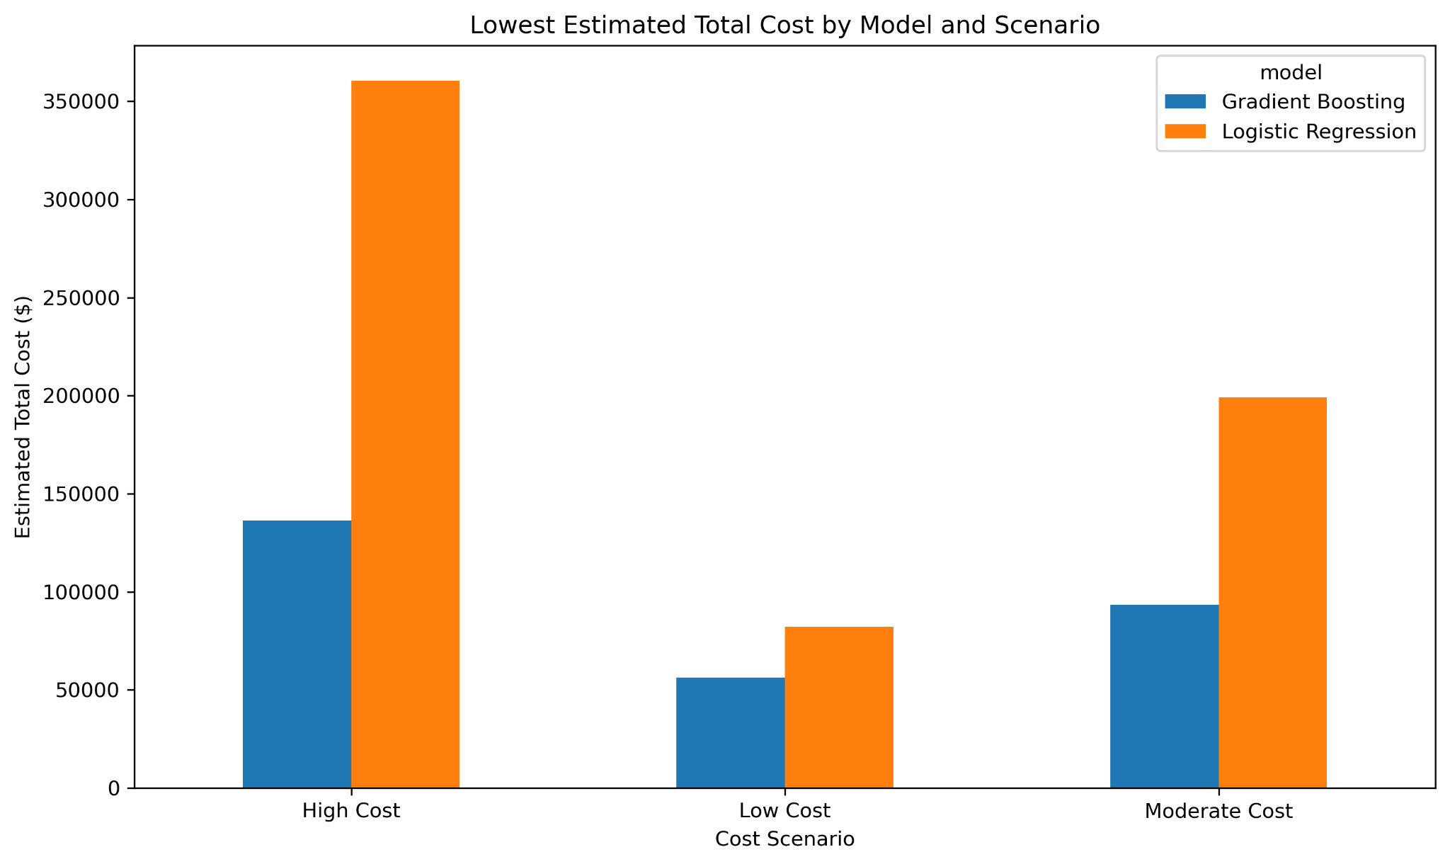
BUSINESS RECOMMENDATION
Cost Scenario Analysis: Recommended Model and Threshold
Moderate-cost recommendation
Gradient Boosting
0.10
recommended model
recommended threshold
$93,392
1,173
estimated total cost
false positives
This recommendation minimizes estimated total cost under the moderate scenario while retaining higher fraud capture than the 0.50 cutoff.
Notes:
The cost scenario analysis applied low, moderate, and high assumptions to false-positive cost and missed fraud cost. Gradient boosting produced the lowest estimated total cost in every scenario. Under the moderate-cost scenario, the recommendation was gradient boosting at a 0.10 threshold, with an estimated total cost of 93,392 dollars and 28 cents. This result had 1,173 false positives, 258 false negatives, and 1,887 true positives. This threshold was not the highest F1-score threshold, but it was the lowest-cost threshold under the business assumptions. That is the main lesson: the best statistical threshold and the best business threshold may not always be the same.

Slide 10
REFERENCES
Selected Sources
Bolton, R. J., & Hand, D. J. (2002). Statistical fraud detection: A review. Statistical Science, 17(3), 235–255.
Creswell, J. W., & Creswell, J. D. (2023). Research design: Qualitative, quantitative, and mixed methods approaches (6th ed.). SAGE.
Custers, B. (2013). Data dilemmas in the information society: Introduction and overview. In B. Custers et al. (Eds.), Discrimination and privacy in the information society. Springer.
Dal Pozzolo, A., Caelen, O., Johnson, R. A., & Bontempi, G. (2015). Calibrating probability with undersampling for unbalanced classification. IEEE Symposium Series on Computational Intelligence.
Ghosh, S., & Reilly, D. L. (1994). Credit card fraud detection with a neural-network. Proceedings of the 27th Hawaii International Conference on System Sciences.
Phua, C., Lee, V., Smith, K., & Gayler, R. (2010). A comprehensive survey of data mining-based fraud detection research. arXiv preprint.
Provost, F., & Fawcett, T. (2013). Data science for business: What you need to know about data mining and data-analytic thinking. O’Reilly Media.
Kartik2112. (2020). Credit card transactions fraud detection dataset. Kaggle. https://www.kaggle.com/datasets/kartik2112/fraud-detection
Additional source details are documented in the final paper and GitHub repository.
10

