Slide 1
CS550 Term Project
Face Mask Detection
Using AWS Rekognition

Slide 2
Outline
1. Problem Description
2. Tools & Services
3. Design Explanation
4. Demonstration
5. Questions & Answers
CS 550 Term Project Face Mask Detection using AWS Rekognition – Salih Emre Kaynar, Güney Doruk Keser

Slide 3



Problem Description
CS 550 Term Project Face Mask Detection using AWS Rekognition – Salih Emre Kaynar, Güney Doruk Keser

Slide 4



Tools & Services
CS 550 Term Project Face Mask Detection using AWS Rekognition – Salih Emre Kaynar, Güney Doruk Keser

Slide 5

Design Explanation
CS 550 Term Project Face Mask Detection using AWS Rekognition – Salih Emre Kaynar, Güney Doruk Keser

Slide 6
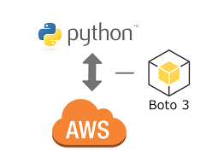
Server Side
Amazon EC2 Instance
Bounding Box Coordinates
CS 550 Term Project Face Mask Detection using AWS Rekognition – Salih Emre Kaynar, Güney Doruk Keser

Slide 7
Client Side
Capture
Connection
Amazon EC2 Instance
Saving Output Image
Drawing Bounding Boxes
Bounding Box Coordinates
CS 550 Term Project Face Mask Detection using AWS Rekognition – Salih Emre Kaynar, Güney Doruk Keser

Slide 8
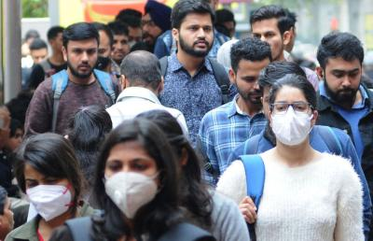
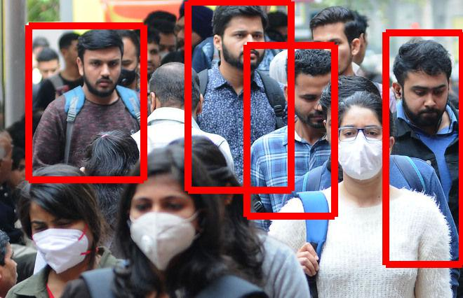
Client Side
CS 550 Term Project Face Mask Detection using AWS Rekognition – Salih Emre Kaynar, Güney Doruk Keser

Slide 9
Live Demonstration
CS 550 Term Project Face Mask Detection using AWS Rekognition – Salih Emre Kaynar, Güney Doruk Keser

Slide 10

Any Questions
CS 550 Term Project Face Mask Detection using AWS Rekognition – Salih Emre Kaynar, Güney Doruk Keser

