Slide 1
System
A system is an interrelated set of business procedures used within one business unit working together for a purpose
A system exists within an environment
A boundary separates a system from its environment
A collection of parts that work together to achieve a goal/task
  Examples
    Solar system
    Digestive systems
    Public transport system
    Central heating system
    Computer system
    Information system
A set of objects and relationships among the objects viewed as a whole and designed to achieve a purpose

Slide 2
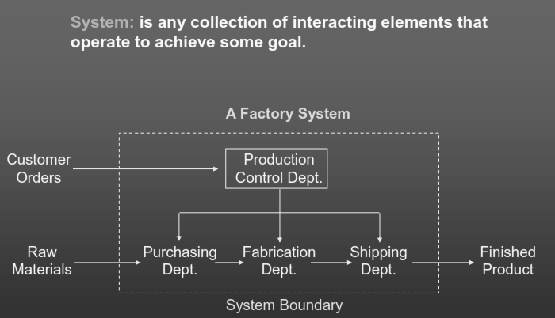

Slide 3
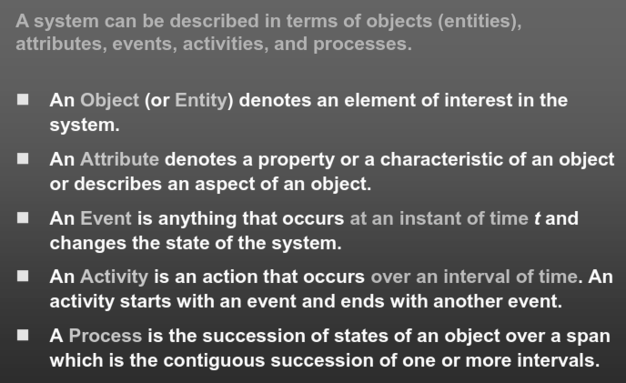

Slide 4
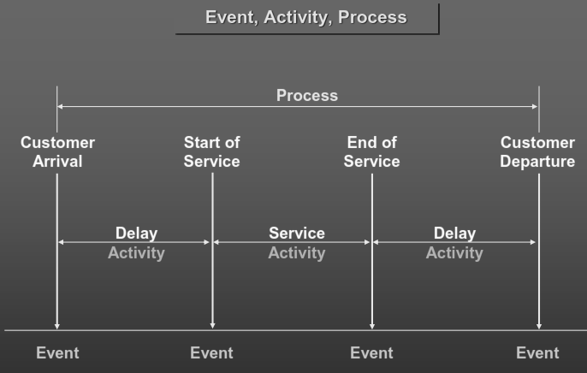

Slide 5
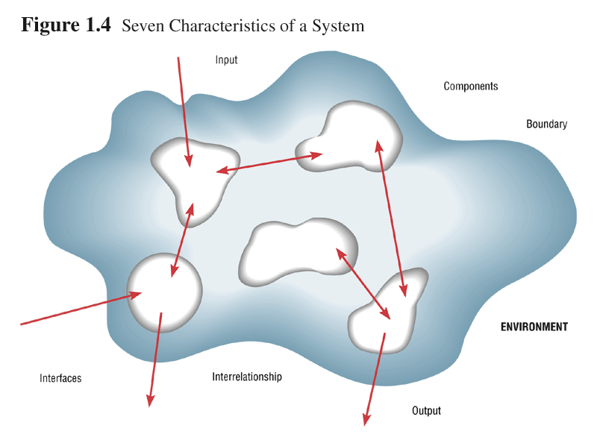
Characteristics of a System
Components
Interrelated Components
Boundary
Purpose
Environment
Interfaces
Constraints
Input
Output

Slide 6
Systems
Can Be Composed of Subsystems
System
Subsys A
Subsys B
Elemental
Part C
SubsysB-1
Subsys A-1
Subsys A-2
SubsysB-2
Subsys A-3
Elemental
part B1

Slide 7
What is subsystem?
A subsystem is simply a system within a system.
  Automobile is a system composed of subsystems:
    Engine system
    Body system
    Frame system
  Each of these subsystem is composed of sub-sub --systems.
    Engine system: carburetor system, generator system, fuel system, and so son

Slide 8
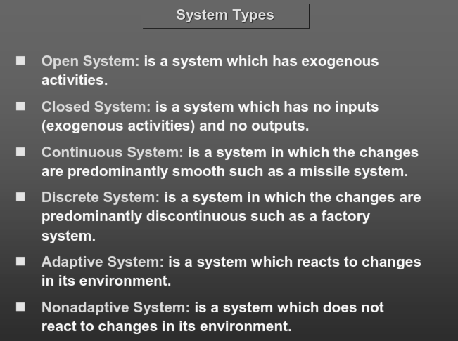

Slide 9
Important System Concepts
Decomposition
  The process of breaking down a system into smaller components
  Allows the systems analyst to:
    Break a system into small, manageable subsystems
    Focus on one area at a time
    Concentrate on component pertinent to one group of users
    Build different components at independent times

Slide 10
Important System Concepts
Modularity
  Process of dividing a system into modules of a relatively uniform size
  Modules simplify system design
Coupling
  Subsystems that are dependent upon each other are coupled
Cohesion
  Extent to which a subsystem performs a single function

Slide 11
Systems Analysts
Systems analysts are the key individuals in the systems development process.
A systems analyst studies the problems and needs of an organization to determine how people, data, processes, communications, and information technology can best accomplish improvements for the business.
The organizational role most responsible for the analysis and design of information systems.
Notes:
Teaching Notes
Actually, we offered two definitions in the chapter. First, we characterized the systems analyst as a “facilitator” of the other stakeholders’ participation in systems development. Then we offered the more precise definition in this slide.

Slide 12
Skills Required by Systems Analysts
  Working knowledge of information technology
  Computer programming experience and expertise
  General business knowledge
  Problem-solving skills
  Interpersonal communication skills
  Interpersonal relations skills
  Flexibility and adaptability
  Character and ethics
  Systems analysis and design skills
Notes:
No additional notes

Slide 13
Systems Analysis: understanding and specifying in detail what an information system should do
System Design: specifying in detail how the parts of an information system should be implemented
Definition of SAD:
  The complex organizational process whereby computer-based information systems are developed and maintained.

Slide 14
System development methodology
A standard process followed in an organization to conduct all the steps necessary to:
    Analyze
    Design
    Implement
    Maintain
  information system

Slide 15
Systems Development Life Cycle (SDLC)
It is a common methodology for systems often follows for system development in many organization, featuring several phases that mark the progress of the systems analysis and design effort.
SDLC phases:
  1-Project identification and selection
  2-Project initiation and planning
  3-Analysis
  4-Design
    4.1Logical design
    4.2Physical design
  5-Implementation
  6-Maintenance
1.<number>

Slide 16
1-Project identification and selection phase
  The first phase of the SDLC in which an organization total information systems needs are identified analyzed, prioritized and arranged.
    Identifying Potential development projects
    Classifying and ranking projects
    Selecting projects for development

Slide 17
2-Project initiation and planning phase
  The second phase of the SDLC in which a potential IS project is explained and an argument for continuing with the project is presented. A detailed plan is also developed for conducting the remaining phases of the SDLC for the propose system. Output are:
    Detailed step – work plan - high level system requirement –assignment of team members

Slide 18
3- Analyzing systems
The primary objective of the analysis phase is to understand and document the business needs and the processing requirements of the new system. There are six primary activities in this phase:
• Gather information.
• Define system requirements.
• Build prototypes for discovery of requirements .
• Prioritize requirements.
• Generate and evaluate alternatives.
• Review recommendations with management

Slide 19
4-Design phase
  The forth phase of the SDLC in which the description of the recommended solution is converted into logical and then physical system specification.
    Logical design:
      The part of the design phase of the SDLC in which all functional feature of the system chosen for development in analysis are described independently of any computer platform.
    Physical design:
      The part of the design phase of the SDLC in which the logical specification of the system from logical design are transformed into technology specific details from which all programming and system construction can be accomplished.

Slide 20
4.1 Logical design output
  Functional,
  Detailed specification of all system elements
    Input
    Output
    Process

Slide 21
4.2 Physical design output
  Technical
  Detailed specification of all system elements
    programs,
    files,
    network,
    system software
    etc
  Acquisition plan of a new technology

Slide 22
Cont.
4- Designing the recommended system
Its primary objective is to convert the description of the recommended alternative solution into system specification.
  High-level design consists of developing an architectural structure for software programs, databases, the user interface, and the operating environment.
  Low-level design entails developing the detailed algorithms and data structures that are required for program development.
Seven major activities must be done during design:
    Design and integrate the network.
    Design the application architecture.
    Design the user interfaces .
    Design the system interfaces.
    Design and integrate the databases.
    Prototype for design details.
    Design and integrate the system controls

Slide 23
5- Implementation
  The fifth phase of the SDLC in which the information system is
    Coded,
    Tested,
    Installed, and
    Supported in the organization.
  Outputs:
    Code, documentation, training procedures and support capabilities

Slide 24
6-Maintances
  The final phase of the SDLC in which the information system is systematically repaired and improved
  Output are:
    New versions of releases of software with associated updates to documentation, training, and support

