Slide 1
Classification of model
Conceptual model is a representation of a system, made of the composition of concepts, which are used to help people know, understand, or simulate a subject the model represents.
Example
State transition modelling in fine state machine, UML diagram(use case, sequence, acivity), data flow model
Abstract Model: The model, which represents the external view without going through the internal details and follows the principle of abstraction.
Example: E-commerce Business Model such as B2B, B2C, C2B, C2C model for Internet Banking, Information system design, Class diagram ,object diagram

Slide 2
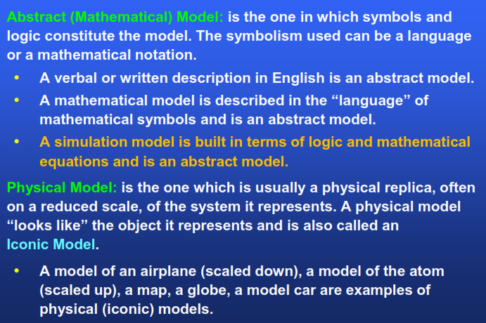

Slide 3
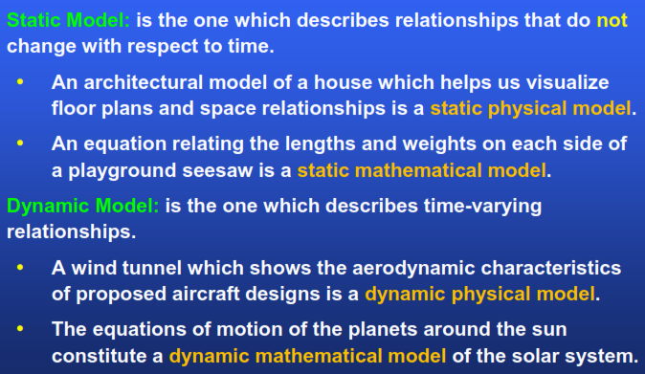

Slide 4
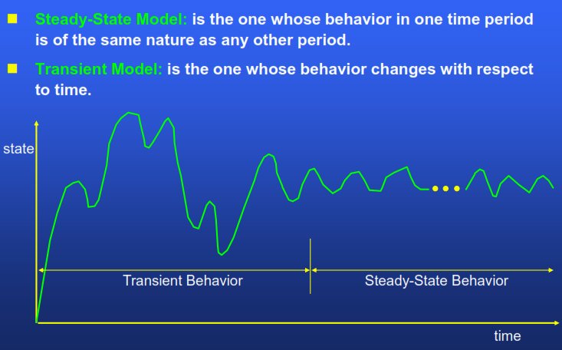

Slide 5
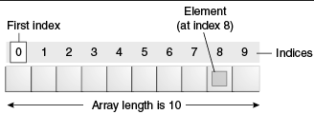
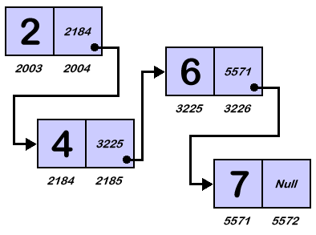
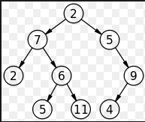
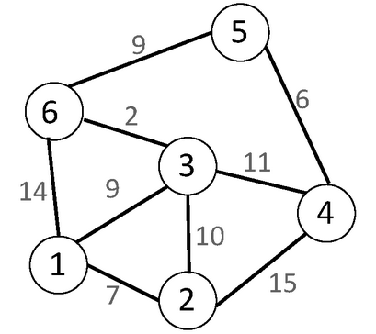
A non-linear data model is a data structure in which a data item is connected to several other data items. So that a given data item has the possibility to reach one-or-more data items. Examples of non-linear data-structures are Graphs and Trees. However Linked List and Arrays are linear data model

Slide 6
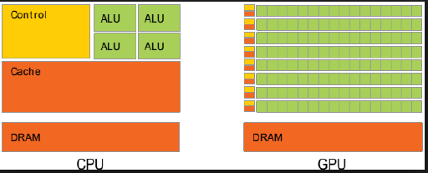
Heterogeneous Model: Model, which integrates more than one system of different type.
Examples: CPU and GPU integration in same silicon die by Intel and IBM processors, distributed database, distributed GUI, distributed OS.

Slide 7
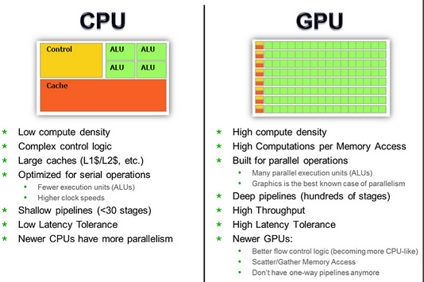
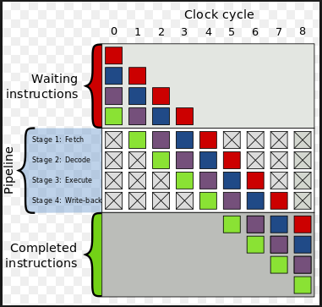

Slide 8
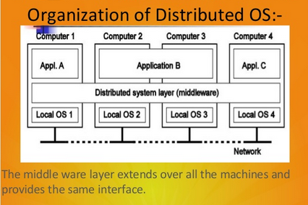
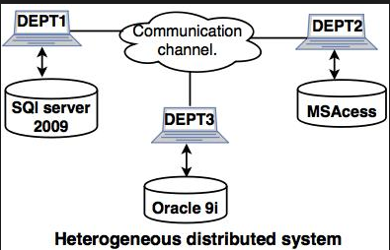
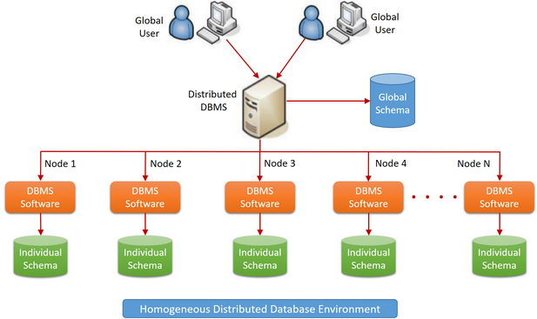

Slide 9
Parallel Process Modelling
Parallel processing a mode of operation in which a process is splits into parts, which are, executed simultaneously on different processors attached to the same computer.
Simultaneous use of more than one CPU to execute a program parallel processing makes a program run faster because there are more CPU running it.
Parallel processing Model Examples
Human Brain model
Artificial intelligence to model complex game for chess, suduko
Multicore Processor model by Intel, IBM, and AMD
Operating system such as window OS, Linus, mac os, Ubuntu OS
Multiple threads can be run on the available core to speed up the computation
Matrix processing
Scientific computation
Earthquake simulation

Slide 10
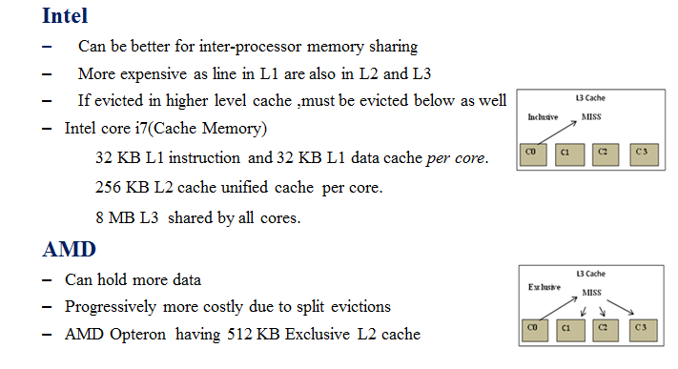

Slide 11
Analytical models are mathematical models that have a closed form solution, i.e. the solution to the equations used to describe changes in a system can be expressed as a mathematical analytic function.
Examples: logic and reasoning, fuzzy logic and crisp logic, probability and statistics etc.
Continuous modelling is the mathematical practice of applying a model to continuous data (data which has a potentially infinite number, and divisibility, of attributes). They often use differential equations and are converse to discrete modelling.
Discrete modelling is the discrete analogue of continuous modelling. In discrete modelling, formulae are fit to discrete data—data that could potentially take on only a countable set of values, such as the integers, and which are not infinitely divisible.

Slide 12
In deterministic models, the output of the model is fully determined by the parameter values and the initial conditions.
A stochastic model is a tool for estimating probability distributions of potential outcomes by allowing for random variation in one or more inputs over time. The random variation is usually based on fluctuations observed in historical data for a selected period using standard time-series techniques.
Stochastic models possess some inherent randomness. The same set of parameter values and initial conditions will lead to an ensemble of different outputs.

