Slide 1
Random Number
Random numbers are numbers that occur in a sequence such that two conditions are met:
The values are uniformly distributed over a defined interval or set, and
It is impossible to predict future values based on past or present ones.
Uses of Random Number
Randomness has many uses in science, art, statistics, cryptography, gaming, gambling, and other fields. For example, random assignment in randomized controlled trials helps scientists to test hypotheses, and random numbers or pseudorandom numbers help video games such as video poker.

Slide 2
A pseudo-random number generator (PRNG) is a program written for, and used in, probability and statistics applications when large quantities of random digits are needed. Most of these programs produce endless strings of single-digit numbers, usually in base 10, known as the decimal system.
How do you generate random number in C++
One way to generate these numbers in C++ is to use the function rand(). Rand is defined as: #include <cstdlib> int rand(); The rand function takes no arguments and returns an integer that is a pseudo-random number between 0 and RAND_MAX.
RAND_MAX. Maximum value returned by rand. This macro expands to an integral constant expression whose value is the maximum value returned by the rand function. This value is library-dependent, but is guaranteed to be at least 32767 on any standard library implementation.

Slide 3
These created values are not truly "random" because a mathematical formula is used to generate the values. srand(x) used to set the starting value (seed) for generating a sequence of pseudo-random integer values. The srand(x) function sets the seed of the random number generator algorithm used by the function rand( ).
Pseudo Random Number Generator (PRNG) Pseudo Random Number Generator(PRNG) refers to an algorithm that uses mathematical formulas to produce sequences of random numbers. PRNGs generate a sequence of numbers approximating the properties of random numbers.
On a completely deterministic machine you can't generate anything you could really call a random sequence of numbers,” . “because the machine is following the same algorithm to generate them. ... Not all randomness is pseudo, however, There are ways that machines can generate truly random numbers

Slide 4
Random Number Generators algorithm
Random number generation is a method of producing a sequence of numbers that lack any discernible pattern.
Random Number Generators (RNGs) have applications in a wide range of different fields and are used heavily in computational simulations.
Pseudo Random Number Generator (PRNG)Algorithms
Linear Congruential Generator.
  X_{n+1} = ( a X_{n} + c ) mod m
Mid-square random number generator.
Lagged Fibonacci Generator
  X_{n} = X_{n-1} + X_{n-2}
Add-with-carry & Subtract-with-borrow
  AWC: X_{n}=(X_{n-l}+X_{n-k}+carry) mod m
  SWB: X_{n}=(X_{n-l}-X_{n-k}-carry) mod m

Slide 5
Linear Congruential Generator
Many built-in RNGs use the Linear Congruential Generator or LCG. This generator is very fast, has low memory requirements but for most serious applications where randomness actually matters, it is useless.
A sequence of random values Xn where:
Xn+1 = ( a Xn + c ) mod m
with well-chosen values of a, c, m

Slide 6
Linear Congruential Generator
Example Sequences:
m=10, a=2, c=1
1
3 (2*1 + 1 % 10)
7 (2*3 + 1 % 10)
5 (2*7 + 1 % 10)
1 (2*5 + 1 % 10)
3 (2*1 + 1 % 10)
7 (2*3 + 1 % 10)
5 (2*7 + 1 % 10)
…
m=10, a=1, c=7
1
8 (1*1 + 7 % 10)
5 (1*8 + 7 % 10)
2 (1*5 + 7 % 10)
9 (1*2 + 7 % 10)
6 (1*9 + 7 % 10)
3 (1*6 + 7 % 10)
0 (1*3 + 7 % 10)
…

Slide 7
Linear Congruential Generator
Various sources use different parameters for the LCG:
Numerical Recipes
m = 2³² a = 1664525 c = 1013904223
GCC
m = 2³² a = 1103515245 c = 12345
MMIX
m = 2⁶⁴ a = 6364136223846793005 c = 1442695040888963407

Slide 8
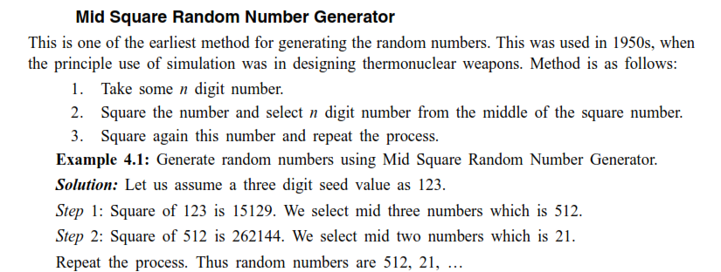
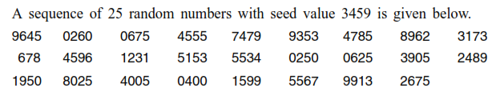

Slide 9
Lagged Fibonacci Generator
The Lagged Fibonacci Generator is based on a generalisation of the Fibonacci sequence
1, 1, 2, 3, 5, 8, 13, 21 ....
Obtained from the sequence
X_{n} = X_{n-1} + X_{n-2}

Slide 10
Lagged Fibonacci Generator
The LFG generator is defined by:
X_{n} = (X_{n-j} OP X_{n-k}) mod m
Where:
OP is some binary operator +, -, *, /, XOR.
0 < j < k
This algorithm produces a higher quality of random numbers but requires the storage of k past states.

Slide 11
Truly Random Numbers
While most computers are incapable of producing truly random numbers there are some modern devices capable of generating a truly random number.
A simulation that uses a truly random number is not repeatable.
These quantum random number generators are not seeded and each simulation will be different.

Slide 12
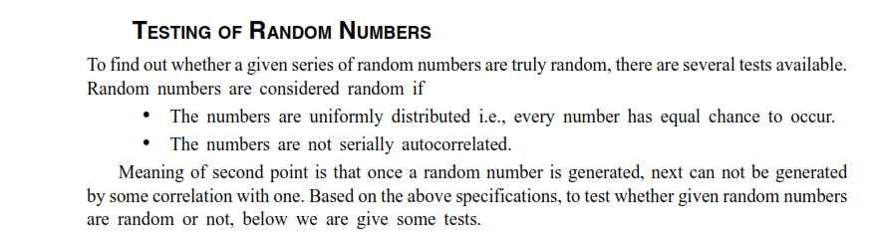




Slide 13
Bit Properties
Ideally a generator will produce numbers that are made up of completely random bits.
From these numbers we can produce any sort of number we want.
In practice, algorithms normally generate integers. We must be careful how we transform them. Uniform floating point values don't have random bits.
Random number generators can be true hardware random-number generators (HRNG), which generate genuinely random numbers.
A one-time password token (OTP token) is a security hardware device or software program that is capable of producing a single-use password or PIN pass-code. ... Today, OTP tokens are often software-based, and the pass-code generated by the token is displayed on the user's smartphone screen.

Slide 14
Based on time-synchronization between the authentication server and the client providing the password (OTPs are valid only for a short period of time)
Using a mathematical algorithm to generate a new password based on the previous password (OTPs are effectively a chain and must be used in a predefined order).
Using a mathematical algorithm where the new password is based on a challenge (e.g., a random number chosen by the authentication server or transaction details) and/or a counter.

