Slide 1
Introduction
First introduced by Carl Adam Petri in 1962.
A diagrammatic tool to model concurrency and synchronization in distributed systems.
Very similar to State Transition Diagrams.
Used as a visual communication aid to model the system behaviour.
Based on strong mathematical foundation.
(C) Copyright 2001, Chris Ling

Slide 2
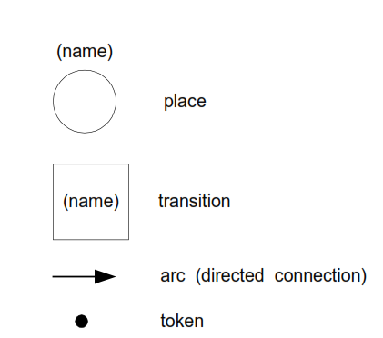
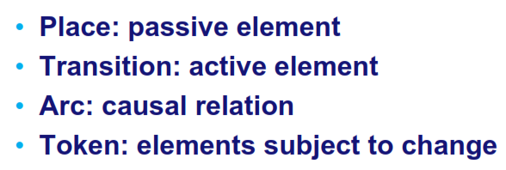
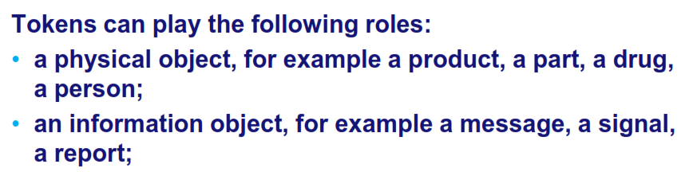
Petri net element

Slide 3
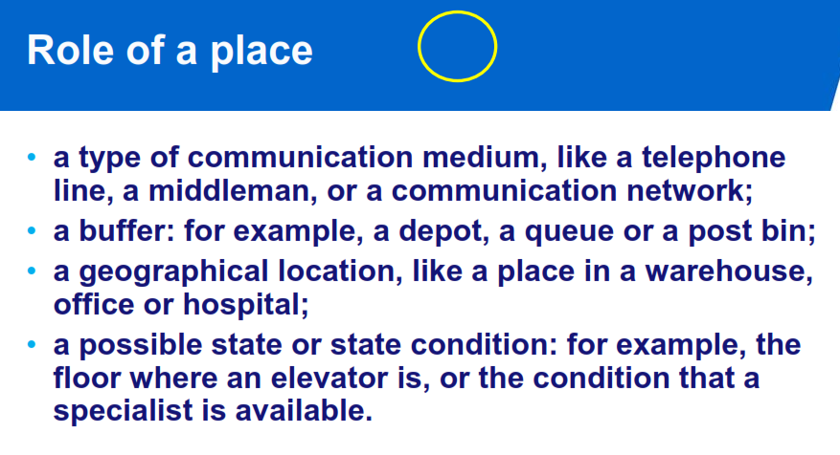
(C) Copyright 2001, Chris Ling

Slide 4
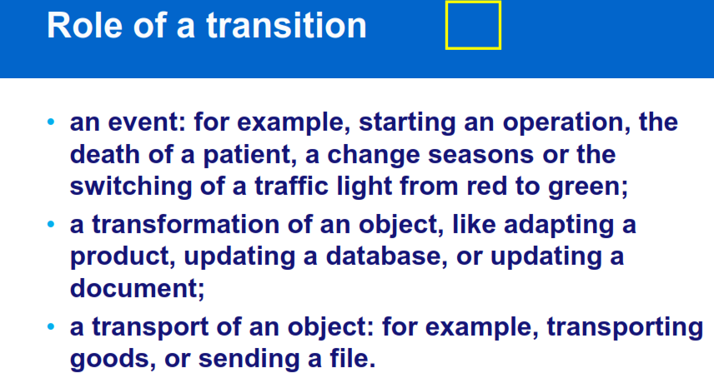
(C) Copyright 2001, Chris Ling

Slide 5
Example: EFTPOS System (STD of an FSM)
(EFTPOS= Electronic Fund Transfer Point of Sale)
Initial
1 digit
d1
1 digit
d2
1 digit
d3
1 digit
d4
OK
OK
OK
OK
OK
OK
pressed
Rejected
Reject
approve
Initial state
Approved
Final state
(C) Copyright 2001, Chris Ling

Slide 6
Example: EFTPOS System (A Petri net)
1 digit
1 digit
1 digit
1 digit
d4
Initial
d1
d2
d3
OK
OK
OK
OK
OK
OK
pressed
Rejected!
Reject
approve
approved
(C) Copyright 2001, Chris Ling

Slide 7
EFTPOS System
Scenario 1: Normal
  Enters all 4 digits and press OK.
Scenario 2: Exceptional
  Enters only 3 digits and press OK.
(C) Copyright 2001, Chris Ling

Slide 8
Example: EFTPOS System (Token Games)
1 digit
1 digit
1 digit
1 digit
d4
Initial
d1
d2
d3
OK
OK
OK
OK
OK
OK
pressed
Rejected!
Reject
approve
approved
(C) Copyright 2001, Chris Ling

Slide 9
A Petri Net Specification ...
consists of three types of components: places (circles), transitions (rectangles) and arcs (arrows):
  Places represent possible states of the system;
  Transitions are events or actions which cause the change of state; And
  Every arc simply connects a place with a transition or a transition with a place.
(C) Copyright 2001, Chris Ling

Slide 10
A Change of State …
is denoted by a movement of token(s) (black dots) from place(s) to place(s); and is caused by the firing of a transition.
The firing represents an occurrence of the event or an action taken.
The firing is subject to the input conditions, denoted by token availability.
(C) Copyright 2001, Chris Ling

Slide 11
A Change of State
A transition is firable or enabled when there are sufficient tokens in its input places.
After firing, tokens will be transferred from the input places (old state) to the output places, denoting the new state.
Note that the EFTPOS example is a Petri net representation of a finite state machine (FSM).
(C) Copyright 2001, Chris Ling

Slide 12
Example: Vending Machine
The machine dispenses two kinds of snack bars – 20c and 15c.
Only two types of coins can be used
– 10c coins and 5c coins.
The machine does not return any change.
(C) Copyright 2001, Chris Ling

Slide 13
Example: Vending Machine (STD of an FSM)
Take 15c snack bar
5 cents
Deposit 10c
15 cents
Deposit 5c
0 cent
Deposit 5c
Deposit 5c
Deposit 5c
Deposit 10c
10 cents
Deposit 10c
20 cents
Take 20c snack bar
(C) Copyright 2001, Chris Ling

Slide 14
Example: Vending Machine (A Petri net)
Take 15c bar
Deposit 10c
15c
5c
Deposit 5c
Deposit
5c
Deposit
5c
0c
Deposit
5c
Deposit 10c
10c
20c
Deposit 10c
Take 20c bar
(C) Copyright 2001, Chris Ling

Slide 15
Example: Vending Machine (3 Scenarios)
Scenario 1:
  Deposit 5c, deposit 5c, deposit 5c, deposit 5c, take 20c snack bar.
Scenario 2:
  Deposit 10c, deposit 5c, take 15c snack bar.
Scenario 3:
  Deposit 5c, deposit 10c, deposit 5c, take 20c snack bar.
(C) Copyright 2001, Chris Ling

Slide 16
Example: Vending Machine (Token Games)
Take 15c bar
Deposit 10c
15c
5c
Deposit 5c
Deposit
5c
Deposit
5c
0c
Deposit
5c
Deposit 10c
10c
20c
Deposit 10c
Take 20c bar
(C) Copyright 2001, Chris Ling

Slide 17
Multiple Local States
In the real world, events happen at the same time.
A system may have many local states to form a global state.
There is a need to model concurrency and synchronization.
(C) Copyright 2001, Chris Ling

Slide 18
Example: In a Restaurant (A Petri Net)
Waiter
free
Customer 1
Customer 2
Take
order
Take
order
wait
Order
taken
wait
eating
eating
Tell
kitchen
Serve food
Serve food
(C) Copyright 2001, Chris Ling

Slide 19
Example: In a Restaurant (Two Scenarios)
Scenario 1:
  Waiter takes order from customer 1; serves customer 1; takes order from customer 2; serves customer 2.
Scenario 2:
  Waiter takes order from customer 1; takes order from customer 2; serves customer 2; serves customer 1.
(C) Copyright 2001, Chris Ling

Slide 20
Example: In a Restaurant (Scenario 1)
Waiter
free
Customer 1
Customer 2
Take
order
Take
order
wait
Order
taken
wait
eating
eating
Tell
kitchen
Serve food
Serve food
(C) Copyright 2001, Chris Ling

Slide 21
Example: In a Restaurant (Scenario 2)
Waiter
free
Customer 1
Customer 2
Take
order
Take
order
wait
Order
taken
wait
eating
eating
Tell
kitchen
Serve food
Serve food
(C) Copyright 2001, Chris Ling

Slide 22
Petri Net Structures
A sequence of events/actions:
Concurrent executions:
e1
e2
e3
e2
e3
e1
e4
e5
(C) Copyright 2001, Chris Ling

Slide 23
Net Structures
Non-deterministic events - conflict, choice or decision: A choice of either e1, e2 … or e3, e4 ...
e1
e2
e3
e4
(C) Copyright 2001, Chris Ling

Slide 24
Net Structures
Synchronization
e1
(C) Copyright 2001, Chris Ling

Slide 25
Net Structures
Synchronization and Concurrency
e1
(C) Copyright 2001, Chris Ling

Slide 26
Behavioural Properties
Reachability
  “Can we reach one particular state from another?”
Boundedness
  “Will a storage place overflow?”
Liveness
  “Will the system die in a particular state?”
(C) Copyright 2001, Chris Ling

Slide 27
Other Types of Petri Nets
High-level Petri nets
  Tokens have “colours”, holding complex information.
Timed Petri nets
  Time delays associated with transitions and/or places.
  Fixed delays or interval delays.
  Stochastic Petri nets: exponentially distributed random variables as delays.
(C) Copyright 2001, Chris Ling

Slide 28
Other Types of Petri Nets
Object-Oriented Petri nets
  Tokens are instances of classes, moving from one place to another, calling methods and changing attributes.
  Net structure models the inner behaviour of objects.
  The purpose is to use object-oriented constructs to structure and build the system.
(C) Copyright 2001, Chris Ling

Slide 29
An O-O Petri Net
Producer
Consumer
ready
accepted
Storage
accept
produce
send
consume
ready
Producer
Consumer
data: ITEM
data: ITEM
ITEM produce( )
ITEM accept( )
void send(ITEM)
void consume(ITEM)
(C) Copyright 2001, Chris Ling

