Slide 1
What is digital system design?
  Use of available digital components
    Microprocessor, e.g. Pentium
    Micro-controller, e.g. 8051
    Digital processing units, e.g. counters, shift registers.
  Combine them to become a useful system

Slide 2
Introduction to VHDL
What is VHDL?
  Very High Speed Integrated Circuit (VHSIC)
  Hardware
  Description
  Language
VHDL: a formal language for specifying the behavior and structure of a digital circuit.
Verilog: another, equally popular, hardware description language (HDL).

Slide 3
VHDL CNTD.
HDL – Hardware Description Language
  A language that allows description of hardware for documentation, simulation, synthesis, verification, …
To use an HDL you need a CAD system that supports it.
Major CAD systems support VHDL, Verilog, System C, System Verilog
CAD systems (just some of them)
  Cadence – Incisive
  Mentor Graphics (Model Sim) – ModelSim, Questa
  Altera, XILINX (have arrangement to use ModelSim)
  Synopsis – Mainly toward synthesis and ASIC production from HDL descriptions

Slide 4
History of VHDL
Designed by IBM, Texas Instruments, and Intermetrics as part of the DoD funded VHSIC program
Standardized by the IEEE in 1987: IEEE 1076-1987
Enhanced version of the language defined in 1993: IEEE 1076-1993
Additional standardized packages provide definitions of data types and expressions of timing data
  IEEE 1164 (data types)
  IEEE 1076.3 (numeric)
  IEEE 1076.4 (timing)

Slide 5
Traditional vs. Hardware Description Languages
Procedural programming languages provide the how or recipes
  for computation
  for data manipulation
  for execution on a specific hardware model
Hardware description languages describe a system
  Systems can be described from many different points of view
    Behavior: what does it do?
    Structure: what is it composed of?
    Functional properties: how do I interface to it?
    Physical properties: how fast is it?

Slide 6
Usage
Descriptions can be at different levels of abstraction
  Switch level: model switching behavior of transistors
  Register transfer level: model combinational and sequential logic components
  Instruction set architecture level: functional behavior of a microprocessor
Descriptions can used for
  Simulation
    Verification, performance evaluation
  Synthesis
    First step in hardware design

Slide 7
Why do we Describe Systems?
Design Specification
  unambiguous definition of components and interfaces in a large design
Design Simulation
  verify system/subsystem/chip performance prior to design implementation
Design Synthesis
  automated generation of a hardware design

Slide 8
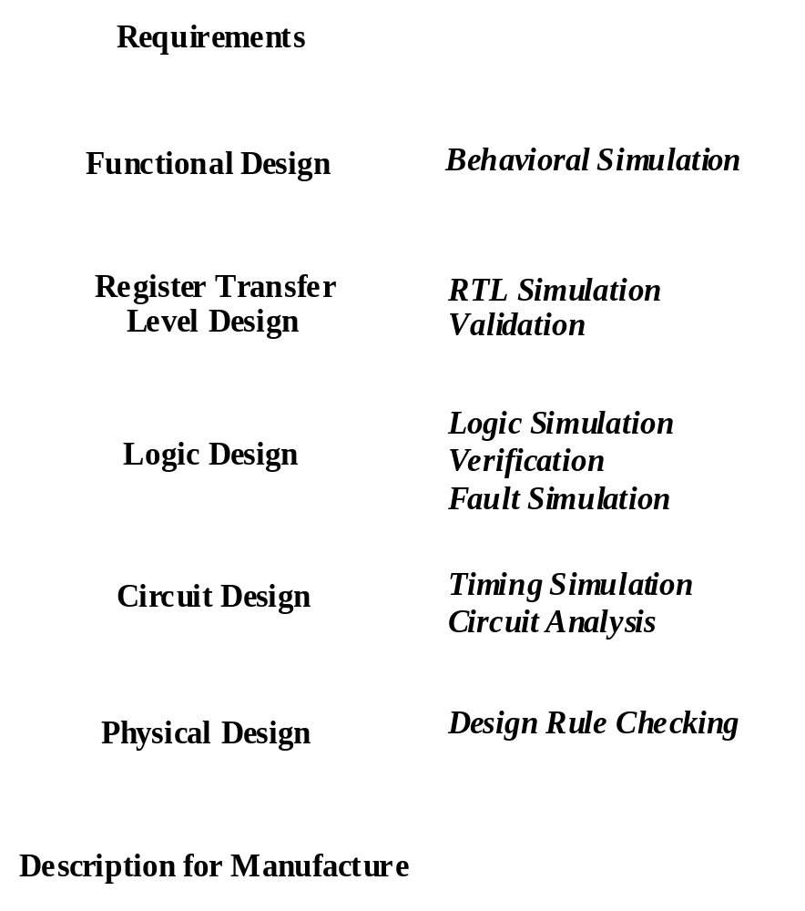
Digital System Design Flow
Design flows operate at multiple levels of abstraction
Need a uniform description to translate between levels
Increasing costs of design and fabrication necessitate greater reliance on automation via CAD tools
  $5M - $100M to design new chips
  Increasing time to market pressures

Slide 9
A Synthesis Design Flow
Requirements
VHDL Model
Functional Design
VHDL Model
Register Transfer
Level Design
Logic Simulation
Synthesis
Behavioral Simulation
(
)
VHDL
Place and Route
Timing Extraction
Automation of design refinement steps
Feedback for accurate simulation
Example targets: ASICs, FPGAs

Slide 10
The Role of Hardware Description Languages
BEHAVIORAL
STRUCTURAL
algorithms
processors
register transfers
registers
Boolean expressions
gates
transfer functions
transistors
cells
modules
chips
boards
PHYSICAL
[Gajski and Kuhn]
Design is structured around a hierarchy of representations
HDLs can describe distinct aspects of a design at multiple levels of abstraction

Slide 11
Domains and Levels of Modeling
Structural
Functional
high level of abstraction
low level of abstraction
Geometric
“Y-chart” due to Gajski & Kahn

Slide 12
Domains and Levels of Modeling
Structural
Functional
Algorithm
(behavioral)
Register-Transfer
Language
Boolean Equation
Differential Equation
Geometric
“Y-chart” due to Gajski & Kahn

Slide 13
Domains and Levels of Modeling
Structural
Functional
Processor-Memory
Switch
Register-Transfer
Gate
Transistor
Geometric
“Y-chart” due to Gajski & Kahn

Slide 14
Domains and Levels of Modeling
Structural
Functional
Polygons
Sticks
Standard Cells
Floor Plan
Geometric
“Y-chart” due to Gajski & Kahn

Slide 15
Basic VHDL Concepts
Interfaces
Modeling (Behavior, Dataflow, Structure)
Analysis, elaboration, simulation
Synthesis

Slide 16
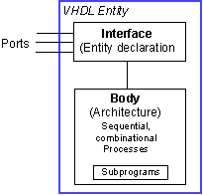
Basic Structure of a VHDL File
Entity
  Entity declaration: interface to outside world; defines input and output signals
  Architecture: describes the entity, contains processes, components operating concurrently

Slide 17
VHDL Example
Entity
A
B
C
A
B
F
C
A
C
B
Architecture

Slide 18
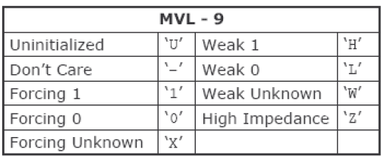
Entity Declaration
entity NAME_OF_ENTITY is
port (signal_names: mode type;
signal_names: mode type;
:
signal_names: mode type);
end [NAME_OF_ENTITY] ;
NAME_OF_ENTITY: user defined
signal_names: list of signals (both input and output)
mode: in, out, buffer, inout
type: boolean, integer, character, std_logic

Slide 19
Architecture
Behavioral Model:
  architecture architecture_name of NAME_OF_ENTITY is
-- Declarations
…..
…..
  begin
-- Statements
  end architecture_name;

Slide 20
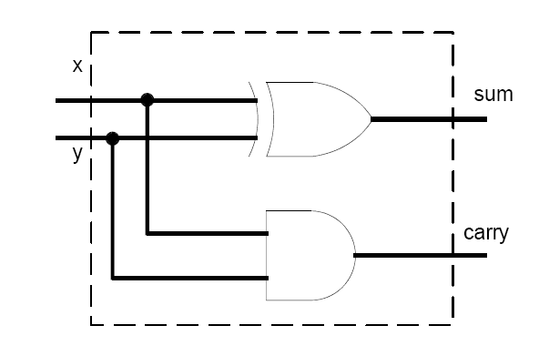
Half Adder
library ieee;
use ieee.std_logic_1164.all;
entity half_adder is
port(
x,y: in std_logic;
sum, carry: out std_logic);
end half_adder;
architecture myadd of half_adder is
begin
sum <= x xor y;
carry <= x and y;
end myadd;

Slide 21
Entity Examples …
entity half_adder is
port(
x,y: in std_logic;
sum, carry: out std_logic);
end half_adder;
FULL ADDER
A
B
C
SUM
CARRY

Slide 22
Architecture Examples: Behavioral Description
Entity FULLADDER is
port ( A, B, C: in std_logic;
SUM, CARRY: in std_logic);
end FULLADDER;
Architecture CONCURRENT of FULLADDER is
begin
SUM <= A xor B xor C after 5 ns;
CARRY <= (A and B) or (B and C) or (A and C) after 3 ns;
end CONCURRENT;

Slide 23
HDL Program:
Library IEEE;
Use IEEE.std_logic_1164.all;
entity V1mux is
port (A,B,S : in STD_LOGIC;
Z : out STD_LOGIC);
end V1mux;
architecture V1mux_arch of V1mux is
begin
Z <= A when S=‘0’ else B;
end V1mux_arch
architecture V1mux_gate_arch of V1mux is
begin
U1: INV(S, SN);
U2: AND2(A,SN,ASN);
U3: AND2(S,B,SB);
U4: OR2(ASN,SB,Z);
end V1mux_gate_arch;

Slide 24
One Entity Many Descriptions
A system (an entity) can be specified with different architectures
Entity
Architecture
A
Architecture
B
Architecture
C
Architecture
D

