Slide 1
Introduction to Python and APIs
Yabebal Fantaye

Slide 2
Big Data recap
What are the three main characteristics of Big Data?
Mention at least one example where Big Data is useful?
What are the main requirements for Big Data analysis?

Slide 3
Python I
Strings
List
Array
Dictionary
File IO
Function
Objects
Class

Slide 4
Introduction to Application Programming Interface (APIs) – Part I

Slide 5
Key Terms
Server: A powerful computer that runs an API
API: The "hidden" portion of a website that is meant for computer consumption
Client: A program that exchanges data with a server through an API
Protocol: An “extremely rigid” set of rules that govern how two computers can speak to each other.

Slide 6
“Extremely rigid”
"My favorite color is blue"
"Blue is my favorite color."
For humans (a) and (b) are the same while it is different for computers talking with a certain protocol.

Slide 7
Computer Protocols
Any communication between computers require a certain protocol.
Bluetooth for connecting devices, POP or IMAP for fetching emails. The web main protocol is the Hyper-Text Transfer Protocol –HTTP.
Most APIs use the HTTP protocol to communicate.

Slide 8
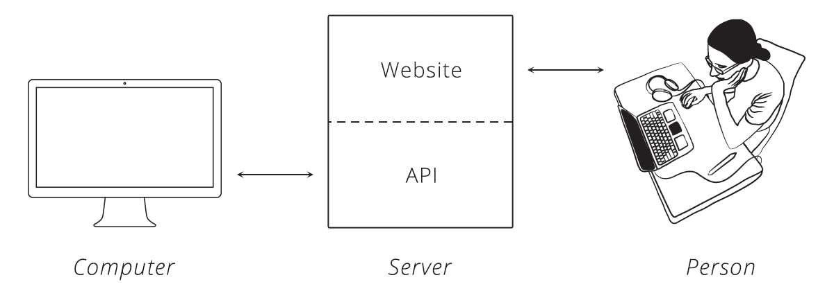
What is an API?
Optimal for humans but difficult for computers
Makes a website's data digestible for a computer
https://zapier.com/learn/apis/chapter-1-introduction-to-apis/

Slide 9
Data Exchange
Once a client makes a successful communication through an API, the server returns a data in a certain format.
The most common formats found in modern APIs are JSON (JavaScript Object Notation) and XML (Extensible Markup Language).

Slide 10
^{Data Formats}
^{Delimited values}
^{Comma Separated Values (CSV)}
^{Tab Separated Values (TSV)}
^{Markup languages}
Hypertext Markup Language (HTML5 / XML)
JavaScript Object Notation (JSON) Hierarchical Data Format (HDF5)
^{Ad hoc formats}
Graph edge lists, voting records, fixed width files, ...

Slide 11
JSON
{
"crust": "original",
"toppings": ["cheese", "pepperoni", "garlic"],
"status": "cooking",
"customer": {
"name": "Brian",
"phone": "573-111-1111"
}
}

Slide 12
XML
<order>
<crust>original</crust>
<toppings>
<topping>cheese</topping>
<topping>pepperoni</topping>
<topping>garlic</topping>
</toppings>
<status>cooking</status>
</order>

Slide 13
Main references
https://zapier.com/learn/apis/chapter-2-protocols/

Slide 14
End

Slide 15
Scikit-learn
some-model-name.fit( )
some-model-name.predict( )
some-model-name.score( )

Slide 16
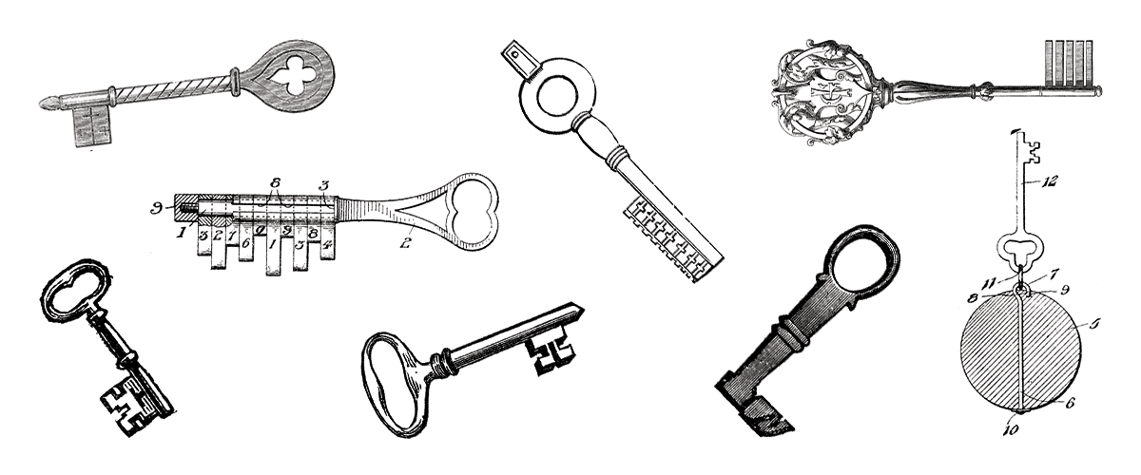
API Authentication
Authentication: process of the client proving its identity to the server
Credentials: secret pieces of info used to prove the client's identity (username, password...)
Basic Auth: scheme that uses an encoded username and password for credentials. Has full control.
API Key Auth: scheme that uses a unique key for credentials. Has limited control.

Slide 17
Open Authorization (Oauth)

Slide 18
What is an API good for?
Sync across different device e.g. laptop, mobile phone, tablet

Slide 19
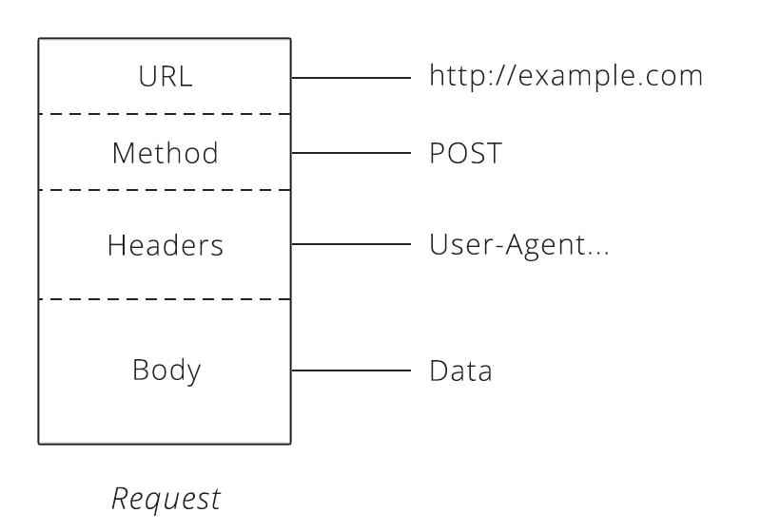
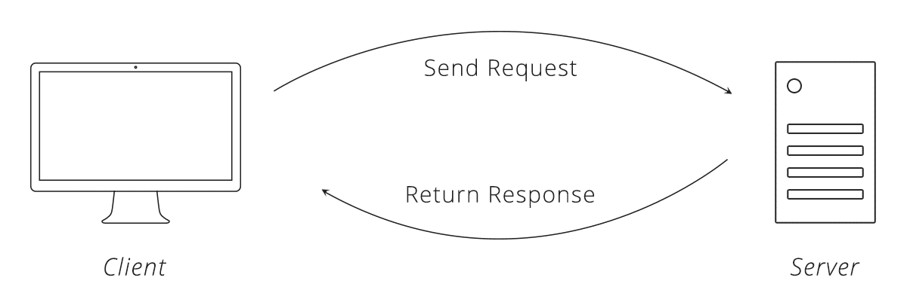
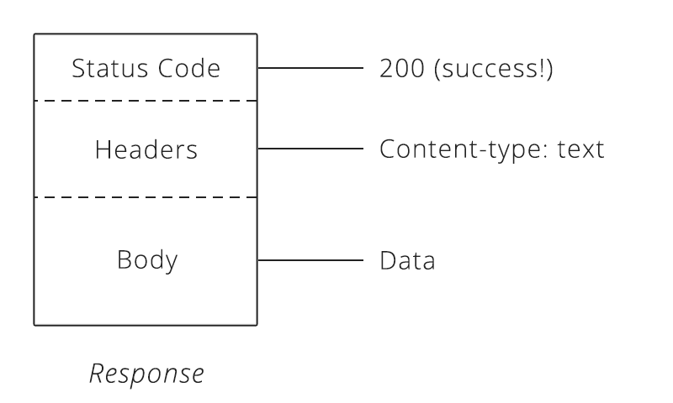
HTTP “request” and “response”
Methods:
GET - Asks the server to retrieve a resource
POST - Asks the server to create a new resource
PUT - Asks the server to edit an existing resource
DELETE - Asks the server to delete a resource

Slide 20

HTTP request: order pizza
You place an order by making a POST request to the restaurant's server with your order details, asking them to create your pizza. As soon as you send the request, however, you realize you picked the wrong style crust, so you make a PUT request to change it.
While waiting on your order, you make a bunch of GET requests to check the status. After an hour of waiting, you decide you've had enough and make a DELETE request to cancel your order.

