Slide 1
Working with JSON and CSV files

Slide 2
5 minutes test
What does the following do?
$ git clone https://github.com/yabebalFantaye/bigdata_aims_senegal.git
$ git add *.py
$ git commit –m ‘My first commit’
$ git push
What is the result of the following python code?
import os
import sys
q = True
u = None
If q: print ‘I am happy!’
If u: print ‘I am not None’

Slide 3
{"created_at":"Wed Feb 11 08:43:55 +0000 2015","id":565431020485607425,"id_str":"565431020485607425","text":"@CaseyJensen \u25ba Interesting blog about traveling in africa on the road - Have a look! \u263a http:\/\/t.co\/NDlAX4oI5C \u25ba","source":"\u003ca href=\"http:\/\/twitter.com\" rel=\"nofollow\"\u003eTwitter Web Client\u003c\/a\u003e","truncated":false,"in_reply_to_status_id":null,"in_reply_to_status_id_str":null,"in_reply_to_user_id":16148820,"in_reply_to_user_id_str":"16148820","in_reply_to_screen_name":"CaseyJensen","user":{"id":2934243924,"id_str":"2934243924","name":"Edita_Buonanno","screen_name":"Edita_3800","location":"","url":null,"description":null,"protected":false,"verified":false,"followers_count":18,"friends_count":176,"listed_count":0,"favourites_count":0,"statuses_count":3209,"created_at":"Thu Dec 18 04:02:10 +0000 2014","utc_offset":null,"time_zone":null,"geo_enabled":false,"lang":"en","contributors_enabled":false,"is_translator":false,"profile_background_color":"C0DEED","profile_background_image_url":"http:\/\/abs.twimg.com\/images\/themes\/theme1\/bg.png","profile_background_image_url_https":"https:\/\/abs.twimg.com\/images\/themes\/theme1\/bg.png","profile_background_tile":false,"profile_link_color":"0084B4","profile_sidebar_border_color":"C0DEED","profile_sidebar_fill_color":"DDEEF6","profile_text_color":"333333","profile_use_background_image":true,"profile_image_url":"http:\/\/pbs.twimg.com\/profile_images\/545428877858713600\/HirwUUoA_normal.jpeg","profile_image_url_https":"https:\/\/pbs.twimg.com\/profile_images\/545428877858713600\/HirwUUoA_normal.jpeg","profile_banner_url":"https:\/\/pbs.twimg.com\/profile_banners\/2934243924\/1418875466","default_profile":true,"default_profile_image":false,"following":null,"follow_request_sent":null,"notifications":null},"geo":null,"coordinates":null,"place":null,"contributors":null,"retweet_count":0,"favorite_count":0,"entities":{"hashtags":[],"trends":[],"urls":[{"url":"http:\/\/t.co\/NDlAX4oI5C","expanded_url":"http:\/\/www.african-road-trip.com\/","display_url":"african-road-trip.com","indices":[87,109]}],"user_mentions":[{"screen_name":"CaseyJensen","name":"CaseyJensen","id":16148820,"id_str":"16148820","indices":[0,12]}],"symbols":[]},"favorited":false,"retweeted":false,"possibly_sensitive":false,"filter_level":"low","lang":"en","timestamp_ms":"1423644235141"}

Slide 4
import numpy as np
import json
import pandas as pd
import matplotlib.pyplot as plt
tweets_data_path = '../data/africa_ethiopia_tweets.txt'
tweets_data = [ ]
tweets_file = open(tweets_data_path, "r")
for line in tweets_file:
try:
tweet = json.loads(line)
tweets_data.append(tweet)
except:
continue
tweets_file.close()
def get_tweet_text(tweet):
return tweet['text']

Slide 5
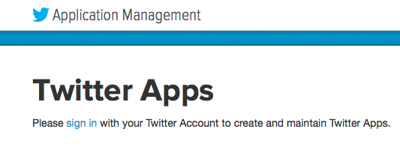
https://apps.twitter.com

Slide 6
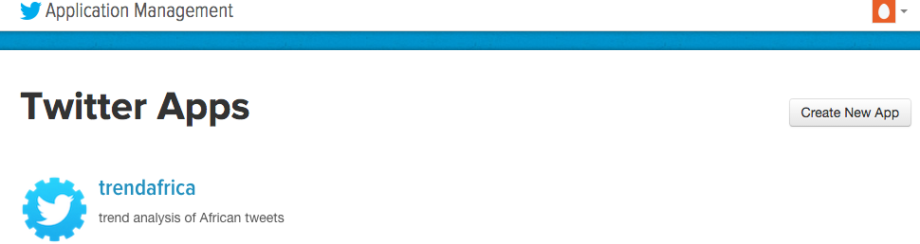
https://apps.twitter.com

Slide 7
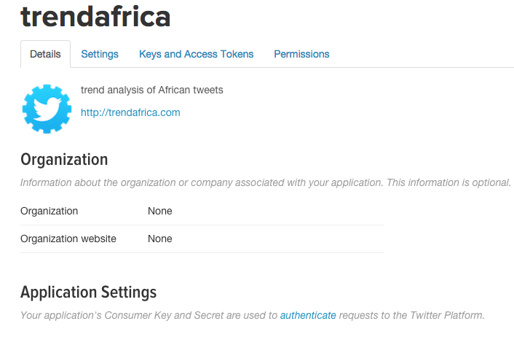
https://apps.twitter.com

Slide 8
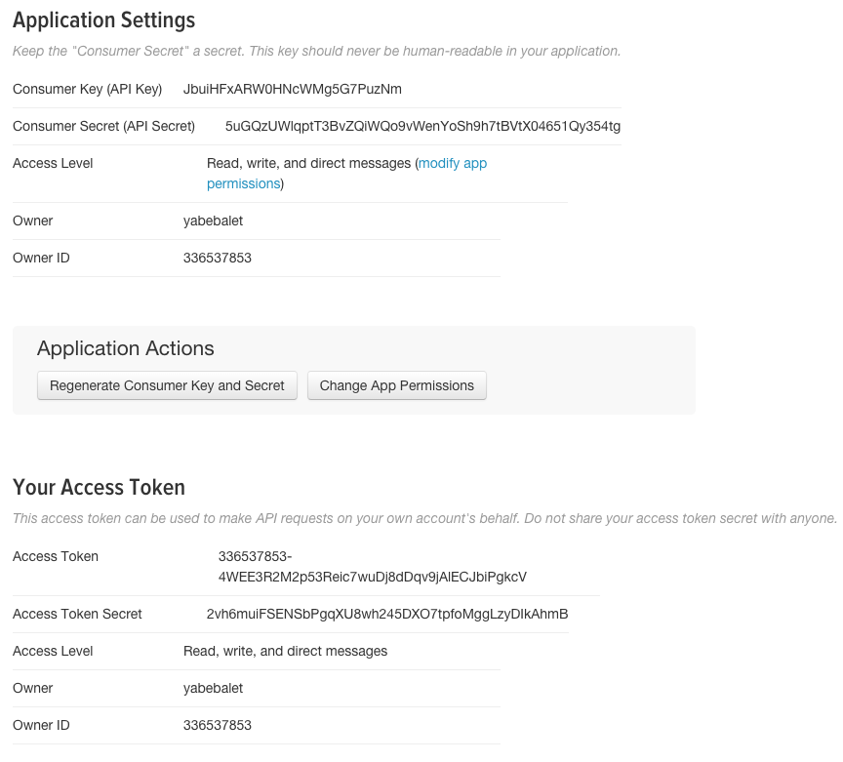
https://apps.twitter.com

