Slide 1
Basics to GIT and Popular APIs
Yabebal Fantaye

Slide 2
5 minutes
How do computers communicate with each other?
What are the results for the following python code
a) print ‘abcde’.index(‘c’)
b) print [1,2,3,4].append(5)
c ) print ‘I ’ + ‘love ’ + ‘python!’

Slide 3
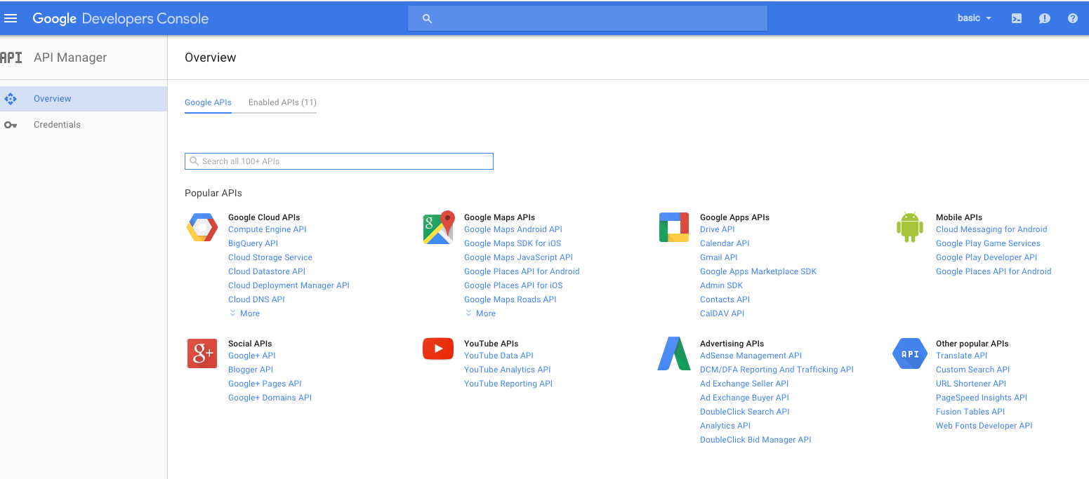
Google

Slide 4
Google API
Example: find all ‘free’ books on ‘Big Data’
import pprint
import sys
from apiclient.discovery import build
# For this example, the API key is provided as a command-line argument.
api_key = sys.argv[1]
# methods specific to the books API. The arguments provided are:
# name of the API ('books')
# version of the API you are using ('v1')
# API key
service = build('books', 'v1', developerKey=api_key)
request = service.volumes().list(source='public', q=’big data')
# The execute() function on the HttpRequest object actually calls the API.
response = request.execute()
https://developers.google.com/api-client-library/python/start/get_started

Slide 5
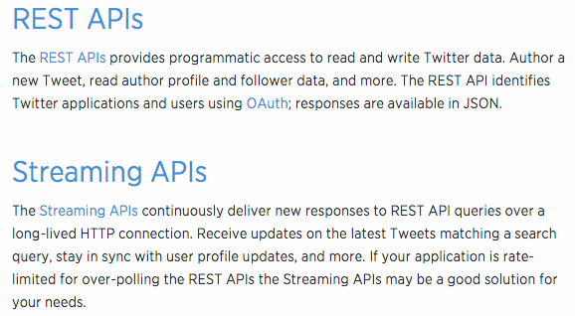
Twitter

Slide 6
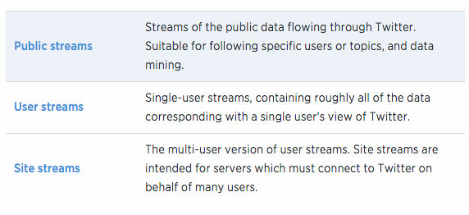
Twitter Stream types

Slide 7
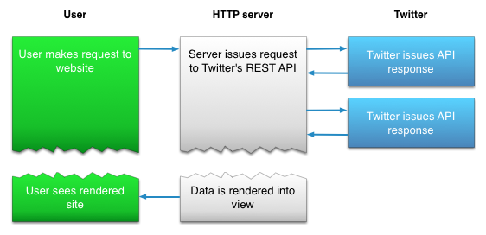
REST API: Twitter
APP

Slide 8
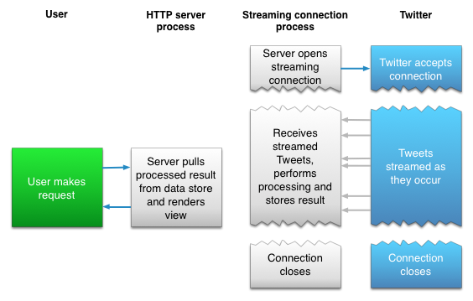
Streaming API: Twitter
performs any parsing, filtering, and/or aggregation
APP

Slide 9
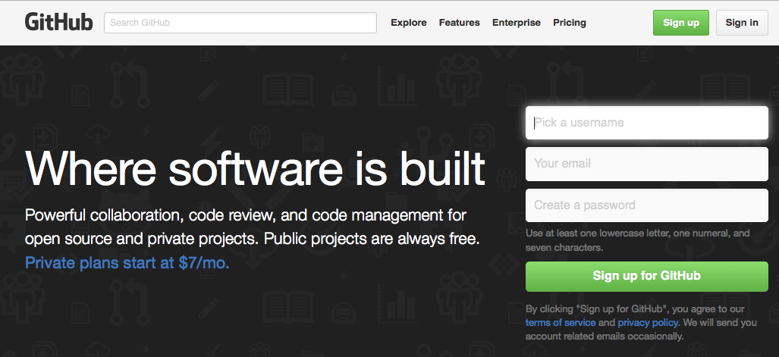
GIT https://github.com/

Slide 10
GIT Basics
#track a folder with git
$ git init
#add files, and commit in a git repo
$ git add *.c
$ git add LICENSE
$ git commit -m 'initial project version’
#clone a package from git
$ git clone https://github.com/libgit2/libgit2

Slide 11
Project

