Slide 1
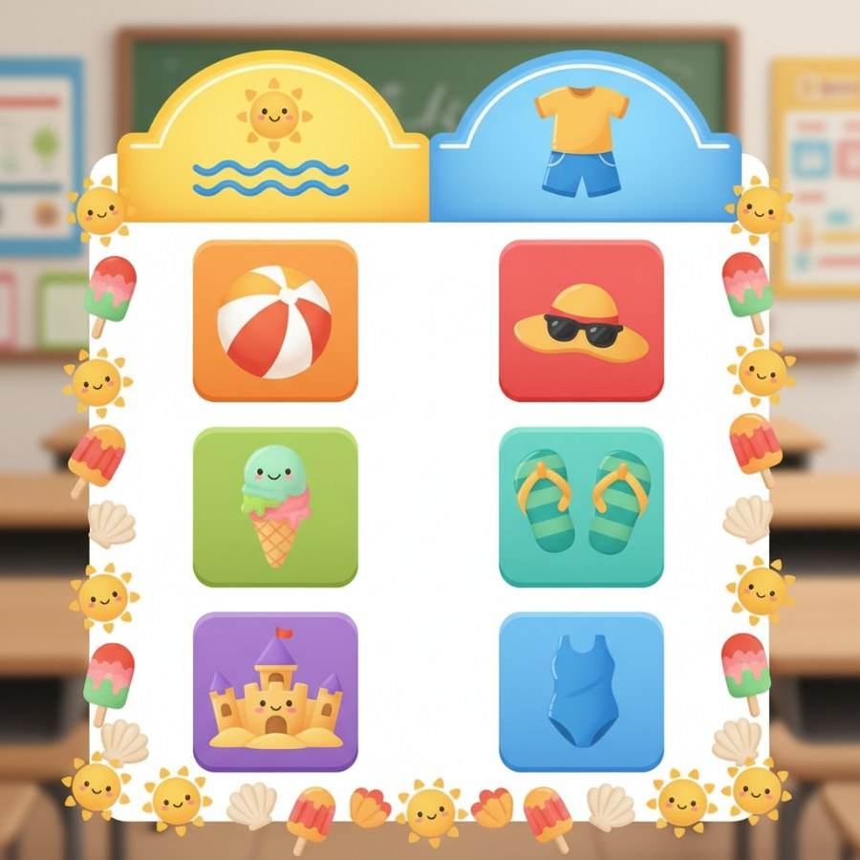
Summer Fun Jeopardy! Board
brightboardapp.com
Notes:
Welcome, teachers! Today we're going to play a fun game of Jeopardy to learn all about summer. We have two categories: 'Summer Fun!' and 'Summer Clothes & Things!'. Each category has three clues worth 10, 20, and 30 points. Let's see how much we know about summer!

Slide 2
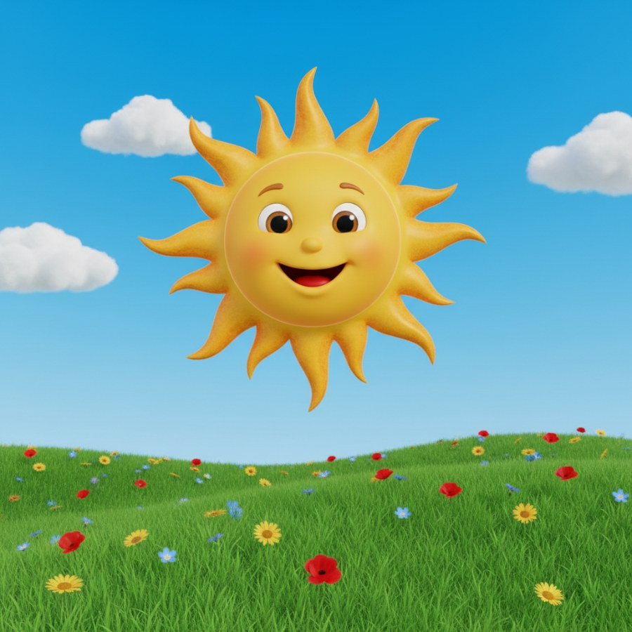
Summer Fun! for 10 Points
📋 Clue: This is a big, hot star in the sky that makes summer warm and bright.
🤔 Think of your answer...
✅ Answer: What is the sun?
brightboardapp.com
Notes:
Let's start with our first clue! Encourage students to think about what makes summer so warm and bright. After they guess, reveal the answer. Discuss how important the sun is for summer fun.

Slide 3
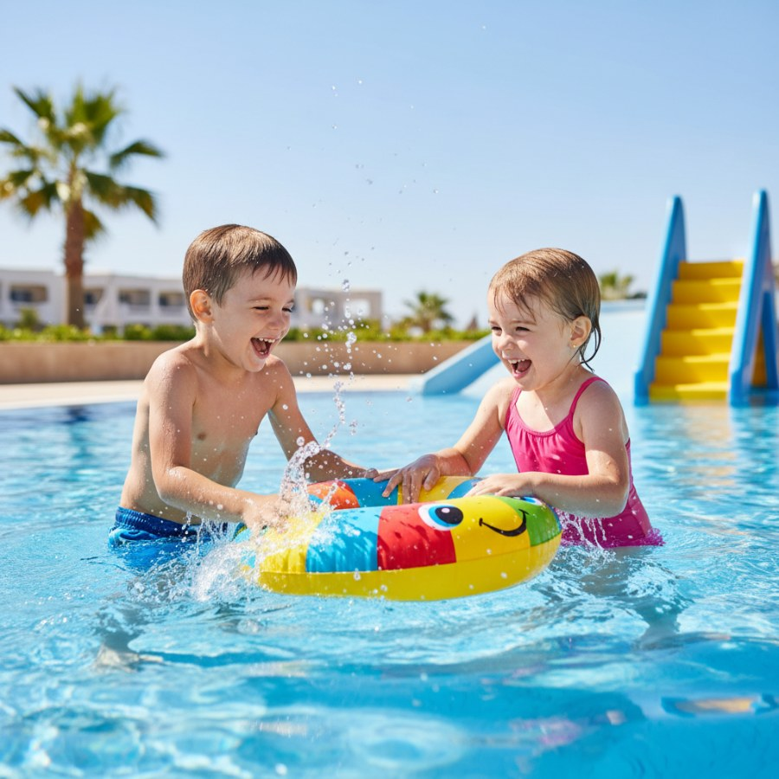
Summer Fun! for 20 Points
📋 Clue: On a hot day, we can jump and splash in this cool place, maybe even with a floaty!
🤔 Think of your answer...
✅ Answer: What is a swimming pool?
brightboardapp.com
Notes:
Time for our next clue! Ask students where they like to go to cool off when it's hot. Emphasize safety around water. Celebrate their correct answers!

Slide 4
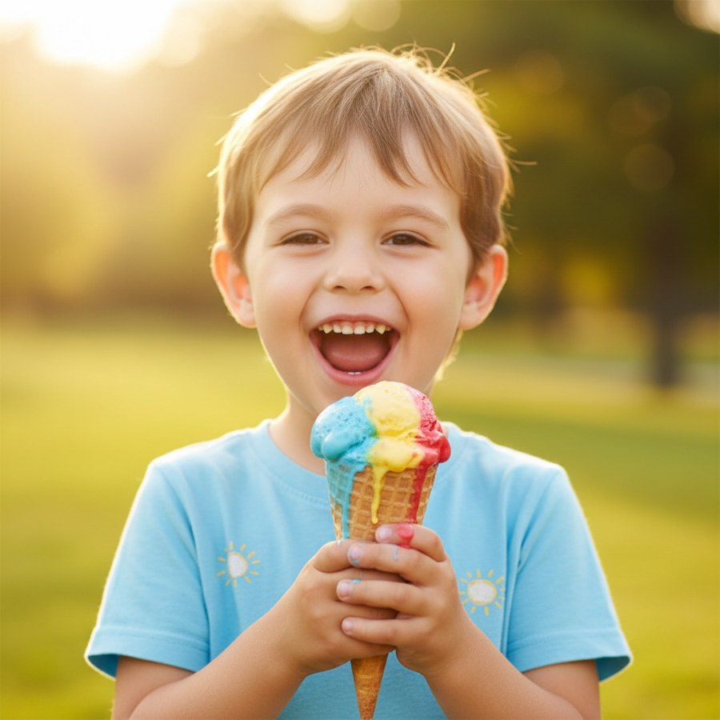
Summer Fun! for 30 Points
📋 Clue: This yummy, cold treat melts fast and comes in flavors like chocolate, vanilla, and strawberry.
🤔 Think of your answer...
✅ Answer: What is ice cream?
brightboardapp.com
Notes:
This clue is about a delicious summer treat! Ask students about their favorite flavors. Talk about how it's a special treat for warm weather.

Slide 5
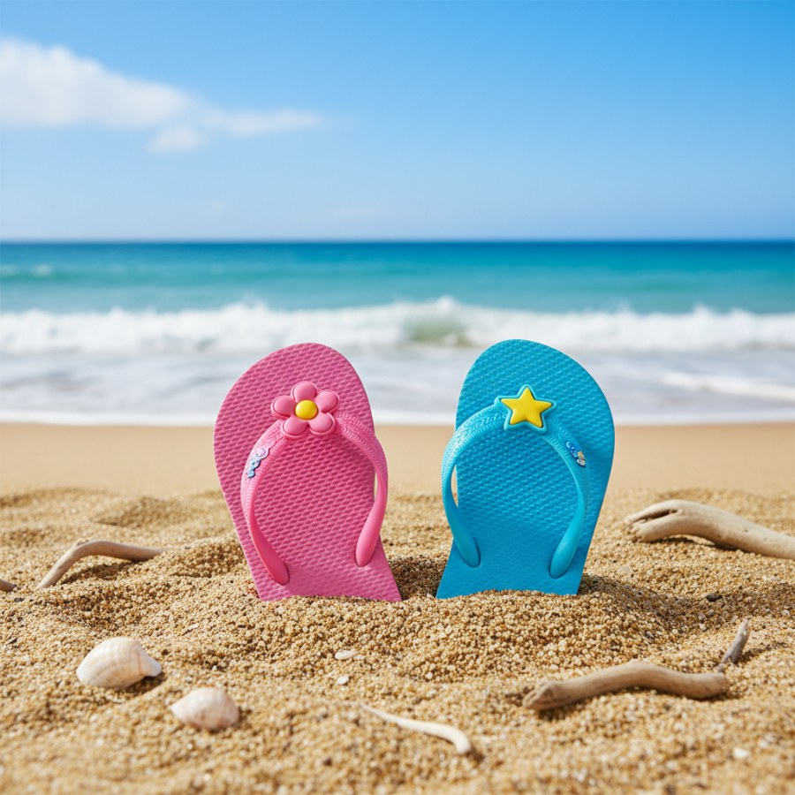
Summer Clothes & Things! for 10 Points
📋 Clue: These go on your feet to protect them from hot sand, and they often have a strap between your toes.
🤔 Think of your answer...
✅ Answer: What are flip-flops?
brightboardapp.com
Notes:
Now we're moving to our 'Summer Clothes & Things!' category! This clue is about something we wear on our feet. Ask students if they have flip-flops and when they wear them.

Slide 6
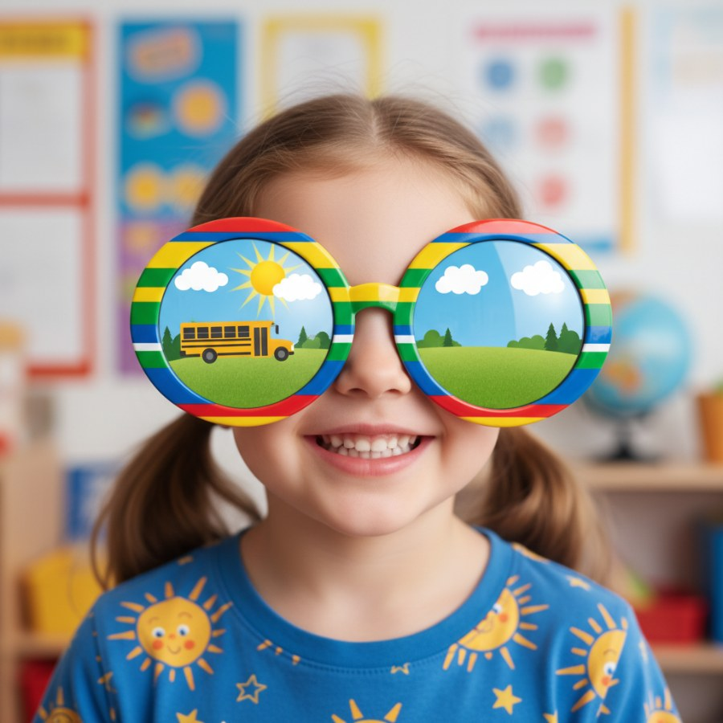
Summer Clothes & Things! for 20 Points
📋 Clue: When the sun is very bright, we wear these on our eyes to help us see better and protect them.
🤔 Think of your answer...
✅ Answer: What are sunglasses?
brightboardapp.com
Notes:
Here's a clue about an important accessory for sunny days. Discuss why it's good to protect our eyes from the sun. Maybe even have students 'model' their pretend sunglasses!

Slide 7
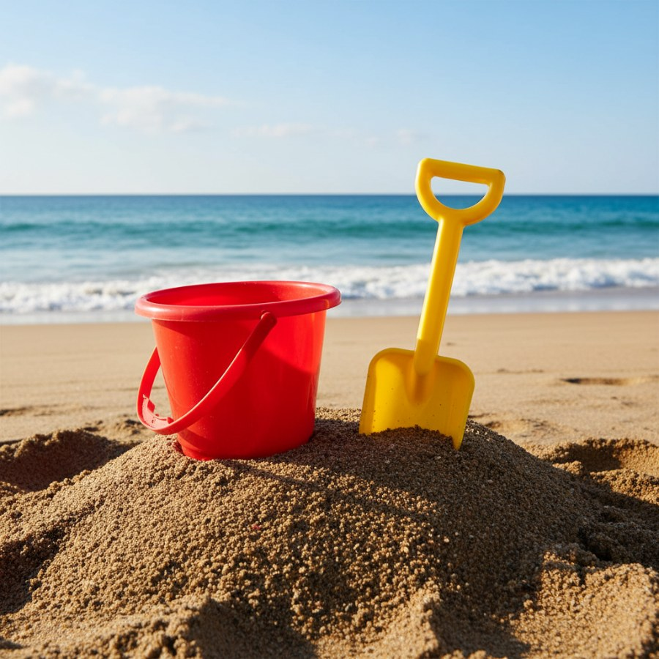
Summer Clothes & Things! for 30 Points
📋 Clue: We use this to build sandcastles at the beach, and it holds sand and water.
🤔 Think of your answer...
✅ Answer: What is a bucket and shovel?
brightboardapp.com
Notes:
Our last clue! This is a classic item for a day at the beach. Ask students about their experiences building sandcastles. Great job everyone playing Summer Fun Jeopardy!

