Slide 1

What does it mean when the weather is 'sunny'?
A) It is raining outside.
B) It is cold and cloudy.
C) The sun is shining brightly!
D) It is very windy.
✅ Answer: C — When it's sunny, the sun is out and bright, making it a perfect day for outdoor play!
brightboardapp.com
Notes:
Teachers, introduce the word 'sunny'. Ask children to describe what a sunny day feels like and what they like to do. Encourage them to use descriptive words.

Slide 2
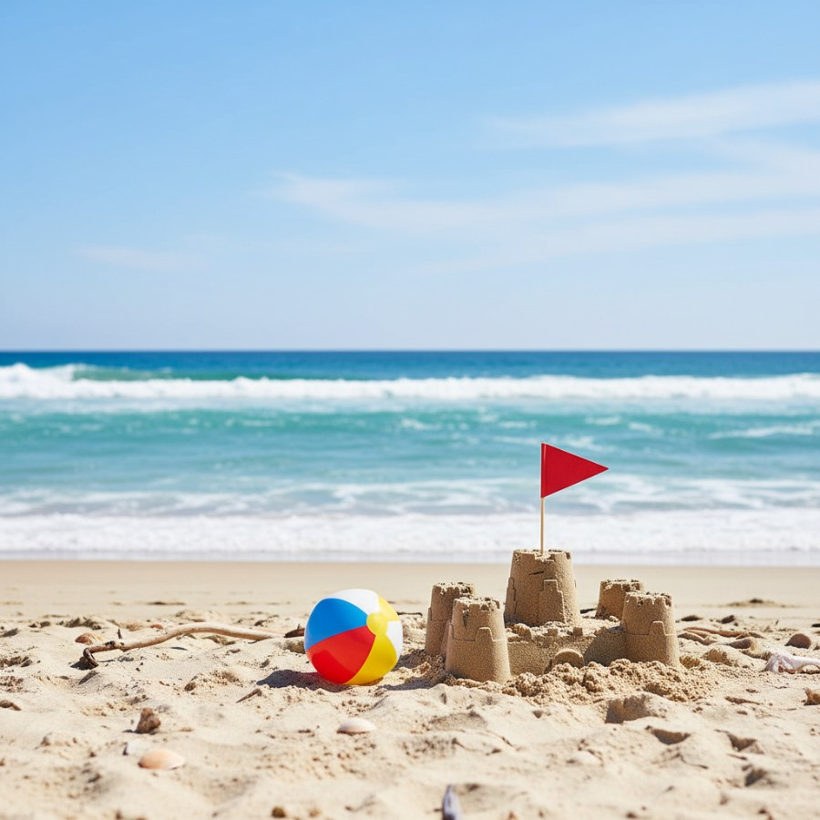
Where do many people go to swim and build sandcastles in the summer?
A) A tall mountain.
B) The sandy beach!
C) A dark forest.
D) A busy city street.
✅ Answer: B — The beach is a wonderful place with sand and water, great for swimming and building sandcastles!
brightboardapp.com
Notes:
Introduce 'beach'. Ask children if they've ever been to a beach and what they did there. Discuss the different things you can see and do at the beach.

Slide 3
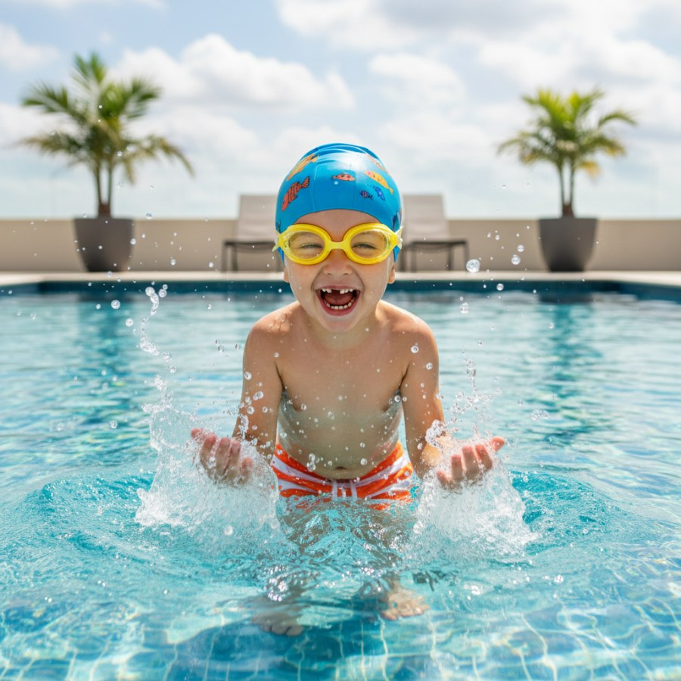
What activity involves playing and moving in water?
A) Running fast.
B) Jumping high.
C) Swimming in the water!
D) Reading a book.
✅ Answer: C — Swimming is a fun way to play and cool off in a pool, lake, or ocean during summer!
brightboardapp.com
Notes:
Introduce 'swim'. Talk about safety rules when swimming and the different places people can swim. Mimic swimming motions together.

Slide 4
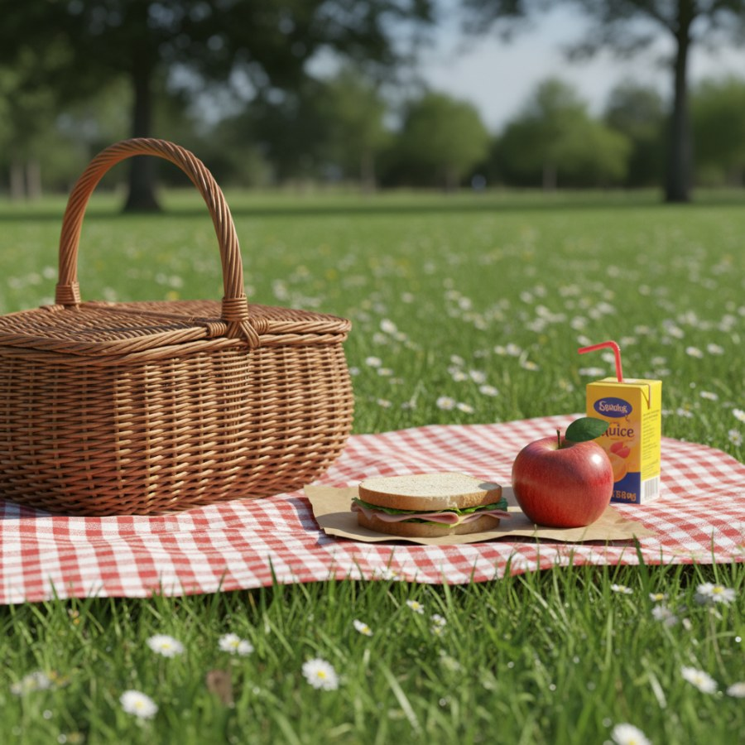
What is it called when you eat a meal outdoors, often on a blanket?
A) Having dinner at home.
B) Going on a picnic!
C) Eating breakfast in bed.
D) Having a quick snack.
✅ Answer: B — A picnic is a special meal eaten outside, often in a park or backyard, on a nice sunny day!
brightboardapp.com
Notes:
Introduce 'picnic'. Ask children what foods they would bring to a picnic and where they would like to have one. Discuss the joy of eating outdoors.

Slide 5
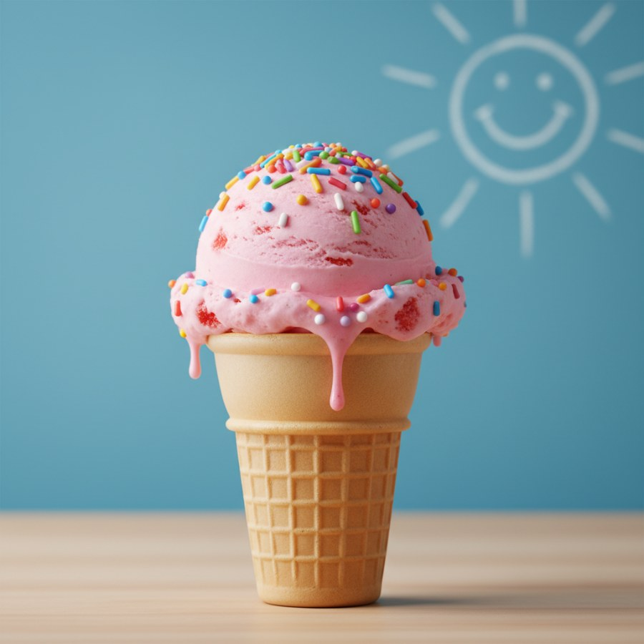
What cold, sweet treat do many people enjoy on a hot summer day?
A) A bowl of hot soup.
B) A cup of hot chocolate.
C) A scoop of ice cream!
D) A slice of pizza.
✅ Answer: C — Ice cream is a delicious frozen dessert that helps us cool down when it's warm!
brightboardapp.com
Notes:
Introduce 'ice cream'. Ask about favorite ice cream flavors. Discuss how ice cream feels and tastes. This is a great sensory word.

Slide 6
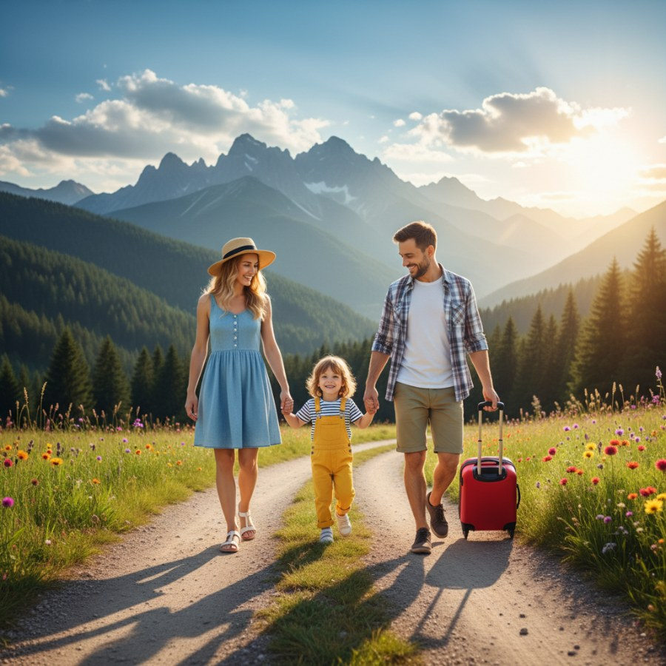
What is a special time when families travel or relax away from school or work?
A) Doing homework every day.
B) Attending class at school.
C) Going on a vacation!
D) Doing chores around the house.
✅ Answer: C — A vacation is a fun break where families can visit new places or relax together!
brightboardapp.com
Notes:
Introduce 'vacation'. Ask children where they might like to go on vacation or what they like to do when they have time off. Emphasize relaxation and fun.

Slide 7
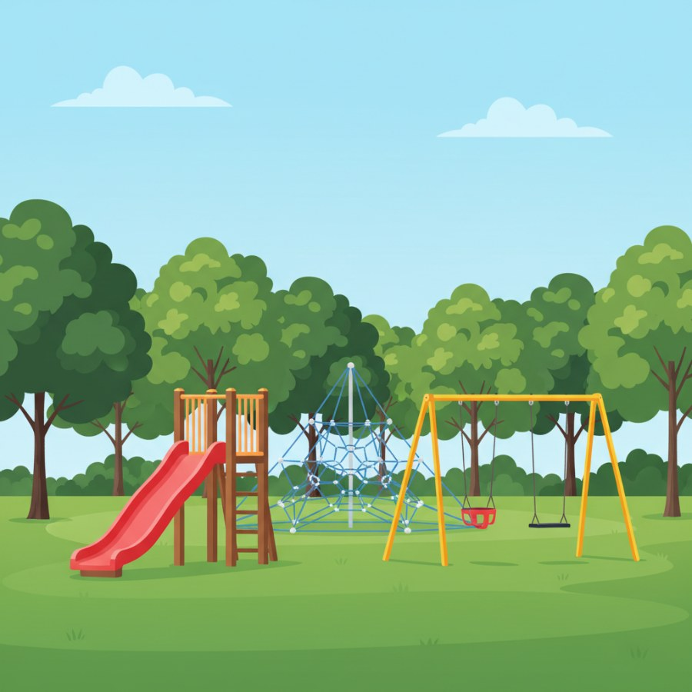
Where can children go to swing, slide, and climb outside?
A) The quiet library.
B) The busy kitchen.
C) The fun playground!
D) Their cozy bedroom.
✅ Answer: C — A playground is an outdoor area designed for children to play on swings, slides, and other equipment!
brightboardapp.com
Notes:
Introduce 'playground'. Discuss favorite playground activities and the importance of playing safely. Encourage children to describe their ideal playground.

