Slide 1
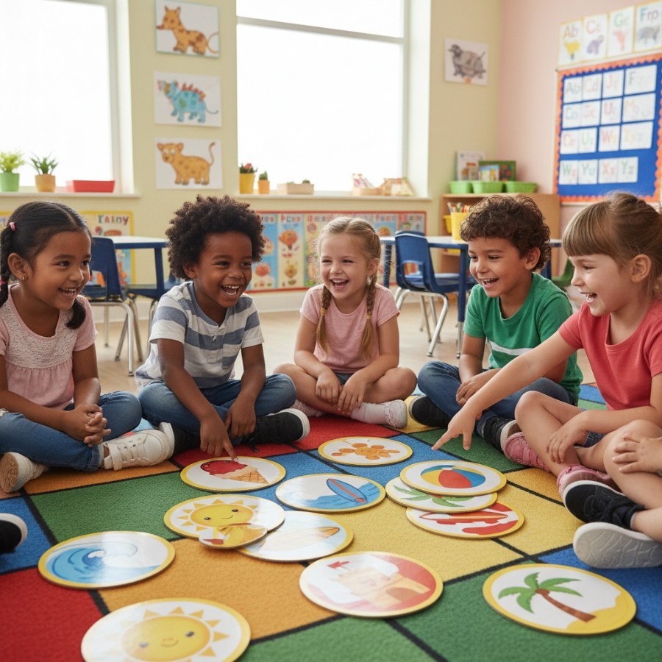
☀️ Summer Fun Memory Match! ☀️
brightboardapp.com
Notes:
Welcome, teachers! Today we're going to play a fun Memory Match game all about summer. We'll look at cards with words and cards with pictures. Your students will listen to clues and try to guess the summer activity! You can print these slides and cut them out to play as a physical memory game, or use them digitally to guess together as a class. Let's get started!

Slide 2
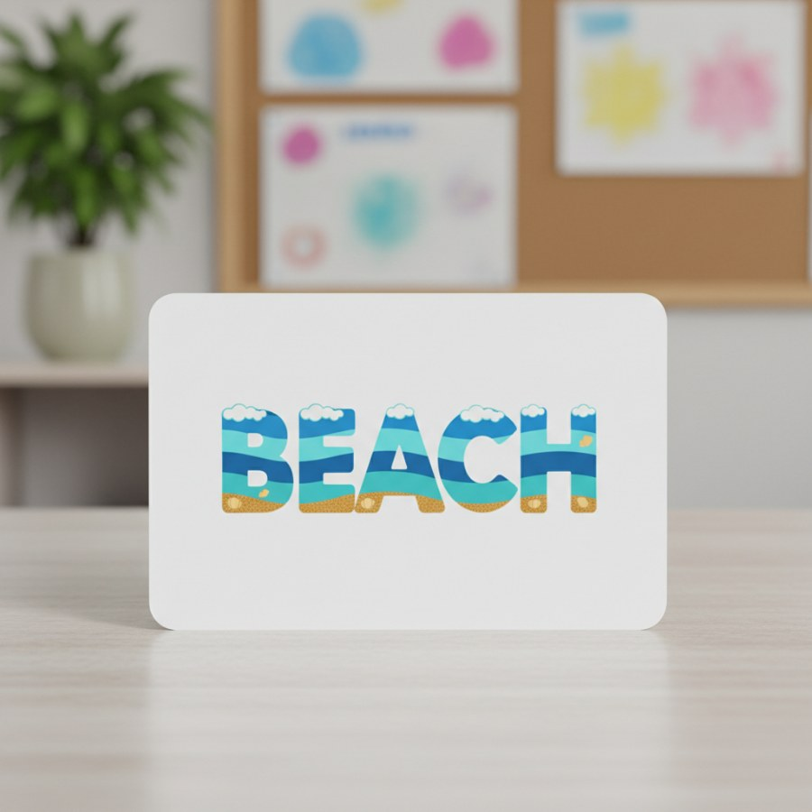
🔤 Beach
You can find sand here.
It's next to the big ocean.
People like to swim and build sandcastles.
You might see seashells!
brightboardapp.com
Notes:
Read these clues aloud to your students. Encourage them to think about what summer place or activity fits all the clues. Ask them to share their ideas before moving to the next card.

Slide 3
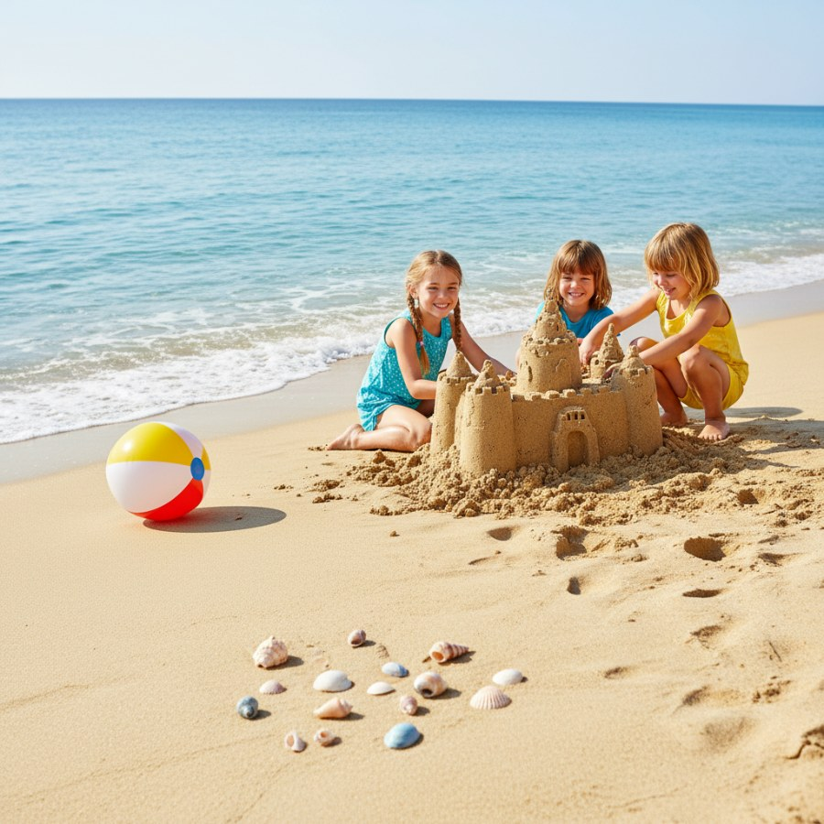
🖼️ What is this?
Look closely at the picture!
What do you see?
Is it a place with sand and water?
It's a... BEACH!
brightboardapp.com
Notes:
Show the picture to the class. Ask them if their guesses matched. Reinforce the word 'beach' and discuss what they see in the image.

Slide 4
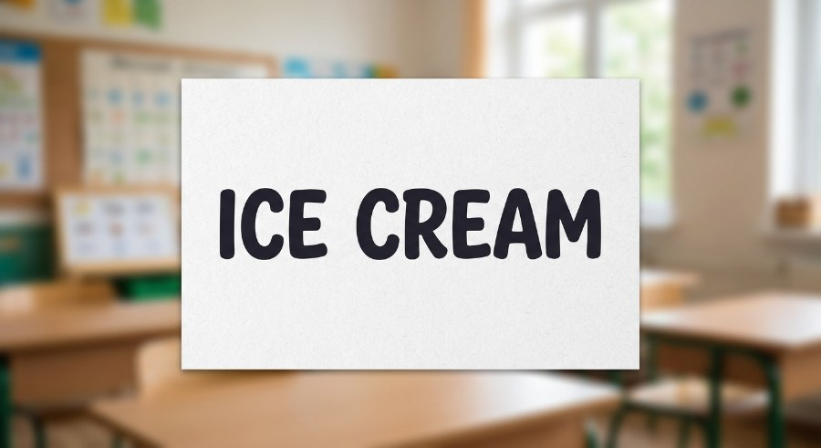
🔤 Ice Cream
It's a yummy, cold treat.
It comes in many flavors like chocolate and vanilla.
It can melt quickly on a hot day!
You often eat it with a cone or spoon.
brightboardapp.com
Notes:
Read these clues aloud. Prompt students to think about their favorite cold treats. What do they love to eat when it's hot outside? Listen to their ideas.

Slide 5
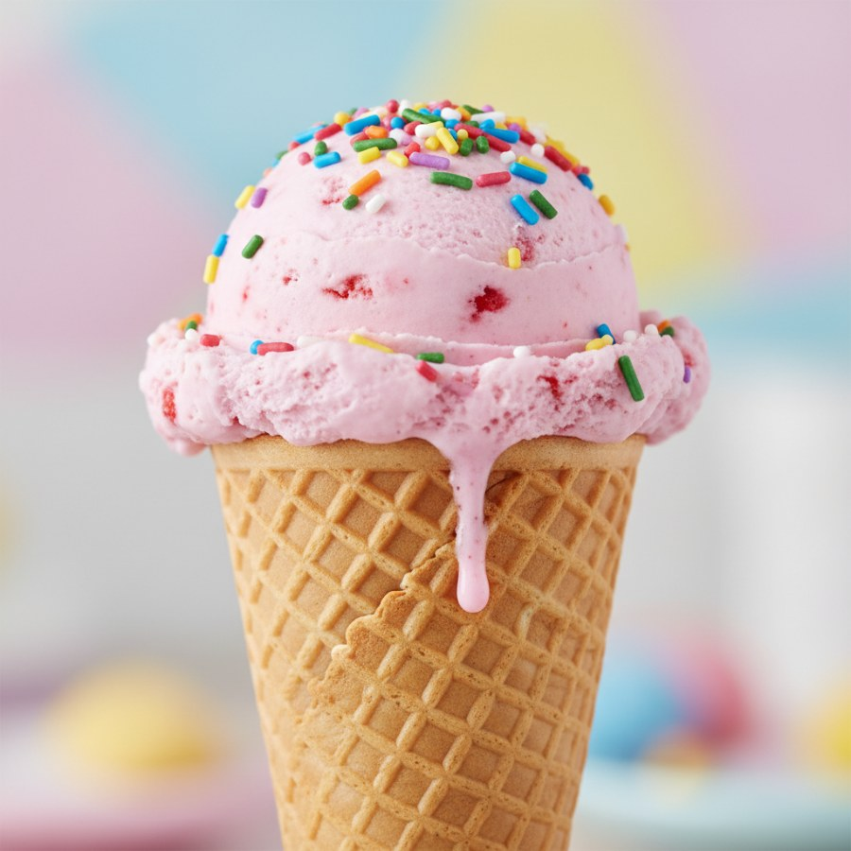
🖼️ What is this?
Look closely at this picture!
What do you want to eat on a hot day?
It's cold and sweet!
It's... ICE CREAM!
brightboardapp.com
Notes:
Reveal the picture. Confirm if their guesses were correct. Discuss the colors and what flavors they might imagine. Emphasize the word 'ice cream'.

Slide 6
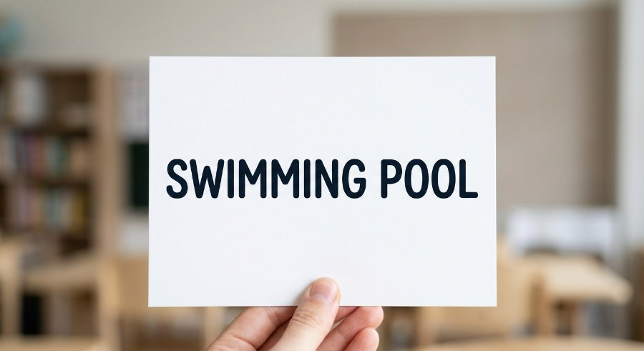
🔤 Swimming Pool
It's a big place filled with water.
You can splash and play here.
It's a fun way to cool off in summer.
Always swim with a grown-up!
brightboardapp.com
Notes:
Read the clues. Ask students where they like to go to cool down. Remind them about the importance of safety around water, especially swimming with an adult.

Slide 7
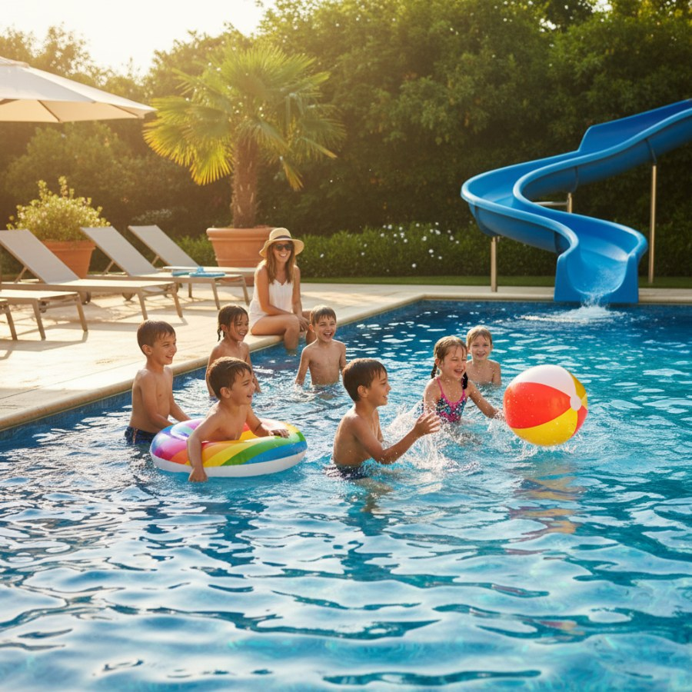
🖼️ What is this?
What do you see in this picture?
Where do people go to swim and splash?
It's a place with cool, blue water!
It's a... SWIMMING POOL!
brightboardapp.com
Notes:
Show the final picture. Celebrate their correct guesses. Review all the summer words and pictures they've matched today. Encourage them to share their favorite summer activities.

