Slide 1
Chapter 1 Introduction to Computers, Programs, and Java

Slide 2
Objectives
To understand computer basics, programs, and operating systems
To describe the relationship between Java and the World Wide Web
To understand the meaning of Java language specification, API, JDK, and IDE
To create, write, compile, and run Java programs
To become familiar with Java programming style and documentation To explain the differences between syntax errors, runtime errors, and logic errors
To navigate , create, compile, run Java programs using Intellij idea
Creating Github repository

Slide 3
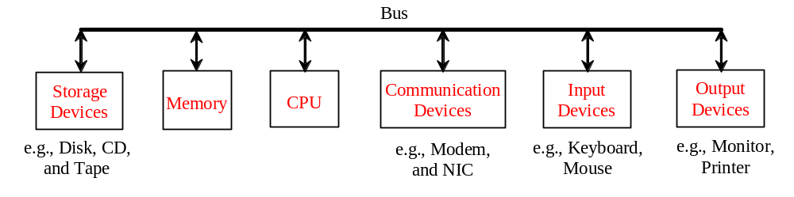
What is a Computer?
A computer consists of a CPU, memory, hard disk, floppy disk, monitor, printer, and communication devices.

Slide 4

CPU
The central processing unit (CPU) is the brain of a computer. It retrieves instructions from memory and executes them. The CPU speed is measured in megahertz (GHz), with 1 gigahertz equaling 1 billion pulses per second. Most CPU’s today have multiple execution units each running at clock speeds greater than 1 GHz.
Java can take advantage of the multiple execution units through its multi-threaded construction

Slide 5

Memory
Memory is to store data and program instructions for CPU to execute. A memory unit is an ordered sequence of bytes, each holds eight bits. A program and its data must be brought to memory before they can be executed. A memory byte is never empty, but its initial content may be meaningless to your program. The current content of a memory byte is lost whenever new information is placed in it.

Slide 6

How Data is Stored?
Data of various kinds, such as numbers, characters, and strings, are encoded as a series of bits (zeros and ones). Computers use zeros and ones because digital devices have two stable states, which are referred to as zero and one by convention. No two data can share or split a same byte. A byte is the minimum storage unit.

Slide 7

Storage Devices
Memory is volatile, because information is lost when the power is off. Programs and data are permanently stored on storage devices and are moved to memory when the computer actually uses them. There are three main types of storage devices:Disk drives (hard disks and floppy disks), CD drives (CD-R and CD-RW), and Tape drives.

Slide 8

Output Devices: Monitor
The monitor displays information (text and graphics). The resolution and dot pitch determine the quality of the display.

Slide 9
Monitor Resolution and Dot Pitch
resolution
The screen resolution specifies the number of pixels in horizontal and vertical dimensions of the display device. Pixels (short for “picture elements”) are tiny dots that form an image on the screen. A common resolution for a 17-inch screen, for example, is 1,024 pixels wide and 768 pixels high. The resolution can be set manually. The higher the resolution, the sharper and clearer the image is.
dot pitch
The dot pitch is the amount of space between pixels, measured in millimeters. The smaller the dot pitch, the sharper the display.

Slide 10

Communication Devices
A regular modem uses a phone line and can transfer data in a speed up to 56,000 bps (bits per second). A DSL (digital subscriber line) also uses a phone line and can transfer data in a speed 20 times faster than a regular modem. A cable modem uses the TV cable line maintained by the cable company. A cable modem is as fast as a DSL. Network interface card (NIC) is a device to connect a computer to a local area network (LAN). The LAN is commonly used in business, universities, and government organizations. A typical type of NIC, called 10BaseT, can transfer data at 10 mbps (million bits per second).

Slide 11
Programs
Computer programs, known as software, are instructions to the computer.
You tell a computer what to do through programs. Without programs, a computer is an empty machine. Computers do not understand human languages, so you need to use computer languages to communicate with them.
Programs are written using programming languages.

Slide 12
Programming Languages
Machine Language Assembly Language High-Level Language
Machine language is a set of primitive instructions built into every computer.
At some point ALL programs get written in or TRANSLATED into machine language!
The instructions are in the form of binary code
Programming with native machine language is a tedious and difficult process.
For example, to add two numbers, you might write an instruction in binary like this:
  1101101010011010

Slide 13
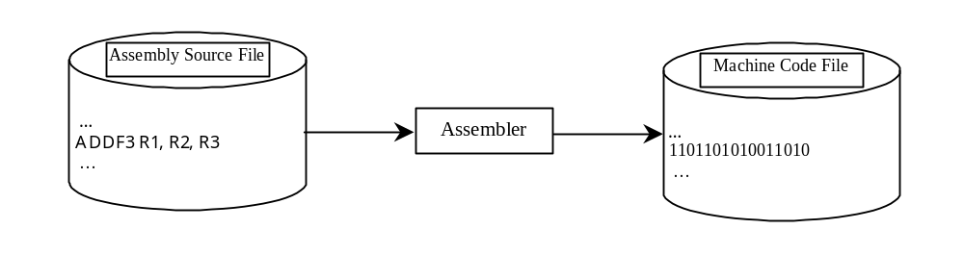
Programming Languages
Machine Language Assembly Language High-Level Language
2nd Generation programming languages like Assembly were developed to make programming easier.
Since the computer cannot understand assembly language, however, a translation program called assembler is used to convert assembly language programs into machine code. For example, to add two numbers, you might write an instruction in assembly code like this:
ADDF3 R1, R2, R3

Slide 14
Programming Languages
Machine Language Assembly Language High-Level Language
3rd generation and later languages known as high-level languages are English-like and easier to learn and program.
For example, the following is a high-level language statement that computes the area of a circle with radius 5:
area = 5 * 5 * 3.1415;

Slide 15

Popular High-Level Languages

Slide 16
Interpreting/Compiling Source Code
A program written in a high-level language is called a source program or source code. Because a computer cannot understand a source program, a source program must be translated into machine code for execution. The translation can be done using another programming tool called an interpreter or a compiler.

Slide 17
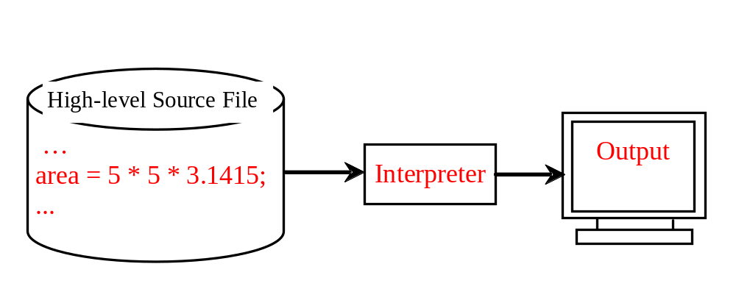
Interpreting Source Code
An interpreter reads one statement from the source code, translates it to the machine code or virtual machine code, and then executes it right away, as shown in the following figure. Note that a statement from the source code may be translated into several machine instructions.

Slide 18
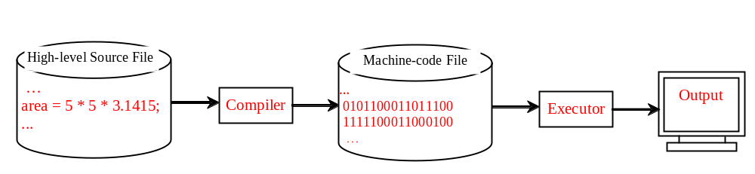
Compiling Source Code
A compiler translates the entire source code into a machine-code file, and the machine-code file is then executed, as shown in the following figure.

Slide 19
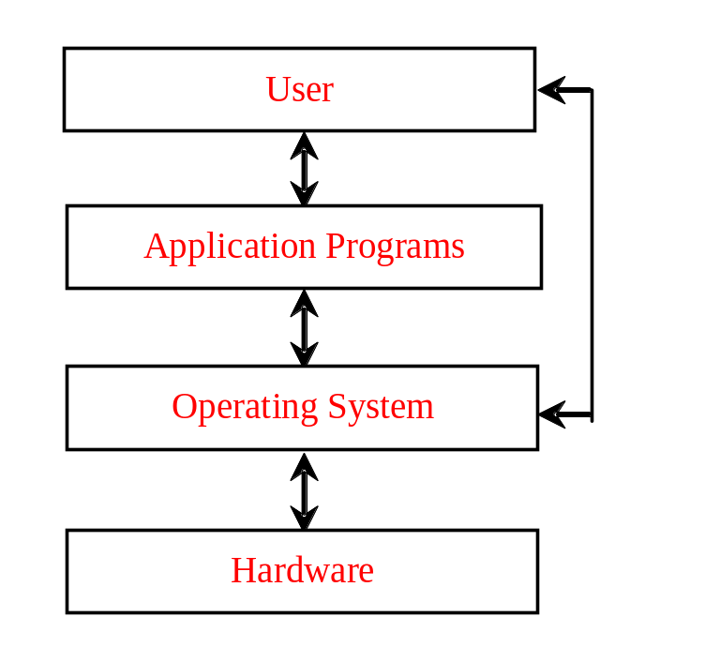
Operating Systems
The operating system (OS) is a program that manages and controls a computer’s activities. The popular operating systems for general-purpose computers are Microsoft Windows, Mac OS, and Linux. Application programs, such as a Web browser or a word processor, cannot run unless an operating system is installed and running on the computer.

Slide 20
Why Java?
The answer is that Java enables users to develop and deploy applications on the Internet for servers, desktop computers, and small hand-held devices. The future of computing is being profoundly influenced by the Internet, and Java promises to remain a big part of that future. Java is the Internet programming language.
Java is a general purpose programming language.
Java is the Internet programming language.

Slide 21
Java, Web, and Beyond
Java can be used to develop Web applications.
Java Applets
Java Web Applications
Java is also the underlying programming language for Android devices!

Slide 22
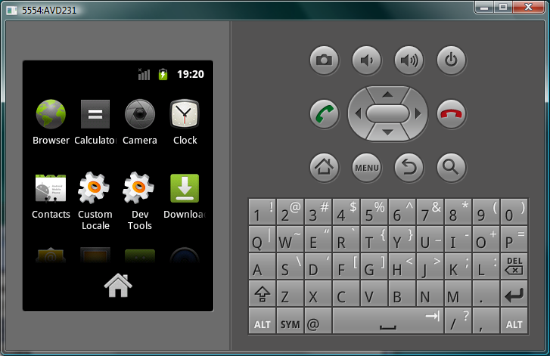
PDA and Cell Phone

Slide 23
Characteristics of Java
Java Is Simple (C++--)
Java Is Object-Oriented (Code re-use and modularity)
Java Is Distributed (Network aware)
Java Is Interpreted (JVM architecture- see next slide)
Java Is Robust (Problems found early in creation)
Java Is Secure
Java Is Architecture-Neutral and Portable
Java's Performance
Java Is Multithreaded
Java Is Dynamic
www.cs.armstrong.edu/liang/JavaCharacteristics.pdf

Slide 24
Java Translation
Java source
code
Java
bytecode
Java
compiler
Bytecode
interpreter
Bytecode
compiler
Machine
code
1-<number>
1-<number>

Slide 25
JDK Versions
JDK 1.02 (1995)
JDK 1.1 (1996)
JDK 1.2 (1998)
JDK 1.3 (2000)
JDK 1.4 (2002)
JDK 1.5 (2004) a. k. a. JDK 5 or Java 5
JDK 1.6 (2006) a. k. a. JDK 6 or Java 6
JDK 1.7 (2011) a. k. a. JDK 7 or Java 7

Slide 26
A Simple Java Program
Listing 1.1
//This program prints Welcome to Java!
public class Welcome
{
public static void main(String[] args)
{
System.out.println("Welcome to Java!");
}
}

Slide 27

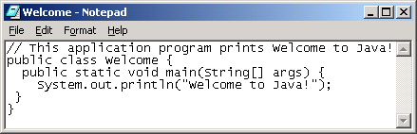
Creating and Editing Using NotePad
To use NotePad, type
  notepad Welcome.java
from the DOS prompt.

Slide 28

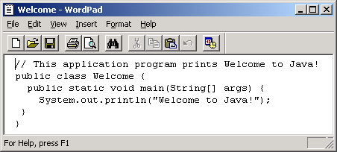
Creating and Editing Using WordPad
To use WordPad, type
  write Welcome.java
from the DOS prompt.

Slide 29
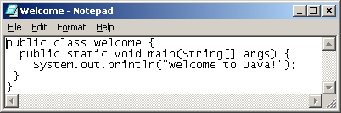
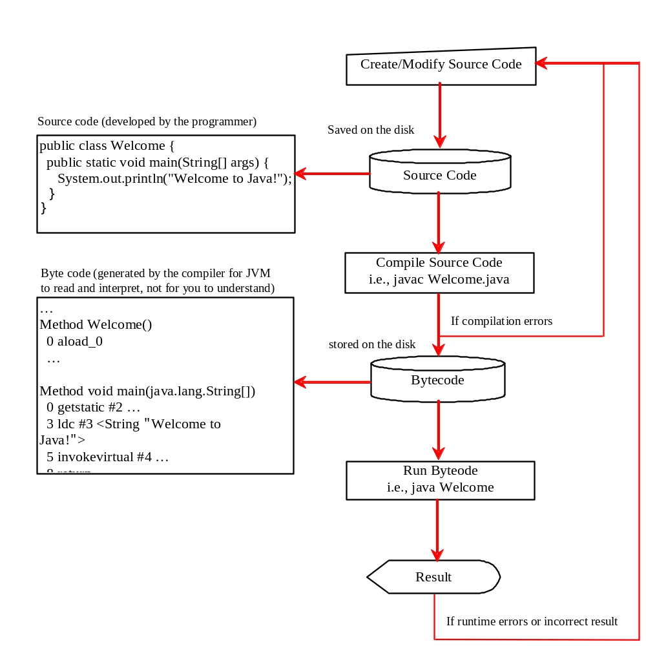
Creating, Compiling, and Running Programs

Slide 30
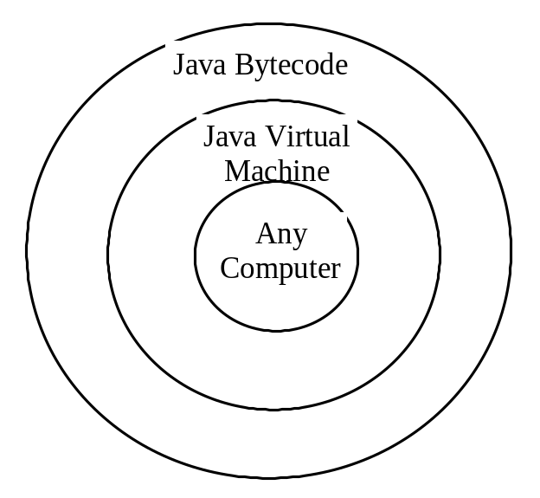
Compiling Java Source Code
You can port a source program to any machine with appropriate compilers. The source program must be recompiled, however, because the object program can only run on a specific machine. Nowadays computers are networked to work together.
Java was designed to run object programs on any platform. With Java, you write the program once, and compile the source program into a special type of object code, known as bytecode.
The bytecode can then run on any computer with a Java Virtual Machine, as shown below. Java Virtual Machine is a software that interprets Java bytecode.

Slide 31
Trace a Program Execution
animation
Enter main method
//This program prints Welcome to Java!
public class Welcome {
public static void main(String[] args) {
System.out.println("Welcome to Java!");
}
}

Slide 32
Trace a Program Execution
animation
Execute statement
//This program prints Welcome to Java!
public class Welcome {
public static void main(String[] args) {
System.out.println("Welcome to Java!");
}
}

Slide 33

Trace a Program Execution
animation
//This program prints Welcome to Java!
public class Welcome {
public static void main(String[] args) {
System.out.println("Welcome to Java!");
}
}
print a message to the console

Slide 34

Compiling and Running Java from the Command Window
Set path to JDK bin directory
  set path=c:\Program Files\java\jdk1.7.0\bin
Set classpath to include the current directory
  set classpath=.
Compile
  javac Welcome.java
Run
  java Welcome

Slide 35
Compiling and Running Java
Writing a program video
Compiling a program Video

Slide 36
Anatomy of a Java Program
Class name
Main method
Statements
Statement terminator
Reserved words
Comments
Blocks

Slide 37
Class Name
Every Java program must have at least one class. Each class has a name. By convention, class names start with an uppercase letter. In this example, the class name is Welcome.
//This program prints Welcome to Java!
public class Welcome {
public static void main(String[] args) {
System.out.println("Welcome to Java!");
}
}

Slide 38
Main Method
Line 2 defines the main method. In order to run a class, the class must contain a method named main. The program is executed from the main method.
//This program prints Welcome to Java!
public class Welcome {
public static void main(String[] args) {
System.out.println("Welcome to Java!");
}
}

Slide 39
Statement
A statement represents an action or a sequence of actions. The statement System.out.println("Welcome to Java!") in the program in Listing 1.1 is a statement to display the greeting "Welcome to Java!“.
//This program prints Welcome to Java!
public class Welcome {
public static void main(String[] args) {
System.out.println("Welcome to Java!");
}
}

Slide 40
Statement Terminator
Every statement in Java ends with a semicolon (;).
//This program prints Welcome to Java!
public class Welcome {
public static void main(String[] args) {
System.out.println("Welcome to Java!");
}
}

Slide 41
Reserved words
Reserved words or keywords are words that have a specific meaning to the compiler and cannot be used for other purposes in the program. For example, when the compiler sees the word class, it understands that the word after class is the name for the class.
//This program prints Welcome to Java!
public class Welcome {
public static void main(String[] args) {
System.out.println("Welcome to Java!");
}
}

Slide 42

Blocks
A pair of braces in a program forms a block that groups components of a program.

Slide 43

Special Symbols

Slide 44
{ … }
// This program prints Welcome to Java!
public class Welcome {
public static void main(String[] args) {
System.out.println("Welcome to Java!");
}
}

Slide 45
( … )
// This program prints Welcome to Java!
public class Welcome {
public static void main(String[] args) {
System.out.println("Welcome to Java!");
}
}

Slide 46
;
// This program prints Welcome to Java!
public class Welcome {
public static void main(String[] args) {
System.out.println("Welcome to Java!");
}
}

Slide 47
// …
// This program prints Welcome to Java!
public class Welcome {
public static void main(String[] args) {
System.out.println("Welcome to Java!");
}
}

Slide 48
" … "
// This program prints Welcome to Java!
public class Welcome {
public static void main(String[] args) {
System.out.println("Welcome to Java!");
}
}

Slide 49
Programming Style and Documentation
Appropriate Comments
Naming Conventions
Proper Indentation and Spacing Lines
Block Styles

Slide 50
Appropriate Comments
Include a summary at the beginning of the program to explain what the program does, its key features, its supporting data structures, and any unique techniques it uses.
Include your name, class section, instructor, date, and a brief description at the beginning of the program.

Slide 51
Naming Conventions
Choose meaningful and descriptive names.
Class names:
  Capitalize the first letter of each word in the name. For example, the class name ComputeExpression.

Slide 52
Proper Indentation and Spacing
Indentation
  Indent two spaces.
Spacing
  Use blank line to separate segments of the code.

Slide 53

Block Styles
Use end-of-line style for braces.

Slide 54
Programming Errors
Syntax Errors
  Detected by the compiler
Runtime Errors
  Causes the program to abort
Logic Errors
  Produces incorrect result

Slide 55
Syntax Errors
public class ShowSyntaxErrors {
public static main(String[] args) {
System.out.println("Welcome to Java);
}
}

Slide 56
Runtime Errors
public class ShowRuntimeErrors {
public static void main(String[] args) {
System.out.println(1 / 0);
}
}

Slide 57
Logic Errors
public class ShowLogicErrors {
public static void main(String[] args) {
System.out.println("Celsius 35 is Fahrenheit degree ");
System.out.println((9 / 5) * 35 + 32);
}
}
9.0/5=1.8

Slide 58
Class work
www.github.com
Create Github account
Creating a java program that prints your name
Add program to Github repository

