Slide 1
Unit 2 Elementary Programming
In the preceding chapter, you learned how to create, compile, and run a Java program. Starting from this chapter, you will learn how to solve practical problems programmatically. Through these problems, you will learn Java primitive data types and related subjects, such as variables, constants, data types, operators, expressions, and input and output.

Slide 2
Understanding Data Types
Primitive Data Types
Character char letterA=‘a’;
Boolean bool result=true;
Integer ( no fractional value)
  Byte, short, int and long
Rational Number( fractional value)
  - Float , double
  Primitive data type store value directly in memory

Slide 3
Introducing Programming with an Example
Listing 2.1 Computing the Area of a Circle
This program computes the area of the circle.
ComputeArea

Slide 4
Trace a Program Execution
animation
allocate memory for radius
public class ComputeArea {
/** Main method */
public static void main(String[] args) {
double radius;
double area;
// Assign a radius
radius = 20;
// Compute area
area = radius * radius * 3.14159;
// Display results
System.out.println("The area for the circle of radius " +
radius + " is " + area);
}
}
radius
no value

Slide 5
Trace a Program Execution
animation
public class ComputeArea {
/** Main method */
public static void main(String[] args) {
double radius;
double area;
// Assign a radius
radius = 20;
// Compute area
area = radius * radius * 3.14159;
// Display results
System.out.println("The area for the circle of radius " +
radius + " is " + area);
}
}
memory
radius
no value
area
no value
allocate memory for area

Slide 6
Trace a Program Execution
animation
public class ComputeArea {
/** Main method */
public static void main(String[] args) {
double radius;
double area;
// Assign a radius
radius = 20;
// Compute area
area = radius * radius * 3.14159;
// Display results
System.out.println("The area for the circle of radius " +
radius + " is " + area);
}
}
assign 20 to radius
radius
20
area
no value

Slide 7
Trace a Program Execution
animation
public class ComputeArea {
/** Main method */
public static void main(String[] args) {
double radius;
double area;
// Assign a radius
radius = 20;
// Compute area
area = radius * radius * 3.14159;
// Display results
System.out.println("The area for the circle of radius " +
radius + " is " + area);
}
}
memory
radius
20
area
1256.636
compute area and assign it to variable area

Slide 8

Trace a Program Execution
animation
public class ComputeArea {
/** Main method */
public static void main(String[] args) {
double radius;
double area;
// Assign a radius
radius = 20;
// Compute area
area = radius * radius * 3.14159;
// Display results
System.out.println("The area for the circle of radius " +
radius + " is " + area);
}
}
memory
radius
20
area
1256.636
print a message to the console

Slide 9
Reading Input from the Console
1. Create a Scanner object
  Scanner input = new Scanner(System.in);
2. Use the methods next(), nextByte(), nextShort(), nextInt(), nextLong(), nextFloat(), nextDouble(), or nextBoolean() to obtain to a string, byte, short, int, long, float, double, or boolean value. For example,
  System.out.print("Enter a double value: ");
  Scanner input = new Scanner(System.in);
  double d = input.nextDouble();
ComputeAreaWithConsoleInput
ComputeAverage

Slide 10
Identifiers
An identifier is a sequence of characters that consist of letters, digits, underscores (_), and dollar signs ($).
An identifier must start with a letter, an underscore (_), or a dollar sign ($). It cannot start with a digit.
  An identifier cannot be a reserved word. (See Appendix A, “Java Keywords,” for a list of reserved words).
An identifier name cannot be true, false, or
null
An identifier can be of any length.

Slide 11
Declaring Variables
int x; // Declare x to be an
// integer variable;
double radius; // Declare radius to
// be a double variable;
char a; // Declare a to be a
// character variable;
JAVA is a STONGLY typed language!

Slide 12
Assignment Statements
x = 1; // Assign 1 to x;
radius = 1.0; // Assign 1.0 to radius;
a = 'A'; // Assign 'A' to a;

Slide 13
Declaring and Initializing in One Step
int x = 1;
double d = 1.4;

Slide 14
Named Constants
final int VALUE=675;
final int CONSTANTNAME = VALUE;
final double RATIO = 3.14159;
final int SIZE = 3;

Slide 15
Naming Conventions
Choose meaningful and descriptive names.
Variables and method names:
  Use lowercase. If the name consists of several words, concatenate all in one, use lowercase for the first word, and capitalize the first letter of each subsequent word in the name. For example, the variables radius and area, and the method computeArea.

Slide 16
Naming Conventions, cont.
Class names:
  Capitalize the first letter of each word in the name. For example, the class name ComputeArea.
Constants:
  Capitalize all letters in constants, and use underscores to connect words. For example, the constant RATIO and MAX_VALUE
  NOTE: naming a constant with UPPERCASE does not make it a constant- the modifier “final” does that!
  Eg private static final double PI = 3.14159;

Slide 17
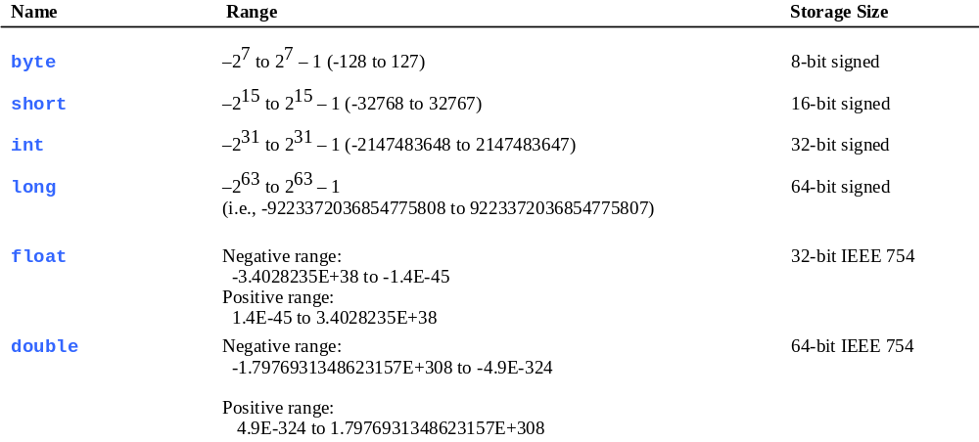
Numerical Data Types

Slide 18
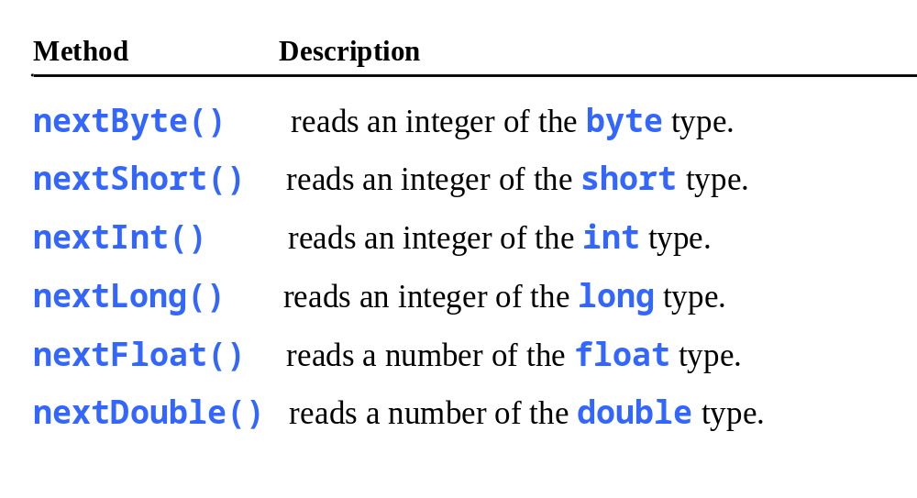
Reading Numbers from the Keyboard
Scanner input = new Scanner(System.in);
int value = input.nextInt();

Slide 19

Numeric Operators

Slide 20
Operator Precedence
What is the order of evaluation in the following expressions?
a + b + c + d + e
a + b * c - d / e
1
2
3
4
3
1
4
2
a / (b + c) - d % e
2
1
4
3
a / (b * (c + (d - e)))
4
3
2
1
2-<number>

Slide 21
Integer Division
+, -, *, /, and %
5 / 2 yields an integer 2.
5.0 / 2 yields a double value 2.5
5 % 2 yields 1 (the remainder of the division)

Slide 22

Remainder Operator
Remainder is very useful in programming. For example, an even number % 2 is always 0 and an odd number % 2 is always 1. So you can use this property to determine whether a number is even or odd. Suppose today is Saturday and you and your friends are going to meet in 10 days. What day is in 10 days? You can find that day is Tuesday using the following expression:

Slide 23
Problem: Displaying Time
Write a program that obtains hours and minutes from seconds.
DisplayTime

Slide 24
Problem: Monetary Units
This program lets the user enter the amount in decimal representing dollars and cents and output a report listing the monetary equivalent in single dollars, quarters, dimes, nickels, and pennies. Your program should report maximum number of dollars, then the maximum number of quarters, and so on, in this order.
ComputeChange

Slide 25
Trace ComputeChange
Suppose amount is 11.56
int remainingAmount = (int)(amount * 100);
// Find the number of one dollars
int numberOfOneDollars = remainingAmount / 100;
remainingAmount = remainingAmount % 100;
// Find the number of quarters in the remaining amount
int numberOfQuarters = remainingAmount / 25;
remainingAmount = remainingAmount % 25;
// Find the number of dimes in the remaining amount
int numberOfDimes = remainingAmount / 10;
remainingAmount = remainingAmount % 10;
// Find the number of nickels in the remaining amount
int numberOfNickels = remainingAmount / 5;
remainingAmount = remainingAmount % 5;
// Find the number of pennies in the remaining amount
int numberOfPennies = remainingAmount;
remainingAmount
1156
remainingAmount initialized

Slide 26
Trace ComputeChange
animation
Suppose amount is 11.56
int remainingAmount = (int)(amount * 100);
// Find the number of one dollars
int numberOfOneDollars = remainingAmount / 100;
remainingAmount = remainingAmount % 100;
// Find the number of quarters in the remaining amount
int numberOfQuarters = remainingAmount / 25;
remainingAmount = remainingAmount % 25;
// Find the number of dimes in the remaining amount
int numberOfDimes = remainingAmount / 10;
remainingAmount = remainingAmount % 10;
// Find the number of nickels in the remaining amount
int numberOfNickels = remainingAmount / 5;
remainingAmount = remainingAmount % 5;
// Find the number of pennies in the remaining amount
int numberOfPennies = remainingAmount;
remainingAmount
1156
numberOfOneDollars
11
numberOfOneDollars assigned

Slide 27
Trace ComputeChange
animation
Suppose amount is 11.56
int remainingAmount = (int)(amount * 100);
// Find the number of one dollars
int numberOfOneDollars = remainingAmount / 100;
remainingAmount = remainingAmount % 100;
// Find the number of quarters in the remaining amount
int numberOfQuarters = remainingAmount / 25;
remainingAmount = remainingAmount % 25;
// Find the number of dimes in the remaining amount
int numberOfDimes = remainingAmount / 10;
remainingAmount = remainingAmount % 10;
// Find the number of nickels in the remaining amount
int numberOfNickels = remainingAmount / 5;
remainingAmount = remainingAmount % 5;
// Find the number of pennies in the remaining amount
int numberOfPennies = remainingAmount;
remainingAmount
56
numberOfOneDollars
11
remainingAmount updated

Slide 28
Trace ComputeChange
animation
Suppose amount is 11.56
int remainingAmount = (int)(amount * 100);
// Find the number of one dollars
int numberOfOneDollars = remainingAmount / 100;
remainingAmount = remainingAmount % 100;
// Find the number of quarters in the remaining amount
int numberOfQuarters = remainingAmount / 25;
remainingAmount = remainingAmount % 25;
// Find the number of dimes in the remaining amount
int numberOfDimes = remainingAmount / 10;
remainingAmount = remainingAmount % 10;
// Find the number of nickels in the remaining amount
int numberOfNickels = remainingAmount / 5;
remainingAmount = remainingAmount % 5;
// Find the number of pennies in the remaining amount
int numberOfPennies = remainingAmount;
remainingAmount
56
numberOfOneDollars
11
numberOfOneQuarters
2
numberOfOneQuarters assigned

Slide 29
Trace ComputeChange
animation
Suppose amount is 11.56
int remainingAmount = (int)(amount * 100);
// Find the number of one dollars
int numberOfOneDollars = remainingAmount / 100;
remainingAmount = remainingAmount % 100;
// Find the number of quarters in the remaining amount
int numberOfQuarters = remainingAmount / 25;
remainingAmount = remainingAmount % 25;
// Find the number of dimes in the remaining amount
int numberOfDimes = remainingAmount / 10;
remainingAmount = remainingAmount % 10;
// Find the number of nickels in the remaining amount
int numberOfNickels = remainingAmount / 5;
remainingAmount = remainingAmount % 5;
// Find the number of pennies in the remaining amount
int numberOfPennies = remainingAmount;
remainingAmount
6
numberOfOneDollars
11
numberOfQuarters
2
remainingAmount updated

Slide 30
NOTE
Calculations involving floating-point numbers are approximated because these numbers are not stored with complete accuracy. For example,
System.out.println(1.0 - 0.1 - 0.1 - 0.1 - 0.1 - 0.1);
displays 0.5000000000000001, not 0.5, and
System.out.println(1.0 - 0.9);
displays 0.09999999999999998, not 0.1. Integers are stored precisely. Therefore, calculations with integers yield a precise integer result.

Slide 31
Exponent Operations
System.out.println(Math.pow(2, 3));
// Displays 8.0
System.out.println(Math.pow(4, 0.5));
// Displays 2.0
System.out.println(Math.pow(2.5, 2));
// Displays 6.25
System.out.println(Math.pow(2.5, -2));
// Displays 0.16

Slide 32
Number Literals
A literal is a constant value that appears directly in the program. For example, 34, 1,000,000, and 5.0 are literals in the following statements:
int i = 34;
long x = 1000000;
double d = 5.0;

Slide 33
Integer Literals
An integer literal can be assigned to an integer variable as long as it can fit into the variable. A compilation error would occur if the literal were too large for the variable to hold. For example, the statement byte b = 1000 would cause a compilation error, because 1000 cannot be stored in a variable of the byte type.
An integer literal is assumed to be of the int type, whose value is between -2³¹ (-2147483648) to 2³¹–1 (2147483647). To denote an integer literal of the long type, append it with the letter L or l. L is preferred because l (lowercase L) can easily be confused with 1 (the digit one).

Slide 34
Floating-Point Literals
Floating-point literals are written with a decimal point. By default, a floating-point literal is treated as a double type value. For example, 5.0 is considered a double value, not a float value. You can make a number a float by appending the letter f or F, and make a number a double by appending the letter d or D. For example, you can use 100.2f or 100.2F for a float number, and 100.2d or 100.2D for a double number.

Slide 35
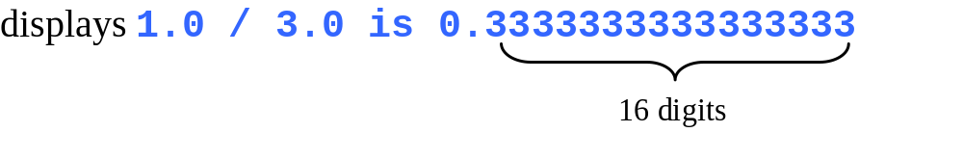
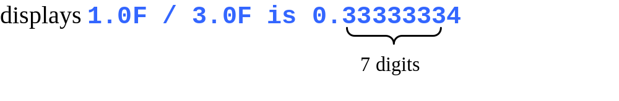
double vs. float
The double type values are more accurate than the float type values. For example,
System.out.println("1.0 / 3.0 is " + 1.0 / 3.0);
System.out.println("1.0F / 3.0F is " + 1.0F / 3.0F);

Slide 36
Scientific Notation
Floating-point literals can also be specified in scientific notation, for example, 1.23456e+2, same as 1.23456e2, is equivalent to 123.456, and 1.23456e-2 is equivalent to 0.0123456. E (or e) represents an exponent and it can be either in lowercase or uppercase.

Slide 37
Math Operations
The Math class has a number of useful tools requiring no import statements and can be used directly in programming statements.
as well as Math.pow (value#, exponent#)
Math.PI allows for you to use a more accurate version of pi than trying to use 3.1415

Slide 38
Increment and
Decrement Operators
Operator Name Description
++var preincrement The expression (++var) increments var by 1 and evaluates
to the new value in var after the increment.
var++ postincrement The expression (var++) evaluates to the original value
in var and increments var by 1.
--var predecrement The expression (--var) decrements var by 1 and evaluates
to the new value in var after the decrement.
var-- postdecrement The expression (var--) evaluates to the original value
in var and decrements var by 1.

Slide 39


Increment and
Decrement Operators, cont.

Slide 40
Assignment Revisited
The right and left hand sides of an assignment statement can contain the same variable
First, one is added to the
original value of count
count = count + 1;
Then the result is stored back into count
(overwriting the original value)
2-<number>

Slide 41
Increment and Decrement
The increment and decrement operators use only one operand
The increment operator (++) adds one to its operand
The decrement operator (--) subtracts one from its operand
The statement
count++;
is functionally equivalent to
count = count + 1;
2-<number>

Slide 42
Numeric Type Conversion
Consider the following statements:
byte i = 100;
long k = i * 3 + 4;
double d = i * 3.1 + k / 2;

Slide 43
Conversion Rules
When performing a binary operation involving two operands of different types, Java automatically converts the operand based on the following rules:
1. If one of the operands is double, the other is converted into double.
2. Otherwise, if one of the operands is float, the other is converted into float.
3. Otherwise, if one of the operands is long, the other is converted into long.
4. Otherwise, both operands are converted into int.

Slide 44
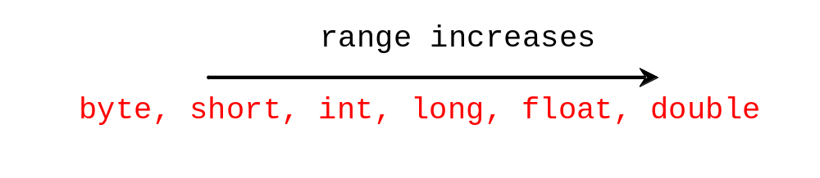
Casting
Implicit casting
double d = 3; (type widening)
Explicit casting
int i = (int)3.0; (type narrowing)
int i = (int)3.9; (Fraction part is truncated)
What is wrong? int x = 5 / 2.0;

Slide 45
Casting in an Augmented Expression
In Java, an augmented expression of the form x1 op= x2 is implemented as x1 = (T)(x1 op x2), where T is the type for x1. Therefore, the following code is correct.
int sum = 0;
sum += 4.5; // sum becomes 4 after this statement
sum += 4.5 is equivalent to sum = (int)(sum + 4.5).

Slide 46
Common Errors and Pitfalls
Common Error 1: Undeclared/Uninitialized Variables and Unused Variables
Common Error 2: Integer Overflow
Common Error 3: Round-off Errors
Common Error 4: Unintended Integer Division
Common Error 5: Redundant Input Objects
Common Pitfall 1: Redundant Input Objects

Slide 47
Common Error 1: Undeclared/Uninitialized Variables and Unused Variables
double interestRate = 0.05;
double interest = interestrate * 45;

Slide 48
Common Error 2: Integer Overflow
int value = 2147483647 + 1;
// value will actually be -2147483648

Slide 49
Common Error 3: Round-off Errors
System.out.println(1.0 - 0.1 - 0.1 - 0.1 - 0.1 - 0.1);
System.out.println(1.0 - 0.9);

Slide 50
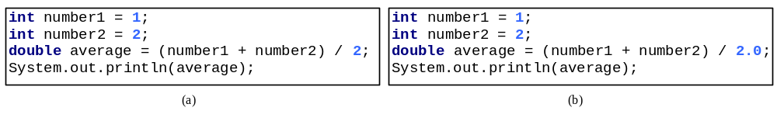
Common Error 4: Unintended Integer Division

Slide 51
Common Pitfall 1: Redundant Input Objects
Scanner input = new Scanner(System.in);
System.out.print("Enter an integer: ");
int v1 = input.nextInt();
Scanner input1 = new Scanner(System.in);
System.out.print("Enter a double value: ");
double v2 = input1.nextDouble();

Slide 52
Formatting Output
Use the printf statement.
  System.out.printf(format, items);
Where format is a string that may consist of substrings and format specifiers. A format specifier specifies how an item should be displayed. An item may be a numeric value, character, boolean value, or a string. Each specifier begins with a percent sign.

Slide 53
Formatting Output
It is often necessary to format values in certain ways so that they can be presented properly
The Java standard class library contains classes that provide formatting capabilities
The NumberFormat class allows you to format values as currency or percentages
The DecimalFormat class allows you to format values based on a pattern
Both are part of the java.text package
3-<number>

Slide 54
Formatting Output
The NumberFormat class has static methods that return a formatter object
getCurrencyInstance()
getPercentInstance()
Each formatter object has a method called format that returns a string with the specified information in the appropriate format
See Purchase.java
3-<number>

Slide 55
import java.util.Scanner;
import java.text.NumberFormat;
public class Purchase{
public static void main (String[] args) {
final double TAX_RATE = 0.06; // 6% sales tax
int quantity;
  double subtotal, tax, totalCost, unitPrice;
  Scanner scan = new Scanner (System.in);
  NumberFormat fmt1 = NumberFormat.getCurrencyInstance();
  NumberFormat fmt2 = NumberFormat.getPercentInstance(); System.out.print ("Enter the quantity: ");
  Quantity= scan.nextInt();
  System.out.print (“Enter the unit price”);
  unitPrice=scan.nextDouble();
  subtotal = quantity * unitPrice;
  tax = subtotal * TAX_RATE;
  totalCost=subtotal + tax;
  System.out.println ("Subtotal: " + fmt1.format(subtotal));
  System.out.println ("Tax: " + fmt1.format(tax) + " at "
  + fmt2.format(TAX_RATE));
  System.out.println ("Total: " + fmt1.format(totalCost));
  }}

Slide 56
Formatting Output
The DecimalFormat class can be used to format a floating point value in various ways
For example, you can specify that the number should be truncated to three decimal places
The constructor of the DecimalFormat class takes a string that represents a pattern for the formatted number
See CircleStats.java
3-<number>

Slide 57
import java.util.Scanner;
import java.text.DecimalFormat;
public class CircleStats {
public static void main (String[] args){
int radius;
double area, circumference;
  Scanner scan = new Scanner(System.in);
  System.out.print (“Enter the circle’s radius”);
  radius = nextInt();
  area = Math.PI * Math.pow(radius, 2);
  circumference = 2 * Math.PI * radius;
  // Round the output to three decimal places
  DecimalFormat fmt = new DecimalFormat ("0.###");
  System.out.println ("The circle's area: " + fmt.format(area));
  System.out.println ("The circle's circumference: "
  + fmt.format(circumference));
  }}

Slide 58
Boolean
A boolean value represents a true or false condition
The reserved words true and false are the only valid values for a boolean type
boolean done = false;
A boolean variable can also be used to represent any two states, such as a light bulb being on or off
2-<number>

Slide 59
Char
Char is another primitive data type and a char stores a character in memory.
Java usually uses the 16 bit Unicode character set for chracter encoding- Remember the computer stores on/offs or 1’s and 0’s so each character like A,b,Y, 9, %, $. [. } must have a unique set of 1’s and 0’s like A=0000000001000001 (0041Hex)

Slide 60

Appendix B: ASCII Character Set
ASCII Character Set is a subset of the Unicode from \u0000 to \u007f

Slide 61
The String Type
The char type only represents one character. To represent a string of characters, use the data type called String. For example,
String message = "Welcome to Java";
String is actually a predefined class in the Java library just like the System class and JOptionPane class. The String type is not a primitive type. It is known as a reference type. Any Java class can be used as a reference type for a variable. Reference data types will be thoroughly discussed in Chapter 8, “Objects and Classes.” For the time being, you just need to know how to declare a String variable, how to assign a string to the variable, and how to concatenate strings.

Slide 62
String Concatenation
// Three strings are concatenated
String message = "Welcome " + "to " + "Java";
// String Chapter is concatenated with number 2
String s = "Chapter" + 2; // s becomes Chapter2
// String Supplement is concatenated with character B
String s1 = "Supplement" + 'B'; // s1 becomes SupplementB

Slide 63
Escape Sequences for Special Characters
Description Escape Sequence Unicode
Backspace \b \u0008
Tab \t \u0009
Linefeed \n \u000A
Carriage return \r \u000D
Backslash \\ \u005C
Single Quote \' \u0027
Double Quote \" \u0022

Slide 64
Lab1
Review Sample Code from GitHub
Lab1

