Slide 1
Consistent and Durable Data Structures for Non-Volatile Byte-Addressable Memory
Shivaram Venkataraman*†, Niraj Tolia‡,
Parthasarathy Ranganathan* and Roy H. Campbell†
*HP Labs, Palo Alto, ‡Maginatics, and
†University of Illinois, Urbana-Champaign

Slide 2
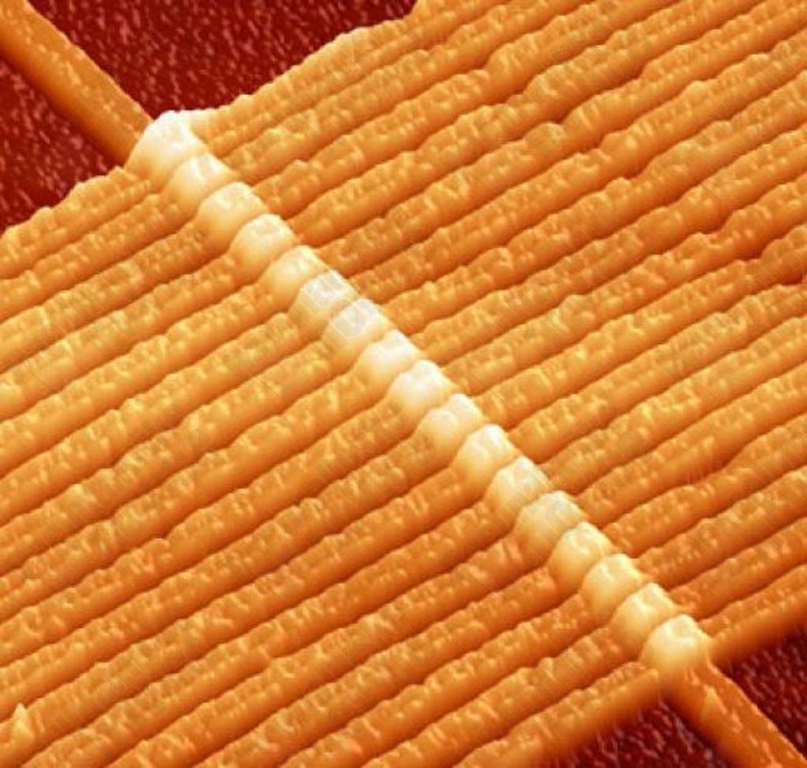
Non-Volatile Byte-Addressable Memory (NVBM)
Phase Change Memory
Memristor
Memristor

Slide 3
Non-Volatile Byte-Addressable Memory (NVBM)
Non-Volatile
50-150 nanoseconds
Scalable
Lower energy
Memristor

Slide 4
Access Times
Hard Disk Writes – 3 ms
Write to SLC Flash – 200 μs
Update DRAM – 55ns
Access L2 cache – 10ns
Processor clock cycle – 1ns

Slide 5
Access Times
Hard Disk Writes – 3 ms
Write to SLC Flash – 200 μs
Writes to PCM / Memristor – 100-150 ns
Update DRAM – 55ns
Access L2 cache – 10ns
Processor clock cycle – 1ns

Slide 6
Data Stores - Disk
Core1
Core2
Traditional DB
L1 Cache
L1 Cache
L2 Cache
L1 Cache
File systems
DRAM
Disk

Slide 7
Data Stores - DRAM
Core1
Core2
RAMCloud
memcached
Memory-based DB
L1 Cache
L1 Cache
L2 Cache
DRAM
Commit Log - Disk

Slide 8
Data Stores - NVBM
Core1
Core2
L1 Cache
L1 Cache
L2 Cache
Single-level store
DRAM
Non-Volatile Memory
Notes:
Single level store gives better performance, efficiency (power usage) and space utilization.

Slide 9
Challenges
10
Consistency
Durability
5
20
2
15
1

Slide 10
Outline
Motivation
Consistent durable data structures
Consistent durable B-Tree
Tembo – Distributed Data Store Implementation
Evaluation

Slide 11
Consistent Durable Data Structures
Versioning for consistency across failures
Restore to last consistent version on recovery
Atomic change across versions
No new processor extensions!

Slide 12
Versioning
Totally ordered – Increasing natural numbers
Every update creates a new version
Last consistent version
Stored in a well-known location
Used by reader threads and for recovery

Slide 13
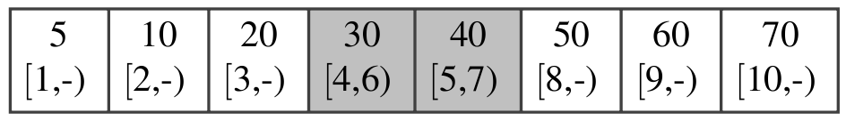
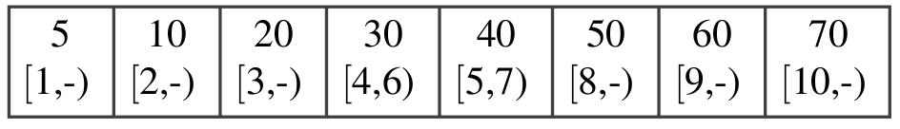
Consistent Durable B-Tree
Key
[start, end)
Live entry
Deleted entry
B – Size of a B-Tree node

Slide 14
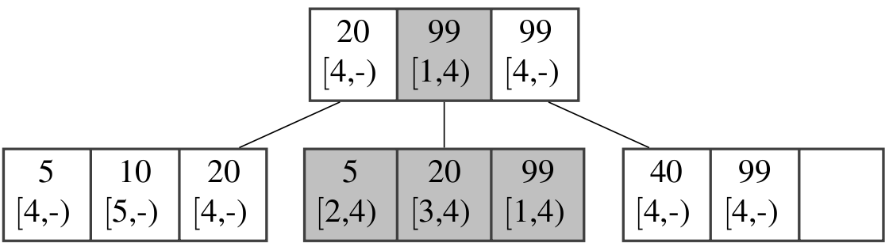
Lookup
Find key 20 at version 5

Slide 15
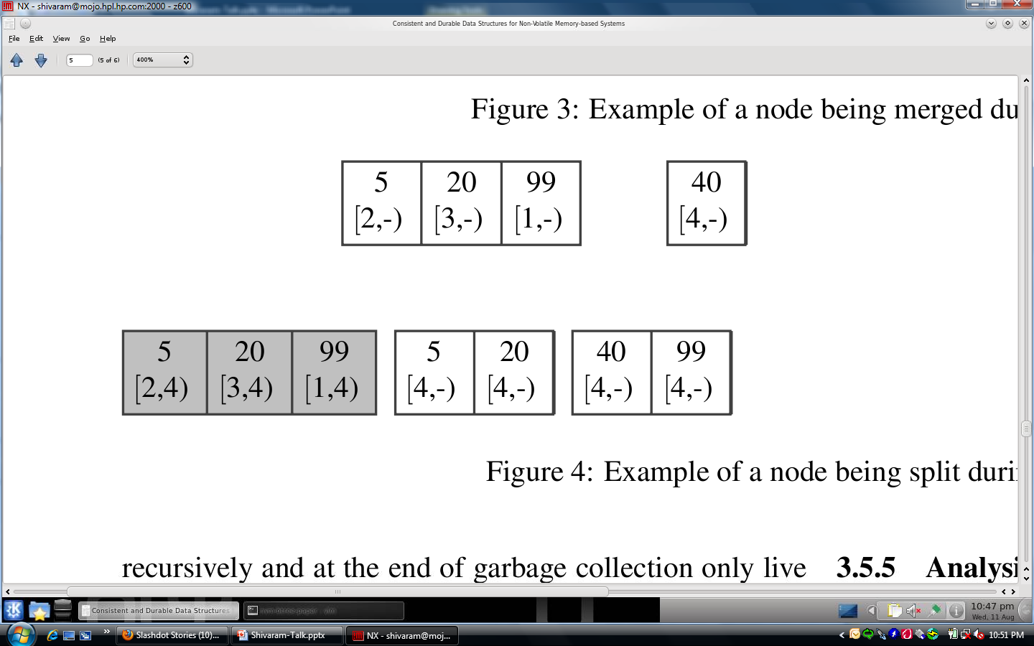
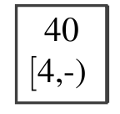
Insert / Split

Slide 16
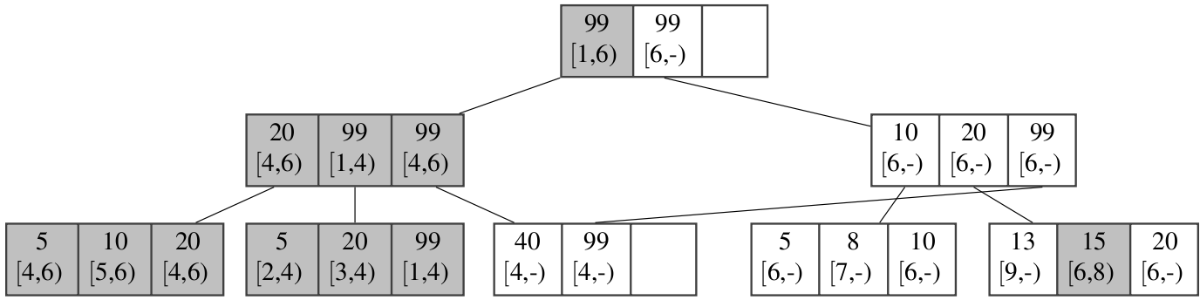
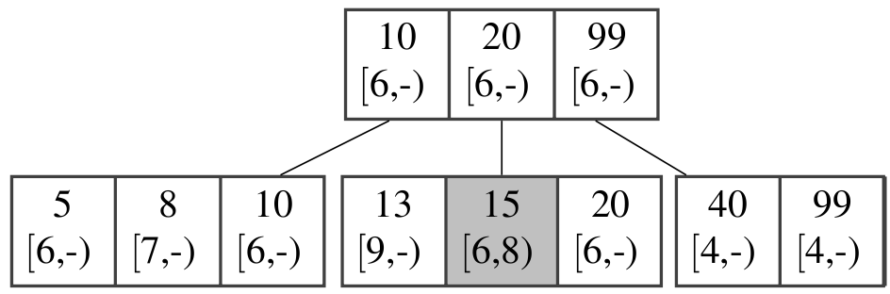
Garbage Collection

Slide 17

Tembo – Distributed Data Store Implementation
Based on open source key-value store
Widely used in production
In-memory dataset

Slide 18
Tembo – Distributed Data Store Implementation
Consistent durable B-Tree
Key Value Server
Single writer, shared reader
Consistent Hashing

Slide 19
Outline
Motivation
Consistent durable data structures
Consistent durable B-Tree
Tembo – Distributed Data Store Implementation
Evaluation

Slide 20
Ease of Integration
 | Lines of Code
Original STX B-Tree | 2110
CDDS Modifications | 1902 (90%)
Redis (v2.0.0-rc4) | 18539
Tembo Modifications | 321 (1.7%)
Notes:
90% changed in b-tree.. 1.7% in tembo

Slide 21
Evaluation - Setup
API Microbenchmarks
Compare with Berkeley DB
Tembo: Versioning vs. write-ahead logging
End-to-End Comparison
NoSQL systems – Cassandra
Yahoo Cloud Serving Benchmark
15 node test cluster
13 servers, 2 clients
720 GB RAM, 120 cores

Slide 22
Durability - Logging vs. Versioning
2M insert operations, two client threads
Notes:
30% better for 4 KB and 15% better than the hashtable. Mean of 5 trials. Standard deviation within 6.7% of the mean. CDDS B-Tree always better than normal B-Tree. Hash table comparison is unfair as it is optimized for random lookups

Slide 23
Yahoo Cloud Serving Benchmark
286%
44%
Notes:
SessionStore…. 286% greater … Disk-backed Cassandra’s throughput was only 22–44% lower than the memory-backed durable configuration

Slide 24
Furthermore
Algorithms for deletion
Analysis for space usage and height of B-Tree
Durability techniques for current processors
Notes:
Poster session ..

Slide 25
Related Work
Multi-version data structures
Used in transaction time databases
NVBM based systems
BPFS – File system (SOSP 2009)
NV-Heaps – Transaction Interface (ASPLOS 2011)
In-memory data stores
H-Store – MIT, Brown University, Yale University
RAMCloud – Stanford University

Slide 26
Work-in-progress
Robust reliability testing
Support for transaction-like operations
Integration of versioning and wear-leveling

Slide 27
Conclusion
Changes in storage media
Rethink software stack
Consistent Durable Data Structures
Single-level store
Durability through versioning
Up to 286% faster than memory-backed systems

