Slide 1
Making Sense of Performance in Data Analytics Frameworks
Kay Ousterhout, Ryan Rasti, Sylvia Ratnasamy, Scott Shenker, Byung-Gon Chun

Slide 2
Large-scale data analytics has become widespread

Slide 3


More resource-efficient
Faster

Slide 4

Spark (or Hadoop/Dryad/etc.) task
…
Task
Task
Task
…
…
Task

Slide 5
Spark (or Hadoop/Dryad/etc.) task
…
Task
Task
Task
…
…
Task

Slide 6
…
Task
Task
Task
Task
Task
Task
…
…
Task
Task

Slide 7
Network
Load balancing: VL2 [SIGCOMM ‘09], Hedera [NSDI ’10], Sinbad [SIGCOMM ’13]
Application semantics: Orchestra [SIGCOMM ’11], Baraat [SIGCOMM ‘14], Varys [SIGCOMM ’14]
Reduce data sent: PeriSCOPE [OSDI ‘12], SUDO [NSDI ’12]
In-network aggregation: Camdoop [NSDI ’12]
Better isolation and fairness: Oktopus [SIGCOMM ’11], EyeQ [NSDI ‘12], FairCloud [SIGCOMM ’12]
Disk
Themis [SoCC ‘12], PACMan [NSDI ’12], Spark [NSDI ’12], Tachyon [SoCC ’14]
Stragglers
Scarlett [EuroSys ‘11], SkewTune [SIGMOD ‘12], LATE [OSDI ‘08], Mantri [OSDI ‘10], Dolly [NSDI ‘13], GRASS [NSDI ‘14], Wrangler [SoCC ’14]

Slide 8
Missing: what’s most important to
end-to-end performance?
Network
Load balancing: VL2 [SIGCOMM ‘09], Hedera [NSDI ’10], Sinbad [SIGCOMM ’13]
Application semantics: Orchestra [SIGCOMM ’11], Baraat [SIGCOMM ‘14], Varys [SIGCOMM ’14]
Reduce data sent: PeriSCOPE [OSDI ‘12], SUDO [NSDI ’12]
In-network aggregation: Camdoop [NSDI ’12]
Better isolation and fairness: Oktopus [SIGCOMM ‘11]), EyeQ [NSDI ‘12], FairCloud [SIGCOMM ’12]
Disk
Themis [SoCC ‘12], PACMan [NSDI ’12], Spark [NSDI ’12], Tachyon [SoCC ’14]
Stragglers
Scarlett [EuroSys ‘11], SkewTune [SIGMOD ‘12], LATE [OSDI ‘08], Mantri [OSDI ‘10], Dolly [NSDI ‘13], GRASS [NSDI ‘14], Wrangler [SoCC ’14]

Slide 9
Widely-accepted mantras:
Network and disk I/O are bottlenecks
Stragglers are a major issue with
unknown causes
Network
Load balancing: VL2 [SIGCOMM ‘09], Hedera [NSDI ’10], Sinbad [SIGCOMM ’13]
Application semantics: Orchestra [SIGCOMM ’11], Baraat [SIGCOMM ‘14], Varys [SIGCOMM ’14]
Reduce data sent: PeriSCOPE [OSDI ‘12], SUDO [NSDI ’12]
In-network aggregation: Camdoop [NSDI ’12]
Better isolation and fairness: Oktopus [SIGCOMM ‘11]), EyeQ [NSDI ‘12], FairCloud [SIGCOMM ’12]
Disk
Themis [SoCC ‘12], PACMan [NSDI ’12], Spark [NSDI ’12], Tachyon [SoCC ’14]
Stragglers
Scarlett [EuroSys ‘11], SkewTune [SIGMOD ‘12], LATE [OSDI ‘08], Mantri [OSDI ‘10], Dolly [NSDI ‘13], GRASS [NSDI ‘14], Wrangler [SoCC ’14]

Slide 10
This work
How can we quantify performance bottlenecks?
Blocked time analysis
(2) Do the mantras hold?
Takeaways based on three workloads run with Spark
Notes:
We examine the mantras, and make two contributions

Slide 11
Takeaways based on three Spark workloads:
Network optimizations
can reduce job completion time by at most 2%
CPU (not I/O) often the bottleneck
<19% reduction in completion time from optimizing disk
Many straggler causes can be identified and fixed

Slide 12
Takeaways will not hold
for every single analytics workload
nor for all time

Slide 13
This work:
Accepted mantras are often not true
Methodology to avoid performance misunderstandings in the future

Slide 14
Outline
Methodology: How can we measure bottlenecks?
Workloads: What workloads did we use?
Results: How well do the mantras hold?
Why?: Why do our results differ from past work?

Slide 15
What is the job’s bottleneck?
network
compute
disk
tasks
Task x: may be bottlenecked on different resources at different times
Time t: different tasks may be bottlenecked on different resources
time

Slide 16
How does network affect the job’s completion time?
:Time when task is blocked on the network
tasks
Blocked time analysis: how much faster would the job complete if tasks never blocked on the network?
time

Slide 17
Blocked time analysis
(1) Measure time when tasks are blocked on the network
tasks
(2) Simulate how job completion time would change

Slide 18
(1) Measure time when tasks are blocked on network
network read
compute
disk write
Original task runtime
: time to handle one record
: time blocked on network
: time blocked on disk
compute
Best case
task runtime if network were infinitely fast

Slide 19
(2) Simulate how job completion time would change
time
Task 0
Task 2
2 slots
: time blocked on network
Task 1
t_{o}: Original job completion time
Task 0
Task 2
2 slots
Task 1
t_{n}: Job completion time with infinitely fast network
Incorrectly computed time: doesn’t account for task scheduling

Slide 20
Blocked time analysis: how quickly could a job have completed if a resource were infinitely fast?

Slide 21
Outline
Methodology: How can we measure bottlenecks?
Workloads: What workloads did we use?
Results: How well do the mantras hold?
Why?: Why do our results differ from prior work?

Slide 22
Large-scale traces?
Don’t have enough instrumentation for blocked-time analysis

Slide 23
SQL Workloads run on Spark
Only 3 workloads
1 Framework
TPC-DS (20 machines, 850GB;
60 machines, 2.5TB; 200 machines, 2.5TB)
Big Data Benchmark (5 machines, 60GB)
Databricks (Production; 9 machines, tens of GB)
Small cluster sizes
2 versions of each: in-memory, on-disk

Slide 24
Outline
Methodology: How can we measure bottlenecks?
Workloads: What workloads did we use?
Results: How well do the mantras hold?
Why?: Why do our results differ from prior work?

Slide 25
How much faster could jobs get from optimizing network performance?

Slide 26
How much faster could jobs get from optimizing network performance?
Percentiles
95
Median improvement: 2%
95%ile improvement: 10%
75
50
25
5

Slide 27
How much faster could jobs get from optimizing network performance?
Percentiles
95
75
50
25
5
Median improvement at most 2%

Slide 28
How much faster could jobs get from optimizing disk performance?
Median improvement at most 19%

Slide 29
How important is CPU?
CPU much more highly utilized than disk or network!

Slide 30
What about stragglers?
5-10% improvement from eliminating stragglers
Based on simulation
Can explain >60% of stragglers in >75% of jobs
Fixing underlying cause can speed up other tasks too!
2x speedup from fixing one straggler cause

Slide 31
Takeaways based on three Spark workloads:
Network optimizations
can reduce job completion time by at most 2%
CPU (not I/O) often the bottleneck
<19% reduction in completion time from optimizing disk
Many straggler causes can be identified and fixed

Slide 32
Outline
Methodology: How can we measure bottlenecks?
Workloads: What workloads did we use?
Results: How well do the mantras hold?
Why?: Why do our results differ from past work?
>
network

Slide 33
Why are our results so different than what’s stated in prior work?
Are the workloads we measured unusually network-light?
How can we compare our workloads to large-scale traces used to motivate prior work?

Slide 34
How much data is transferred per CPU second?
Microsoft ’09-’10: 1.9–6.35 Mb / task second
Google ’04-‘07: 1.34–1.61 Mb / machine second

Slide 35
Why are our results so different than what’s stated in prior work?
Our workloads are network light
Incomplete metrics
Conflation of CPU and network time

Slide 36
When is the network used?
map task
reduce task
Input data (read locally)
map task
reduce task
Output data
…
…
map task
reduce task
(1) To shuffle intermediate data
(2) To replicate output data
Some work focuses only on the shuffle

Slide 37
How does the data transferred over the network compare to the input data?
Shuffled data is only ~1/3 of input data!
Even less output data
Not realistic to look only at shuffle!
Or to use workloads where all input is shuffled

Slide 38
Prior work conflates CPU and network time
To send data over network:
(1) Serialize objects into bytes
(2) Send bytes
(1) and (2) often conflated.
Reducing application data sent reduces both!

Slide 39
When does the network matter?
Network important when:
Computation optimized
Serialization time low
Large amount of data sent over network

Slide 40
Why are our results so different than what’s stated in prior work?
Our workloads are network light
1) Incomplete metrics
e.g., looking only at shuffle time
2) Conflation of CPU and network time
Sending data over the network has an associated CPU cost

Slide 41
Limitations
Only three workloads
Industry-standard workloads
Results sanity-checked with larger production traces
Small cluster sizes
Results don’t change when we move between cluster sizes
One framework (Spark)
Results sanity-checked with production traces from other frameworks
We instrumented and evaluated Hadoop, with consistent results

Slide 42
Limitations aren’t fatal
Only three workloads
Industry-standard workloads
Results sanity-checked with larger production traces
Small cluster sizes
Takeaways don’t change when we move between cluster sizes
One framework (Spark)
Results sanity-checked with production traces from other frameworks
We instrumented and evaluated Hadoop, with consistent results

Slide 43
Will change with time!
Network optimizations
can reduce job completion time by at most 2%
CPU (not I/O) often the bottleneck
<19% reduction in completion time from optimizing disk
Many straggler causes can be identified and fixed
Takeaway: performance understandability should be a first-class concern!
Instrument systems for blocked time analysis
(almost) All Instrumentation now part of Spark
All traces publicly available: tinyurl.com/nsdi-traces

Slide 44
Backup Slides

Slide 45
Why is the CPU time so high?
Compression and serialization are costly

Slide 46
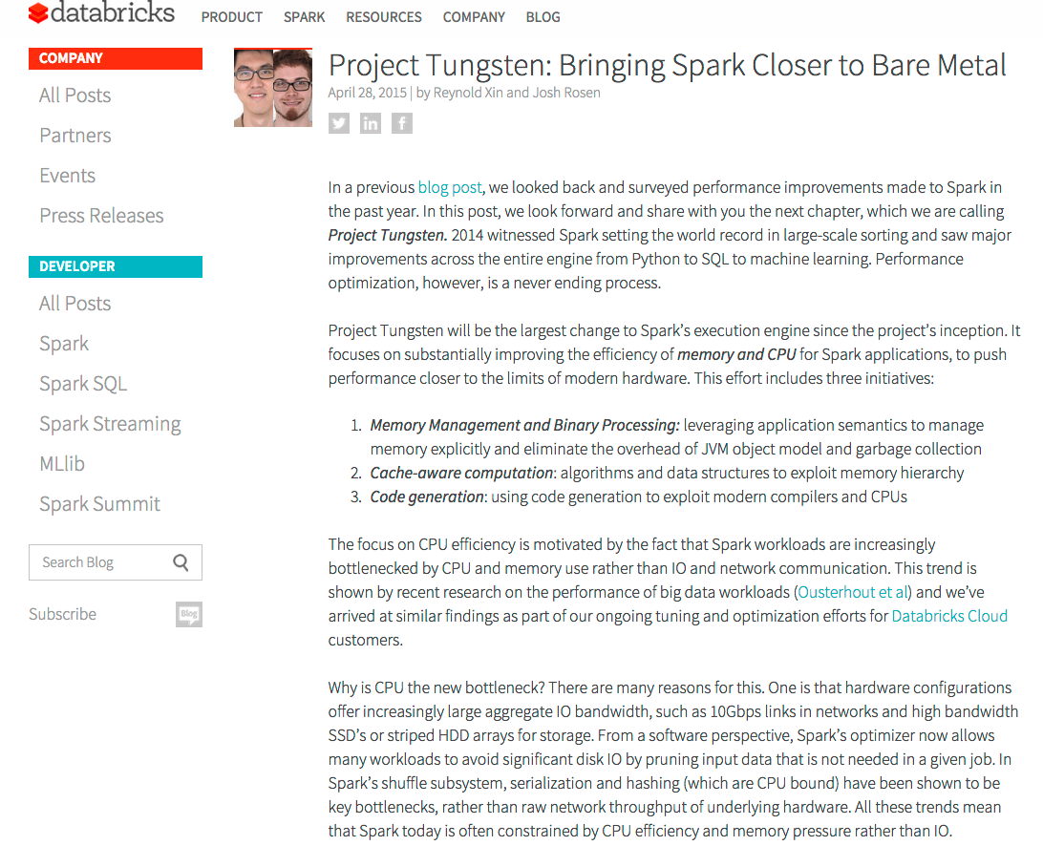
What can be done to reduce compute time?

