Slide 1
Making Sense of Performance in Data Analytics Frameworks
Kay Ousterhout
Joint work with Ryan Rasti, Sylvia Ratnasamy, Scott Shenker, Byung-Gon Chun
UC Berkeley

Slide 2
About Me
PhD student at UC Berkeley
Thesis work centers around performance of large-scale distributed systems
Spark PMC member

Slide 3
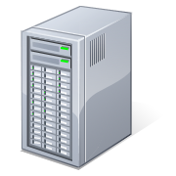
Spark (or Hadoop/Dryad/etc.) task
…
Task
Task
Task
…
…
Task
Notes:
First, a quick refresher on how these frameworks work.
Current execution engines architected in a similar way. Job: some analysis on large amount of data. Basic idea: split job into increments of work called tasks; each task runs on one machine.

Slide 4
Spark (or Hadoop/Dryad/etc.) task
…
Task
Task
Task
…
…
Task
Notes:
First, a quick refresher on how these frameworks work.
Current execution engines architected in a similar way. Job: some analysis on large amount of data. Basic idea: split job into increments of work called tasks; each task runs on one machine.

Slide 5
…
Task
Task
Task
Task
Task
Task
…
…
Task
Task

Slide 6
How can we make this job faster?
Cache input data in memory
Task
Task
…
Notes:
First, a quick refresher on how these frameworks work.
Current execution engines architected in a similar way. Job: some analysis on large amount of data. Basic idea: split job into increments of work called tasks; each task runs on one machine.

Slide 7
How can we make this job faster?
Cache input data in memory
Task
Task
…

Slide 8
How can we make this job faster?
Task
Cache input data in memory
Optimize the network
Task
Task
Task
…

Slide 9
How can we make this job faster?
Task
Cache input data in memory
Optimize the network
Task
Task
Task
Task
…
Task

Slide 10
How can we make this job faster?
Task: 2s
Cache input data in memory
Optimize the network
Mitigate effect of stragglers
Task
Task: 3s
Task: 30s
Task
…
Task: 2s

Slide 11
Disk
Themis [SoCC ‘12], PACMan [NSDI ’12], Spark [NSDI ’12], Tachyon [SoCC ’14]
Network
Load balancing: VL2 [SIGCOMM ‘09], Hedera [NSDI ’10], Sinbad [SIGCOMM ’13]
Application semantics: Orchestra [SIGCOMM ’11], Baraat [SIGCOMM ‘14], Varys [SIGCOMM ’14]
Reduce data sent: PeriSCOPE [OSDI ‘12], SUDO [NSDI ’12]
In-network aggregation: Camdoop [NSDI ’12]
Better isolation and fairness: Oktopus [SIGCOMM ’11], EyeQ [NSDI ‘12], FairCloud [SIGCOMM ’12]
Stragglers
Scarlett [EuroSys ‘11], SkewTune [SIGMOD ‘12], LATE [OSDI ‘08], Mantri [OSDI ‘10], Dolly [NSDI ‘13], GRASS [NSDI ‘14], Wrangler [SoCC ’14]
Notes:
In the context of data analytics frameworks, TONS of work on improving performance.
Lots of valuable work here: many cite impressive improvements.
But this work leaves is without an end-to-end understanding of performance.
If I’m implementing a new system, do I need to implement all of these things? What are the biggest remaining problems?
What are the biggest problems? What do we do next

Slide 12
Missing: what’s most important to
end-to-end performance?
Disk
Themis [SoCC ‘12], PACMan [NSDI ’12], Spark [NSDI ’12], Tachyon [SoCC ’14]
Network
Load balancing: VL2 [SIGCOMM ‘09], Hedera [NSDI ’10], Sinbad [SIGCOMM ’13]
Application semantics: Orchestra [SIGCOMM ’11], Baraat [SIGCOMM ‘14], Varys [SIGCOMM ’14]
Reduce data sent: PeriSCOPE [OSDI ‘12], SUDO [NSDI ’12]
In-network aggregation: Camdoop [NSDI ’12]
Better isolation and fairness: Oktopus [SIGCOMM ’11], EyeQ [NSDI ‘12], FairCloud [SIGCOMM ’12]
Stragglers
Scarlett [EuroSys ‘11], SkewTune [SIGMOD ‘12], LATE [OSDI ‘08], Mantri [OSDI ‘10], Dolly [NSDI ‘13], GRASS [NSDI ‘14], Wrangler [SoCC ’14]

Slide 13
Widely-accepted mantras:
Network and disk I/O are bottlenecks
Stragglers are a major issue with
unknown causes
Disk
Themis [SoCC ‘12], PACMan [NSDI ’12], Spark [NSDI ’12], Tachyon [SoCC ’14]
Network
Load balancing: VL2 [SIGCOMM ‘09], Hedera [NSDI ’10], Sinbad [SIGCOMM ’13]
Application semantics: Orchestra [SIGCOMM ’11], Baraat [SIGCOMM ‘14], Varys [SIGCOMM ’14]
Reduce data sent: PeriSCOPE [OSDI ‘12], SUDO [NSDI ’12]
In-network aggregation: Camdoop [NSDI ’12]
Better isolation and fairness: Oktopus [SIGCOMM ’11], EyeQ [NSDI ‘12], FairCloud [SIGCOMM ’12]
Stragglers
Scarlett [EuroSys ‘11], SkewTune [SIGMOD ‘12], LATE [OSDI ‘08], Mantri [OSDI ‘10], Dolly [NSDI ‘13], GRASS [NSDI ‘14], Wrangler [SoCC ’14]

Slide 14
This work
How can we quantify performance bottlenecks?
Blocked time analysis
(2) Do the mantras hold?
Takeaways based on three workloads run with Spark

Slide 15
Takeaways based on three Spark workloads:
Network optimizations
can reduce job completion time by at most 2%
CPU (not I/O) often the bottleneck
<19% reduction in completion time from optimizing disk
Many straggler causes can be identified and fixed

Slide 16
Takeaways will not hold
for every single analytics workload
nor for all time
Notes:
This work is about characterizing where we are today (the mantras don’t hold!) and providing a methodology to avoid performance misunderstandings in the future

Slide 17
This work:
Accepted mantras are often not true
Methodology to avoid performance misunderstandings in the future

Slide 18
Outline
Methodology: How can we measure Spark bottlenecks?
Workloads: What workloads did we use?
Results: How well do the mantras hold?
Why?: Why do our results differ from past work?
Demo: How can you understand your own workload?

Slide 19
Outline
Methodology: How can we measure Spark bottlenecks?
Workloads: What workloads did we use?
Results: How well do the mantras hold?
Why?: Why do our results differ from past work?
Demo: How can you understand your own workload?

Slide 20
What’s the job’s bottleneck?

Slide 21
What exactly happens in a Spark task?
Task reads shuffle data, generates in-memory output
network
(4) Continue fetching remote data
(1) Request a few shuffle blocks
compute
(2) Start processing local data
(3) Process data fetched remotely
disk
: time to handle one shuffle block
time

Slide 22
What’s the bottleneck for this task?
Task reads shuffle data, generates in-memory output
network
compute
Bottlenecked on network and disk
Bottlenecked on network
Bottlenecked on CPU
disk
time

Slide 23
What’s the bottleneck for the job?
network
compute
disk
tasks
Task x: may be bottlenecked on different resources at different times
Time t: different tasks may be bottlenecked on different resources
time

Slide 24
How does network affect the job’s completion time?
:Time when task is blocked on the network
tasks
Blocked time analysis: how much faster would the job complete if tasks never blocked on the network?
time

Slide 25
Blocked time analysis
(1) Measure time when tasks are blocked on the network
tasks
(2) Simulate how job completion time would change

Slide 26
(1) Measure time when tasks are blocked on network
: time blocked on network
network
: time blocked on disk
compute
disk
Original task runtime
Best case
task runtime if network were infinitely fast

Slide 27
(2) Simulate how job completion time would change
time
Task 0
Task 2
2 slots
: time blocked on network
Task 1
t_{o}: Original job completion time
Task 0
Task 2
2 slots
Task 1
Incorrectly computed time: doesn’t account for task scheduling

Slide 28
(2) Simulate how job completion time would change
time
Task 0
Task 2
2 slots
: time blocked on network
Task 1
t_{o}: Original job completion time
Task 0
2 slots
Task 1
Task 2
t_{n}: Job completion time with infinitely fast network

Slide 29
Blocked time analysis: how quickly could a job have completed if a resource were infinitely fast?

Slide 30
Outline
Methodology: How can we measure Spark bottlenecks?
Workloads: What workloads did we use?
Results: How well do the mantras hold?
Why?: Why do our results differ from past work?
Demo: How can you understand your own workload?

Slide 31
Large-scale traces?
Don’t have enough instrumentation for blocked-time analysis

Slide 32
SQL Workloads run on Spark
Only 3 workloads
TPC-DS (20 machines, 850GB;
60 machines, 2.5TB; 200 machines, 2.5TB)
Big Data Benchmark (5 machines, 60GB)
Databricks (Production; 9 machines, tens of GB)
Small cluster sizes
2 versions of each: in-memory, on-disk

Slide 33
Outline
Methodology: How can we measure Spark bottlenecks?
Workloads: What workloads did we use?
Results: How well do the mantras hold?
Why?: Why do our results differ from past work?
Demo: How can you understand your own workload?

Slide 34
How much faster could jobs get from optimizing network performance?

Slide 35
How much faster could jobs get from optimizing network performance?
Percentiles
95
Median improvement: 2%
95%ile improvement: 10%
75
50
25
5
Notes:
1Gbps network link – nothing insane.

Slide 36
How much faster could jobs get from optimizing network performance?
Percentiles
95
75
50
25
5
Median improvement at most 2%
Notes:
2 disks, 8 cores (relatively under provisioned, I/O-wise)

Slide 37
How much faster could jobs get from optimizing disk performance?
Median improvement at most 19%
Notes:
Includes disk reading input data, reading/writing intermediate (shuffle) data from disk, writing output data
Highest median: 19%!
Includes all disk and network (impossible to separate these)
Caps improvement from flash etc.
Need aids here, partially to help pause and partially to help people pay attention. Try putting fat line at 19%.

Slide 38
How important is CPU?
CPU much more highly utilized than disk or network!

Slide 39
What about stragglers?
5-10% improvement from eliminating stragglers
Based on simulation
Can explain >60% of stragglers in >75% of jobs
Fixing underlying cause can speed up other tasks too!
2x speedup from fixing one straggler cause
Notes:
*very different than past work: which just focused on mitigation.
In fact, understanding is hugely useful for eliminating them! Fixed lots of other tasks too. Issues often representative of broader issues.

Slide 40
Takeaways based on three Spark workloads:
Network optimizations
can reduce job completion time by at most 2%
CPU (not I/O) often the bottleneck
<19% reduction in completion time from optimizing disk
Many straggler causes can be identified and fixed

Slide 41
Outline
Methodology: How can we measure Spark bottlenecks?
Workloads: What workloads did we use?
Results: How well do the mantras hold?
Why?: Why do our results differ from past work?
Demo: How can you understand your own workload?
>
network

Slide 42
Why are our results so different than what’s stated in prior work?
Are the workloads we measured unusually network-light?
How can we compare our workloads to large-scale traces used to motivate prior work?

Slide 43
How much data is transferred per CPU second?
Microsoft ’09-’10: 1.9–6.35 Mb / task second
Google ’04-‘07: 1.34–1.61 Mb / machine second
Notes:
Compare to Facebook, where we have per-job information. Generally, much lower.
For Microsoft / Google, only have aggregate information: total bytes written, total machine (or task) seconds. Also not CPU seconds – so would be slightly higher using the cpu metric. Says NOTHING about tail behavior. But still – if anything, much less network bound than the workload we looked at.

Slide 44
Why are our results so different than what’s stated in prior work?
Our workloads are network light
Incomplete metrics
Conflation of CPU and network time

Slide 45
When is the network used?
map task
reduce task
Input data (read locally)
map task
reduce task
Output data
…
…
map task
reduce task
(1) To shuffle intermediate data
(2) To replicate output data
Some work focuses only on the shuffle

Slide 46
How does the data transferred over the network compare to the input data?
Shuffled data is only ~1/3 of input data!
Even less output data
Not realistic to look only at shuffle!
Or to use workloads where all input is shuffled

Slide 47
Prior work conflates CPU and network time
To send data over network:
(1) Serialize objects into bytes
(2) Send bytes
(1) and (2) often conflated.
Reducing application data sent reduces both!
Notes:
People have conflated the two. Some people who have eliminated serialization time to get big improvements!
Improvements came from eliminating both of these!!
This left us wondering: are there any workloads that are network-bound?

Slide 48
When does the network matter?
Network important when:
Computation optimized
Serialization time low
Large amount of data sent over network
Notes:
ML workload that computes a least squares fit. Each task in this workload does a matrix multiply using optimized native code (FORTRAN!!! Partially C/assembly). Array of doubles.

Slide 49
Why are our results so different than what’s stated in prior work?
Our workloads are network light
1) Incomplete metrics
e.g., looking only at shuffle time
2) Conflation of CPU and network time
Sending data over the network has an associated CPU cost

Slide 50
Limitations
Only three workloads
Industry-standard workloads
Results sanity-checked with larger production traces
Small cluster sizes
Results don’t change when we move between cluster sizes

Slide 51
Limitations aren’t fatal
Only three workloads
Industry-standard workloads
Results sanity-checked with larger production traces
Small cluster sizes
Takeaways don’t change when we move between cluster sizes

Slide 52
Outline
Methodology: How can we measure Spark bottlenecks?
Workloads: What workloads did we use?
Results: How well do the mantras hold?
Why?: Why do our results differ from past work?
Demo: How can you understand your own workload?

Slide 53
Demo

Slide 54
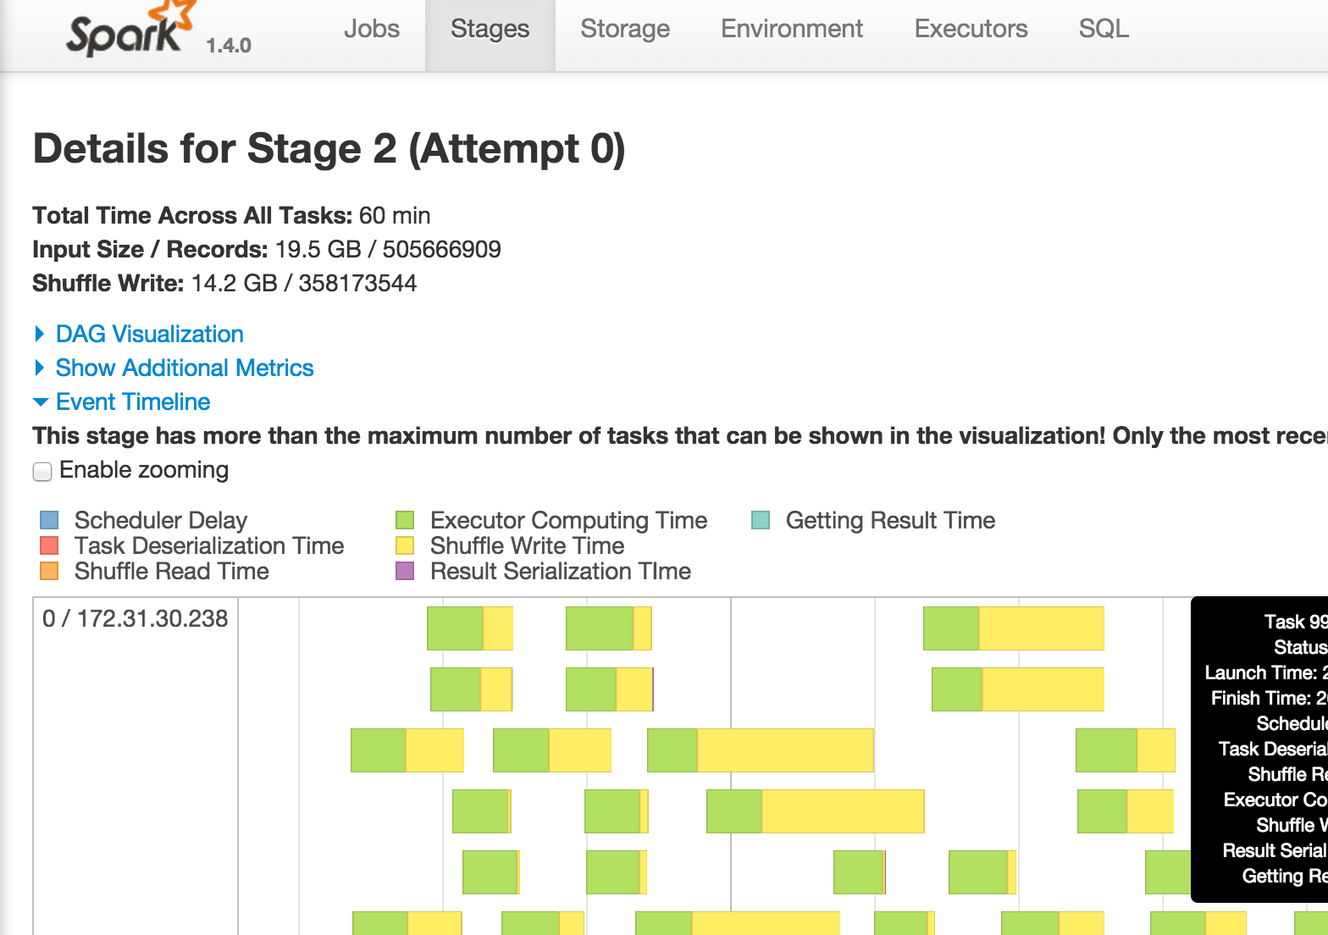
Demo
Often can tune parameters to shift the bottleneck
(e.g., change snappy to lzf)

Slide 55
What’s missing from Spark metrics?
Time blocked on reading input data and writing output data (HADOOP-11873)
Time spent spilling intermediate data to disk (SPARK-3577)

Slide 56
Will change with time!
Network optimizations
can reduce job completion time by at most 2%
CPU (not I/O) often the bottleneck
<19% reduction in completion time from optimizing disk
Many straggler causes can be identified and fixed
Takeaway: performance understandability should be a first-class concern!
(almost) All Instrumentation now part of Spark
I want your workload! keo@eecs.berkeley.edu
All traces and tools publicly available:
tinyurl.com/summit-traces

